Slide 1
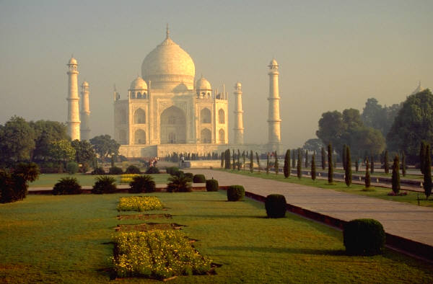
This TANTRA came from India.
It doesn’t matter whether you are or not supersticious. It’s really worth reading, OK?
This is a Nepalese Tantra Totem for good luck.
You will be greeted with good luck 4 days upon receiving and reading this mail.
TANDRA.
Send copies to whoever you want to wish good luck......There are many... If I forget someone but have them in my heart, they will also be lucky.
I won’t send you money, because I don’t have it.

Slide 2
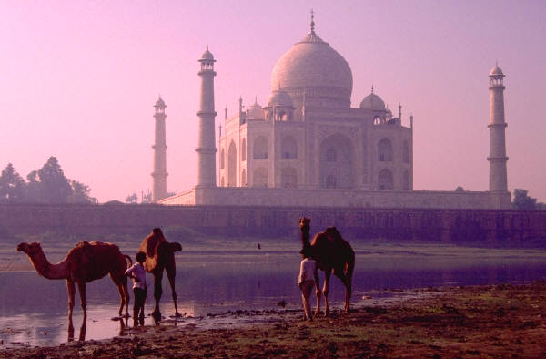
INSTRUCTIONS FOR YOUR LIFE:
Eat lots of rye rice.
Give people more than what they want, and do it with all your heart.
Memorize your favorite poem.
Do not believe everything you hear, do not spend all you have, and do not sleep for as long as you wish.
Whenever you say “I love You”, mean it.
Whenever you say “I’m sorry”, look the person right in the eyes.

Slide 3
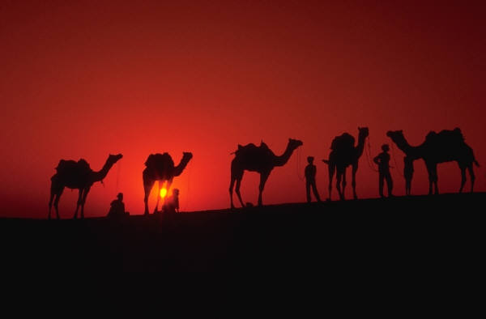
Believe in love at first sight.
Never ignore someone’s dreams.
Love deeply and passionately, you may get hurt, but this is the only way to live life completely.
Tackle any disagreements in a clean manner, do not offend.
Never judge a person based on their relatives.
Speak slowly, but think fast.

Slide 4
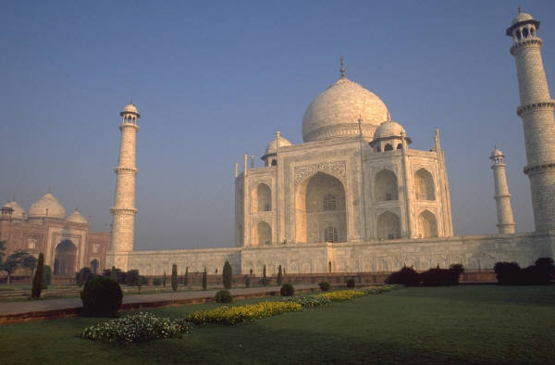
Whenever someone asks you something you don’t want to answer, smile and ask “why do you want to know”?
Remember that the deepest love and the greatest achievements are the ones bearing the most risk.
Call your mother. If you can’t, at least think of her.
Say “Bless you” whenever someone sneezes.
If you happen to loose, do not miss the lesson.

Slide 5

Remember the 3 R’s: Respect yourself,
Respect everyone else, and be Responsible
for all of your actions.
Do not allow a little dispute to put an end to
a great friendship.
Whenever you notice you’ve made a mistake, do all what is
necessary to fix it.
Immediately.
Smile whenever you pick up the phone, for the caller will be able to notice it.
Marry to a person that likes to chat,
for when your old age comes, chatting will be one of the best qualities you can find in someone.

Slide 6
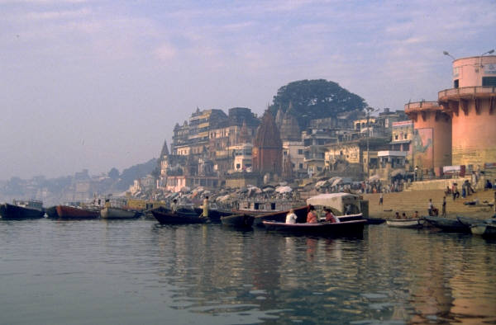
Spend sometime alone.
Embrace changes, but do not repudiate your own values.
Remember that sometimes silence is the best answer.
Read more books and watch less TV.
Lead a good and honest life. Like this, when you are old and remember the past, you will see how you can enjoy it all once again.
Trust GOD, but lock your car well.

Slide 7

A good atmosphere in your home is important.
Do whatever is possible to keep your home peaceful and harmonious.
If you have a quarrel with someone close to you, try to solve only the present issue.
Do not revolve the past.
Read inbetween the lines.
Share your knowledge. It’s a way of
achieving immortality.

Slide 8
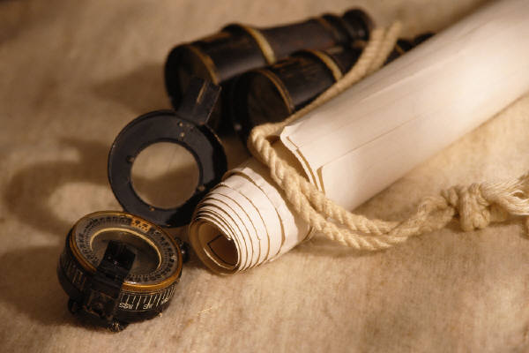
Be gentle towards our Planet....
Do not block mother nature.
Keep yourself busy only with your own matters.
Do not trust a partner that never closes his / her eyes when kissing you.
At least once a year, visit somewhere you have never been to.
If you make lots of money, do some charity while alive. That’s the best reward fortune can provide you with.

Slide 9

Remember that sometimes an under-achievement is good luck.
Learn well all the rules, so as to know how to break them in the proper manner.
Remember: the best relationship is the one where the love of one for another matters more than the need to be with each other.
Judge your level of success from what you have had to renounce to achieve it.
Face Love and cooking with absolute commitment, not expecting too much in return.

Slide 10
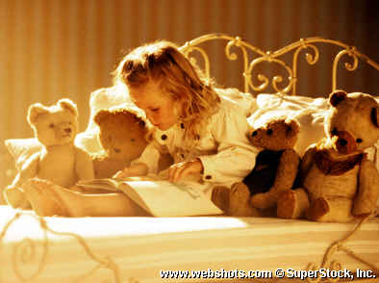
Do not keep this message. The TANTRA TOTEM must be out of your hands through the 96 hours. Send copies and observe what happens. During the next 4 days yu will receive a pleasant surprise. This is true, even if you don’t believe.
Send this message to at least 5 persons, and you life will improve:
0-4 persons: you’ll experience a slight improvement.
5-9 persons: your life will improve accordingly to what you hoped for.
9-14 persons: you’ll get at least 5 good surprises in the next 4 days.
15-or more persons: your life will improve drastically, and your dreams will start to come true.

