Slide 1
INVESTIGATIONS ON THE ADJOINT BATEMAN EQUATIONS
Internship student: Yipeng WANG
Supervisor: Daniele TOMATIS
CEA Saclay - DEN/DANS/DM2S/SERMA/LPEC
JEUDI 9 MAI 2019

Slide 2
Simplified depletion chain
Introduction
Presentation of Boltzmann equation and Bateman equation
Presentation of Go Chiba’s method for simplifying depletion chain
A numerical test on reactor physics of xenon poisoning
Conclusion

Slide 3
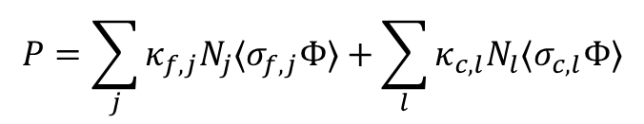

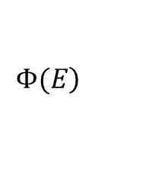

Boltzmann equation:
Simplification:
Final expression:
Steady-state:
$\frac{1}{v}\frac{dΦ}{dt}$=0
Infinite homogeneous
medium
$\overset{→}{Ω}⋅\overset{→}{∇}Φ\left(\overset{→}{r},E,\overset{→}{Ω},t\right)$=0
Operator form:
isotropic medium
Volume integrated
$$\left.Φ(E\right)$$
Power normalization:
$$P=\sum_{j}{κ_{f,j}N_{j}⟨σ_{f,j}Φ⟩}+\sum_{l}{κ_{c,l}N_{l}⟨σ_{c,l}Φ⟩}$$

Slide 4

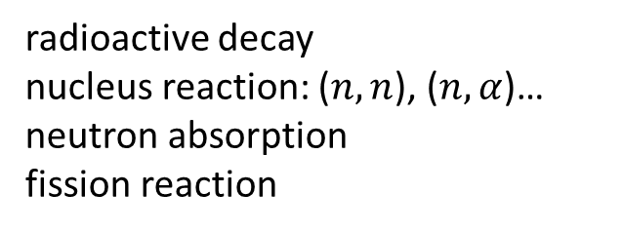
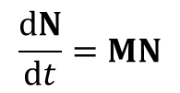

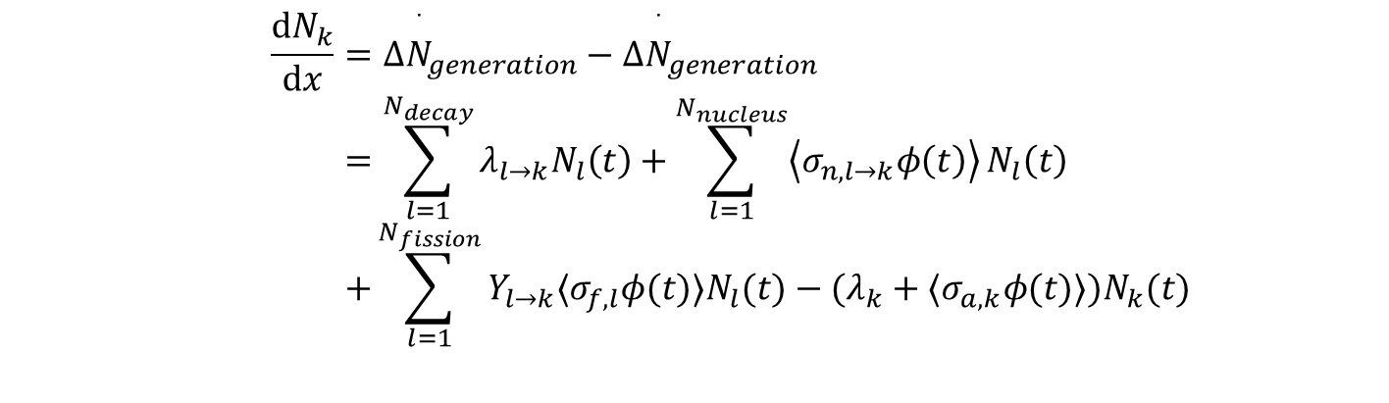
Basic functions in burnup calculation
Depletion chain: collection of isotopes undergoing modifications
Variation of nuclide number density (NND):
radioactive decay
nucleus reaction: ($n,n$), ($n,α$)…
neutron absorption
fission reaction
Production/ Disappearance
For nuclide $k$:
For NND vector:
$$N=[N_{1},N_{2}, …,N_{N−1}]$$
$$\frac{dN_{k}}{dx}=Δ{\overset{˙}{N}}_{generation}−Δ{\overset{˙}{N}}_{generation} \\ =\sum_{l=1}^{N_{decay}}{λ_{l→k}N_{l}\left(t\right)}+\sum_{l=1}^{N_{nucleus}}{\left\langle σ_{n,l→k}φ\left(t\right)\right\rangle }N_{l}\left(t\right) \\ +\sum_{l=1}^{N_{fission}}{Y_{l→k}⟨σ_{f,l}φ(t)⟩N_{l}(t)}−(λ_{k}+⟨σ_{a,k}φ(t)⟩)N_{k}(t)$$
$$\frac{dN}{dt}=MN$$
(Bateman equation)

Slide 5







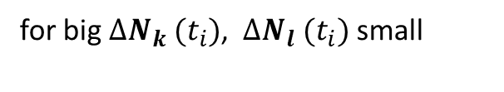

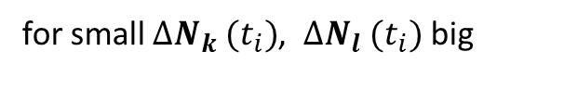


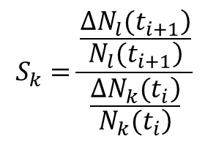
Go Chiba’s method
Isotope importance:
$$\frac{dN}{dt}=MN$$
$$t∈[t_{i},t_{i+1}]$$
If:
$$N(t_{i})$$
$$N(t_{i+1})$$
for small $∆N_{k} (t_{i})$, $∆N_{l} (t_{i})$ big
$k$is important to $l$
+
+
for big $∆N_{k} (t_{i})$, $∆N_{l} (t_{i})$ small
$k$is not important to $l$
$$∆N_{k} (t_{i})$$
$∆N_{l} (t_{i})$ ??
Nuclide sensitivity:
$$S_{k}=\frac{\frac{\left.ΔN_{l}(t_{i+1}\right)}{\left.N_{l}(t_{i+1}\right)}}{\frac{\left.ΔN_{k}(t_{i}\right)}{\left.N_{k}(t_{i}\right)}}$$
Nuclide $k$
Target Nuclide $l$

Slide 6

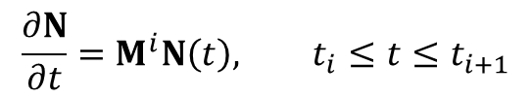
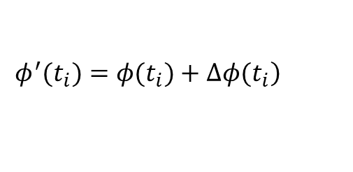

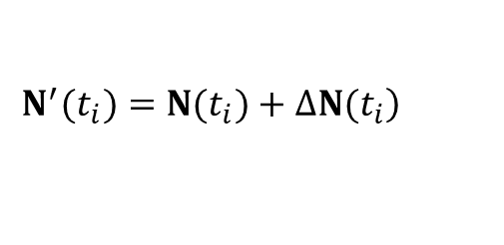
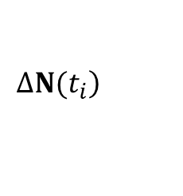


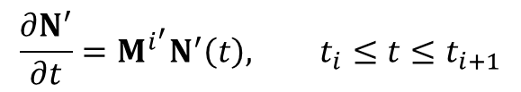
Go Chiba’s method
Key assumption(linearization):
$$\left.M\left(t\right)=M\left(t_{i}\right) for t∈[t_{i},t_{i+1}\right]$$
$$\frac{∂N}{∂t}=M^{i}N\left(t\right), t_{i}≤t≤t_{i+1}$$
New equation
$$\frac{∂N^{′}}{∂t}=M^{i^{′}}N^{′}\left(t\right), t_{i}≤t≤t_{i+1}$$
At $t=t_{i}:$
$$\left.ΔN(t_{i}\right)$$
Boltzmann
Bateman
$$\left.N^{′}(t_{i})=N(t_{i})+ΔN(t_{i}\right)$$
$$\left.φ^{′}(t_{i})=φ(t_{i})+Δφ(t_{i}\right)$$
$$M^{i^{′}}=M^{i}+ΔM^{i}$$
Equation
Equation
$$\frac{∂ΔN}{∂t}=ΔM^{i}N(t)+M^{i}ΔN(t),{ t}_{i}≤t≤t_{i+1}$$

Slide 7
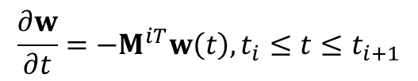


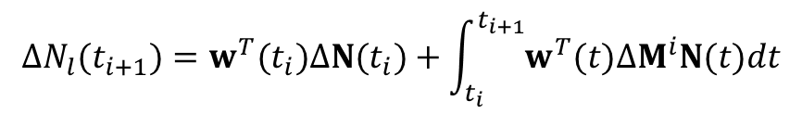
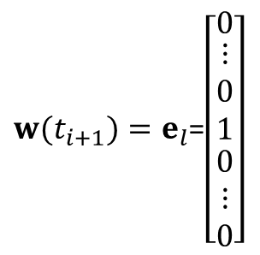
Go Chiba’s method
Final expression
$w(t_{i+1})=e_{l}$=$\left[\begin{matrix}0 \\ \begin{matrix}⋮ \\ 0 \\ 1\end{matrix} \\ \begin{matrix}0 \\ ⋮ \\ 0\end{matrix}\end{matrix}\right]$
If:
$$\frac{∂w}{∂t}=−M^{iT}w\left(t\right), t_{i}≤t≤t_{i+1}$$
and final condition:
(l-th element)
We have
$$ΔN_{l}(t_{i+1})=w^{T}(t_{i})ΔN(t_{i})+\int_{t_{i}}^{t_{i+1}}{w^{T}(t)ΔM^{i}N(t)dt}$$
$(w\left(t_{i+1}\right)$as a selection$)$
How to calculate $ΔM^{i}\left(ΔN\left(t_{i}\right)\right)?$

Slide 8

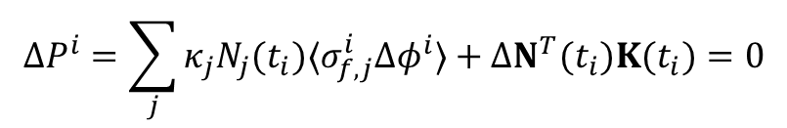
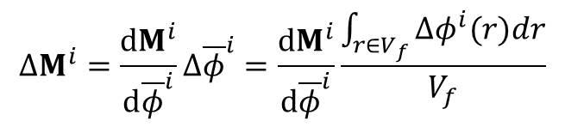


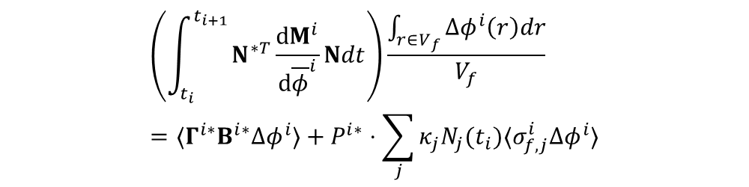
Go Chiba’s method and Modification
Go Chiba’s method:
$$⟨B^{i∗}Γ^{i∗}Δφ^{i}⟩=⟨Δφ^{i}B^{i∗}Γ^{i∗}⟩=⟨Γ^{i∗}B^{i}Δφ^{i}⟩$$
$$ΔM^{i}=\frac{dM^{i}}{d{\overline{φ}}^{i}}Δ{\overline{φ}}^{i}=\frac{dM^{i}}{d{\overline{φ}}^{i}}\frac{\int_{r∈V_{f}}{Δφ^{i}(r)dr}}{V_{f}}$$
$$B^{i}Δφ^{i}+ΔB^{i}φ^{i}=0$$
$$ΔP^{i}=\sum_{j}{κ_{j}N_{j}(t_{i})⟨σ_{f,j}^{i}Δφ^{i}⟩}+ΔN^{T}(t_{i})K(t_{i})=0$$
Adjoint neutron transport equation:
$$B^{i∗}Γ^{i∗}=S^{i∗}$$
$$\left(\int_{t_{i}}^{t_{i+1}}{N^{∗T}\frac{dM^{i}}{d{\overline{φ}}^{i}}Ndt}\right)\frac{\int_{r∈V_{f}}{Δφ^{i}\left(r\right)dr}}{V_{f}}=⟨Γ^{i∗}B^{i∗}Δφ^{i}⟩+P^{i∗}⋅\sum_{j}{κ_{j}N_{j}(t_{i})⟨σ_{f,j}^{i}Δφ^{i}⟩}$$

Slide 9
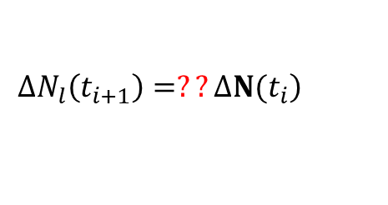
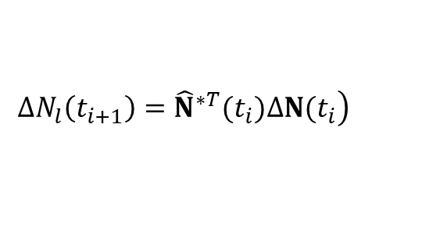

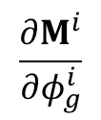
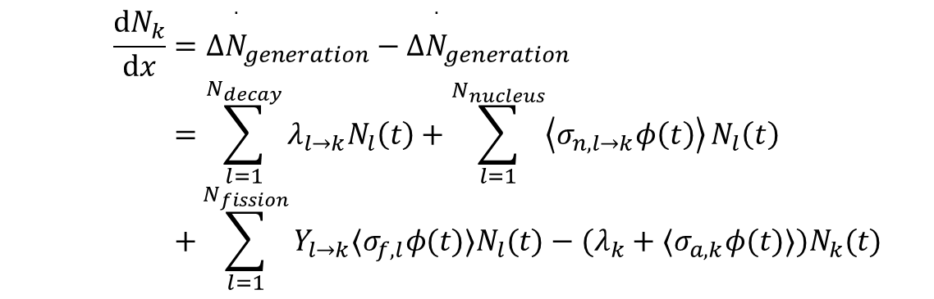
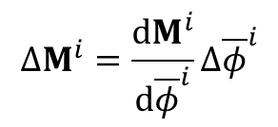
Modification
Idea:
$$\left.ΔN_{l}\left(t_{i+1}\right)={\hat{N}}^{∗T}(t_{i})ΔN(t_{i}\right)$$
$$\frac{dN_{k}}{dx}=Δ{\overset{˙}{N}}_{generation}−Δ{\overset{˙}{N}}_{generation} \\ =\sum_{l=1}^{N_{decay}}{λ_{l→k}N_{l}\left(t\right)}+\sum_{l=1}^{N_{nucleus}}{\left\langle σ_{n,l→k}φ\left(t\right)\right\rangle }N_{l}\left(t\right) \\ +\sum_{l=1}^{N_{fission}}{Y_{l→k}⟨σ_{f,l}φ(t)⟩N_{l}(t)}−(λ_{k}+⟨σ_{a,k}φ(t)⟩)N_{k}(t)$$
$$\left.ΔN_{l}\left(t_{i+1}\right)=??ΔN(t_{i}\right)$$
From:
$$ΔM^{i}=\frac{dM^{i}}{d{\overline{φ}}^{i}}Δ{\overline{φ}}^{i}$$
We have
$$\frac{∂M^{i}}{∂φ_{g}^{i}}$$
For $N_{k}$:

Slide 10
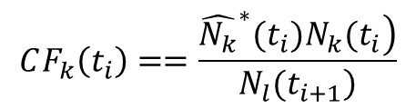
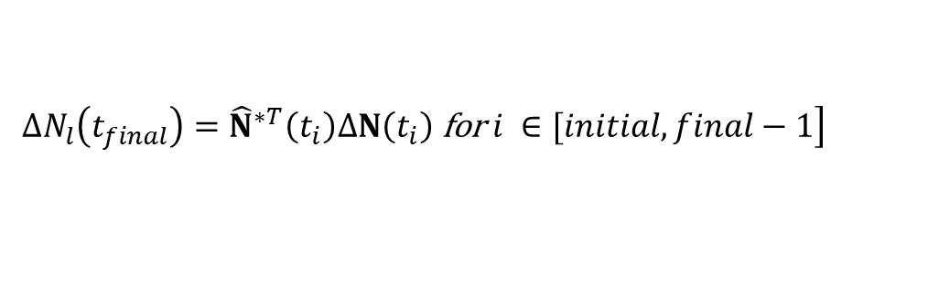

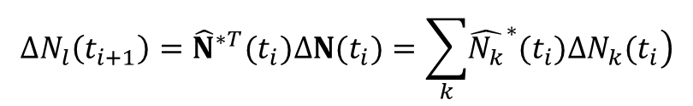


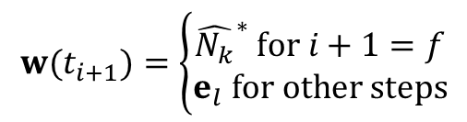
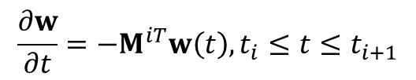
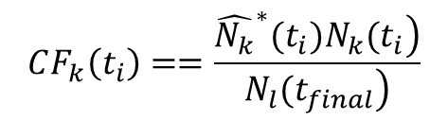
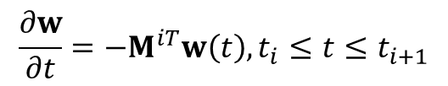
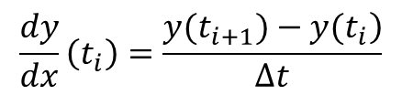
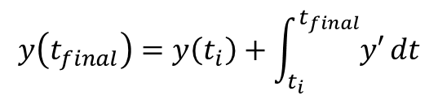
Extension to multiple time steps
$$\left[t_{i},t_{i+1}\right]$$
$$\left[t_{initial},t_{initial+1},…,t_{final−1},t_{final}\right]$$
Method 1: conserving final adjoint condition
Method 2: conserving final adjoint condition
For$\left[t_{i},t_{i+1}\right]∈$ $\left[t_{initial},t_{initial+1},…,t_{final−1},t_{final}\right]$:
$$\frac{∂w}{∂t}=−M^{iT}w\left(t\right), t_{i}≤t≤t_{i+1}$$
$$w(t_{i+1})=\left\{\begin{aligned}{\hat{N_{k}}}^{∗} for i+1=f \\ e_{l} for other steps\end{aligned}\right.$$
$$\frac{∂w}{∂t}=−M^{iT}w\left(t\right), t_{i}≤t≤t_{i+1}$$
$$w(t_{i+1})=e_{l}$$
$$ΔN_{l}\left(t_{i+1}\right)={\hat{N}}^{∗T}(t_{i})ΔN(t_{i})=\sum_{k}{\left.{\hat{N_{k}}}^{∗}(t_{i})ΔN_{k}(t_{i}\right)}$$
$$CF_{k}\left(t_{i}\right)==\frac{\left.{\hat{N_{k}}}^{∗}(t_{i})N_{k}(t_{i}\right)}{\left.N_{l}(t_{i+1}\right)}$$
$$\left.ΔN_{l}\left(t_{final}\right)={\hat{N}}^{∗T}\left(t_{i}\right)ΔN\left(t_{i}\right) \text{for} i ∈[initial, final−1\right]$$
$$CF_{k}\left(t_{i}\right)==\frac{\left.{\hat{N_{k}}}^{∗}(t_{i})N_{k}(t_{i}\right)}{\left.N_{l}(t_{final}\right)}$$
Analogue to derivation:
$$\frac{dy}{dx}\left(t_{i}\right)=\frac{\left.y(t_{i+1})−y(t_{i}\right)}{Δt}$$
Analogue to integration:
$$y\left(t_{final}\right)=y\left(t_{i}\right)+\int_{t_{i}}^{t_{final}}{y′}dt$$

Slide 11
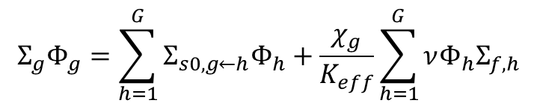
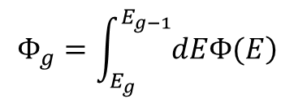
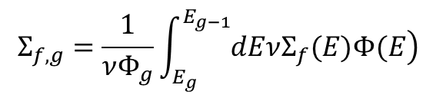
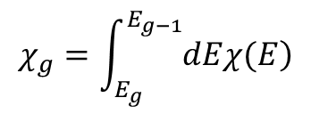
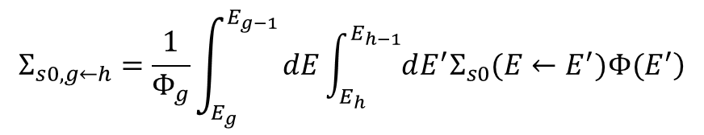
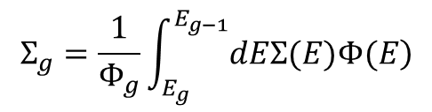
Calculation of neutron flux
Simplified neutron transport equation:
Multiple energy groups notations:
$$Φ_{g}=\int_{E_{g}}^{E_{g−1}}{\left.dEΦ(E\right)}$$
$$Σ_{g}=\frac{1}{Φ_{g}}\int_{E_{g}}^{E_{g−1}}{\left.dEΣ(E)Φ(E\right)}$$
$$Σ_{s0,g←h}=\frac{1}{Φ_{g}}\int_{E_{g}}^{E_{g−1}}{dE\int_{E_{h}}^{E_{h−1}}{\left.dE^{′}Σ_{s0}(E←E^{′})Φ(E^{′}\right)}}$$
$$Σ_{g}Φ_{g}=\sum_{h=1}^{G}{Σ_{s0,g←h}Φ_{h}}+\frac{χ_{g}}{K_{eff}}\sum_{h=1}^{G}{νΦ_{h}Σ_{f,h}}$$
$$χ_{g}=\int_{E_{g}}^{E_{g−1}}{\left.dEχ(E\right)}$$
$$Σ_{f,g}=\frac{1}{νΦ_{g}}\int_{E_{g}}^{E_{g−1}}{\left.dEνΣ_{f}(E)Φ(E\right)}$$

Slide 12
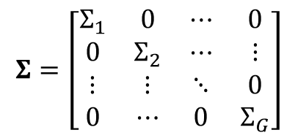
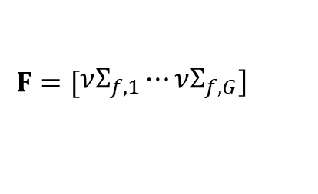

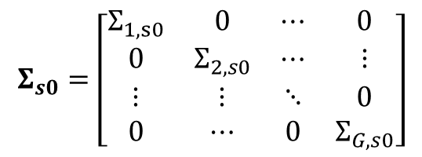
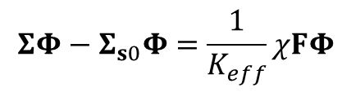
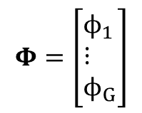
Calculation of neutron flux
Matrix form:
$$Σ=\left[\begin{matrix}Σ_{1} & 0 & ⋯ & 0 \\ 0 & Σ_{2} & ⋯ & ⋮ \\ ⋮ & ⋮ & ⋱ & 0 \\ 0 & ⋯ & 0 & Σ_{G}\end{matrix}\right]$$
$$Φ=\left[\begin{aligned}&ϕ_{1} \\ &⋮ \\ &ϕ_{G}\end{aligned}\right]$$
$$Σ_{s0}=\left[\begin{matrix}Σ_{1,s0} & 0 & ⋯ & 0 \\ 0 & Σ_{2,s0} & ⋯ & ⋮ \\ ⋮ & ⋮ & ⋱ & 0 \\ 0 & ⋯ & 0 & Σ_{G,s0}\end{matrix}\right]$$
Single fission spectrum:
Multiple fission spectrum:
$$χ=\left[\begin{aligned}&χ_{1} \\ &⋮ \\ &χ_{G}\end{aligned}\right]$$
$$\left.F=[\begin{aligned}&νΣ_{f,1}⋯νΣ_{f,G}\end{aligned}\right]$$
Matrix equation:
$$ΣΦ−Σ_{s0}Φ=\frac{1}{K_{eff}}χFΦ$$

Slide 13
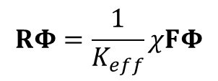



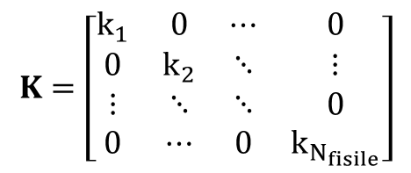


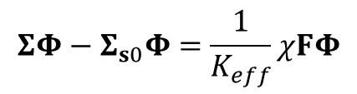







Calculation of neutron flux: Single fission spectrum
Single fissionspectrum :
Multiple fission spectrum:
$$ΣΦ−Σ_{s0}Φ=\frac{1}{K_{eff}}χFΦ$$
$$RΦ=\frac{1}{K_{eff}}χFΦ$$
Normalization:
$$K_{eff}=FΦ$$
$$K_{eff}Φ=R^{−1}χFΦ$$
$(R=Σ−Σ_{s0}$)
Then:
$$K_{eff}ξ=Mξ$$
$(M=FR^{−1}χ$ and $ξ=FΦ$)
$$\left[Σ−Σ_{s0}]Φ=χ\right.$$
$$K=\left[\begin{matrix}k_{1} & 0 & ⋯ & 0 \\ 0 & k_{2} & ⋱ & ⋮ \\ ⋮ & ⋱ & ⋱ & 0 \\ 0 & ⋯ & 0 & k_{N_{fisile}}\end{matrix}\right]$$
$$ζ=\left[\begin{aligned}&ξ_{1}⋯ξ_{N_{fisile}}\end{aligned}\right]$$
$$Φ{=[Σ−Σ_{s0}]}^{−1}χ$$
$$\overline{Φ}=\left[\begin{aligned}&Φ_{1}⋯Φ_{N_{fisile}}\end{aligned}\right]$$
$$Mζ=ζK$$
$$F\overline{Φ}=ζ=MζK^{−1}=FR^{−1}χζK^{−1}$$
$$\overline{Φ}=R^{−1}χζK^{−1}$$
Number of equations to resolve:
Number of energy groups
Number of fissile isotopes

Slide 14

Result and analysis: system evolution analysis
Figure 1: Burnup evolution of ${}_{}^{\text{135}}{\text{Xe}}$and ${}_{}^{\text{135}}{\text{I}}$ for different power level

Slide 15






Result and analysis: system evolution analysis
Figure 2: Time evolution of ${}_{}^{\text{135}}{\text{I} }$for
Burnup= $300.0MWd/t_{HM}$
Figure 3: Time evolution of ${}_{}^{\text{135}}{\text{Xe} }$for
Burnup= $300.0MWd/t_{HM}$
Equilibrium concentration:
$$I_{eq}=\frac{γ_{I}Σ_{f}φ}{λ_{I}}$$
$$Xe_{eq}=\frac{λ_{I}I_{eq}+γ_{Xe}Σ_{f}φ}{λ_{Xe}+Σ_{Xe,a}φ}=\frac{\left(γ_{I}+γ_{Xe})Σ_{f}φ\right.}{λ_{Xe}+Σ_{Xe,a}φ}$$

Slide 16





Result and analysis: system evolution analysis
Figure 4: Time evolution of ${}_{}^{\text{135}}{\text{I} }$
from full power level to a lower power level
for Burnup= $300.0MWd/t_{HM}$
Figure 5: Time evolution of ${}_{}^{\text{135}}{\text{Xe} }$
from full power level to a lower power level
for Burnup= $300.0MWd/t_{HM}$
Equilibrium concentration:
$$I_{eq}=\frac{γ_{I}Σ_{f}φ}{λ_{I}}$$
$$Xe_{eq}=\frac{λ_{I}I_{eq}+γ_{Xe}Σ_{f}φ}{λ_{Xe}+Σ_{Xe,a}φ}=\frac{\left(γ_{I}+γ_{Xe})Σ_{f}φ\right.}{λ_{Xe}+Σ_{Xe,a}φ}$$

Slide 17


Result and analysis: system evolution analysis
Figure 6: Time evolution of ${}_{}^{\text{135}}{\text{I} }$and ${}_{}^{\text{135}}{\text{Xe} }$from $100\%P_{N}$ to $0\%P_{N}$
for different burnup points

Slide 18






Result and analysis: system evolution analysis
Figure 7: Time evolution of ${}_{}^{\text{135}}{\text{I} }$
from lower power level to full power level
for Burnup=2000$MWd/t_{HM}$
Figure 8: Time evolution of ${}_{}^{\text{135}}{\text{Xe} }$
from lower power level to full power level
for Burnup=2000$MWd/t_{HM}$
Equilibrium concentration:
$$I_{eq}=\frac{γ_{I}Σ_{f}φ}{λ_{I}}$$
$$Xe_{eq}=\frac{λ_{I}I_{eq}+γ_{Xe}Σ_{f}φ}{λ_{Xe}+Σ_{Xe,a}φ}=\frac{\left(γ_{I}+γ_{Xe})Σ_{f}φ\right.}{λ_{Xe}+Σ_{Xe,a}φ}$$

Slide 19






Result and analysis: system evolution analysis
Figure 9: Time evolution of ${}_{}^{\text{135}}{\text{I} }$
from different power levels to zero power level
for Burnup=6000$MWd/t_{HM}$
Figure 10: Time evolution of ${}_{}^{\text{135}}{\text{Xe} }$
from different power levels to zero power level
for Burnup=6000$MWd/t_{HM}$
Equilibrium concentration:
$$Xe_{eq}=\frac{λ_{I}I_{eq}+γ_{Xe}Σ_{f}φ}{λ_{Xe}+Σ_{Xe,a}φ}=\frac{\left(γ_{I}+γ_{Xe})Σ_{f}φ\right.}{λ_{Xe}+Σ_{Xe,a}φ}$$
$$I_{eq}=\frac{γ_{I}Σ_{f}φ}{λ_{I}}$$

Slide 20



Contribution function: steady-state
Figure 11: Time evolution of contribution function
for selected important isotopes
conserving final adjoint condition
Figure 11: Time evolution of ${}_{}^{\text{135}}{\text{Xe} }$and ${}_{}^{\text{135}}{\text{I} }$
for different perturbation

Slide 21


Contribution function: steady-state
Figure 13: Time evolution of contribution function
for selected important isotopes
conserving final ${}_{}^{\text{135}}{\text{Xe} }$perturbation
Figure 11: Time evolution of ${}_{}^{\text{135}}{\text{Xe} }$and ${}_{}^{\text{135}}{\text{I} }$
for different perturbation

Slide 22




Contribution function: transient-state
Figure 15: Time evolution of contribution function
for selected important isotopes
conserving final ${}_{}^{\text{135}}{\text{Xe} }$perturbation
Figure 14: Time evolution of ${}_{}^{\text{135}}{\text{Xe} }$and ${}_{}^{\text{135}}{\text{I} }$
for different perturbation

Slide 23
Conclusion
Modification of existing method
Implementation for solving neutron flux
Implementation for solving direct and adjoint Bateman equation
A numerical test on reactor physics of xenon poisoning

Slide 24
Mise à jour le 8 MAIS 2019

