Slide 1



Foursquare data to improve tourism in Uzbekistan
by
NDarvishev

Slide 2
Content
Objective of the Project
Background to Tourism industry
Data
Methodology
Data analysis
Exploring Tashkent
Demonstration of venues in New York City
Demonstration of venues in Toronto
Results
Conclusion

Slide 3
The Study Purpose
Recently, the Tourism Agency of Uzbekistan has requested an app for tourists:
Tourists do not have enough information about uzbek cities, venues, restaurants, cafes and other interesting places;
The agency director also requested to demonstrate and magnify each city's venues, sightseeings and cultural heritage.
The goals is to compare cities in terms of what it offers, what it is famous for, communication and commute channels, time and means and how comfortable visiting the city is.
However, there is a huge problem of data sufficiency and availability.
By the time, the Tourism agency collects and updates its database and prepares relevant information, the team is willing to start working on a demo for Toronto and New York
Stakeholders: Tourists, Hotels, Restaurants & Cafes, Venue owners, local municipality

Slide 4
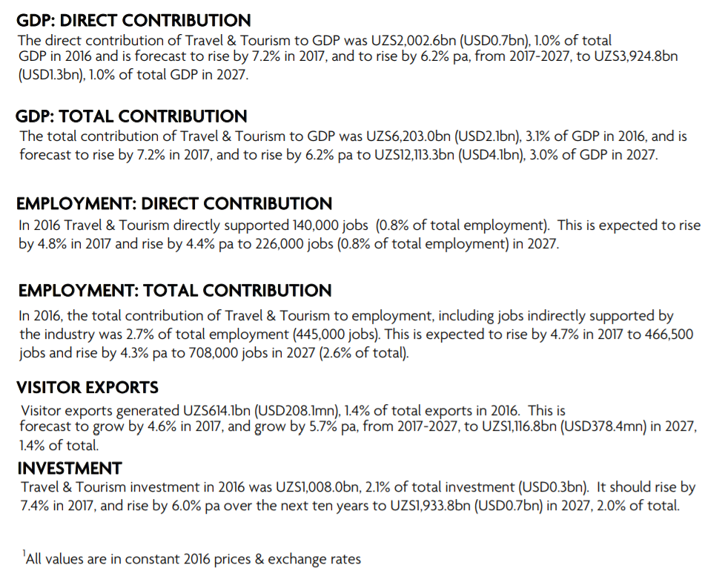
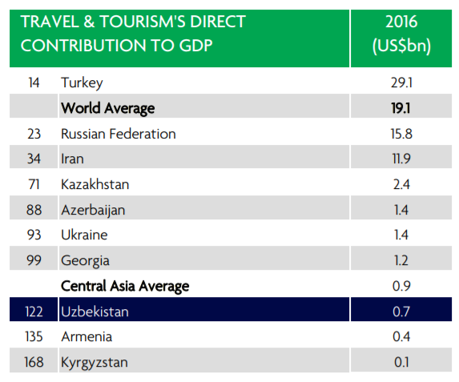
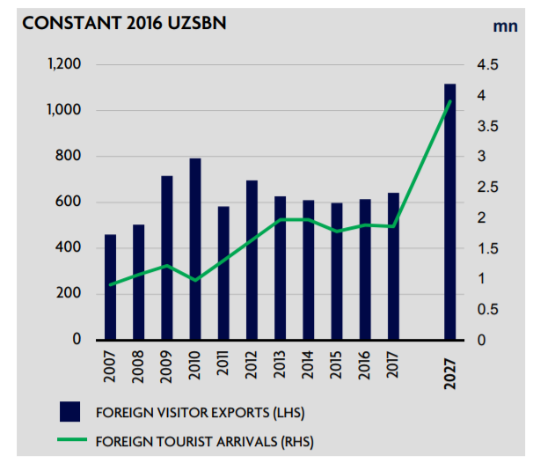
Key facts about tourism in Uzbekistan

Slide 5
Why low tourism in Uzbekistan?
Uzbekistan has many historic and ancient cities such as Khiva, Bukhara and Samarkand;
But there are not as many tourists as the Tourism agency expects:
Uzbekistan remained closed for about 20 years;
Expensive, highly beauracritized visa processing and tourist registration requirements;
Unfriendly environment at the airport: long lines for passport and customs control;
Restrictions to take photos in many places;
Lack of quality data, apps and resources to locate other interesting venues, restaurants, cafes and etc;
Limited number of hotels (~ 550 hotels around the country) and hostels as well.

Slide 6
Methodology (1/3)
We will use spatial and location data by Foursquare API to demonstrate venues first in Tashkent to show the data deficit;
We will use spatial and location data by Foursquare API to explore neighborhoods in Toronto and New York City to locate the most common venue categories in each neighborhood;
We will then group the neighborhoods into clusters using the k-means clustering algorithm;
We will visualize the neighborhoods in Toronto and New York City and their emerging clusters.
We will focus our first test on Tashkent, because it’s the capital city and it’s the first entrance destination for tourists.

Slide 7
Methodology (2/3)
Employ Python and its many libraries and capabilities;
Obtain Foursquare Developer Account to obtain API;
Jupyterlab used to run Python codes;
Installed libraries:
Pandas – for handling data in a vectorized manner;
Numpy – to conduct data analysis;
Json – to manage json files;
Json_normalize – to transform json files into panda dataframes
Geopy – to work with Foursquare API;
Geopy.geocoders - convert an address into latitude and longitude values
Requests – to handle url requests;
Matplotlib – to plot visuals, graphs and maps;
Sklearn – to conduct machine learning algorithms – k-means clustering;
Folio – library to render maps.

Slide 8
Methodology (3/3)
Clustering: K-Means
There are many models for clustering out there.
We will be presenting the model that is considered one of the simplest models amongst them.
Despite its simplicity, the K-means is vastly used for clustering in many data science applications, especially useful if you need to quickly discover insights from unlabeled data.
Some real-world applications of k-means:
Customer segmentation
Understand what the visitors of a website are trying to accomplish
Pattern recognition
Machine learning
Data compression

Slide 9
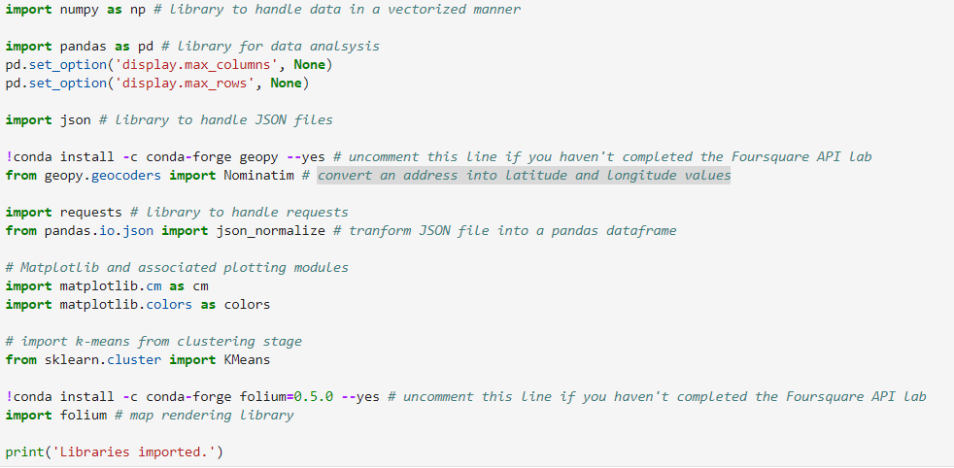
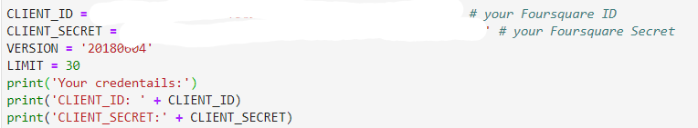
Data Analysis
All the necessary libraries are installed and imported;
Foursquare API credentials are defined

Slide 10
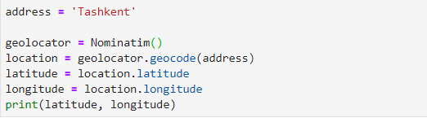

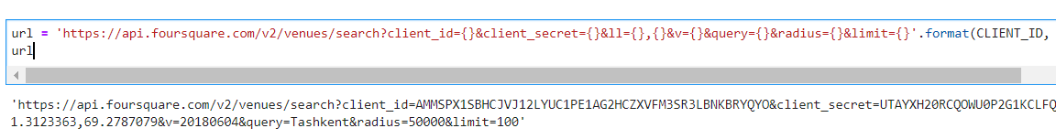
Exploring Tashkent (1/4):
3. The Geographical coordinates of Tashkent:
Latitude: 41.3123363 Longitude: 69.2787079
4. We will look for venues with names “Tashkent” around 5km in Tashkent by using the following code:

Slide 11
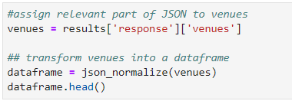

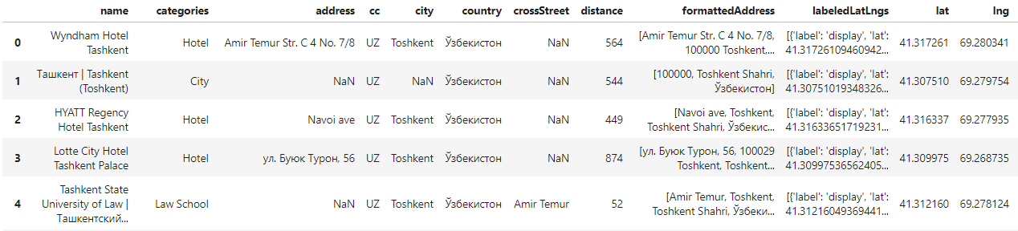
Exploring Tashkent (2/4):
5. Results of the search query are stored in json dataframe:
6. We will retain only columns that include venue name, and anything that is associated with location:

Slide 12
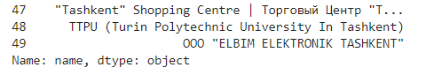
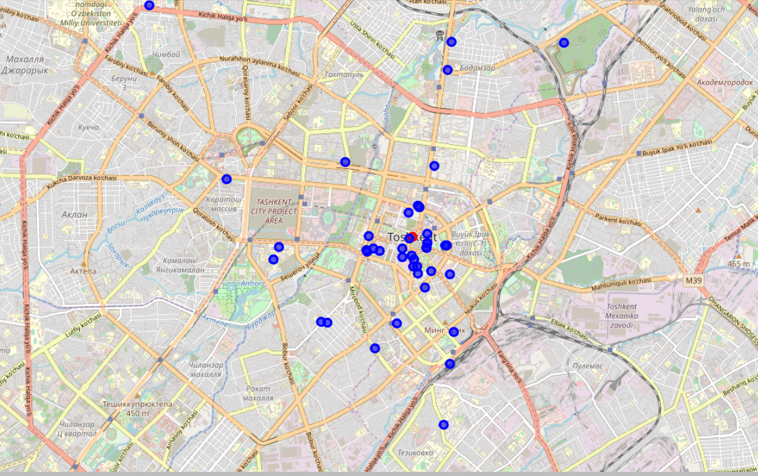
Exploring Tashkent (3/4):
7. There are 49 venues with names Tashkent:
6. Below map testifies to our statement about lack of venue data for the capital city -- Tashkent:

Slide 13
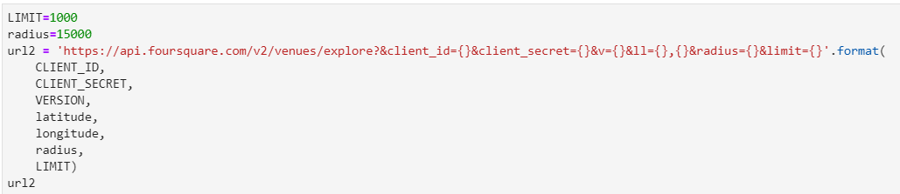
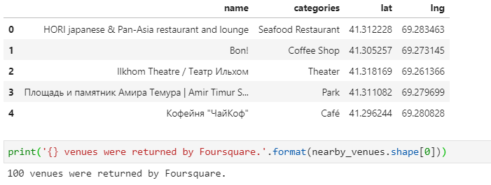
Exploring Tashkent (4/4):
7. Now let’s get 1000 venues located within 15kms of the city center:
6. The results of this query also confirms the lack of venue data in Foursquare. Within 15kms of the city center there are still 10 venues:

Slide 14
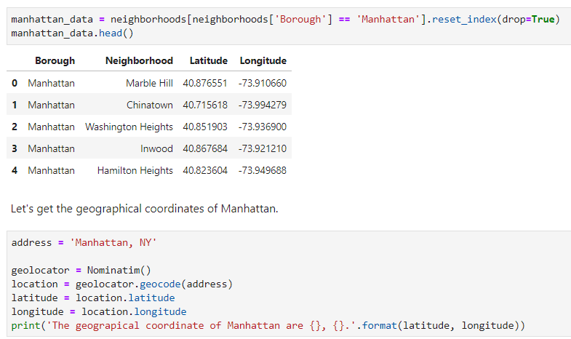
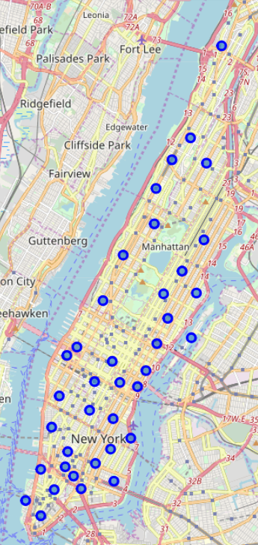
Demonstration of venues in NYC (1/3)
New York City is too large. Therefore, we will concentrate on Manhattan area:

Slide 15
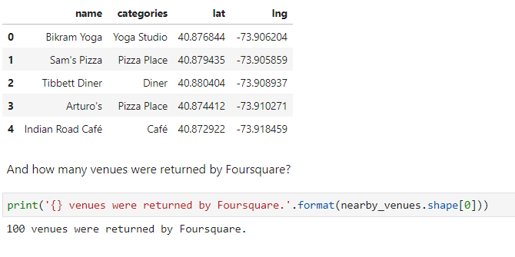
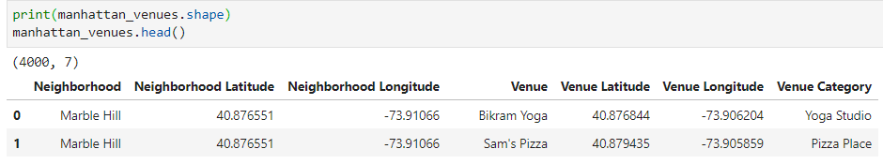
Demonstration of venues in NYC (2/3)
Search query for 100 venues around the Marble Hill hotel:
We created a special function in Python to explore the venues in Manhattan. There are more than 4000 venues.

Slide 16
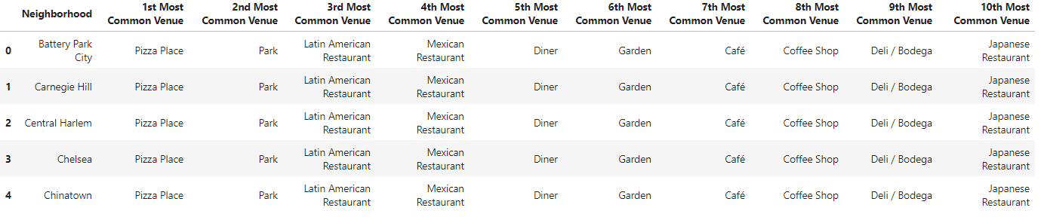
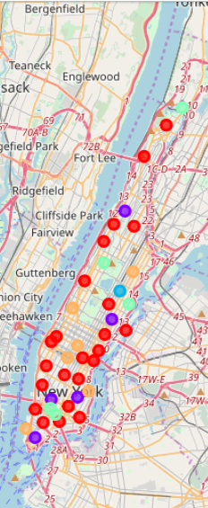
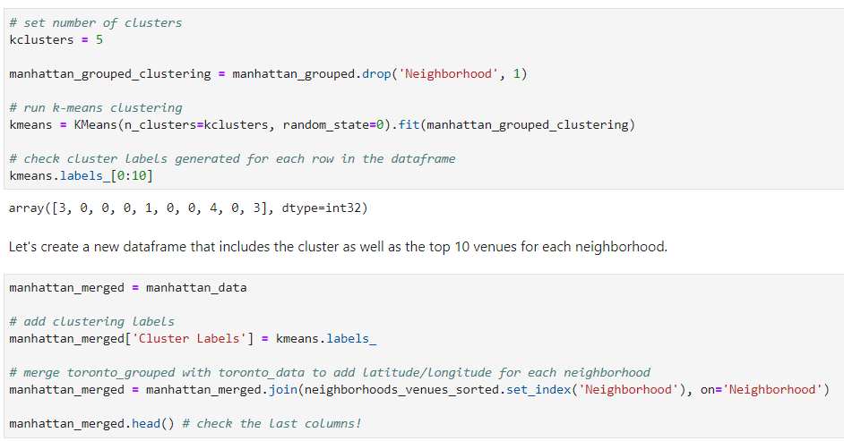
Demonstration of venues in NYC (3/3)
We grouped the venues by neighborhoods and analyzed them by taking the mean of the frequency of occurrence of each category:
We ran k-means clustering for 5 clusters with top 10 venues

Slide 17
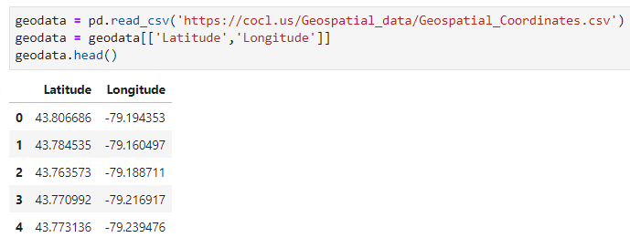
Demonstration of venues in Toronto (1/2)
We will now look at venues in Toronto, but focus on North York;
To get data about neighborhoods (boroughs) in Toronto we needed to refer to Wikipedia;
Given this, we installed additional libraries such as msgpack, url, and Wikipedia;
Using panda we obtained geodata for Toronto neighborhoods

Slide 18
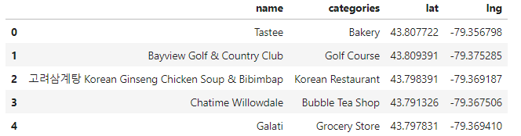
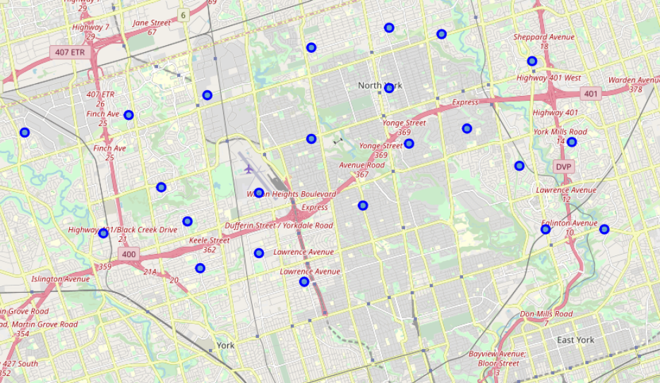
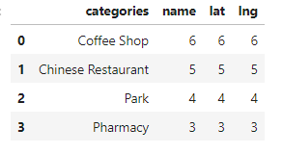
Demonstration of venues in Toronto (2/2)
Following the same data wrangling and data analysis procedures as in the case of NYC, we identified that there are 47 venues around the North York area.
The most popular venues in the North York are Coffee Shops and Chinese Restaurants

Slide 19
Results
Spatial, location and venue data for the capital city is very poor. Yet we didn’t run the test for Samarkand, Bukhara and Khiva;
A search query with a limit of 1000 venues located within 15kms of the city center resulted in only 100 venues. In comparison, a similar query generated more than 4000 venues in Manhattan;
We ran k-means clustering for 5 clusters with top 10 venues in Manhattan and obtained this information in separate tables;
A search query of venues within 500 meters in North York borough, Toronto generated around 50 venues;
And we showed that Coffee Shops and Chinese Restaurants are the most frequently visited places in North York, Toronto

Slide 20
Conclusion
Spatial, location and venue data for the capital city is very poor. Yet we didn’t run the test for Samarkand, Bukhara and Khiva.
Tourists are unable to obtain useful information about venues around the neighborhoods they’re staying.
Uncertainty is a factor in decision making process;
When you’re in a different and unusual environment, you look for information for restaurants, cafes, and other interesting venues from others;
Tourists need guidance and the Tourism agency should work hard on building a special app for tourists coming to Uzbekistan and link it to popular social network services;
This way, the Tourism agency is likely to attract more tourists also by targeting various age and income group tourists.

Slide 21
Thank You for your attention!

