Slide 1

Weka

Slide 2
Association Analysis
Considering our problem statement we were curious as to see what interesting rules were generated to lead to fatalities
Achieved by using Weka
Initial data made it difficult to find interesting rules to our problem
Rules were found to be infrequent thus never showed up despite increasing number of rules to generate and the lower bound
Oversampling helped immensely
Set the consequent to the Injury Type which outputs Confidence only

Slide 3
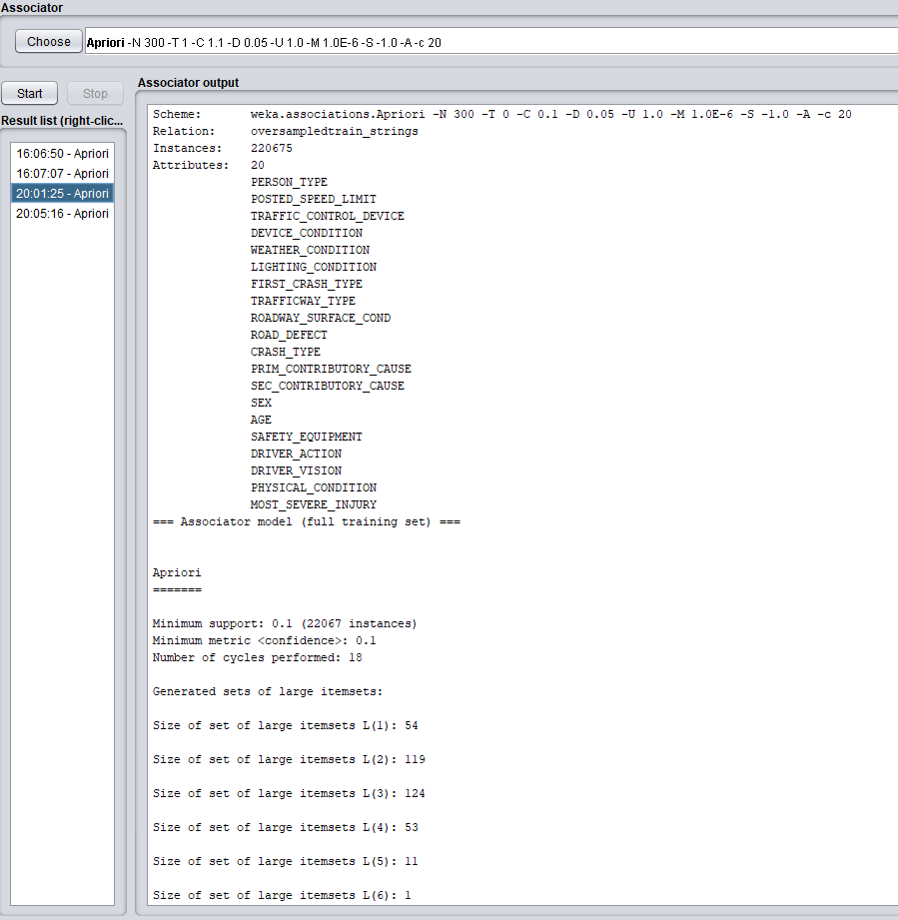

Slide 4
A few interesting rules found
LIGHTING_CONDITION=DAYLIGHT FIRST_CRASH_TYPE=ANIMAL CRASH_TYPE=INJURY AND / OR TOW DUE TO CRASH 2 ==> INJURY_CLASSIFICATION=FATAL
Very low confidence…
Crashing into an animal always resulted in a Fatal injury
TRAFFIC_CONTROL_DEVICE=NO_CONTROLS LIGHTING_CONDITION=DARKNESS LIGHTED ROAD ROAD_DEFECT=NO DEFECTS SEX=M ==> INJURY_CLASSIFICATION=FATAL
.87 confidence
FIRST_CRASH_TYPE=FIXED OBJECT SEX=M DRIVER_VISION=UNKNOWN ==> INJURY_CLASSIFICATION=FATAL
.85 confidence

Slide 5
Determining what classifiers to use
Our dataset already has labels and a decent number of features:
Naïve Bayes
High scalable
Pretty fast!
Decision Stump
One level decision tree
Random Tree (Decision tree)
Built on a random subset of columns
Random Forest
Different samples of data taken to grow multiple trees where all trees vote on what the output should be (the majority vote wins)

Slide 6
Using Weka to Classify
Attempted classification with a 10 fold split on the training data

Slide 7
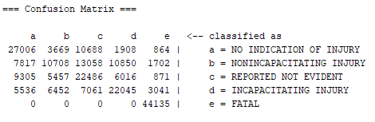
Results of Classification
Naïve Bayes
57.3% correct classified, 42.7% incorrectly classified
Precision = .557
Recall = .573
F Measure = .558
Overall not too terrible!

Slide 8
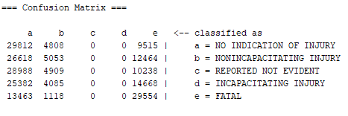
Results of Classification
Decision Stump
29.2% correct classified, 70.8% incorrectly classified
Recall = .292
Pretty bad…

Slide 9
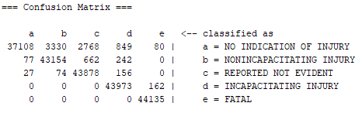
Results of Classification
Random Tree
96.2% correct classified, 3.8% incorrectly classified
Precision = .964
Recall = .962
F Measure = .961
Really good!

Slide 10
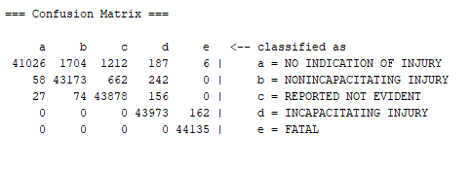
Results of Classification
Random Forest
98% correct classified, 2% incorrectly classified
Precision = . 980
Recall = .980
F Measure = .980
20 seconds to build model
About 6 minutes to classify
Excellent!

Slide 11
Now classifying using new test data…
Test data taken from Summer 2017
49,000 entries of people that were involved in crashes

Slide 12
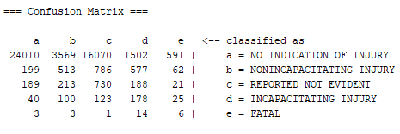
Naïve Bayes
51.1% correct classified, 48.9% incorrectly classified
Precision = .911
Recall = .512
F Measure = .640

Slide 13
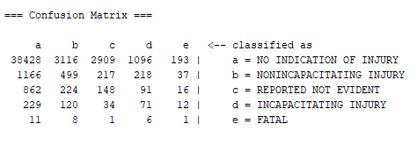
Random Tree
78.7% correct classified, 21.3% incorrectly classified
Precision = .876
Recall = .787
F Measure = .828

Slide 14
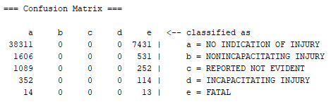
Decision Stump
77.1% correct classified, 22.9% incorrectly classified
Recall = .771

Slide 15
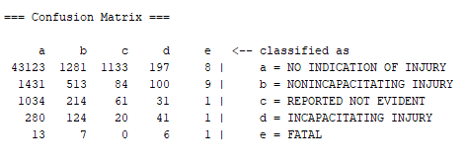
Random Forest
88% correct classified, 12% incorrectly classified
Precision = .877
Recall = .880
F Measure = .879

Slide 16
Interpretation of Our Results
There doesn’t seem to be to be any overfitting/underfitting
Excellent accuracy when ran on the never seen test data!

