Slide 1

Weka

Slide 2
Association Analysis
Considering our problem statement we were curious as to see what interesting rules were generated to lead to fatalities
Achieved by using Weka
Initial data made it difficult to find interesting rules to our problem
Rules were found to be infrequent thus never showed up despite increasing number of rules to generate and the lower bound
Oversampling helped immensely
Set the consequent to the Injury Type which outputs Confidence only

Slide 3
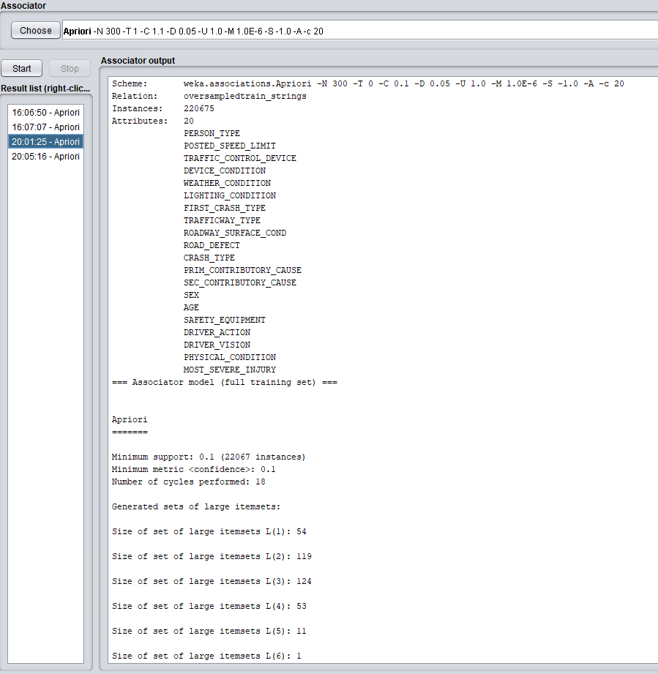

Slide 4
A few interesting rules found
LIGHTING_CONDITION=DAYLIGHT FIRST_CRASH_TYPE=ANIMAL CRASH_TYPE=INJURY AND / OR TOW DUE TO CRASH 2 ==> MOST_SEVERE_INJURY=FATAL 2
Crashing into an animal always resulted in a Fatal injury
PRIM_CONTRIBUTORY_CAUSE=OPERATING VEHICLE IN ERRATIC, RECKLESS, CARELESS, NEGLIGENT OR AGGRESSIVE MANNER POSTED_SPEED_LIMIT=SPEED LIMIT 15 DEVICE_CONDITION=NO CONTROLS FIRST_CRASH_TYPE=PEDESTRIAN 2 ==> MOST_SEVERE_INJURY=INCAPACITATING INJURY
PRIM_CONTRIBUTORY_CAUSE=UNDER THE INFLUENCE OF ALCOHOL/DRUGS (USE WHEN ARREST IS EFFECTED) FIRST_CRASH_TYPE=PEDALCYCLIST CRASH_TYPE=INJURY AND / OR TOW DUE TO CRASH 2 ==> MOST_SEVERE_INJURY=INCAPACITATING INJURY 2

Slide 5
Using Weka to Classify
Attempted classification with a 10 fold split:
Naïve Bayes
Naïve independent assumption of features to build independent
Decision Stump
One level decision tree
Random Tree (Decision tree)
Built on a random subset of columns
Random Forest
Different samples of data taken to grow multiple trees where all trees vote on what the output should be (the majority vote wins)

Slide 6
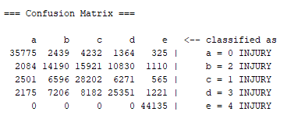
Results of Classification
Naïve Bayes
66.9% correct classified, 33.1% incorrectly classified
Precision = .663
Recall = .669
F Measure = .662
Overall not too terrible!

Slide 7
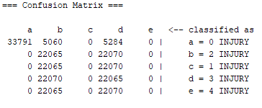
Results of Classification
Decision Stump
35.3% correct classified, 64.7% incorrectly classified
Recall = .353
Pretty bad…

Slide 8
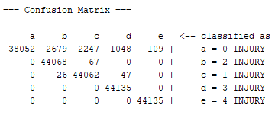
Results of Classification
Random Tree
97.1% correct classified, 2.8% incorrectly classified
Precision = .973
Recall = .972
F Measure = .971
Really good!

Slide 9
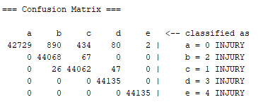
Results of Classification
Random Forest
99.2% correct classified, .07% incorrectly classified
Precision = . 993
Recall = .993
F Measure = .993
18 seconds to build model
About 3 minutes to classify
Excellent!

