Slide 1
Midterm topics:
Truth tables! Practice proving expressions involving A, B, ∧, ∨, ⇔, ⇒,¬
Practice proving these expressions without truth tables (remember all the laws and theorems)
Practice dealing with complicated nested quantifiers: ∃, ∀ and ∀, ∃
When can you switch them? When can you not? How do you negate them? Converge? Contrapositive?
Look at your Mobius quizzes! Practice working with complicated sentences containing ∀, ∃
Sets! You absolutely need to do both WA05 questions involving sets, before midterm!
Given A and B defined using set builder notation, prove that A ⊆ B, A∩B, A−B=∅, etc.
Look over assignments! Proofs like, if A then B ∨ C. How do you prove something like that?
IFF proofs (prove both directions)
Binomial Theorem! Formula will be given, but make sure you’re comfortable with using it!
Strong induction involving sequences. Practice!
Proofs involving divisibility
Polynomials

Slide 2
Midterm tips!
Use the entire time, please!
I used to give 0 to anyone that submitted exam with time still remaining
…unless they got perfect
Glance through entire midterm before you start it. Make yourself aware of what’s coming.
Get all the “mechanical” questions done.
Truth tables,
Logical equivalence proofs
Relatively easy divisibility proofs,
Relatively easy induction proofs,
Relatively easy binomial theorem proofs (e.g. manipulating expressions in sum notation to get desired result)
T/F questions
some might be hard. Be careful, but if something starts taking long, switch to a different question, then come back!
Mark pages that you’re complete (checkmark in corner), and ones where you have to come back
Proofs: it might not be obvious where to begin (for some of them). Give yourself 1 hour!
Guide. If 10 questions (4 hard proofs and 6 mechanical/easy proofs like induction that follows the usual pattern): Spend 40 minutes on the 6 “easy” questions, 1 hour on 4 “hard” questions, 10 minutes double-checking solutions, or going back to mechanical questions if proofs were easy, or more time on proofs.
Go to the midterm room earlier in the day so you know where it is! Some of you are in a diff. building!
Bring enough lead, or sharpened-pencils, erasers, etc. !!!

Slide 3
Midterm topics:
Truth tables! Practice proving expressions involving A, B, ∧, ∨, ⇔, ⇒,¬
Practice proving these expressions without truth tables (remember all the laws and theorems)
Practice dealing with complicated nested quantifiers: ∃, ∀ and ∀, ∃
When can you switch them? When can you not? How do you negate them? Converge? Contrapositive?
Look at your Mobius quizzes! Practice working with complicated sentences containing ∀, ∃
Sets! You absolutely need to do both WA05 questions involving sets, before midterm!
Given A and B defined using set builder notation, prove that A ⊆ B, A∩B, A−B=∅, etc.
Look over assignments! Proofs like, if A then B ∨ C. How do you prove something like that?
IFF proofs (prove both directions)
Binomial Theorem! Formula will be given, but make sure you’re comfortable with using it!
Strong induction involving sequences. Practice!
Proofs involving divisibility
Polynomials

Slide 4
Midterm tips!
Use the entire time, please!
I used to give 0 to anyone that submitted exam with time still remaining
…unless they got perfect
Glance through entire midterm before you start it. Make yourself aware of what’s coming.
Get all the “mechanical” questions done.
Truth tables,
Logical equivalence proofs
Relatively easy divisibility proofs,
Relatively easy induction proofs,
Relatively easy binomial theorem proofs (e.g. manipulating expressions in sum notation to get desired result)
T/F questions
some might be hard. Be careful, but if something starts taking long, switch to a different question, then come back!
Mark pages that you’re complete (checkmark in corner), and ones where you have to come back
Proofs: it might not be obvious where to begin (for some of them). Give yourself 1 hour!
Guide. If 10 questions (4 hard proofs and 6 mechanical/easy proofs like induction that follows the usual pattern):
Spend 40 minutes on the 6 “easy” questions, 1 hour on 4 “hard” questions, 10 minutes double-checking solutions, or going back to mechanical questions if proofs were easy, or more time on proofs.
Go to the midterm room earlier in the day so you know where it is! Some of you are in a diff. building!
Bring enough lead, or sharpened-pencils, erasers, etc. !!!

Slide 5
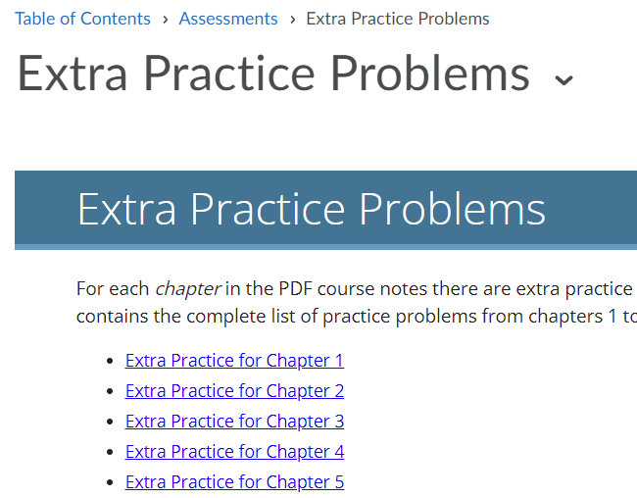
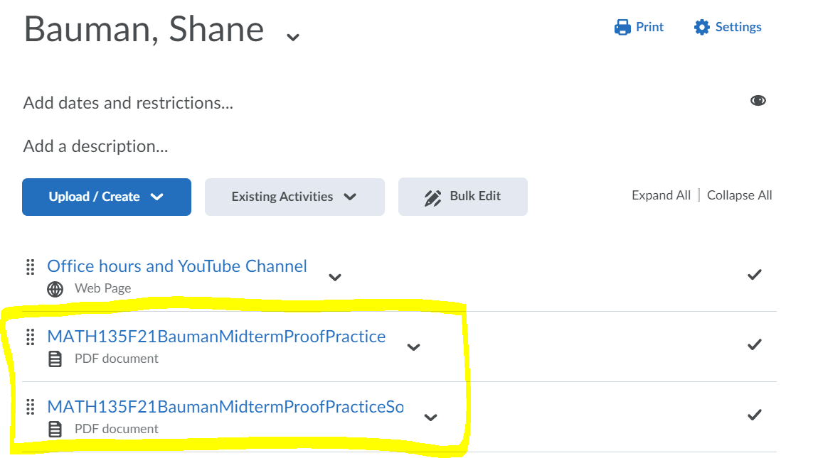
Winter midterm is coming, what should I do?

Slide 6
MATH 135: Lecture 14
Dr. Nike Dattani
8 October 2021

Slide 7
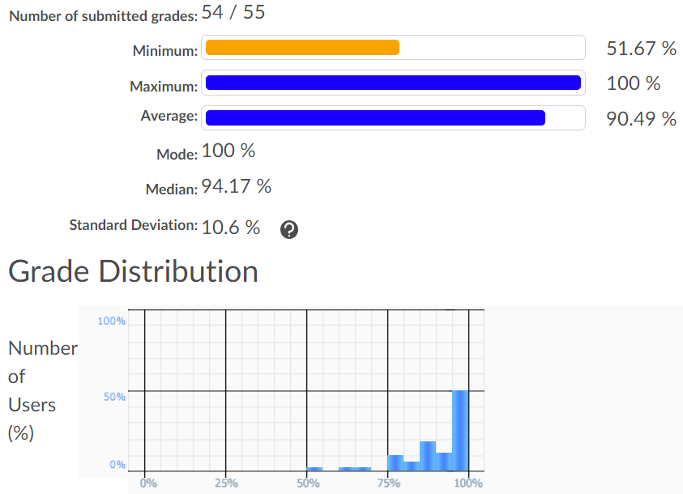
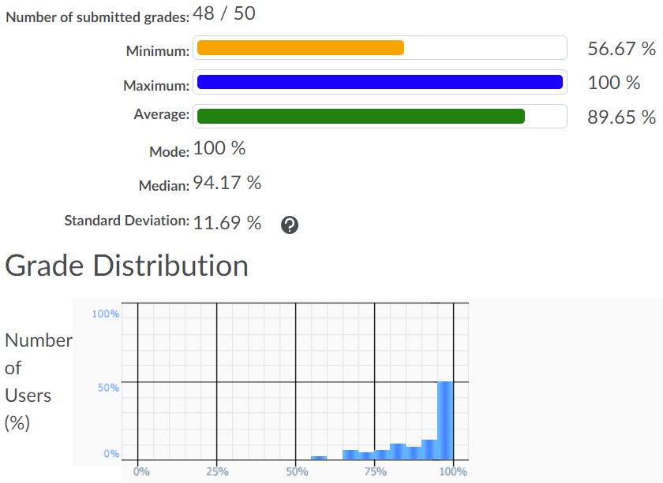
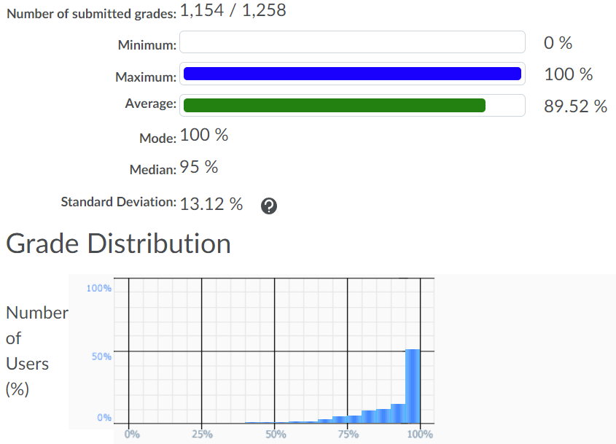
Nike’s Section 19
Nike’s Section 16
Entire MATH 135

Slide 8
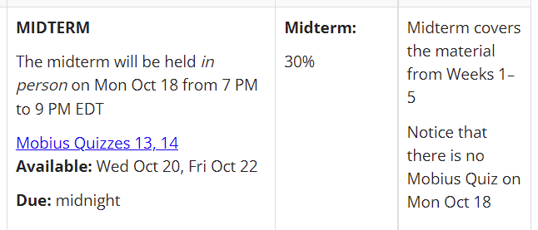
Weeks 1-5. So ignore any practice midterm questions that talk about gcd, mod, etc.

Slide 9
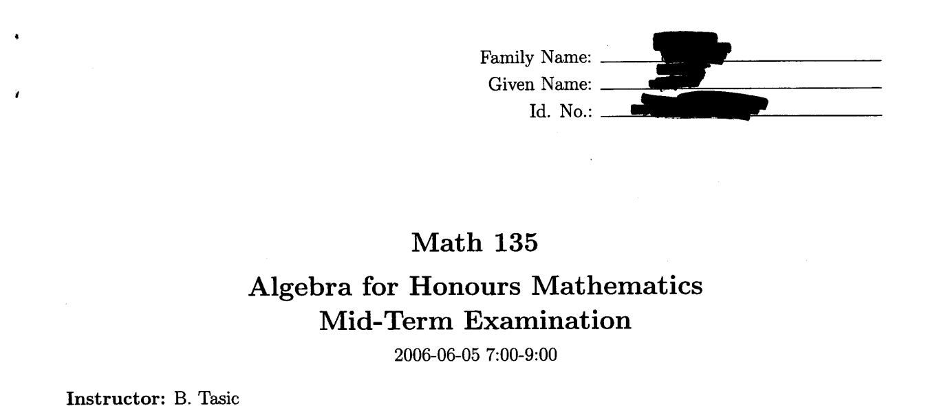

Slide 10

Euclid’s proof (Proposition 20 in Book 9 of The Elements):
Assume there’s only a finite set of primes, ordered from smallest to largest: F = { p₁, p₂, … , p_{n}}
Let P = p₁ p₂ … p_{n} (product of all primes).
Let Q = P + 1.
Case 1: Q is prime. Then F does not contain all primes, because Q > p_{n} and Q is prime.
Case 2: Q is not prime,
so it contains some factor prime r such that r | Q, where r ≠ Q and r ≠ 1 (i.e. 1 < r < Q)
Then r | Q and Q = P + 1, so r | P + 1
Also, r < Q, so r ≤ Q – 1, so r ≤ P.
If r is in the set F, then r | P.
r | P, and r | P + 1, so r | Px + (P + 1)y (D.I.C.)
r | P, and r | P + 1, so r | P + 1 - P (y = 1, x = -1)
r | 1 (the only number that divides 1 is 1, so r ∉ F)
So for any finite set F of primes, there’s at least one prime missing (either Q, as in Case 1, or r as in Case 2).
*Note: This is the idea behind Euclid’s proof, but he unfortunately set notation wasn’t invented yet, so it was less elegant.

Slide 11
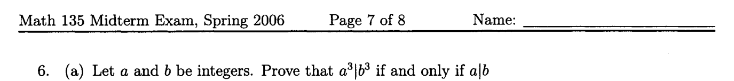
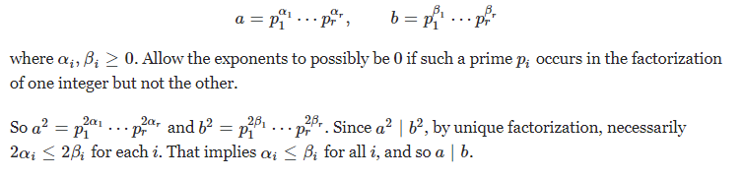
a | b => a³ | b³
b = k a, so b³ = k³a³
k³ is an integer, so a³ | b³ with k₃ the constant.
a³ | b³ => a | b
b = p₁ p₂ … p_{n} (prime factorization)
a = q₁ q₂ … q_{n} (prime factorization)
b³ = p³₁ p³₂ … p³_{n}
a³ = p₁³ ₂³ … q_{n}³
q₁³ q₂³ … q_{n}³ | p³₁ p³₂ … p³_{n}

Slide 12
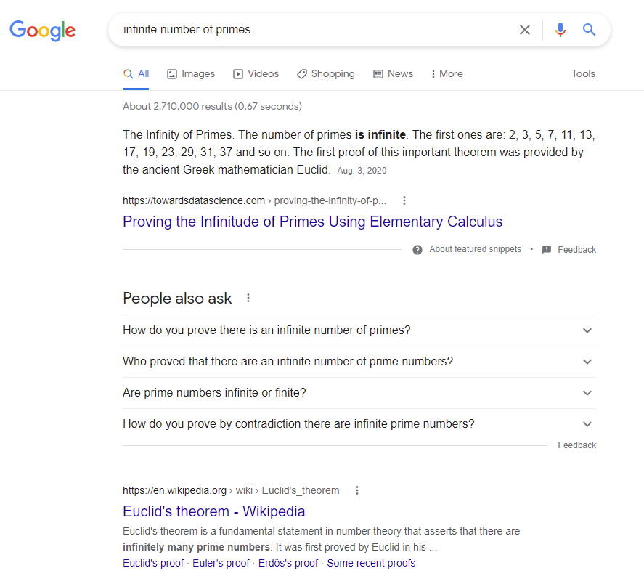
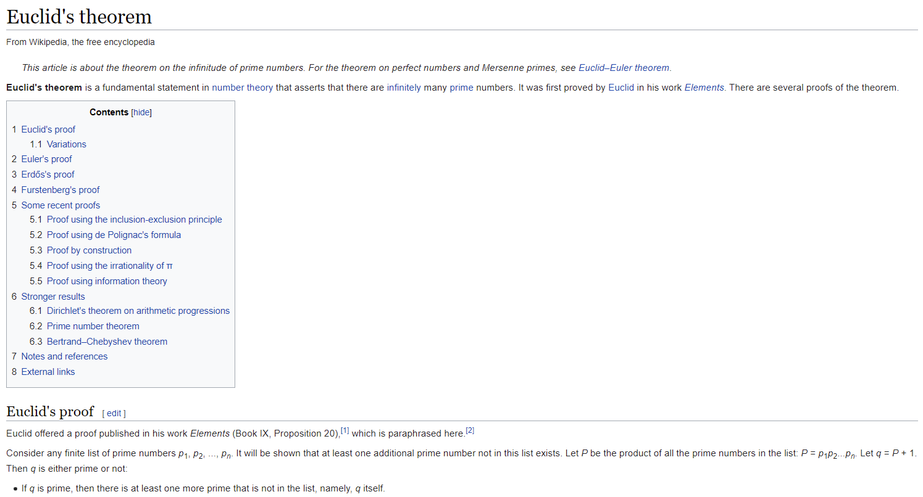

Slide 13
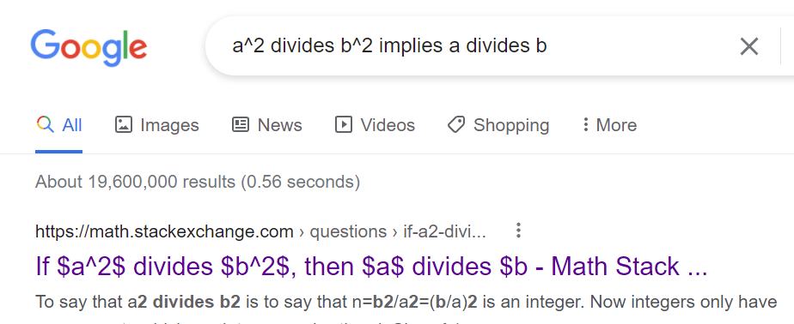
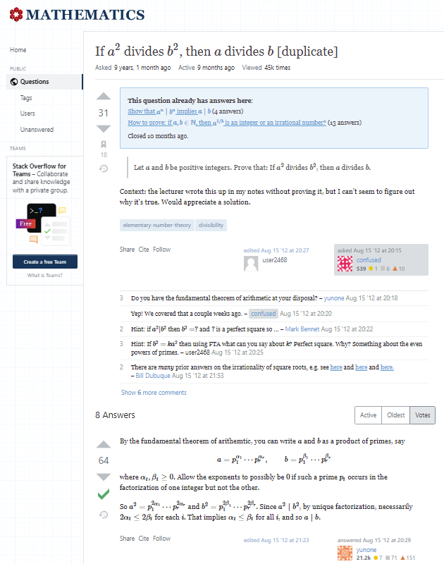

Slide 14
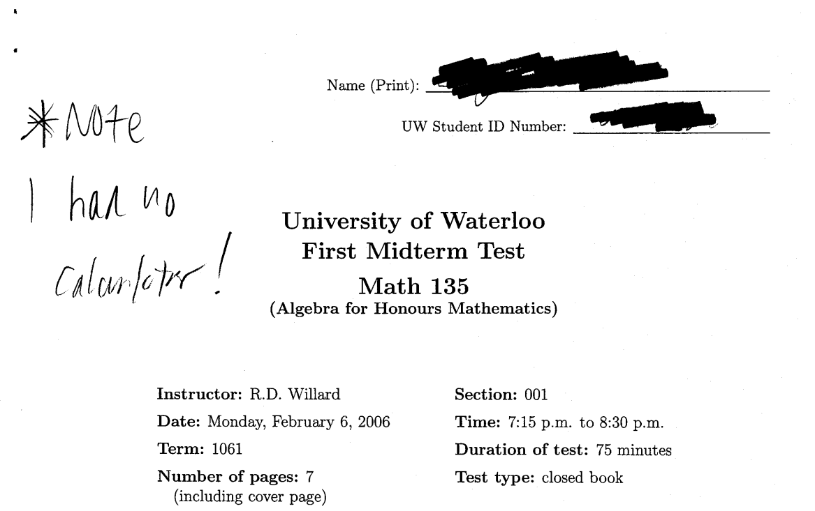

Slide 15
Fall 2006, Final:
a ( m / n )⁴ + b ( m / n )³ + c ( m / n )² + d ( m / n ) + e ( m / n ) = 0
am⁴ + bm³n⁴ + cm²n² + dmn³ + emn⁴ = 0 ( multiply both sides by n⁴)
m ( am³ + bm²n⁴ + cmn² + dn³) + en⁴ = 0 ( factor out m)
m ( am³ + bm²n⁴ + cmn² + dn³) = - en⁴
So m | - en⁴
So m | en⁴
But m ∤ n, so m ∤ n⁴ (if m/n is in “lowest terms” then we cannot have m | n)
So m | e
Is the last step okay?

Slide 16
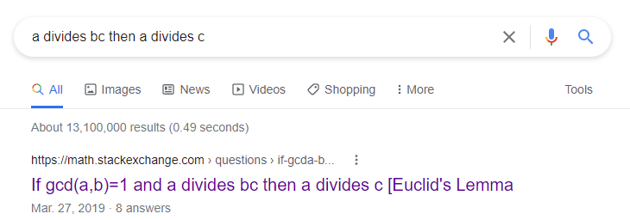
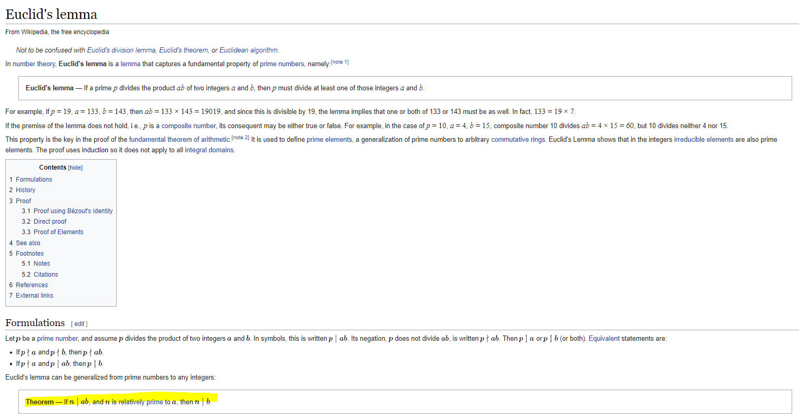

Slide 17
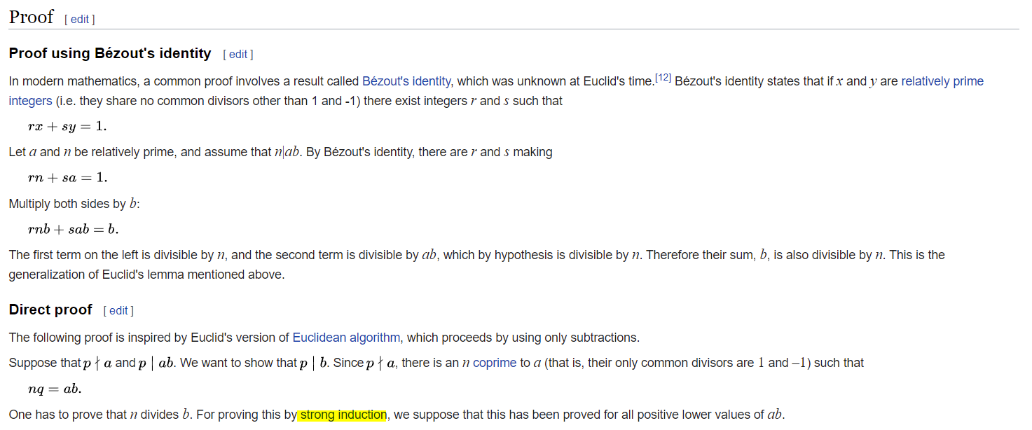

Slide 18
Good luck on midterm !!!
Thank you so much for paying attention so far!

