Slide 1
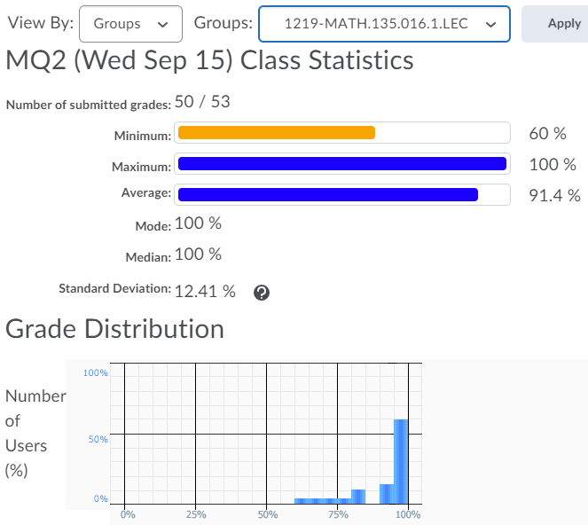
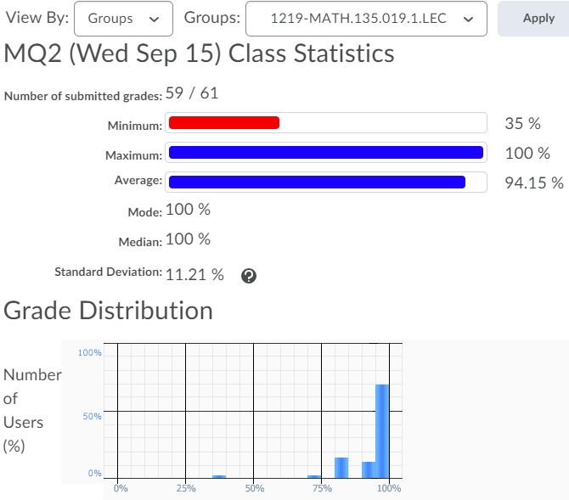

Slide 2
Friday 17 September:
Mobius Quiz 3
Sunday 19 September:
Complete reading up to the end of Section 0.2 (Polynomials)
There’s a question on next MQ based on the polynomials reading!
Monday 20 September:
Mobius Quiz 4
Wednesday 22 September:
Complete Written Assignment 2: WA2
Wednesday 22 September:
Mobius Quiz 5
Thursday 23 September:
WA02 solutions will be posted, hopefully before 12pm: Check the solutions in detail!
Friday 24 September before class:
Complete reading Chapter 2 of the course notes
Friday 24 September before class:
Mobius Quiz 6

Slide 3
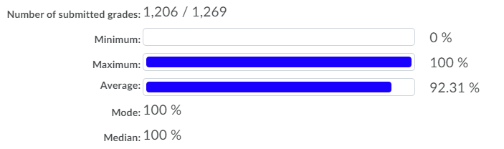

Slide 4
MATH 135: Lecture 5
Dr. Nike Dattani
17 September 2021

Slide 5
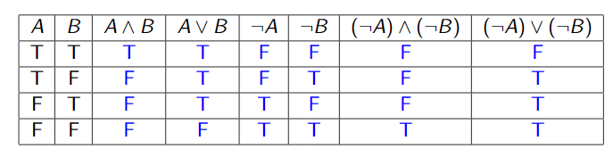
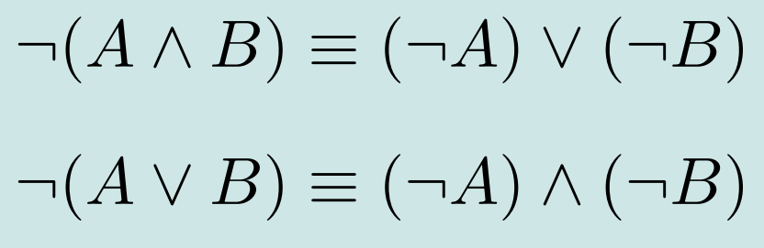
De Morgan’s laws!

Slide 6

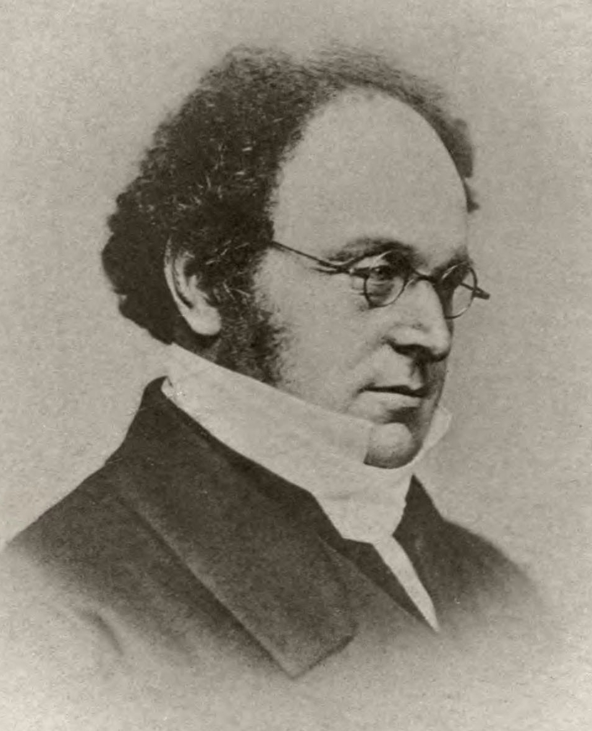
Assignment 2!
Do not skip steps!
How many columns will you have in the truth table for proving this:
¬(a < b < c )?
¬( (a < b) ^ (b < c ) )
How is this simplified?
Hint:
De Morgan’s Laws!

Slide 7
“I come to campus only if I have to teach MATH 135”
Do I come to campus if there’s no MATH 135?
If there’s MATH 135 then do I come to campus?
If I have to teach MATH 135 then I come to campus: A => B
I come to campus only if I have to teach MATH 135: B => A
I come to campus iff I have to teach MATH 135: B => A (if is from only if)
B <= A (only if is from if/then)
I have to teach MATH 135 iff I come to campus: A <= B (if is from only if)
A => B (only if is from if/then)

Slide 8
Assignment 2!
“The only positive integers are those in ℚ.”
Is this iff ?
Positive integer => ℚ
ℚ => Positive integer?
Q2c on WA02 had a typo.
It was written as only A => B, but should be A <=> B.
Remember that: A <=> B can be turned into: (A => B) ^ (B => A).
(it’s the only way something can be a positive integer)
(Some ℚ are not integers)

Slide 9
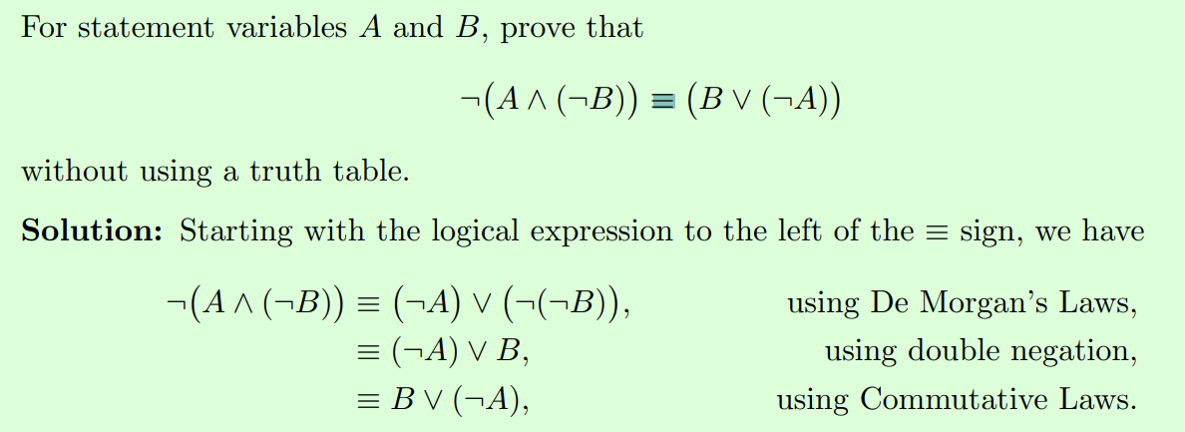
Assignment 2!
Prove without using a truth table:
¬ (A ^ (¬B)) ≡ B ∨ (¬A)

Slide 10
Prove without using a truth table
What are some of the properties you can use?
De Morgan’s laws!
Double negation
Commutativity
Associativity
Distributivity
Negation of an implication: ¬ (A => B)
Negation of an iff: ¬ (A => B) = ¬(A => B ^ B => A)
Do not skip any steps !!!

Slide 11
If x and y are in Z, then x is in Z and y is not in Z
Hypothesis?
Conclusion?
Converse?
Contrapositive?
Negation?
¬(A ^ B) = ¬A V ¬B
→ What’s the last one called?

Slide 12
Q5: Justification is necessary!
Given x,y, there exists some r that has a certain relation to x,y
How would you justify that it’s true?
An easy way is often to just find the r!
How would you justify that it’s not true?
An easy way is to find an (x,y) pair for which it’s impossible to have such an r

Slide 13
Review of last lecture
If the hypothesis A is false, is B true?
- No! Only (A => B) is true!

Slide 14

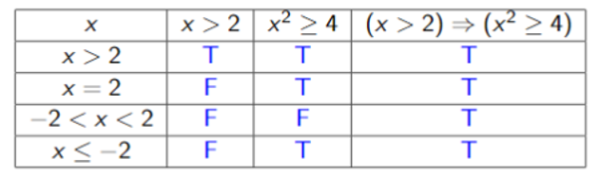
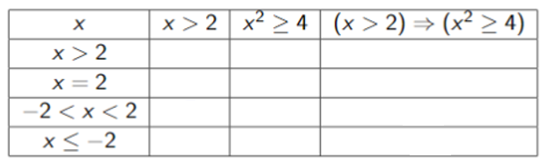
Hypothesis FALSE, but Conclusion also FALSE
Hypothesis (A)
Conclusion (B)
Implication always TRUE if Hypothesis is FALSE
Implication (A => B)
We will use the convention that (A => B) is true if A is false. In this case we say it’s “vacuously true”.
This way we don’t have to spend time checking cases that do not impact the open sentence.
This convention might not be followed in some types of non-classical logic (click for link to Wikipedia page!).

