Slide 1
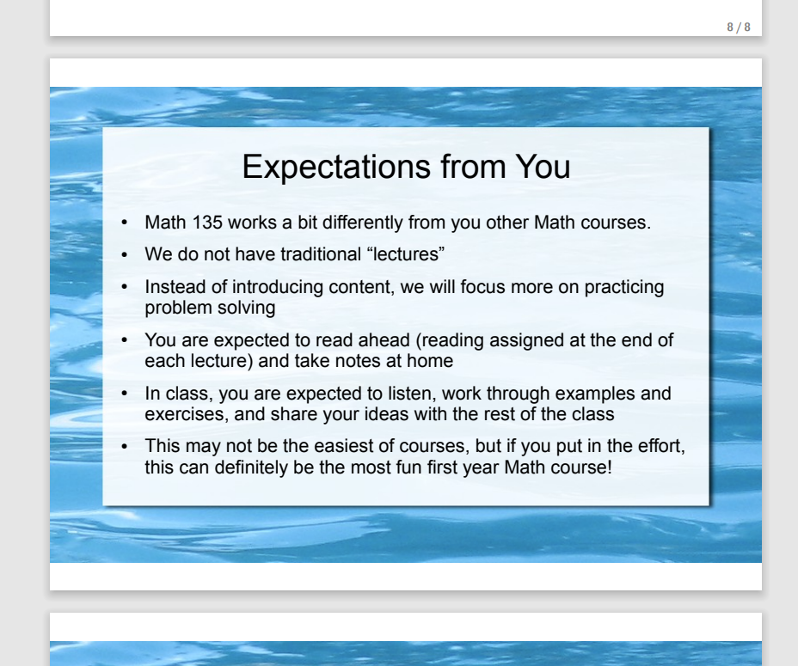
Lecture 1 slide from a different MATH 135 instructor:

Slide 2
MATH 135: Lecture 24
Dr. Nike Dattani
8 November 2021

Slide 3
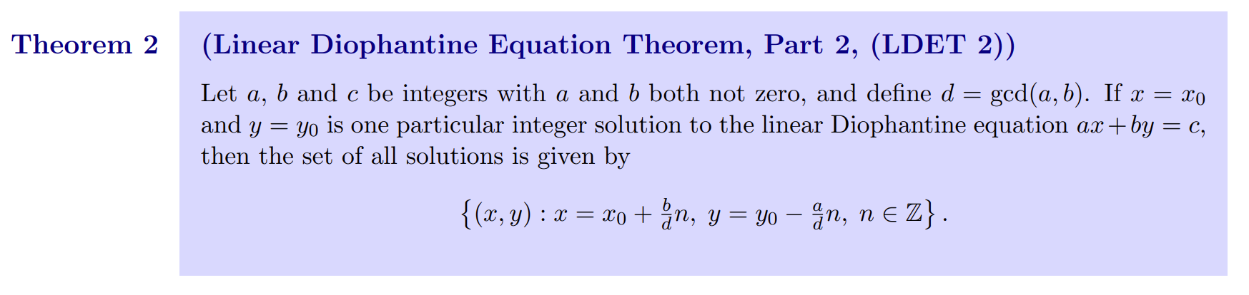
Does anybody not know how to find the general solution to an LDE?
Chapter 7 was only 5 pages long (2 simple theorems).

Slide 4
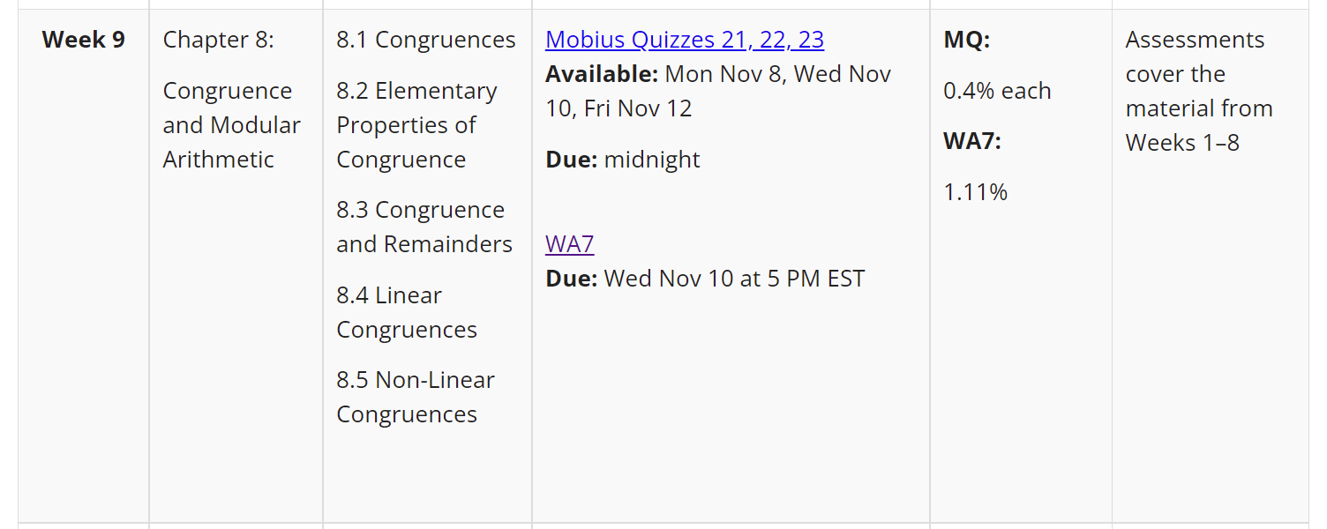
This week we’re supposed to be doing Chapter 8
Usually I wait until Wednesday, to maximize assignment help
But end of Ch6 was just prime factorization. Ch7: not much content
I started Ch8 early because…

Slide 5
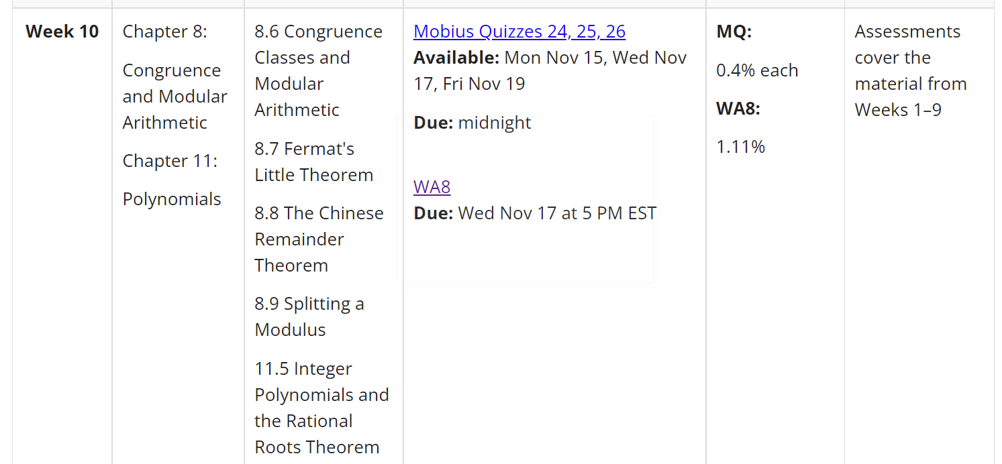
The proofs will be complex: Must know EVERYTHING.
(divisibility, gcd, Diophantine, modular arithmetic, congruence classes, FLT, CRT, polynomials, etc.)

Slide 6
Regrade requests:
If you disagree with your regrade, let me know by end of Tuesday
Monday 8 November:
Mobius quiz tonight! (covers up to middle of page 121)
Wednesday 10 November:
Submit Written Assignment 7: WA7 (covers up to page 121)
Reading: 8.1-8.4 (122-133) won’t take long (I’ve covered it already!)
Reading: 8.5-8.9 (122-148) worth getting a head start!

Slide 7
What’s the last digit of 7³³³³?
Latin: digiti = fingers
Latin: decem = 10.
Binary “digit” is a bit
In quantum computing: qubit
Powers of 7:
7, 49, 343, 2401, 16807

Slide 8
What’s the last digit of 7³³³³?
Latin: digiti = fingers
Latin: decem = 10.
Binary “digit” is a bit
In quantum computing: qubit
Powers of 7:
7, 49, 343, 2401, 16807
7² ≡ -1 (mod 10)
7³³³³ ≡ 7^{2 ∙ 1666} 7¹ (mod 10)
≡ (-1)^{2 ∙ 1666} 7 (mod 10)
≡ 7 (mod 10)

Slide 9
How do you know if a number is divisible by 3?
Proposition 8 in Chapter 8.3.
How do you know if a number is divisible by 11?
Proposition 9 in Chapter 8.3:
Check if 11 | A – B,
A = sum of 1st, 3rd, 5th, 7th, etc. digits
B = sum of 2nd, 4th, 6th, 8th, etc. digits
Does 11 | 6455874532635 ?

Slide 10

x = 20n + 12
(20n + 12) ≡ 11 (mod 39)
20n ≡ -1 (mod 39)
20n = 39y - 1
1 = 39y -20n [now solve the Diophantine eqn]

Slide 11


x = 20n + 12

Slide 12


Slide 13

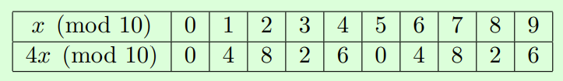
Small modulus! Skip the EEA:

Slide 14

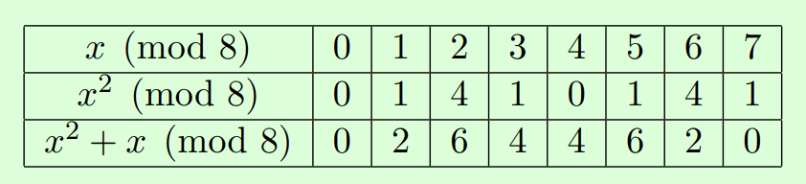

Slide 15
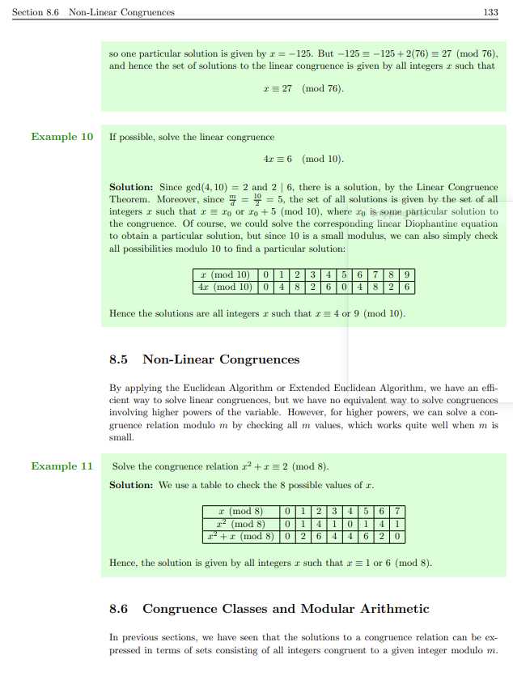

Slide 16
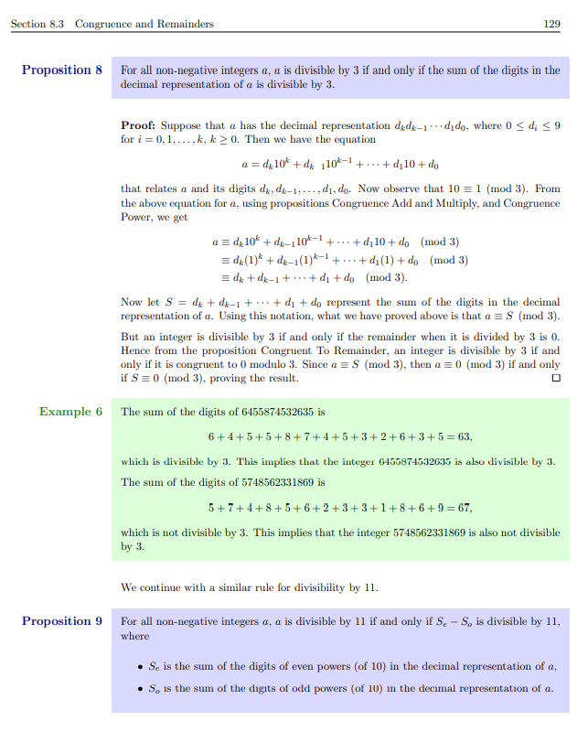

Slide 17
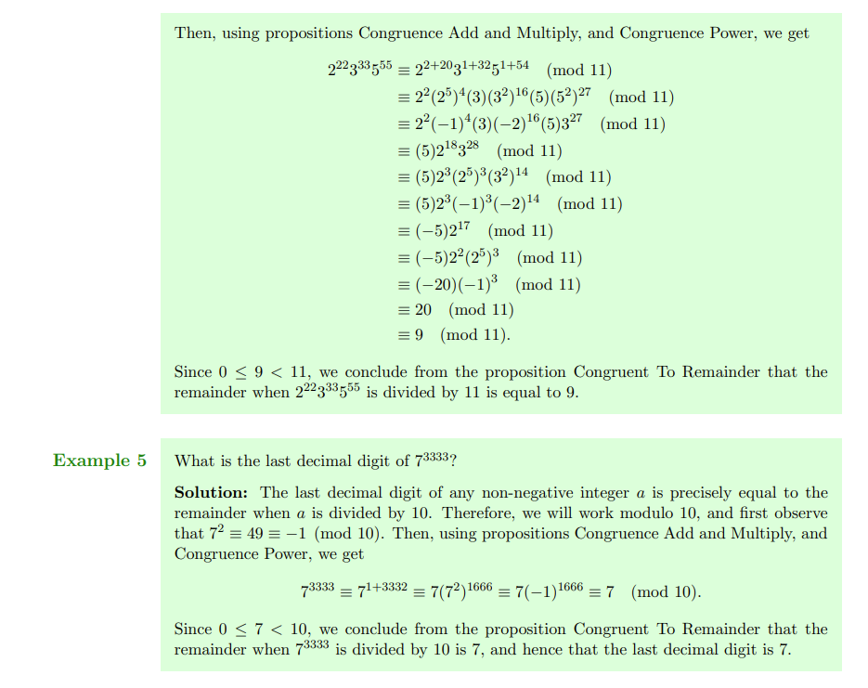

Slide 18
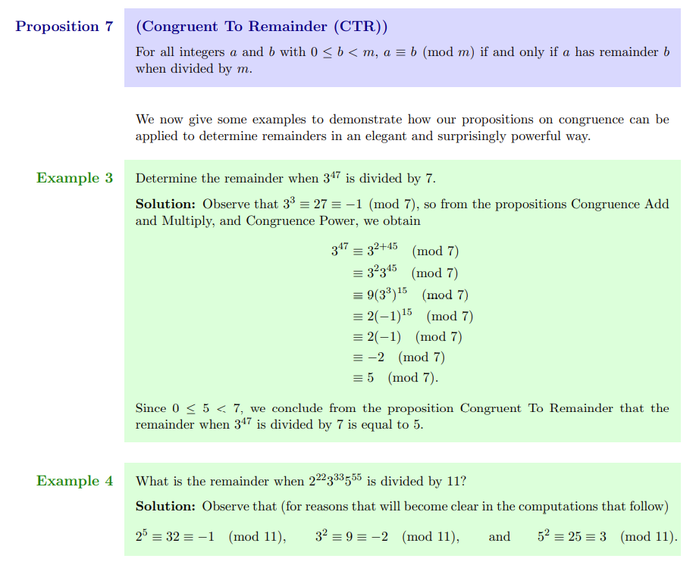

Slide 19
Thank you!

