Slide 1
If a number’s last digit is 5,
then is the last digit of its square always 5?
Prove it.

Slide 2
Upcoming responsibilities!
Monday 13 September:
Complete Mobius Quiz 1: MQ1
Wednesday 15 September:
Complete Mobius Quiz 2: MQ2
Wednesday 15 September 5PM:
Complete first Written Assignment (WA)
Friday 17 September 2PM:
Complete reading Chapter 2 of the course notes
Friday 17 September:
Complete Mobius Quiz 3: MQ3
Sunday 19 September:
Complete reading up to the end of Section 0.2 (Polynomials)

Slide 3
If a number’s last digit is 5, then is the last digit of its square always 5?
S = {Integers for which the last digit is 5}
Ɐ N ϵ S , N² ϵ S ?
Ɐ N, ∃ a ϵ ℤ s.t. N = 10a +5
(10a + 5)² = 100a² + 100a + 25
= 100a(a+1) + 25
∃ b ϵ ℤ s.t. N² = 100b + 25
Ɐ b ϵ ℤ, 100b + 25 ϵ S
∴ N² ϵ S , Ɐ N ϵ S

Slide 4
MATH 135: Lecture 3
Dr. Nike Dattani
10 September 2021

Slide 5
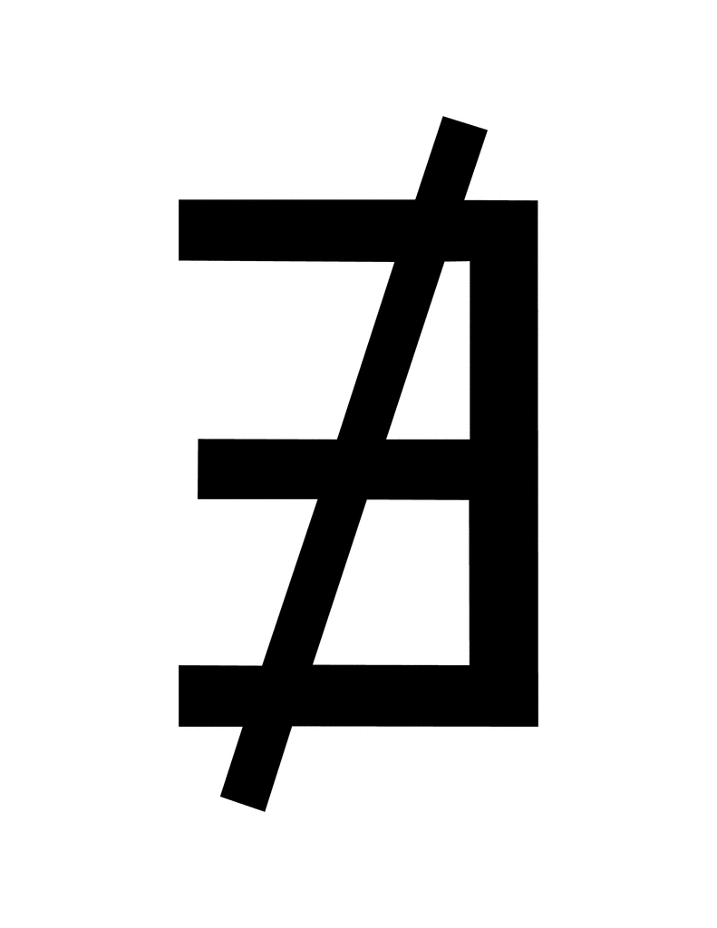


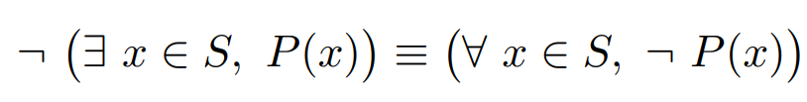
Tips for Assignment 1!
Don’t use these:
Everything can be done using what’s in the course notes (e.g. § 1.4.3 & 1.5.3):

Slide 6
Tips for Assignment 1!
If S is unknown, and/or if P(x) is unknown:
∀ x ∈ S, P(x)
cannot be true or false until we specify S or P(x).
Technically, the above is an open sentence in S and an open sentence in P, let’s say Q(S,P)
What’s an example of P(x)?
Now that we’ve chosen P(x), the above is still an open sentence in S, let’s say: Q(S).

Slide 7
Tips for Question 4!
Open sentence or statement ?
∀ x ∈ S, ∃ y ∈ S , P(x,y)
What’s a property of an infinite set of integers like:
S = {……,-3,-2,-1,0,1,2,3,4}
For all x in S, what do we know about the other elements y?
A and B are logically equivalent if A is true when B is true
AND also A is false when B is false.

Slide 8
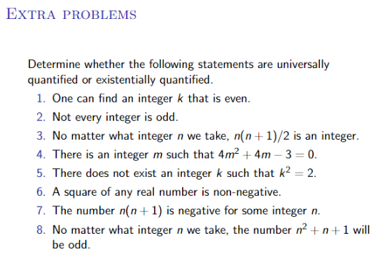

Slide 9

¬(∃ p,q ϵ ℤ s.t. sqrt(3) = p/q)
Do we have to worry about q=0?
Answer: We’re only saying that there exists a q such that sqrt(3) = p/q,
not that p/q must make sense for all q.
Outline of Proof:
Assume: ∃ p,q ϵ ℤ s.t. sqrt(3) = p/q
Square both sides: 3q² = p²
Case 1: q is even.
=> 3q² is even (whatever factor of 2 is in q, is still going to be a factor of 3q²)
=> p² is even, and p is even
=> p/q is an integer (since p and q are even). [Prove that sqrt(3) is not an integer: Exercise].

Slide 10
Assumption: ∃ p,q ϵ ℤ s.t. sqrt(3) = p/q
Case 2: is odd.
=> 3q² is also odd (where else would 3q² get the factor of 2?).
=> p² is also odd
∃ n ϵ ℤ s.t. p = 2n+1
∃ m ϵ ℤ s.t. q = 2m+1
sqrt(3) q = p
sqrt(3) (2m + 1) = (2n + 1)
3(2m + 1)² = (2n + 1)²
3(4m² + 4m + 1) = 4n² + 4n + 1
12m² + 12m + 3 = 4n² + 4n + 1
12m² + 12m + 2 = 2n² + 2n
12(m² + m) + 1 = 2n(n+1)
Let n(n+1) = A, m² + m = B.
A ϵ ℤ , B ϵ ℤ
12A + 1 = 2B
12A + 1 is odd. 2B is even. ➔ Contradiction!
∴ ¬(∃ p,q ϵ ℤ s.t. sqrt(3) = p/q)

