Slide 1
If a number’s last digit is 5,
then is it always 5 times an odd number?
Prove it.

Slide 2
MATH 135: Lecture 4
Dr. Nike Dattani
14 September 2021

Slide 3
Upcoming responsibilities!
Thursday 16 September:
WA01 solutions will be posted, hopefully before 12pm: Check the solutions in detail!
Friday 17 September before class:
Complete reading Chapter 2 of the course notes
Friday 17 September:
Complete Mobius Quiz 3: MQ3
Sunday 19 September:
Complete reading up to the end of Section 0.2 (Polynomials)
There’s a question on next MQ based on the polynomials reading!
Monday 20 September:
Complete Mobius Quiz 4: MQ4
Wednesday 22 September:
Complete Written Assignment 2: WA2
Wednesday 22 September:
Complete Mobius Quiz 5: MQ5

Slide 4
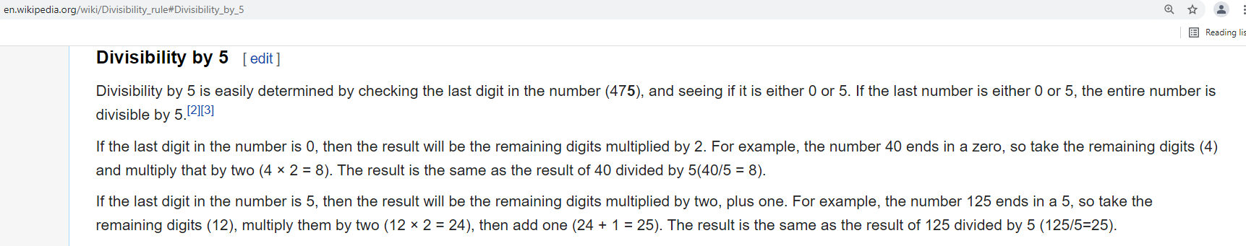
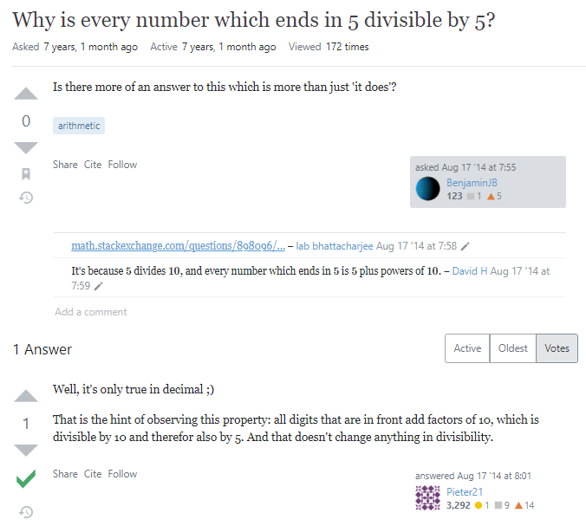
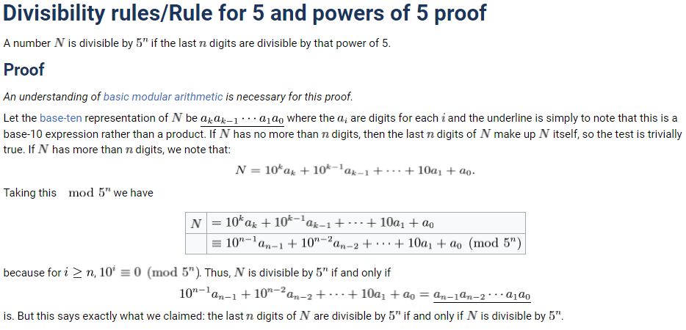

Slide 5
If a number’s last digit is 5, then is it always 5 times an odd number?
S = {Integers for which the last digit is 5}
Ɐ N ϵ S , ∃ m ϵ ℤ , N = 5(2m+1) ?
Ɐ N ϵ S, ∃ a ϵ ℤ , N = 10a + 5
N = 5(a+1)
Ɐ N ϵ S, ∃ b ϵ ℤ , N = 5b
b is either even or odd.
Case 1: b is even:
N = 5b => N is even.
But if N ends in 5 it must be odd. Contradiction! So b must be odd.

Slide 6
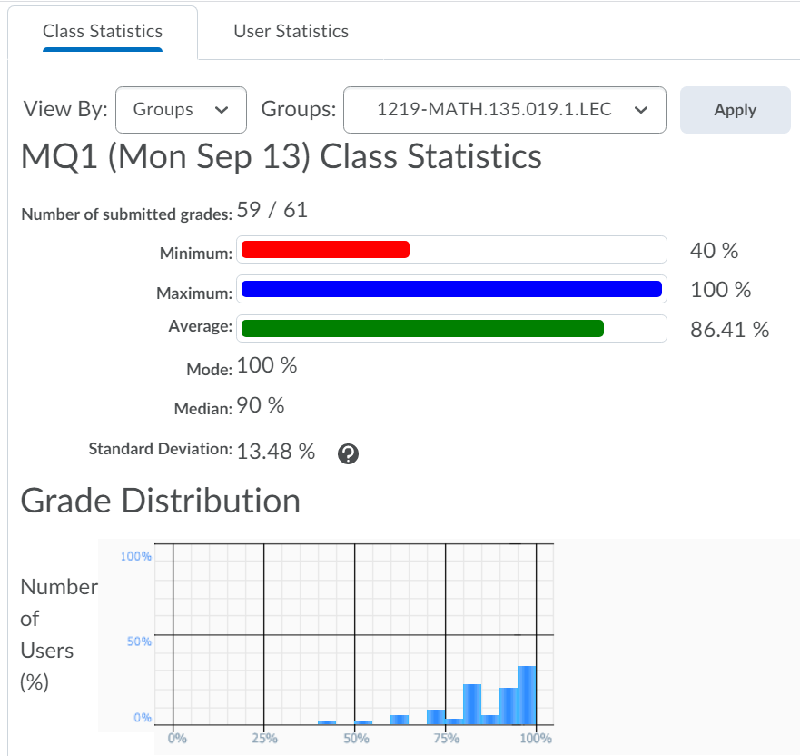
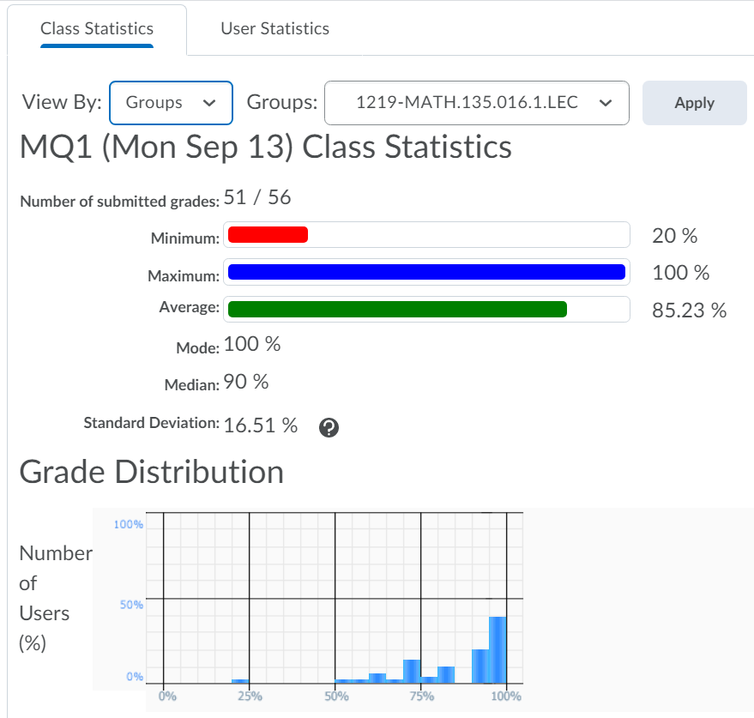

Slide 7
Tips for MATH 135!
Do not use “s.t.” but you can instead use a comma.
How many people here use GitHub?
Lecture Notes:
Github → ndattani → Lecture_Notes
https://github.com/ndattani/Lecture_Notes
Private repository: send me your username and I’ll give you access!
Tips for username: Just use your actual name!
GitHub is a portfolio of all of your academic work, and later career work

Slide 8
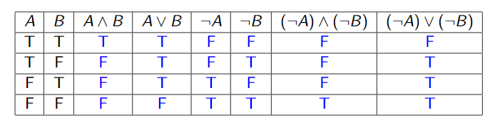
Logic
∧ = AND (∧ looks like A)
∨ = OR

Slide 9
Logic
∧ = AND (∧ looks like A)
∨ = OR

Slide 10
Logic
∧ = AND (∧ looks like A)
∨ = OR

Slide 11
Logic
∧ = AND (∧ looks like A)
∨ = OR

Slide 12
Logic
∧ = AND (∧ looks like A)
∨ = OR

Slide 13
Logic
∧ = AND (∧ looks like A)
∨ = OR

Slide 14
Logic
∧ = AND (∧ looks like A)
∨ = OR

Slide 15
Logic
∧ = AND (∧ looks like A)
∨ = OR

Slide 16
Logic
∧ = AND (∧ looks like A)
∨ = OR

Slide 17
Logic
∧ = AND (∧ looks like A)
∨ = OR

Slide 18
Logic
∧ = AND (∧ looks like A)
∨ = OR

Slide 19
Logic
∧ = AND (∧ looks like A)
∨ = OR

Slide 20
Logic
∧ = AND (∧ looks like A)
∨ = OR

Slide 21
Logic
∧ = AND (∧ looks like A)
∨ = OR

Slide 22
Logic
∧ = AND (∧ looks like A)
∨ = OR

Slide 23
Logic
∧ = AND (∧ looks like A)
∨ = OR

Slide 24
Logic
∧ = AND (∧ looks like A)
∨ = OR

Slide 25
Logic
∧ = AND (∧ looks like A)
∨ = OR

Slide 26
Logic
∧ = AND (∧ looks like A)
∨ = OR

Slide 27
Logic
∧ = AND (∧ looks like A)
∨ = OR

Slide 28
Logic
∧ = AND (∧ looks like A)
∨ = OR

Slide 29
Logic
∧ = AND (∧ looks like A)
∨ = OR

Slide 30
Logic
∧ = AND (∧ looks like A)
∨ = OR

Slide 31
Logic
∧ = AND (∧ looks like A)
∨ = OR

Slide 32
Logic
∧ = AND (∧ looks like A)
∨ = OR

Slide 33
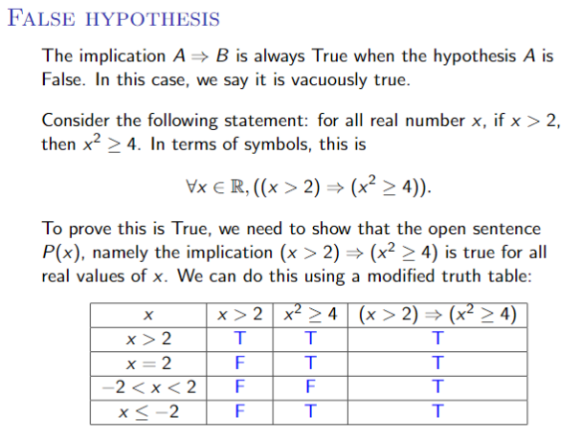

Slide 37
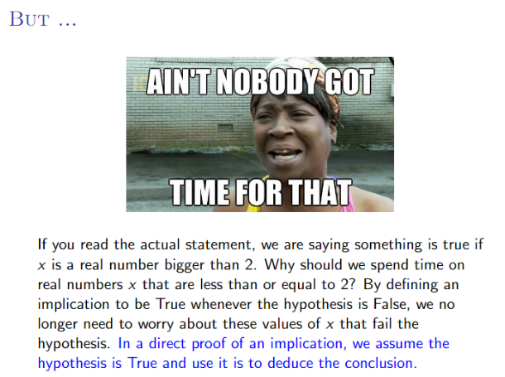

Slide 38
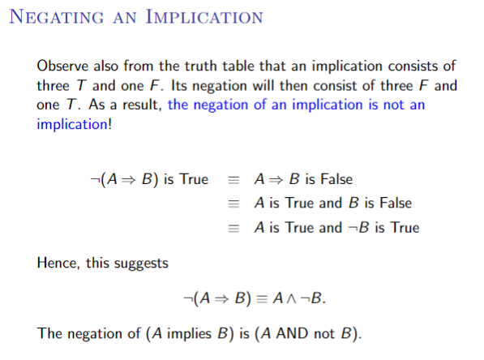

Slide 40
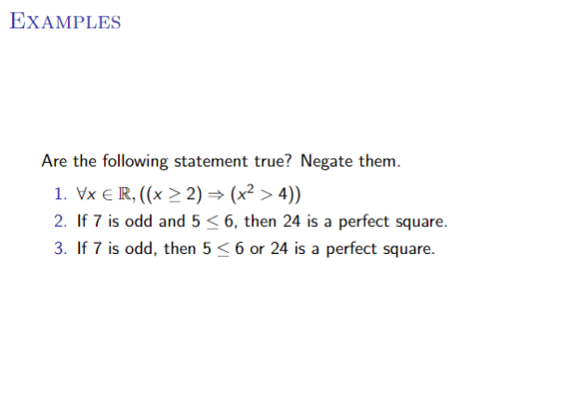

Slide 41
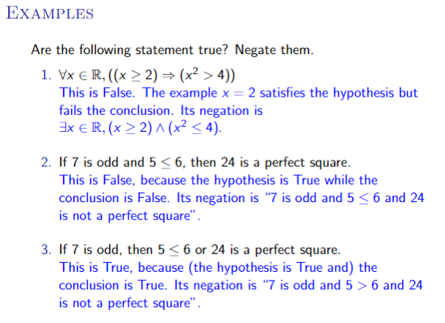

Slide 42
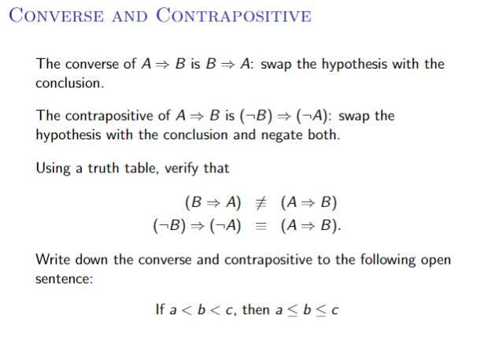

Slide 43
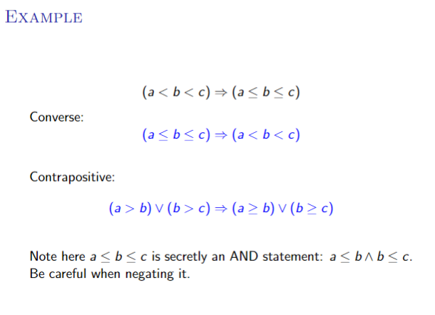

Slide 44
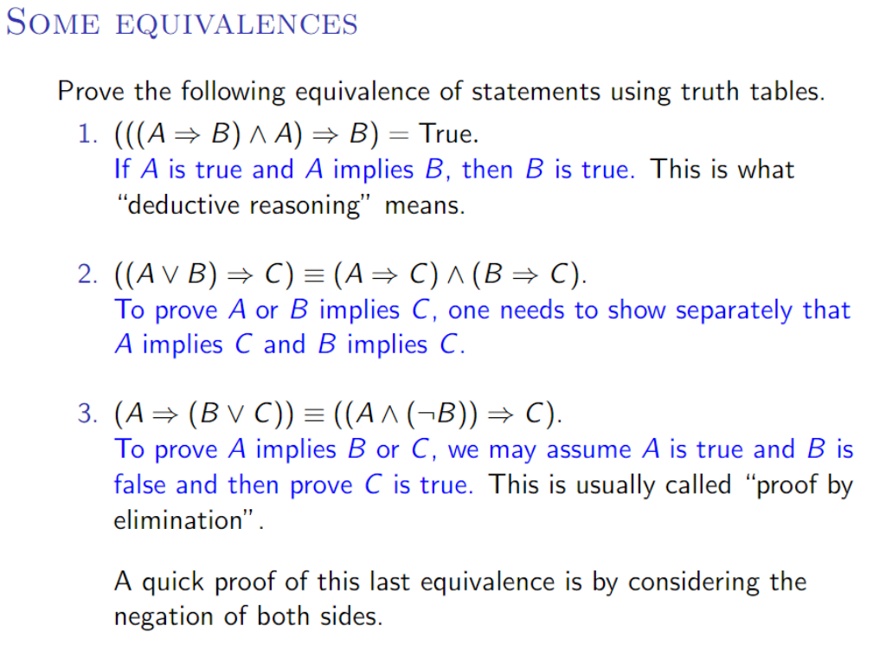

Slide 45

¬(∃ p,q ϵ ℤ s.t. sqrt(3) = p/q)
Do we have to worry about q=0?
Answer: We’re only saying that there exists a q such that sqrt(3) = p/q,
not that p/q must make sense for all q.
Outline of Proof:
Assume: ∃ p,q ϵ ℤ s.t. sqrt(3) = p/q
Square both sides: 3q² = p²
Case 1: q is even.
=> 3q² is even (whatever factor of 2 is in q, is still going to be a factor of 3q²)
=> p² is even, and p is even
=> p/q is an integer (since p and q are even). [Prove that sqrt(3) is not an integer: Exercise].

Slide 46
Assumption: ∃ p,q ϵ ℤ s.t. sqrt(3) = p/q
Case 2: is odd.
=> 3q² is also odd (where else would 3q² get the factor of 2?).
=> p² is also odd
∃ n ϵ ℤ s.t. p = 2n+1
∃ m ϵ ℤ s.t. q = 2m+1
sqrt(3) q = p
sqrt(3) (2m + 1) = (2n + 1)
3(2m + 1)² = (2n + 1)²
3(4m² + 4m + 1) = 4n² + 4n + 1
12m² + 12m + 3 = 4n² + 4n + 1
12m² + 12m + 2 = 2n² + 2n
12(m² + m) + 1 = 2n(n+1)
Let n(n+1) = A, m² + m = B.
A ϵ ℤ , B ϵ ℤ
12A + 1 = 2B
12A + 1 is odd. 2B is even. ➔ Contradiction!
∴ ¬(∃ p,q ϵ ℤ s.t. sqrt(3) = p/q)

