Slide 1
Tuesday 5 October:
Look at your WA03 results thoroughly! Where did you lose marks?
Tuesday 5 October:
Complete reading Chapter 5 of the course notes. Pages 82-93.
Wednesday 6 October:
Submit Written Assignment 4: WA4
Wednesday 6 October:
Mobius Quiz 11 (covers up to the end of Chapter 4.4, Strong Induction).
Thursday 7 October:
Look at WA5 !!!
Thursday 7 October:
WA04 solutions will be posted, hopefully before 12pm: Check the solutions in detail!
Friday 1 October:
Mobius Quiz 12 (covers up to the end of Chapter 4.4, Strong Induction).
Reading week:
Practice, practice, practice, practice, practice, practice, practice, practice, practice, practice, practice, practice, practice!

Slide 2
MATH 135: Lecture 12
Dr. Nike Dattani
4 October 2021

Slide 3
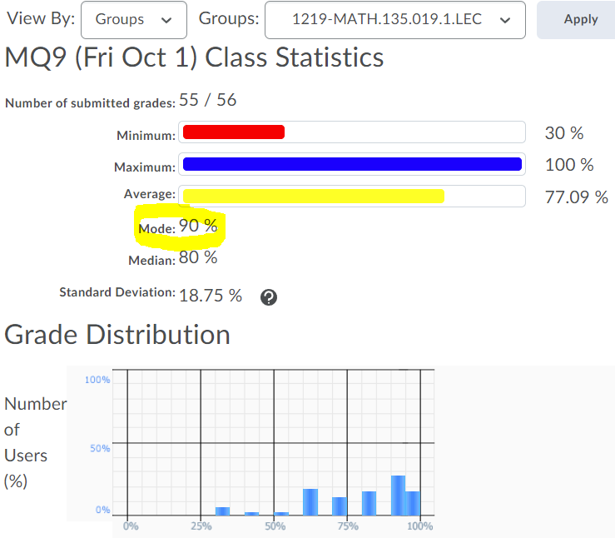
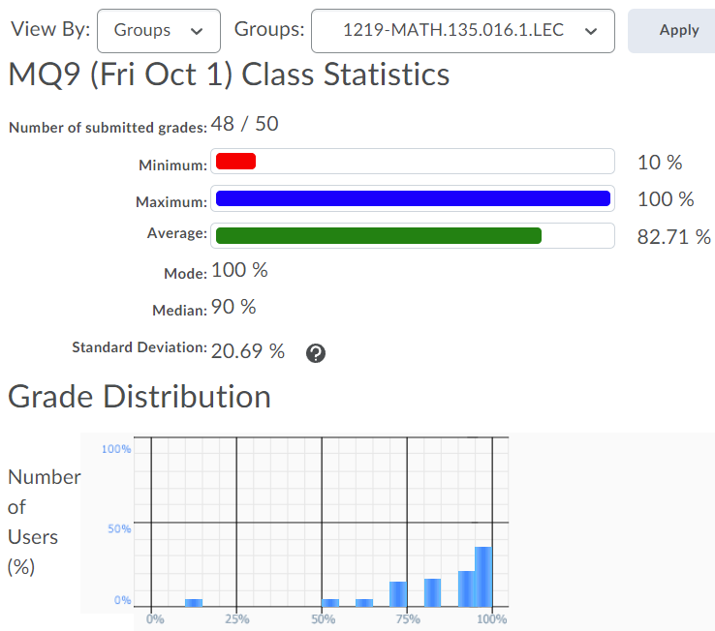
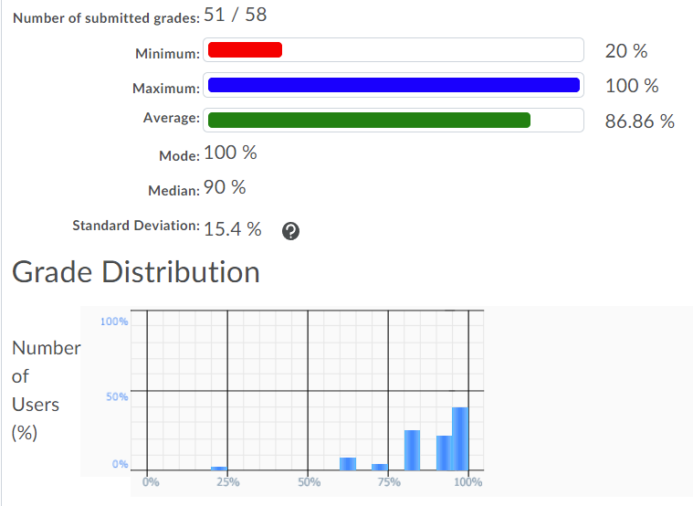
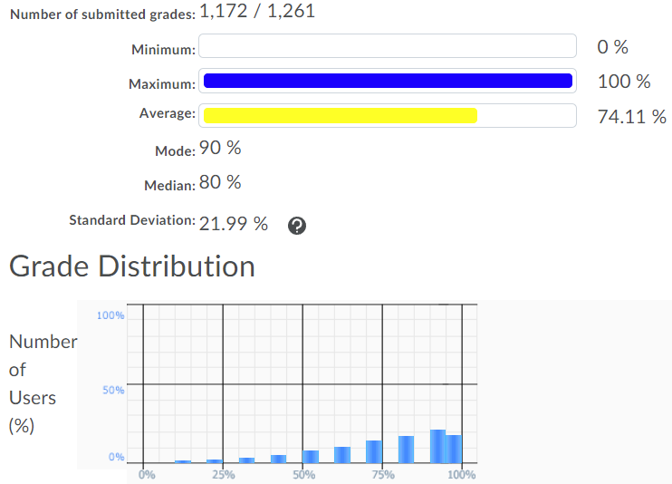
Nike’s Section 19
Nike’s Section 16
Emma’s Section 8
Entire MATH 135

Slide 4
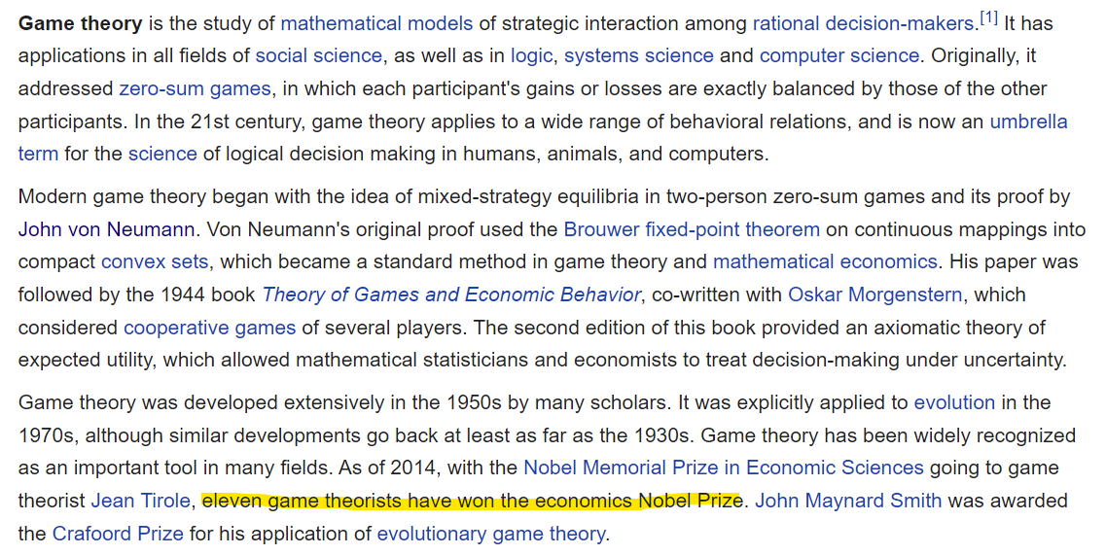

Slide 5

Cover makes it look like it’s about sex, but it’s really about math.

Slide 6
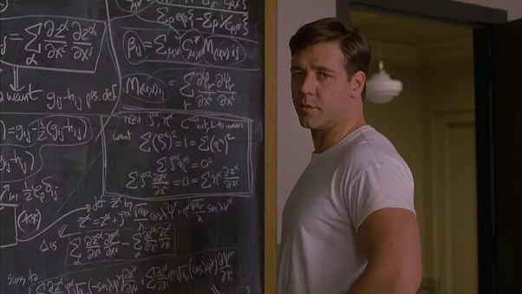
Cover makes it look like it’s about sex, but it’s really about math.

Slide 7


Cover makes it look like it’s about sex, but it’s really about math.

Slide 8
Game theory courses at UW
CO 456: Introduction to Game Theory
CO 759: Algorithmic Game Theory
Required:
CO 255: Introduction to Optimization
MATH 235: Introduction to Combinatorics
MATH 135

Slide 9
Study groups and carpooling

Slide 10
Does 0 | 0 ?
Yes
Does any integer other than 0 divide 0?
Yes! Which ones?
All
Does 0 divide anything?

Slide 11
Proof Practice!
Is the sum of two consecutive integers odd?
Let a, b in Z, where b = a+1
Consider c = a + b = a + a + 1 = 2a + 1

Slide 12
Tip for Q4 of WA4

Slide 13
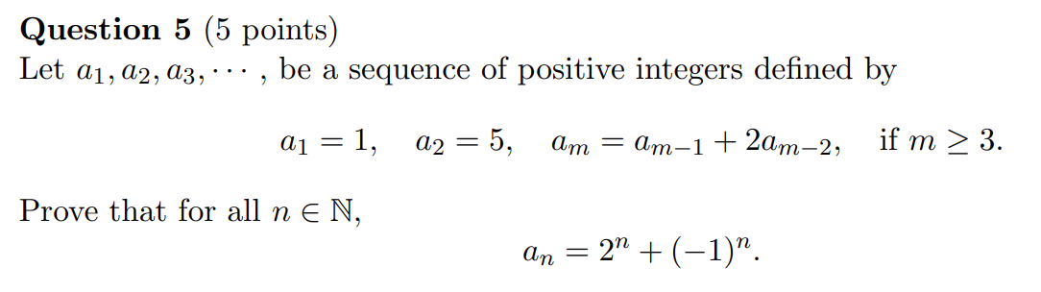
Midterm Exam, Fall 2019

Slide 14
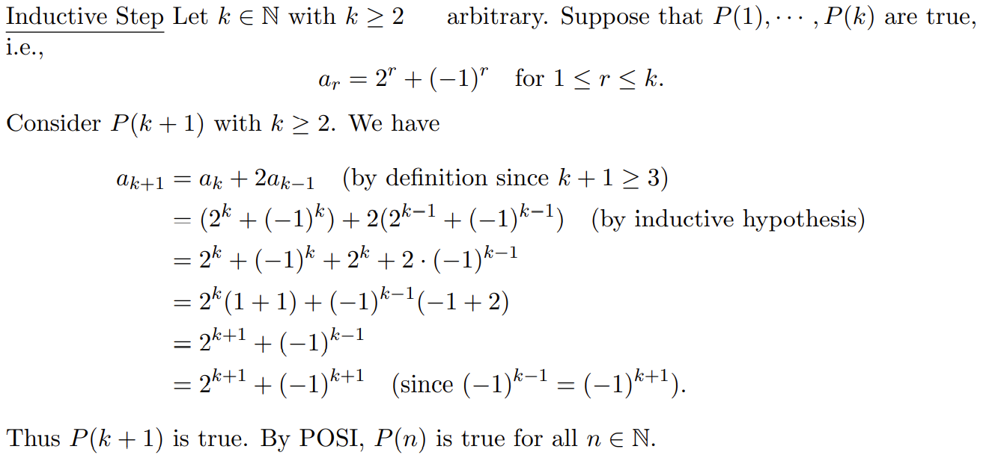

Slide 19
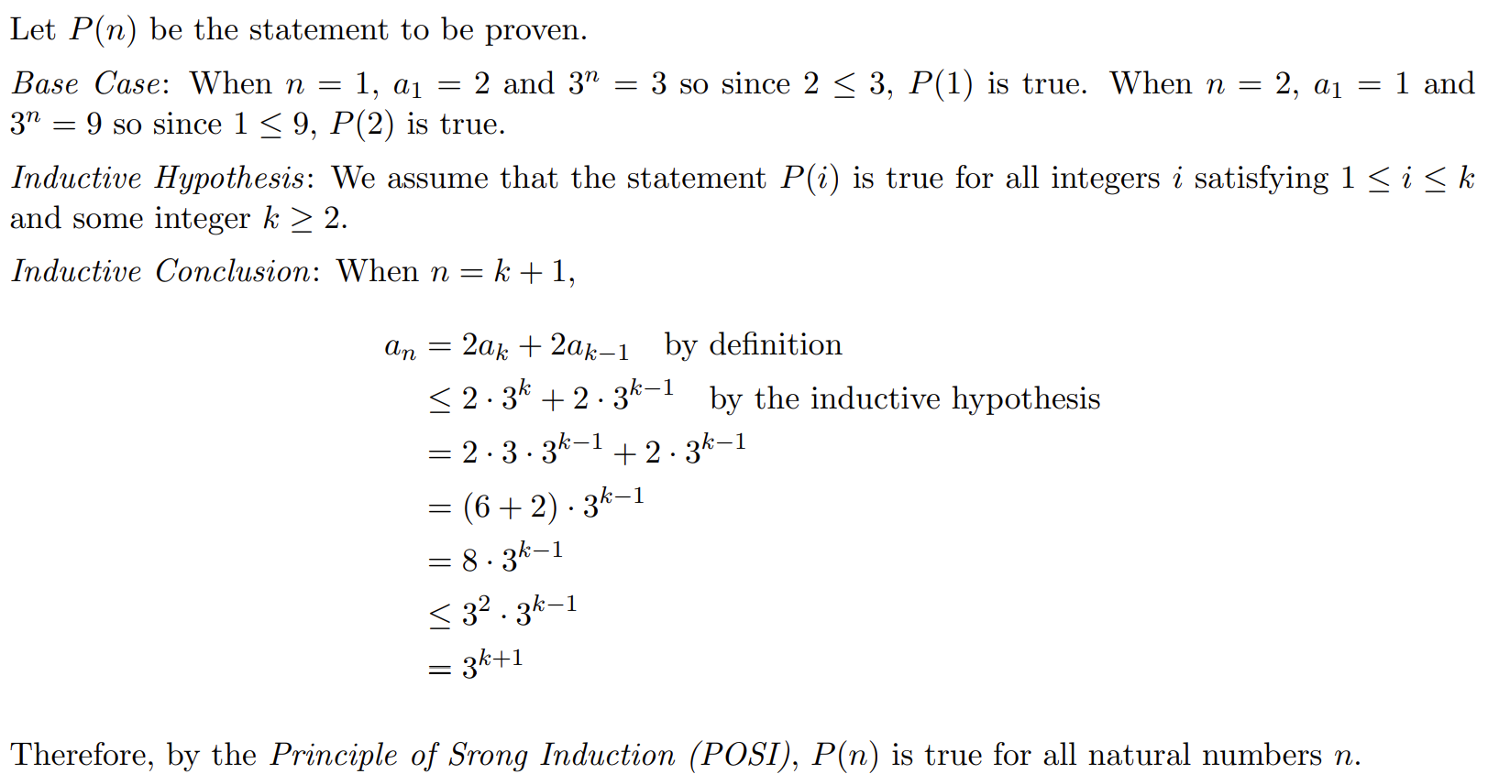

Slide 23
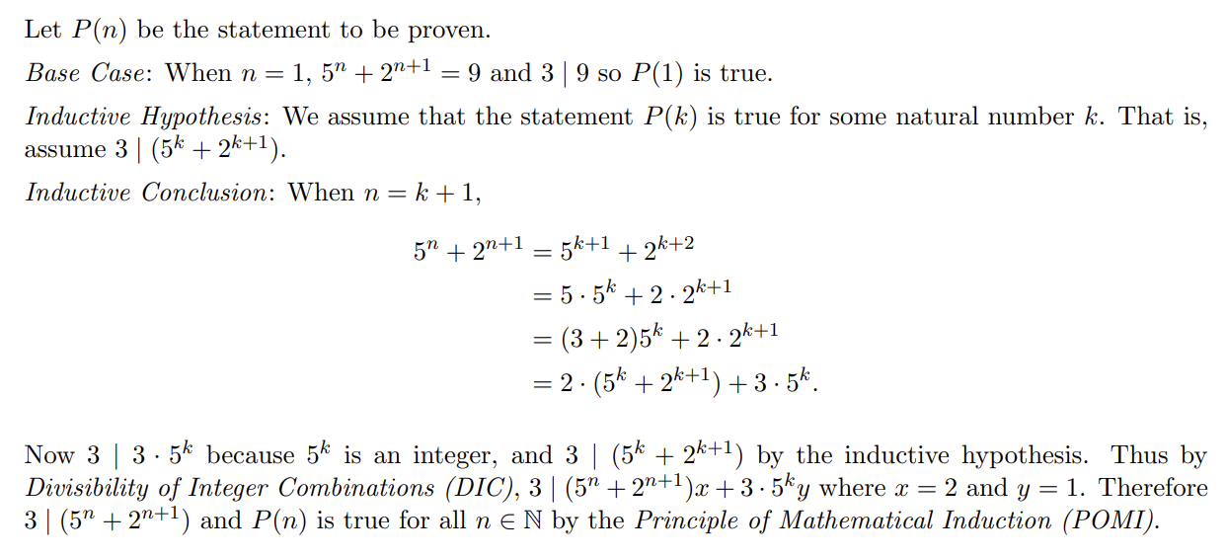

Slide 26
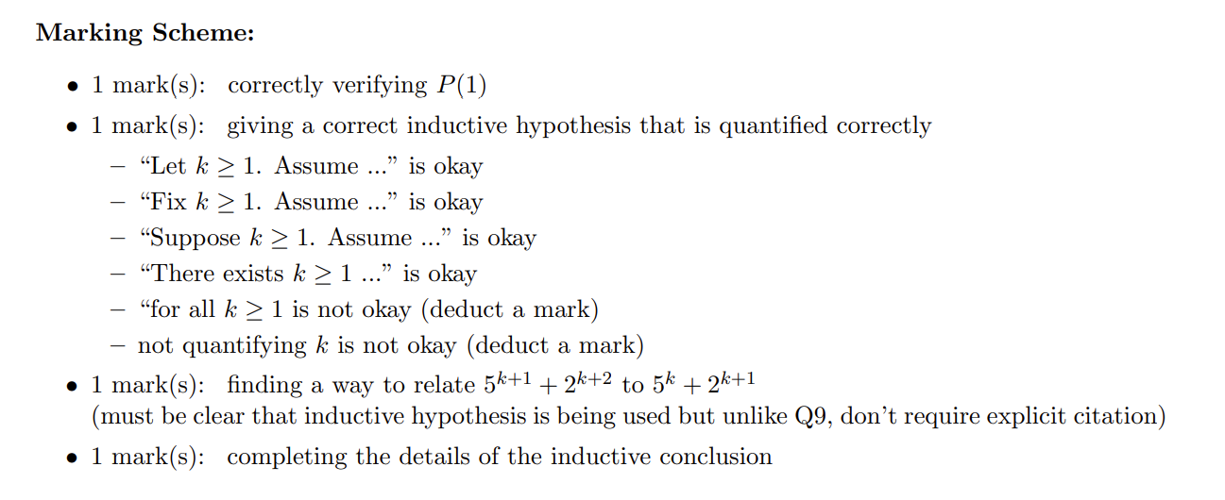

Slide 28
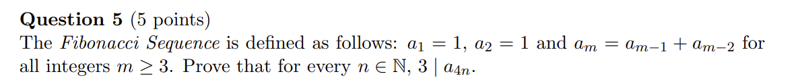
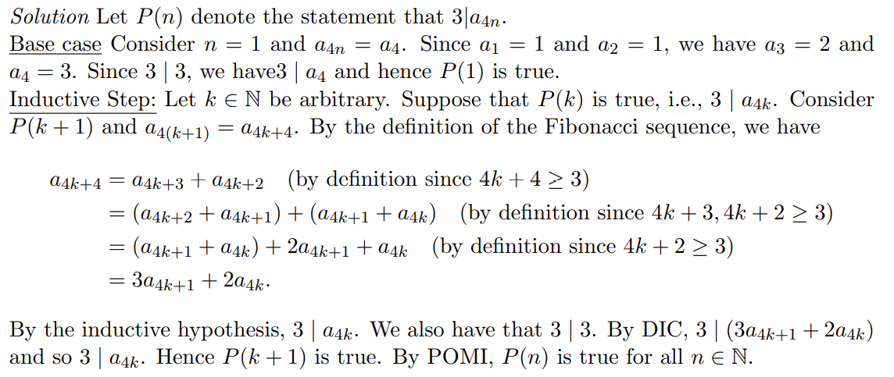

Slide 36
+4

