Slide 1
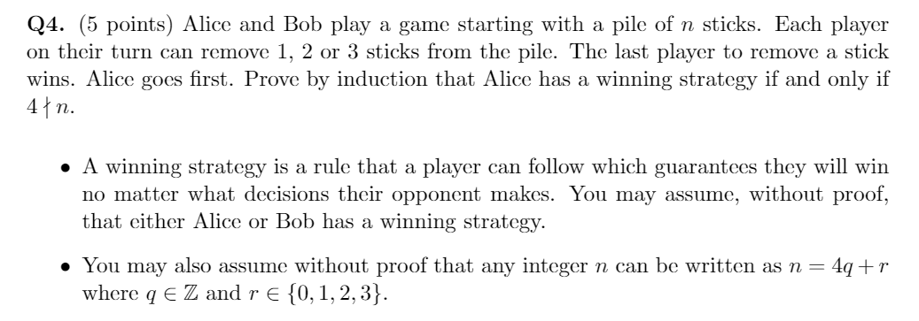
Assignment 4:

Slide 2
MATH 135: Lecture 11
Dr. Nike Dattani
1 October 2021

Slide 3
Thursday 30 September:
Look at WA4 !!!
Thursday 30 September:
WA03 solutions will be posted, hopefully before 12pm: Check the solutions in detail!
Thursday 30 September:
Complete reading from Chapter 3.6 up to 5 of the course notes. Pages 55-81.
Friday 1 October:
Mobius Quiz 9
Sunday 3 October:
You’ll need to know more before 0.4 (Polynomials), so use this time to review Pages 55-81, and do practice problems!
Monday 4 October:
Mobius Quiz 10
Tuesday 28 September:
Look at your WA02 results thoroughly! Where did you lose marks?
Wednesday 29 September:
Complete Written Assignment 3: WA3
Wednesday 29 September:
Mobius Quiz 8

Slide 4
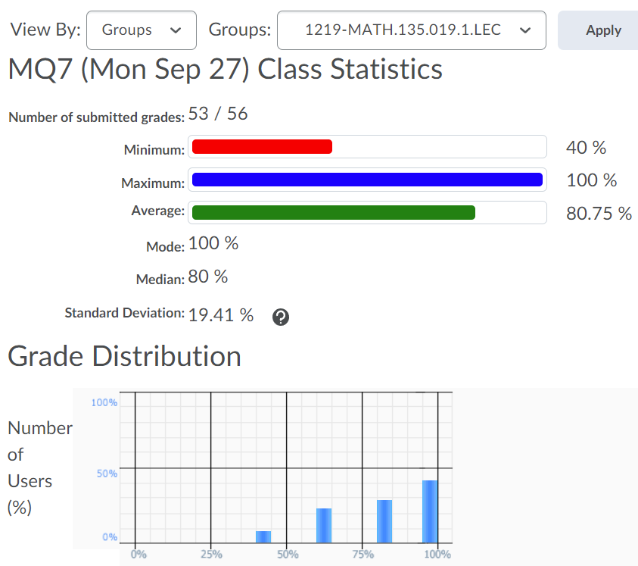
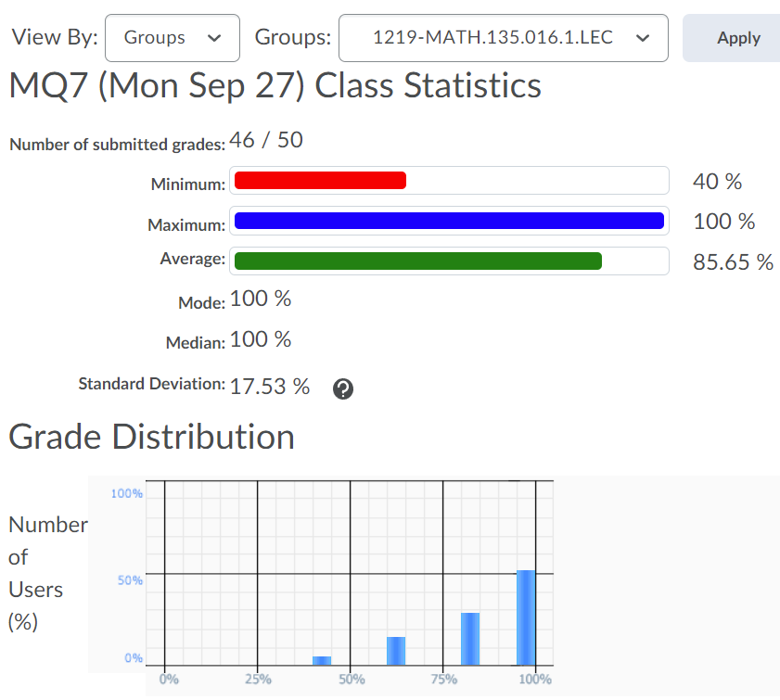
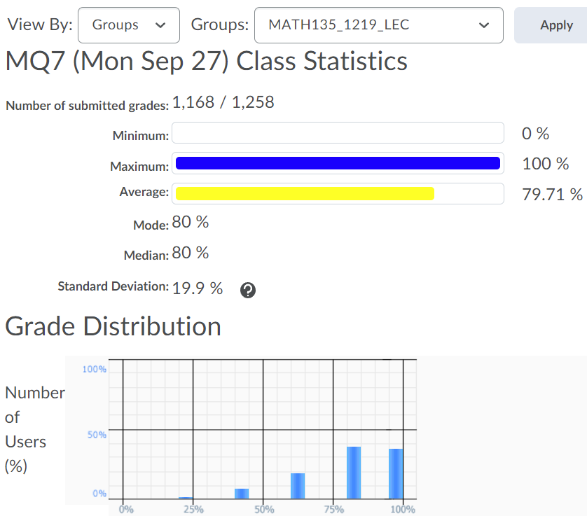

Slide 5
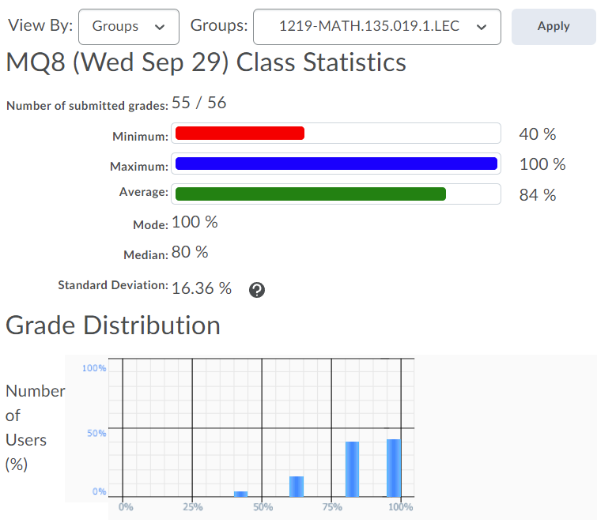
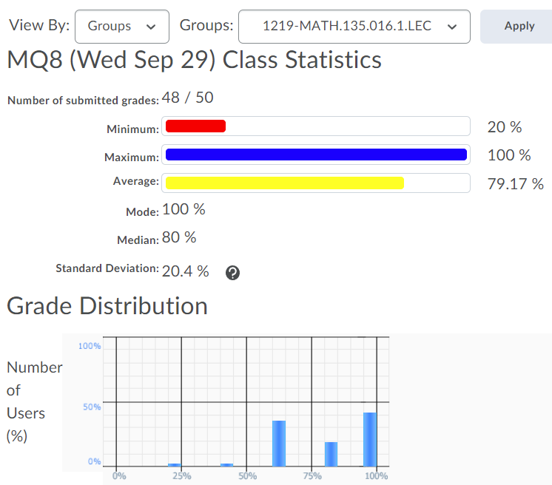
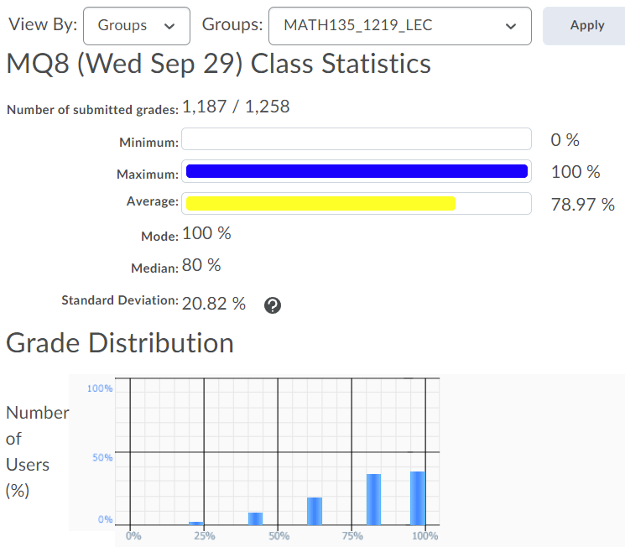

Slide 6
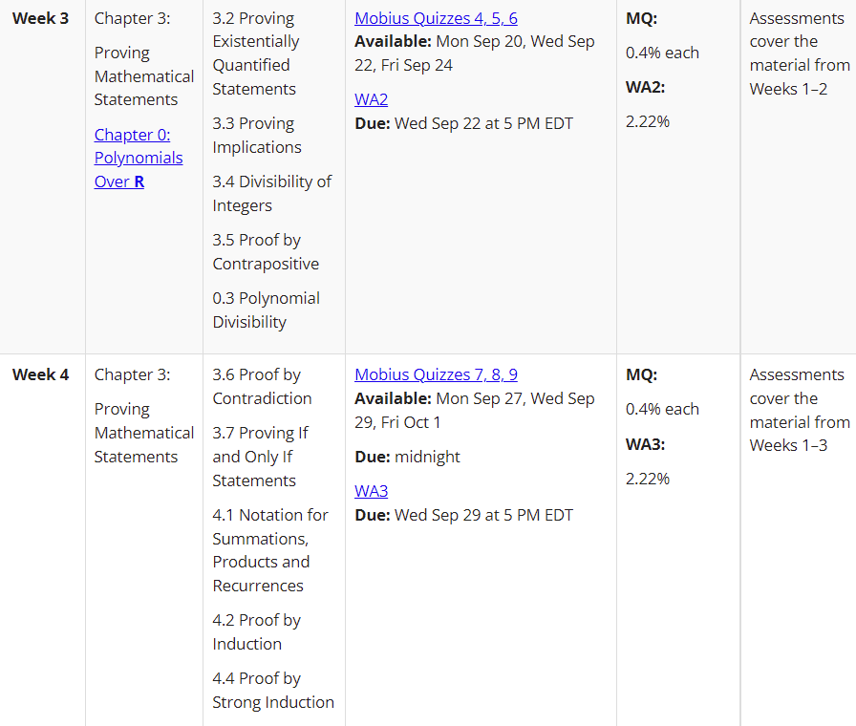

Slide 7
Q1) We want to prove something fall all integers n.
What method?
Induction on n.
Inductive step:
Case 1: kα/π an integer
Case 2: kα/π not an integer
e.g. of kα/π an integer?

Slide 8
Q1) We want to prove something fall all integers n.
What method?
Induction on n.
Inductive step:
Case 1: kα/π an integer
Case 2: kα/π not an integer
e.g. of kα/π an integer? α = π
e.g. of kα/π not an integer?

Slide 9
Q1) We want to prove something fall all integers n.
What method?
Induction on n.
Inductive step:
Case 1: kα/π an integer
Case 2: kα/π not an integer
e.g. of kα/π an integer? α = π
e.g. of kα/π not an integer? α = 1

Slide 10
Q1) We want to prove something fall all integers n.
What method?
Induction on n.
Inductive step:
Case 1: kα/π an integer
Case 2: kα/π not an integer
e.g. of kα/π an integer? α = π
e.g. of kα/π not an integer? α = 1
If (k+1)α/π is not an integer, then is kα/π not an integer?
k+1 =17, α = π/16, (k+1)α/π = 17/16
k = 16, α = π/16, kα/π = 1

Slide 11
Q1) We want to prove something fall all integers n.
What method?
Induction on n.
Inductive step:
Case 1: kα/π an integer
Case 2: kα/π not an integer
Case 2 is the harder one (need to use the hint).
Another hint: can denominator be 0?
It can’t if we’re in Case 2.
b) What type of proof?
Contradiction! Assume cot(1⁰) is rational!
Try some values of n. If cos(1 ⁰) is rational and nα/π is non-integer, then cot(nα) must be rational (because of part a).
If we violate what we proved in part (a), then cos(1 ⁰) is not rational.

Slide 12
Q2)
First show that m exists.
Marks lost if you assume it exists!
Figure out an m that works, then plug it into n² = 8m +1.
Then show it’s unique!!
Example of proving uniqueness. If we have:
(n⁴ = 9m₁) ^ (n⁴ = 9m₂), then:
9m₁ = n⁴ = 9m₂
m₁ = m₂ (So they are the same. You can also try with m₃, m₄, etc.)

Slide 13
Q3) Strong induction.
Induction hypothesis:
Make sure you give the correct range for k.
Make sure induction hypothesis is not “for all k”.
P(r) is true for r = 1,…,k for k ≥ last base case.
Inductive step begins with the definition of the sequence, then you use the induction hypothesis to prove that the definition of the sequence works for k+1.

Slide 14
Q5)
Use induction

Slide 15
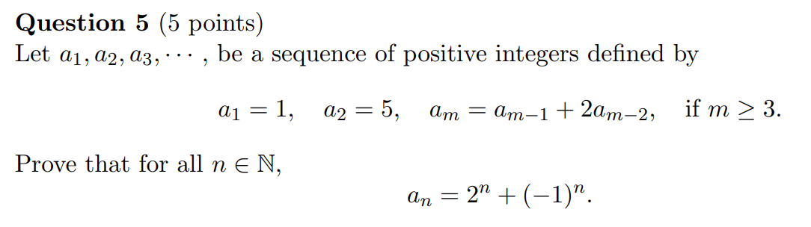
Midterm Exam, Fall 2019

Slide 16
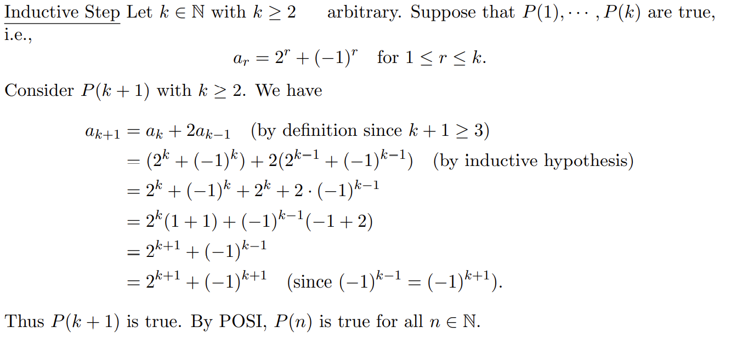

Slide 21
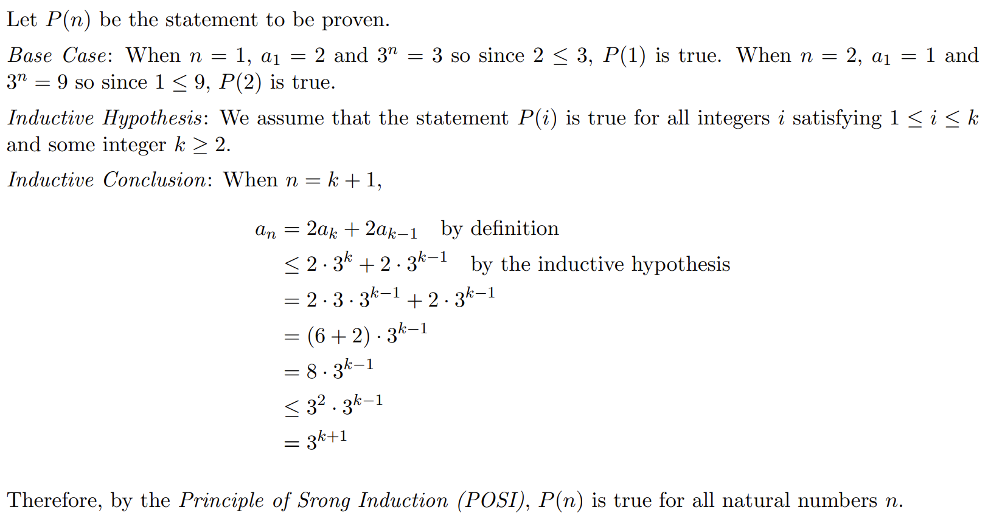

Slide 25
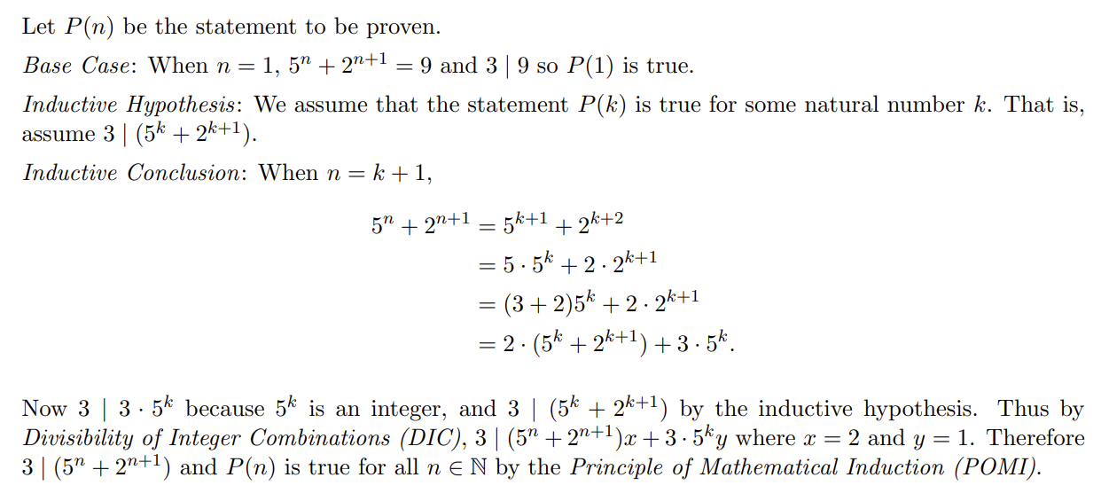

Slide 28
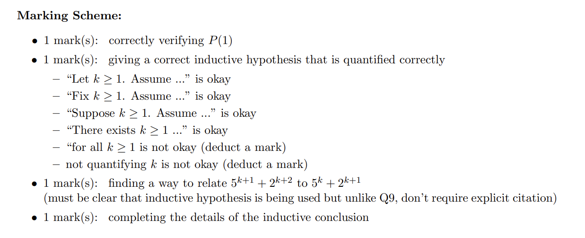

Slide 30
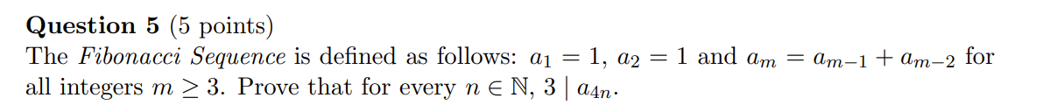
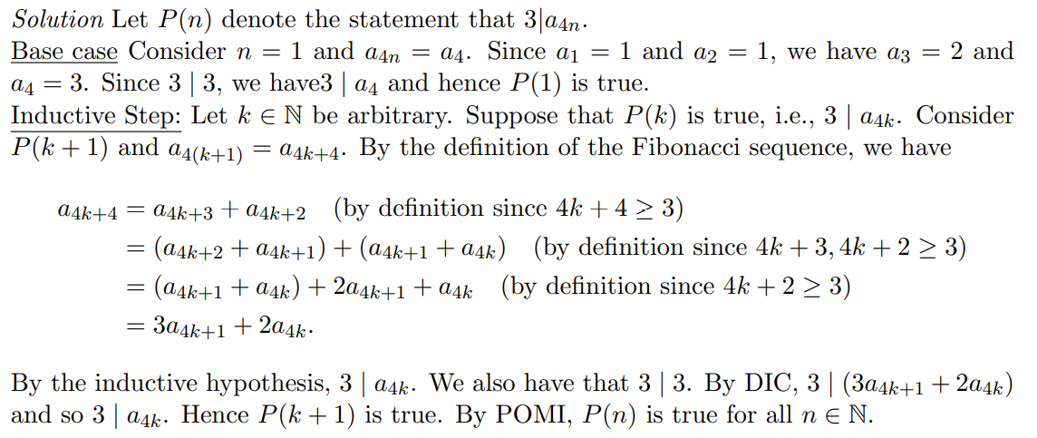

Slide 38
+4

Slide 39
Study groups and carpooling

Slide 40
Does 0 | 0 ?
Yes
Does any integer other than 0 divide 0?
Yes! Which ones?
All
Does 0 divide anything?

Slide 41
Proof Practice!
Is the sum of two consecutive integers odd?
Let a, b in Z, where b = a+1
Consider c = a + b = a + a + 1 = 2a + 1

Slide 42
MATH 135: Lecture 12
Dr. Nike Dattani
4 October 2021

Slide 43
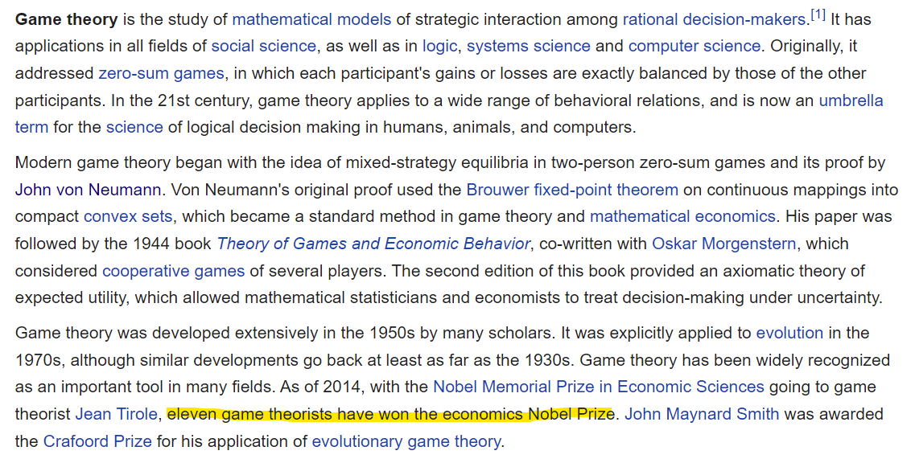

Slide 44

Cover makes it look like it’s about sex, but it’s really about math.

Slide 45
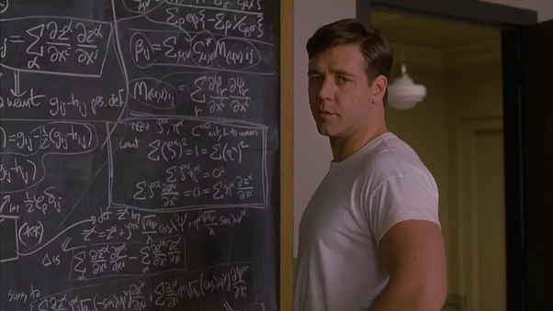
Cover makes it look like it’s about sex, but it’s really about math.

Slide 46


Cover makes it look like it’s about sex, but it’s really about math.

Slide 47
Tip for Q4 of WA4

