Slide 1
If a number’s last digit is 5,
then is the last digit of its square always 5?
Prove it.

Slide 2
MATH 135: Lecture 3
Dr. Nike Dattani
13 September 2021

Slide 3
Upcoming responsibilities!
Monday 13 September:
Complete Mobius Quiz 1: MQ1
Wednesday 15 September:
Complete Mobius Quiz 2: MQ2
Wednesday 15 September 5PM:
Complete first Written Assignment (WA)
Friday 17 September 2PM:
Complete reading Chapter 2 of the course notes
Friday 17 September:
Complete Mobius Quiz 3: MQ3
Sunday 19 September:
Complete reading up to the end of Section 0.2 (Polynomials)

Slide 4
If a number’s last digit is 5, then is the last digit of its square always 5?
S = {Integers for which the last digit is 5}
Ɐ N ϵ S , N² ϵ S ?
Ɐ N ϵ S, ∃ a ϵ ℤ s.t. N = 10a +5
(10a + 5)² = 100a² + 100a + 25
= 100a(a+1) + 25
∃ b ϵ ℤ s.t. N² = 100b + 25
Ɐ b ϵ ℤ, 100b + 25 ϵ S
∴ N² ϵ S , Ɐ N ϵ S

Slide 5
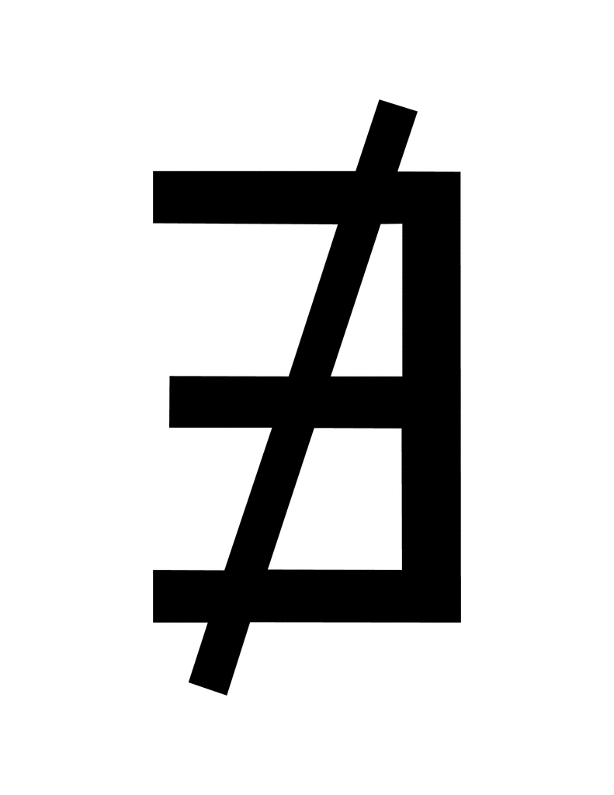


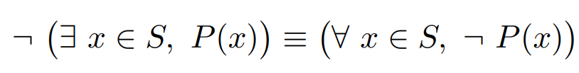
Assignment 1!
Don’t use these:
Everything can be done using what’s in the course notes (e.g. § 1.4.3 & 1.5.3):

Slide 6
Assignment 1!
If S is unknown, and/or if P(x) is unknown:
∀ x ∈ S, P(x)
cannot be true or false until we specify S or P(x).
Technically, the above is an open sentence in S and an open sentence in P, let’s say Q(S,P)
What’s an example of P(x)?
Now that we’ve chosen P(x), the above is still an open sentence in S, let’s say: Q(S).

Slide 7
Question 4
Open sentence or statement ?
∀ x ∈ S, ∃ y ∈ S , P(x,y)
What’s a property of an infinite set of integers like:
S = {……,-3,-2,-1,0,1,2,3,4}
For all x in S, what do we know about the other elements y?

Slide 8
