Slide 1
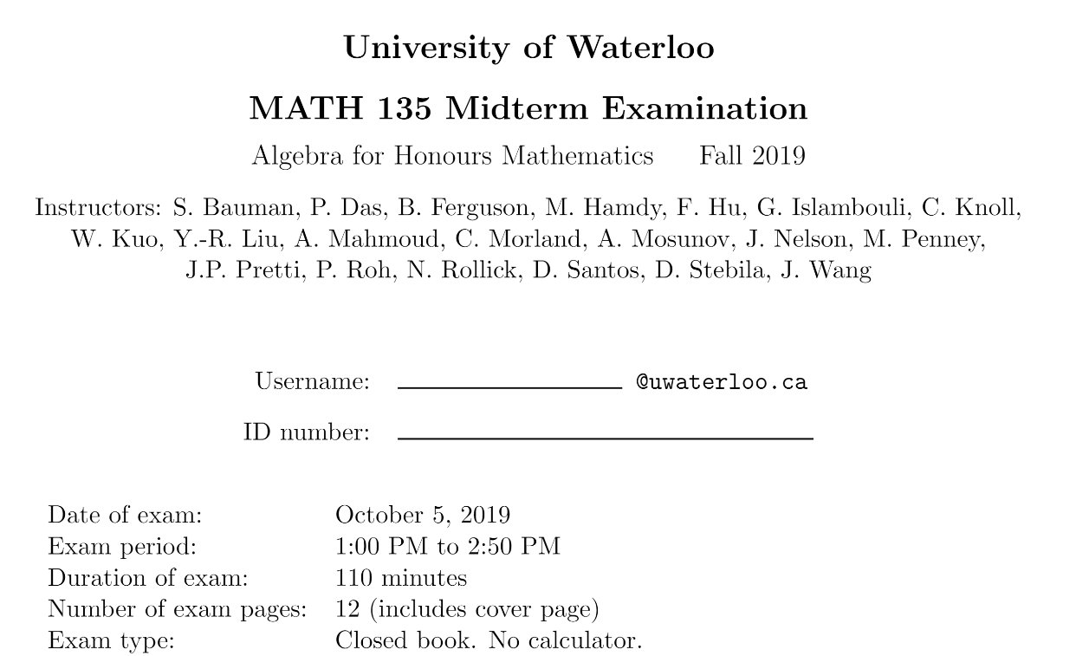

Slide 2
MATH 135: Lecture 9
Dr. Nike Dattani
27 September 2021

Slide 3
Monday 27 September:
Mobius Quiz 7
Tuesday 28 September:
Look at your WA02 results thoroughly! Where did you lose marks?
Tuesday 28 September:
Complete reading from Chapter 3.6 up to 4.4 of the course notes. Pages 55-75.
Wednesday 29 September:
Complete Written Assignment 3: WA3
Wednesday 29 September:
Mobius Quiz 8
Thursday 30 September:
WA03 solutions will be posted, hopefully before 12pm: Check the solutions in detail!
Friday 1 October:
Mobius Quiz 9
Sunday 3 October:
You’ll need to know more before 0.4 (Polynomials), so use this time to review Pages 55-75, and do practice problems!

Slide 4
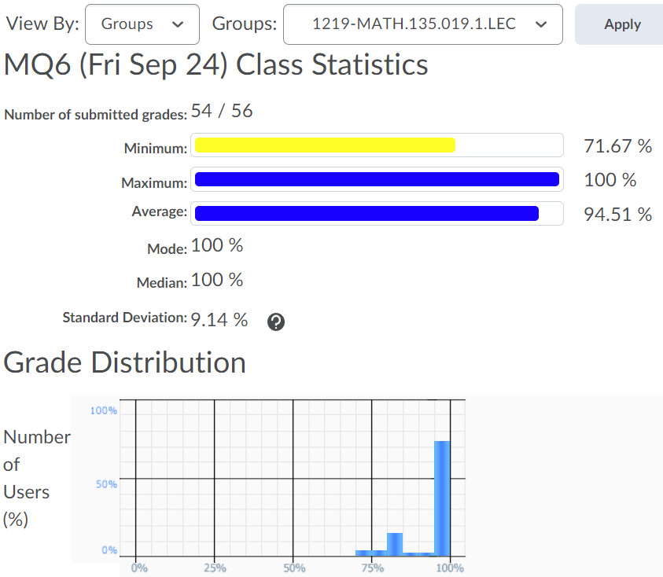
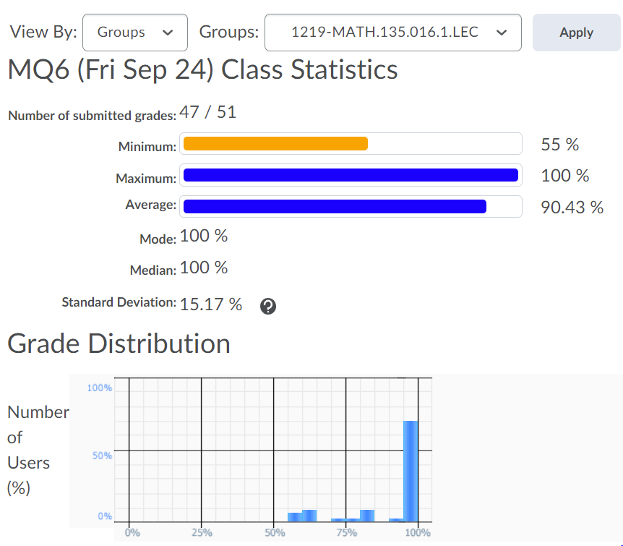
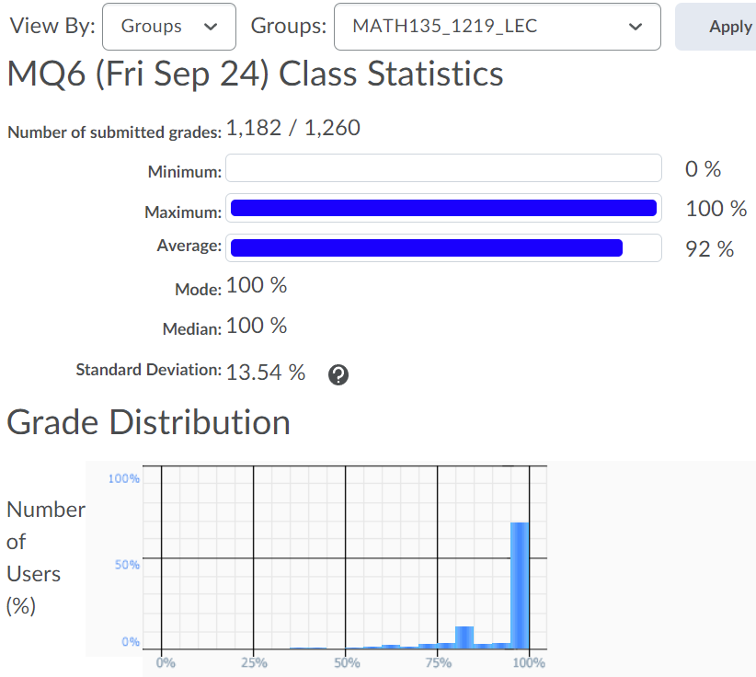

Slide 5
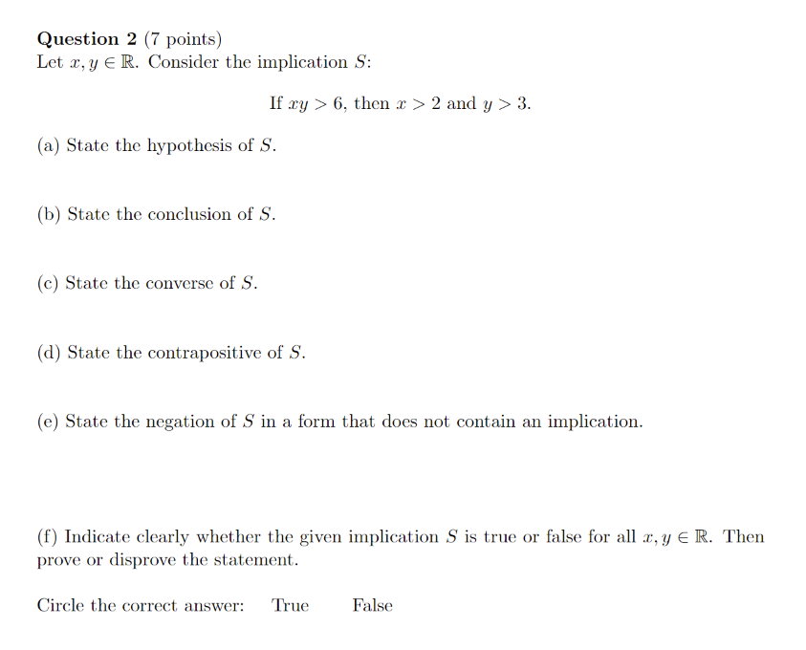
Midterm Exam, Fall 2019
xy > 6 => (x > 2) ^ (y > 3)
x=1 , y = 7 => xy > 6, but x < 2

Slide 6
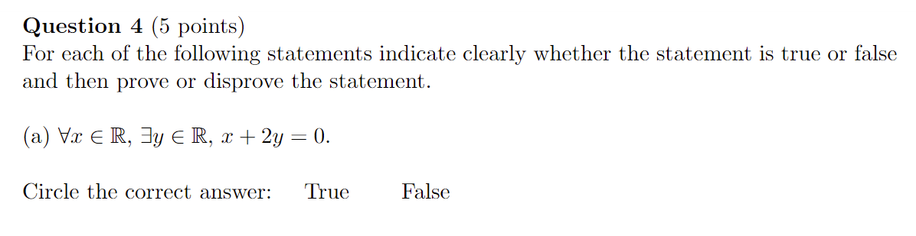
Midterm Exam, Fall 2019
∀ x ∈ ℝ , -x /2 ∈ ℝ
Let y = -x /2
2y + x = 2 ( -x / 2 ) + x
= -x + x
= 0

Slide 7

¬ (∃ y ∈ ℝ , ∀ x ∈ ℝ , x + 2y = 0)
∀ y ∈ ℝ , ∃ x ∈ ℝ , x + 2y ≠ 0
∀ y ∈ ℝ , ∃ x ∈ ℝ , x = -2y + 1
x + 2y = -2y + 1 + 2y
= 1
≠ 0
Now let’s consider x + 2y, when x = -2y + 1:
∀ y ∈ ℝ, let x = -2y + 1
x + 2y = -2y + 1 + 2y
= 1
≠ 0

Slide 8

Don’t like the ∤ symbol:
¬(( a ∤ 3b + 1) V (3a ∤ 7b - 2)) => ¬(a ≠ 13)
¬( a ∤ 3b + 1) ^ ¬(3a ∤ 7b - 2) => ¬(a ≠ 13)
( a | 3b + 1) ^ (3a | 7b - 2) => a = 13
(a | 3a ) ^ (3a | 7b -2) => a | 7b -2
( a | 3b + 1) ^ ( a | 7b - 2) => a |x(3b + 1) + y(7b-2), ∀x,y ∈ ℤ
x = 7, y = -3
a | 7(3b + 1) – 3(7b – 2)
a | 21b - 21b + 7 + 6
a | 13
The only integers that divide 13 are -1, 1, -13 and 13,
But a >= 2, so a = 13.

Slide 9
Try to prove the contrapositive:
¬(( a ∤ 3b + 1) V (3a ∤ 7b - 2)) => ¬(a ≠ 13)
¬( a ∤ 3b + 1) ^ ¬(3a ∤ 7b - 2) => ¬(a ≠ 13)
( a | 3b + 1) ^ (3a | 7b - 2) => a = 13
a | 3a (corollary of the definition of divisibility)
(a | 3a) ^ (3a | 7b -2) => a | 7b -2 (by transitivity of divisbility)
( a | 3b + 1) ^ ( a | 7b - 2) => a |x(3b + 1) + y(7b-2), ∀x,y ∈ ℤ (by D.I.C. Maybe also talk about 3b-1 ∈ ℤ)
Now let, x = 7, y = -3
a | 7(3b + 1) – 3(7b – 2) (by D.I.C.)
a | 21b - 21b + 7 + 6
a | 13
The only integers that divide 13 are -1, 1, -13 and 13,
But a >= 2, so a must be 13.

Slide 10

Case 1: n = 2k for k ∈ ℤ (n is even)
(2k)² + (2k) + 1
4k² + 2k + 1
4k² is even because it contains a factor of 2
2k is even for the same reason
4k² + 2k is even because an even number plus an even number is even.
4k² + 2k + 1 because an even number plus an odd number is odd.

Slide 11
Case 1: n = 2k for k ∈ ℤ (n is even)
(2k)² + (2k) + 1
4k² + 2k + 1
4k² is even because it contains a factor of 2
2k is even for the same reason
4k² + 2k is even because an even number plus an even number is even.
Let E = 4k² + 2k, which we know is even.
4k² + 2k + 1 = E + 1, which is odd because an even number plus an odd number is odd.
Case 2: n = 2k + 1k ∈ ℤ (n is odd)
(2k + 1)^2 = 4k² + 4k + 1

Slide 12
Case 1: n = 2k for k ∈ ℤ (n is even)
(2k)² + (2k) + 1
4k² + 2k + 1
4k² is even because it contains a factor of 2
2k is even for the same reason
4k² + 2k is even because an even number plus an even number is even.
Let E = 4k² + 2k, which we know is even.
4k² + 2k + 1 = E + 1, which is odd because an even number plus an odd number is odd.
Case 2: n = 2k + 1k ∈ ℤ (n is odd)
(2k + 1)^2 = 4k² + 4k + 1 (odd because of Case 1?)

Slide 13
Case 1: n = 2k for k ∈ ℤ (n is even)
(2k)² + (2k) + 1
4k² + 2k + 1
4k² is even because it contains a factor of 2
2k is even for the same reason
4k² + 2k is even because an even number plus an even number is even.
Let E = 4k² + 2k, which we know is even.
4k² + 2k + 1 = E + 1, which is odd because an even number plus an odd number is odd. (*)
Case 2: n = 2k + 1k ∈ ℤ (n is odd)
(2k + 1)² = 4k² + 4k + 1
(2k + 1)² + (2k + 1) + 1
4k² + 4k + 1 + 2k + 1 + 1
4k² + 6k + 3
Let E = 4k² + 6k, which is even because it contains a factor of 2.
4k² + 6k + 3 = E + 3, which is odd by the same reasoning as in (*).
Since all integers are either even or odd, we have proven that the statement is true for all possible cases.

Slide 14
(d | n² + n + 1 ) ^ (d | n² + n + 3 ) => d | (n² + n + 1 )(1) + (n² + n + 3 )(-1) (by D.I.C. with x=1, y= -1)
∴ d | -2
∴ d | 2 (corollary to definition of divisibility)
∴ d = -2, -1, +1, or + 2

Slide 15
(d | n² + n + 1 ) ^ (d | n² + n + 3 ) => d | (n² + n + 1 )(1) + (n² + n + 3 )(-1) (by D.I.C. with x=1, y= -1)
∴ d | -2
∴ d | 2 (corollary to definition of divisibility)
∴ d is either -2, -1, +1, or + 2

Slide 16
(d | n² + n + 1 ) ^ (d | n² + n + 3 ) => d | (n² + n + 1 )(1) + (n² + n + 3 )(-1) (by D.I.C. with x=1, y= -1)
∴ d | -2
∴ d | 2 (corollary to definition of divisibility)
∴ d is either -2, -1, +1, or + 2
But n² + n + 1 is odd, so 2 ∤ n² + n + 1 and -2 ∤ n² + n + 1
If d = 2 or -2, then we would have a contradiction.
So d is either -1 or +1
But d is in ℕ.

Slide 17
Does 0 | 0 ?
Yes
Does any integer other than 0 divide 0?
Yes! Which ones?
All
Does 0 divide anything?

Slide 18
Proof Practice!
Is the sum of two consecutive integers odd?
Let a, b in Z, where b = a+1
Consider c = a + b = a + a + 1 = 2a + 1

Slide 19
Thank you for coming to class!

