Slide 1
Monday 4 October:
Mobius Quiz 10 (covers up to the end of Chapter 4.4, Strong Induction).
Tuesday 5 October:
Look at your WA03 results thoroughly! Where did you lose marks?
Tuesday 5 October:
Complete reading Chapter 5 of the course notes. Pages 82-93.
Wednesday 6 October:
Submit Written Assignment 4: WA4
Wednesday 6 October:
Mobius Quiz 11 (covers up to the end of Chapter 4.4, Strong Induction).
Thursday 7 October:
Look at WA5 !!!
Thursday 7 October:
WA04 solutions will be posted, hopefully before 12pm: Check the solutions in detail!
Friday 1 October:
Mobius Quiz 12 (covers up to the end of Chapter 4.4, Strong Induction).
Reading week:
Practice, practice, practice, practice, practice, practice, practice, practice, practice, practice, practice, practice, practice!

Slide 2
MATH 135: Lecture 13
Dr. Nike Dattani
6 October 2021

Slide 3
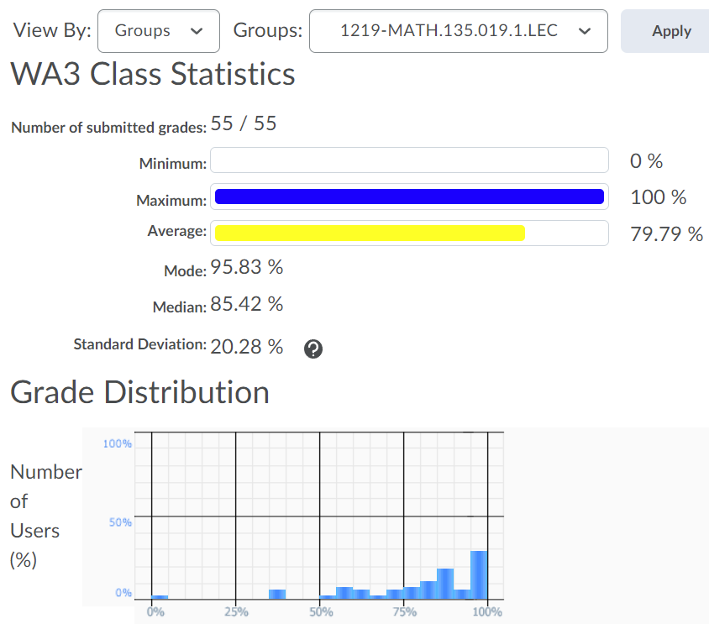
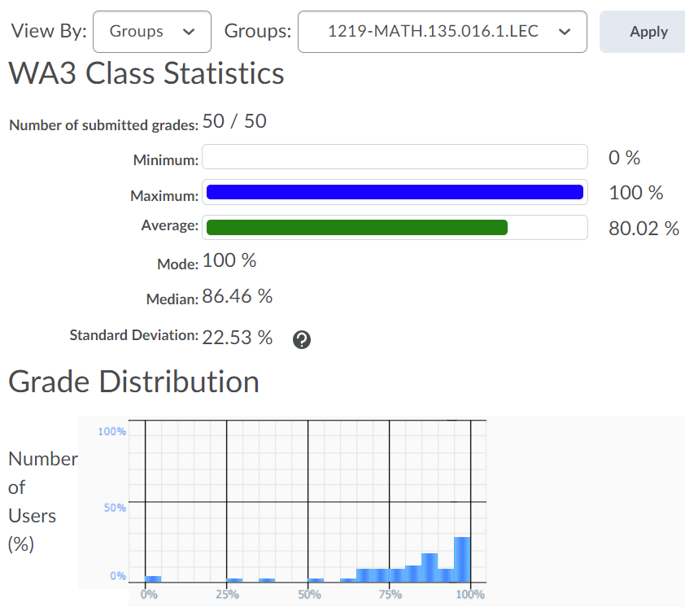
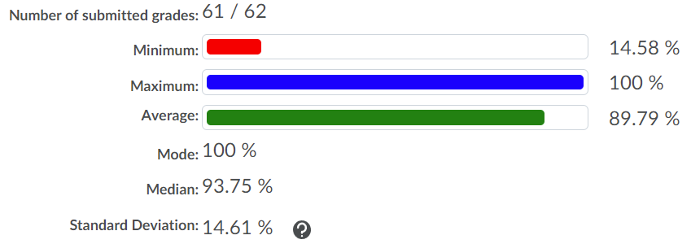
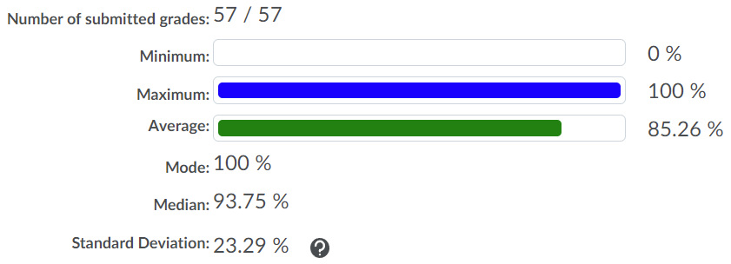
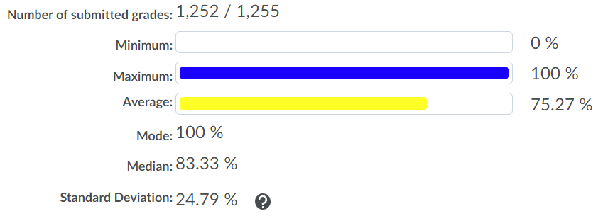
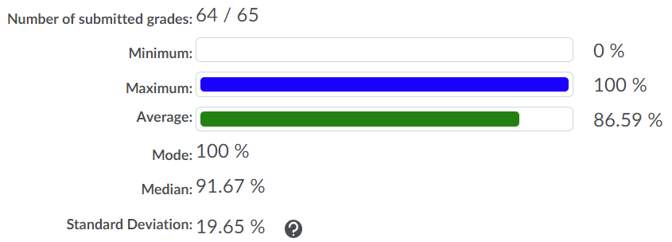
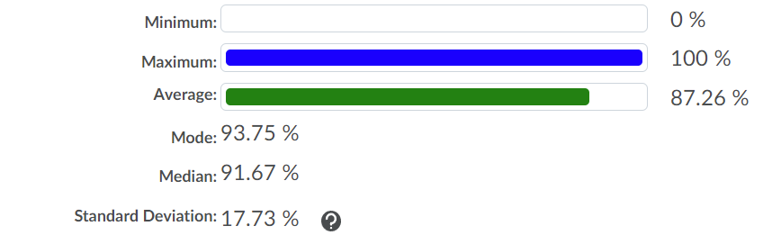
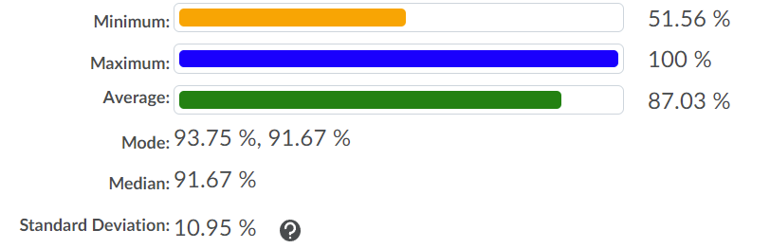
Nike’s Section 19
Nike’s Section 16
Anton’s Section 7
Emma’s Section 8
Entire MATH 135
Mark’s Section 1
Ali’s Section 21
Ali’s Section 22

Slide 4
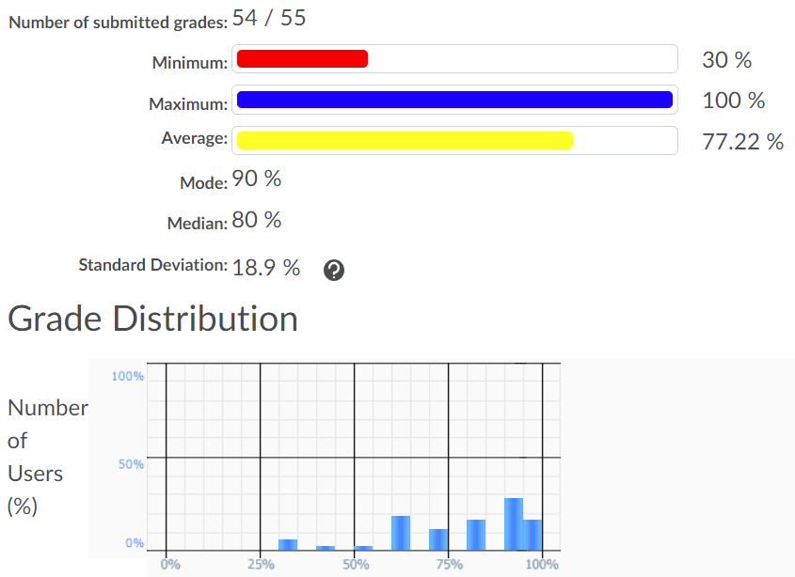
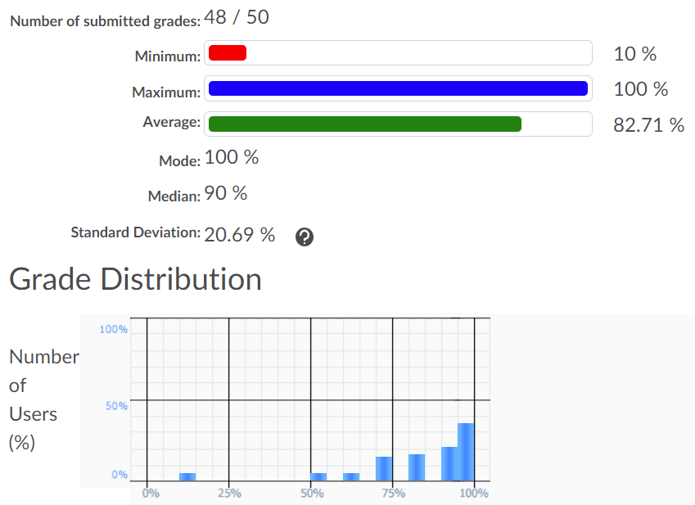
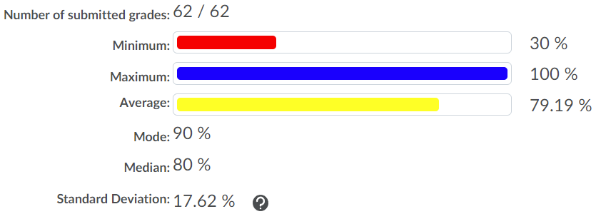
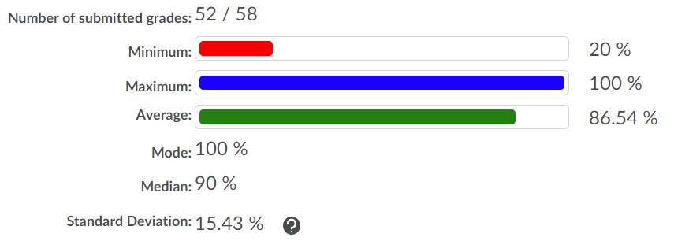

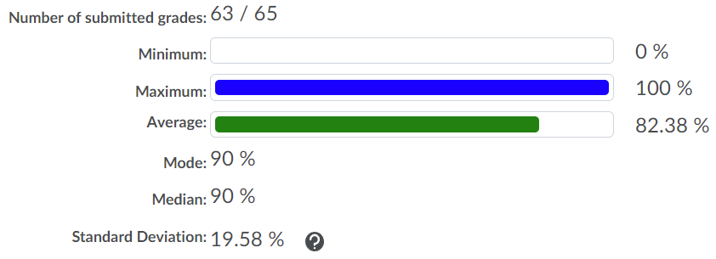
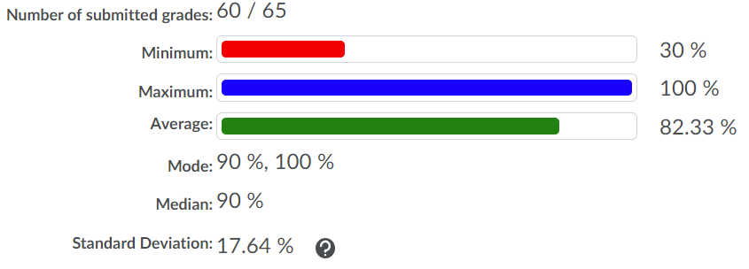
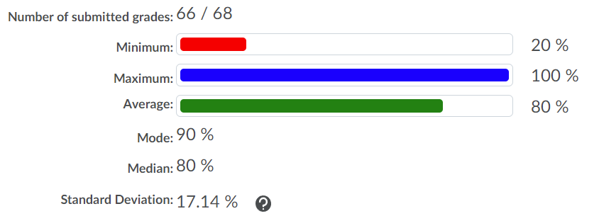
Nike’s Section 19
Nike’s Section 16
Anton’s Section 7
Emma’s Section 8
Entire MATH 135
Mark’s Section 1
Ali’s Section 22
Ali’s Section 21

Slide 5
Game theory example: Prisoner’s Dilemma (1950)
Alice and Bob were both convicted of crime #1,
and suspected of committing crime #2.
Both will be sentenced to 2 years in prison (for crime #1) if nothing else happens.
If Alice provides incriminating evidence against Bob for crime #2, and Bob stays silent:
Alice’s 2-year sentence is reduced to a 1-year sentence (a reward for helping the police!)
Bob’s 2-year sentence gets increased to a 4-year sentence (he’s guilty and uncooperative)
If the other way around, Bob’s sentence becomes 1 year and Alice’s becomes 4 years.
If both betray each other, they both have to serve an extra year (both are guilty of 2 crimes)
Alice
Confess
Deny
Confess
3
4
3
1
Bob
Deny
1
2
4
2

Slide 6
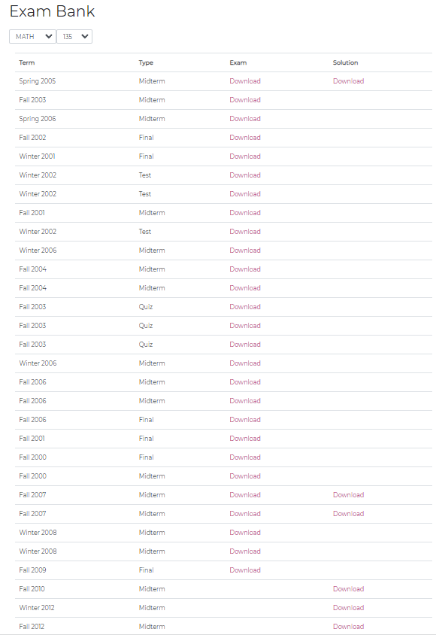

Slide 7
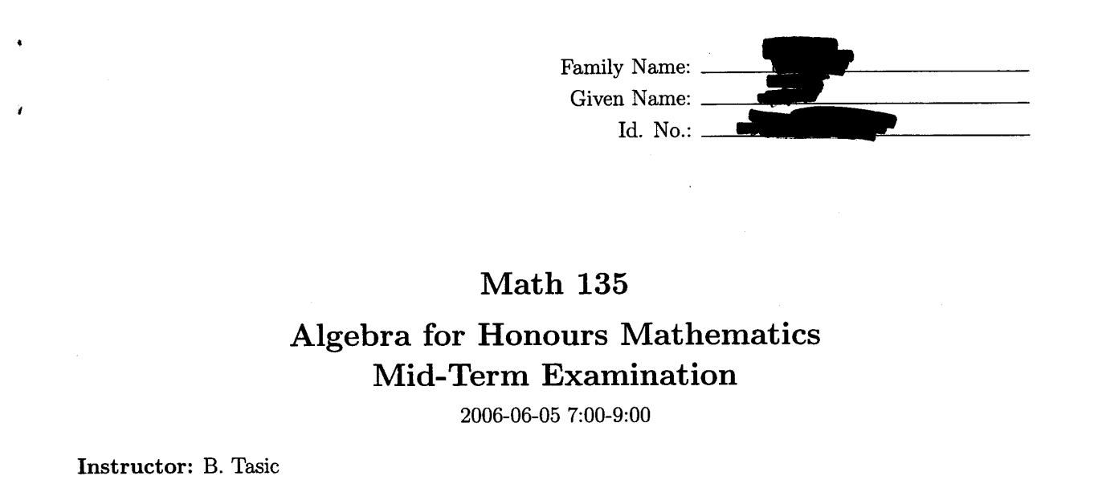

Slide 8

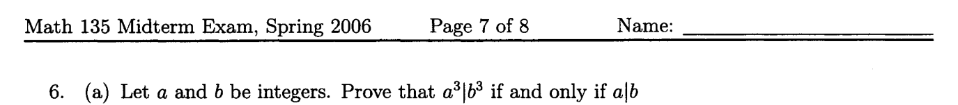

Slide 9
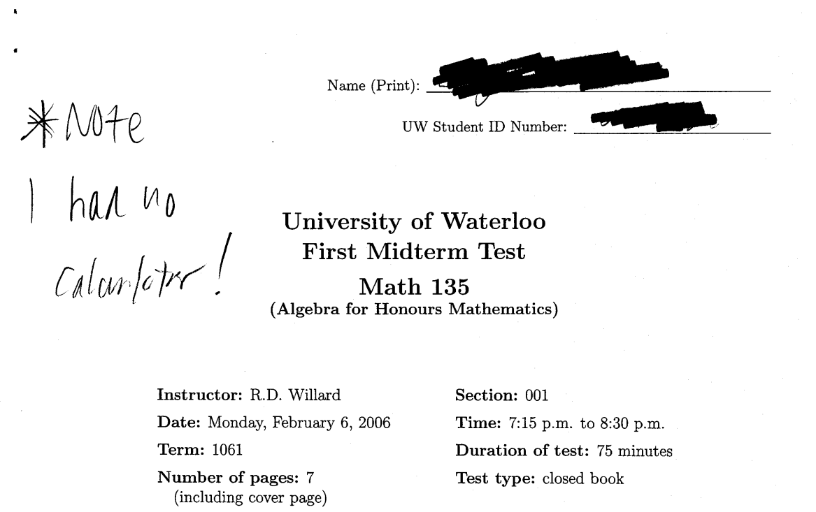

Slide 10
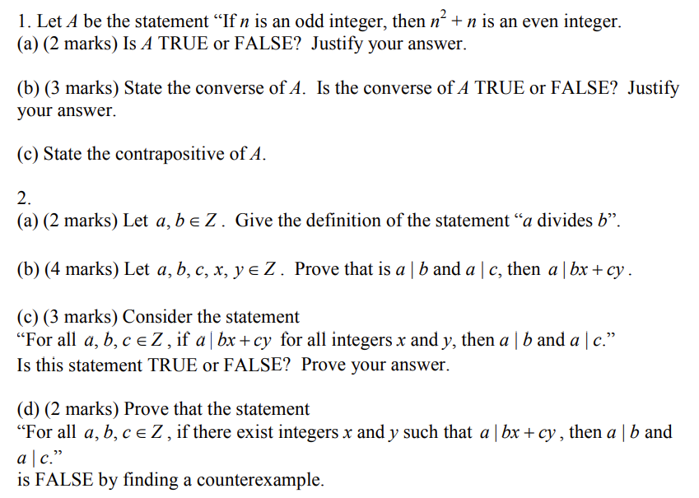
Fall 2006, Midterm:

Slide 11
Fall 2006, Final:

