Slide 1


gcd(2ª – 1,2^{b} -1) | 2ª – 1
2ª ≡ 1 mod( gcd(2ª – 1,2^{b} -1) )
2^{ax} ≡ 1^{x} mod( gcd(2ª – 1,2^{b} -1) )
gcd(2ª – 1,2^{b} -1) | 2^{b} – 1
2^{b} ≡ 1 mod( gcd(2ª – 1,2^{b} -1) )
2^{by} ≡ 1^{y} mod( gcd(2ª – 1,2^{b} -1) )
2^{ax} 2^{by} ≡ 1^{x} 1^{y} mod( gcd(2ª – 1,2^{b} -1) )
2^{ax} ⁺ ^{by} ≡ 1 mod( gcd(2ª – 1,2^{b} -1) )
2^{gcd(a,b)} ≡ 1 mod( gcd(2ª – 1,2^{b} -1) )
gcd(2ª – 1,2^{b} -1) | 2^{gcd(a,b)} -1

Slide 2
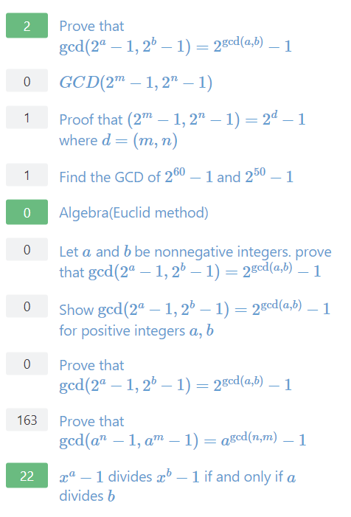
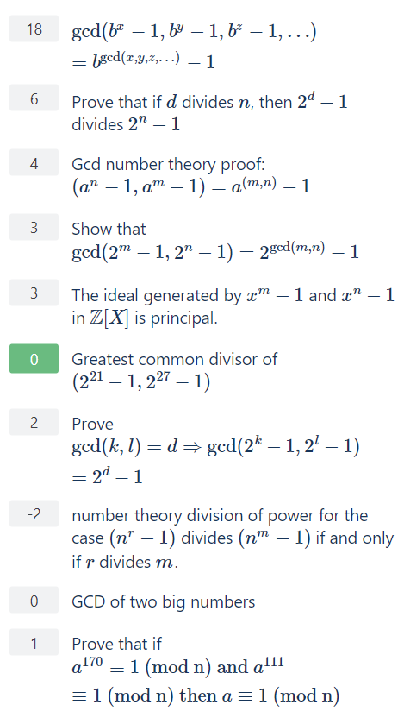

Slide 3
MATH 135: Lecture 25
Dr. Nike Dattani
10 November 2021

Slide 4
I am so proud of you!

Slide 5
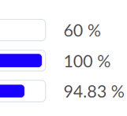
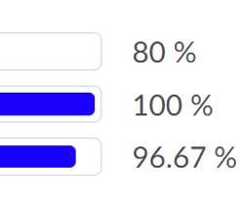
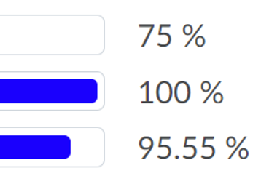
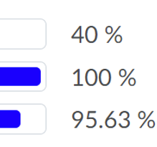
MQ 15
Anton’s Section 7
Nike’s Section 19*
1.1% difference
Emma’s Section 8
Ali’s Section 22
*Similar for Section 16

Slide 6
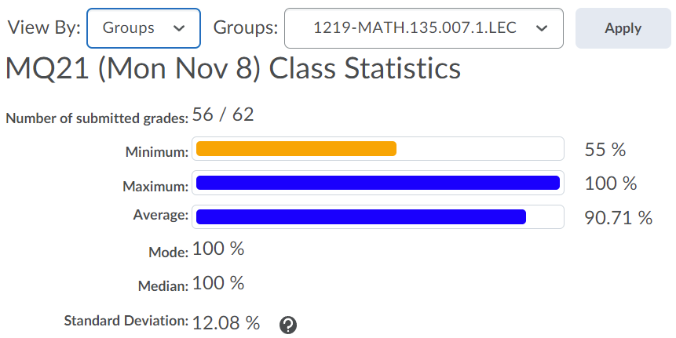
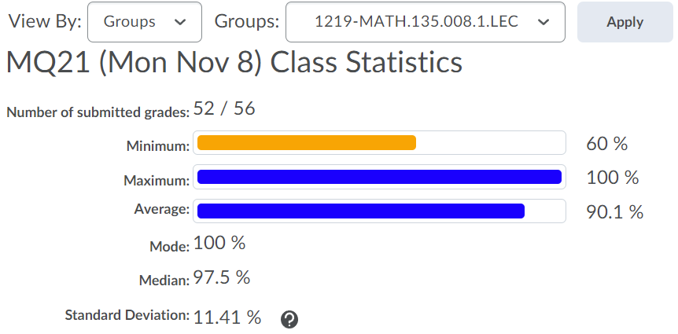
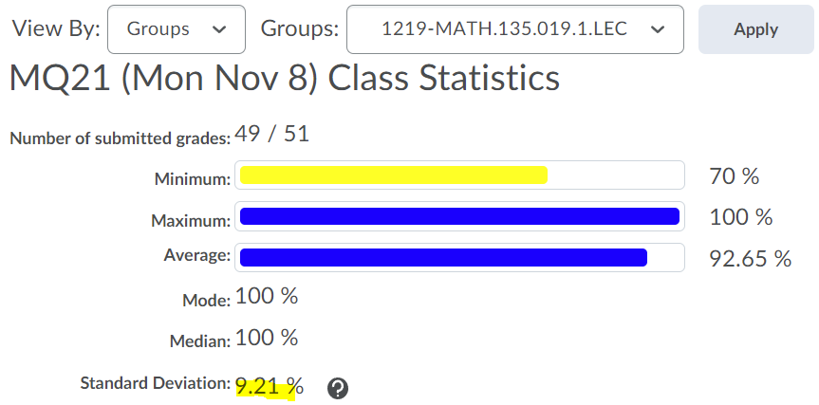
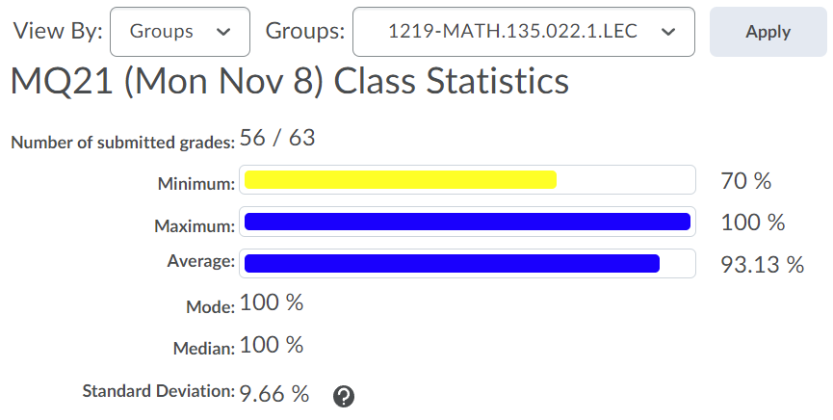
MQ 21

Slide 7
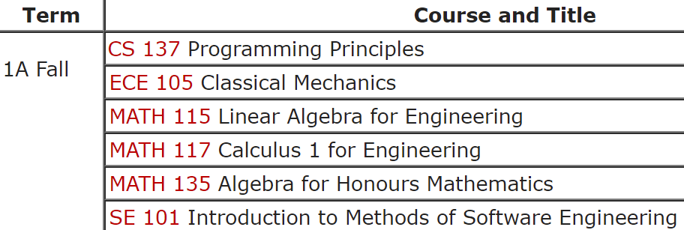

Slide 8
MQ 15
Anton’s Section 7
Nike’s Section 19*
Emma’s Section 8
Ali’s Section 22
*Similar for Section 16

Slide 9
This is the best MATH 135 class!
You are all awesome!

Slide 10
Wednesday 10 November:
Mobius quiz tonight! (covers up to middle of page 121)
Wednesday 10 November:
Submit Written Assignment 7: WA7 (covers up to page 121)
Reading: 8.1-8.4 (122-133) won’t take long (I’ve covered it already!)
Reading: 8.5-8.9 (122-148) worth getting a head start!

Slide 11
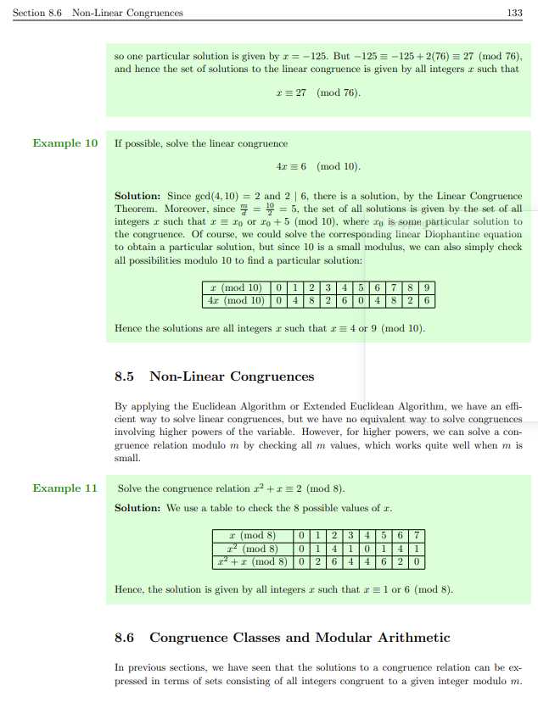

Slide 12
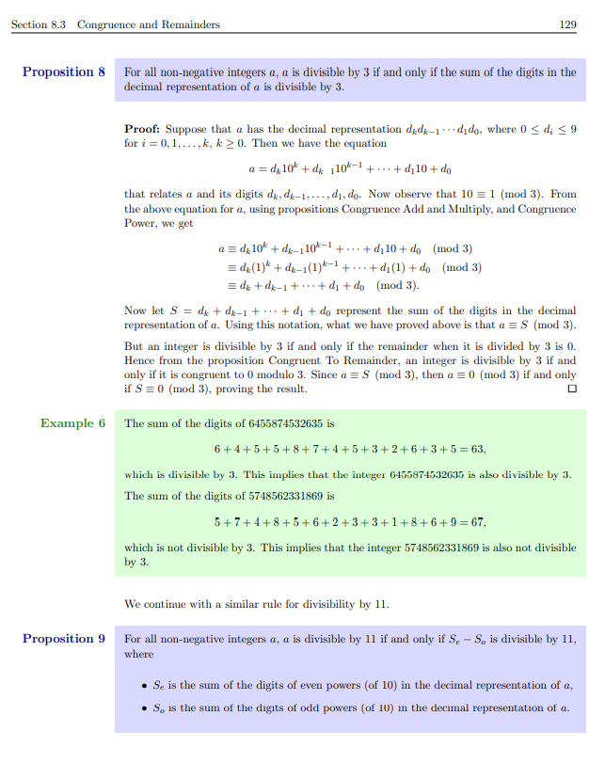

Slide 13
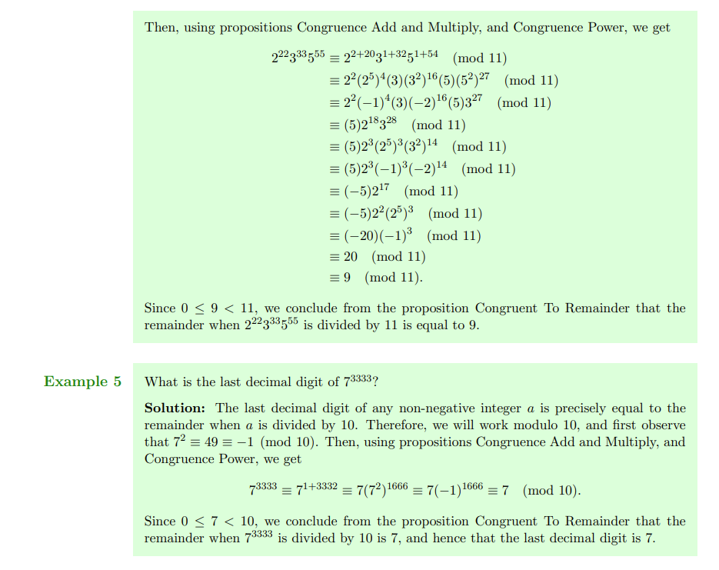

Slide 14
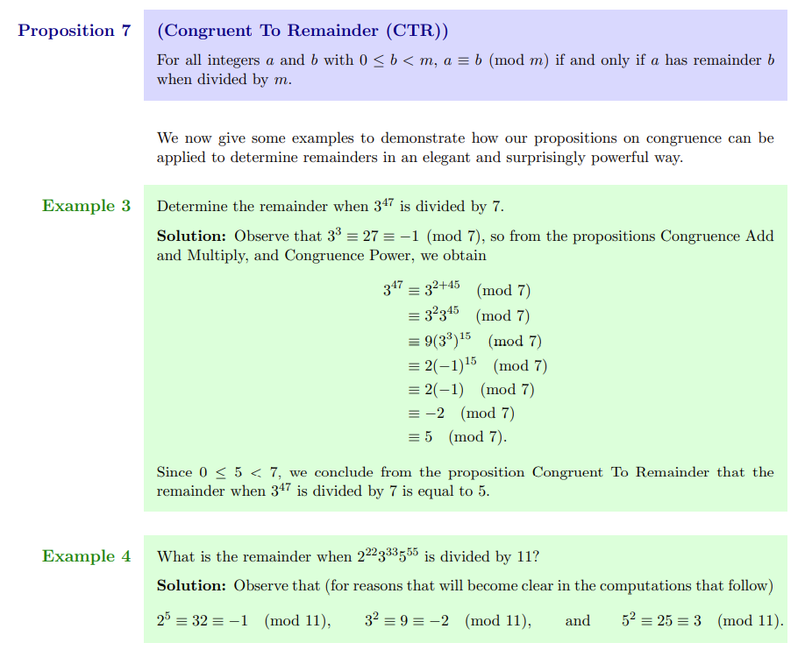

Slide 15
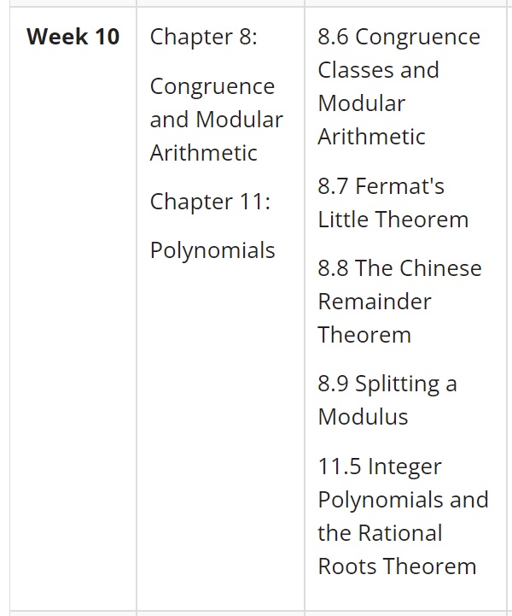
I’d like to do more examples but:
There’s not much sense in doing more examples until you’ve learned all this
Why practice proving things without these theorems,
if on the exam you’ll be allowed to use them?
The faster we get there,
the sooner we can start doing practice exams more seriously / realistically.

Slide 16
If I went through 8.1 to 8.5 too fast:
Tell me what you need me to go through more slowly, and I will do it.
- Read the course notes to fill in the gaps
- Ask on Piazza.
- Ask at office hours
- Go to online tutorial centre
- If you really think you’ll learn what’s in the course notes better if “lectured”,
Look at lecture notes of other instructors on LEARN
→ no assignment tips, no previous exam problems, but content covered
But be careful: Lectures don’t tend to be as “refined” as the course notes. One mistake could be very costly.

Slide 17
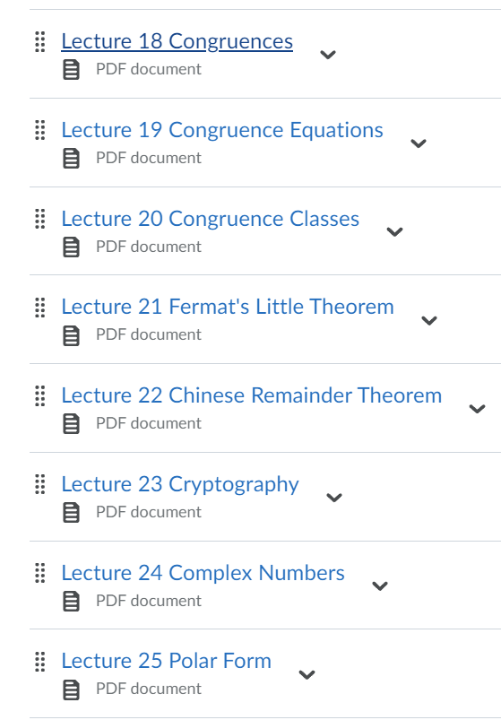

Slide 18
Check this out:
6 ≡ 6 (mod 11)

Slide 19
Check this out:
-5 ≡ 6 ≡ 6 (mod 11)

Slide 20
Check this out:
17 ≡ -5 ≡ 6 ≡ 6 (mod 11)

Slide 21
Check this out:
28 ≡ 17 ≡ -5 ≡ 6 ≡ 6 (mod 11)

Slide 22
Check this out:
-16 ≡ 28 ≡ 17 ≡ -5 ≡ 6 ≡ 6 (mod 11)
[6] = {…,-16,-5,6,17,28,…}

Slide 23
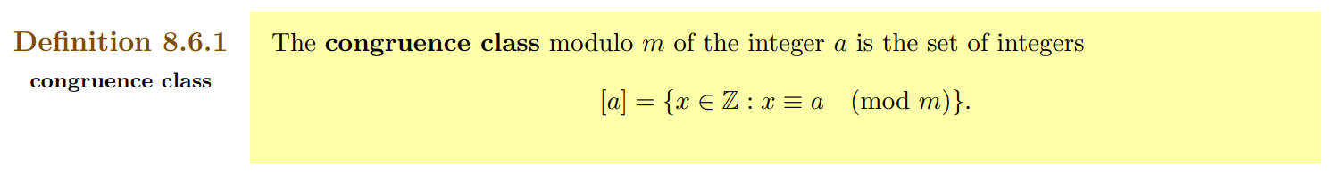
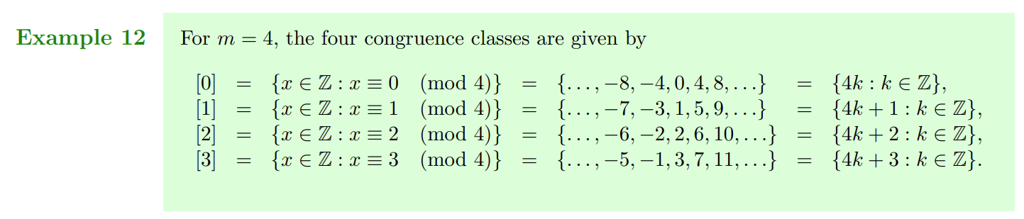

Slide 24
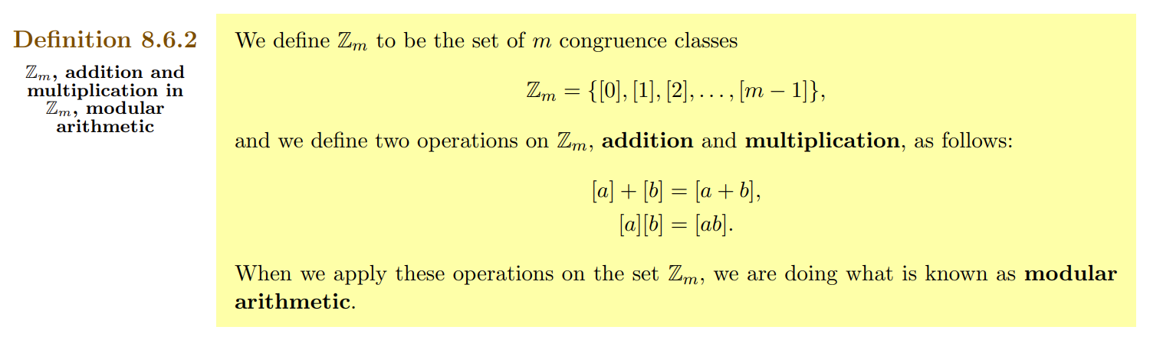

Slide 26
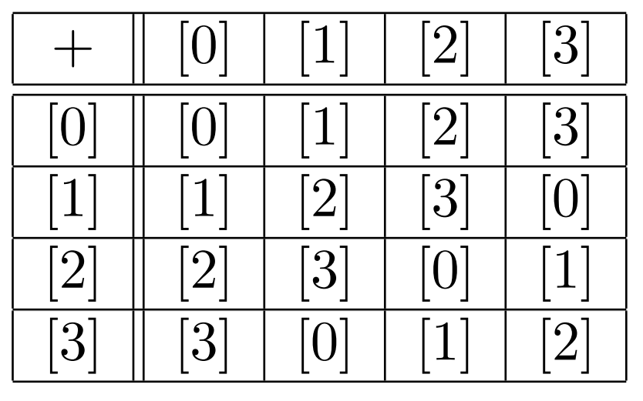


Slide 32
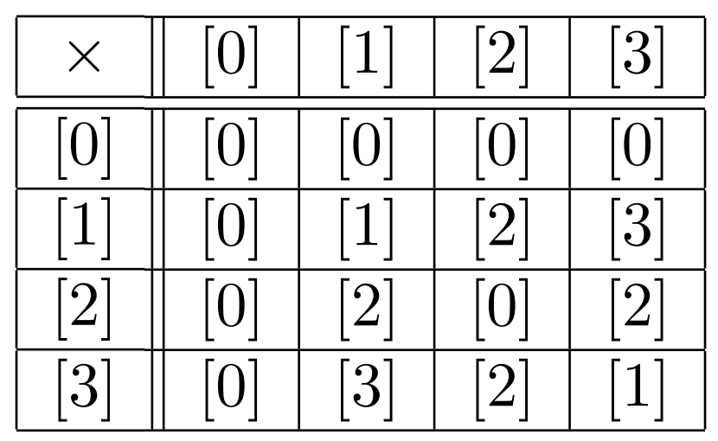

Slide 38
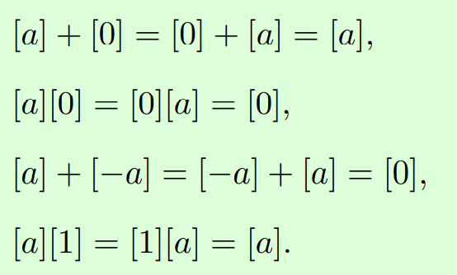
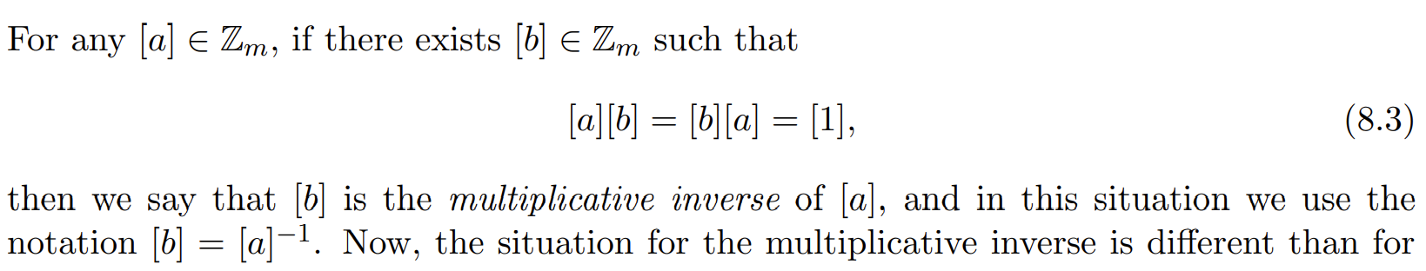
[0] = Additive Identity
[-a] = Additive Inverse
[1] = Multiplicative Identity

Slide 39

Solve for [x] in :
[8][x] = [4]
11y + 8x = 4

Slide 40
When does [a] have a multiplicative inverse in ℤ_{m}?
_{Answer: Iff gcd(a,m) = 1}

Slide 41
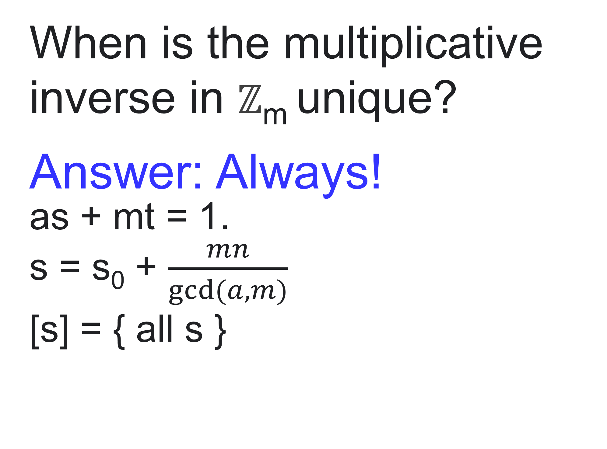
When is the multiplicative inverse in ℤ_{m} unique?
_{Answer: Always!}
as + mt = 1.
s = s₀ + $\frac{mn}{gcd⁡(a,m)}$
[s] = { all s }

Slide 42
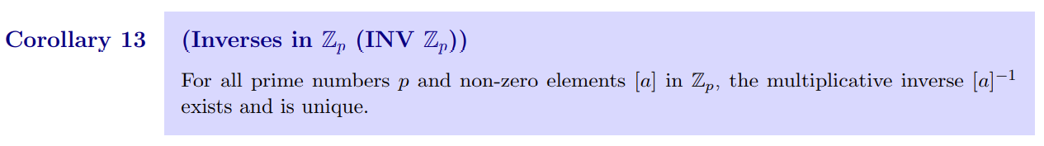
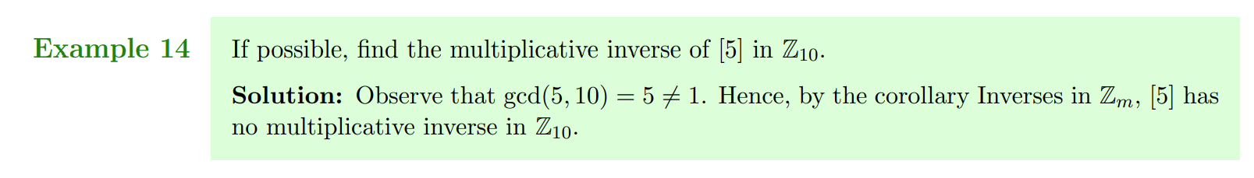

Slide 44
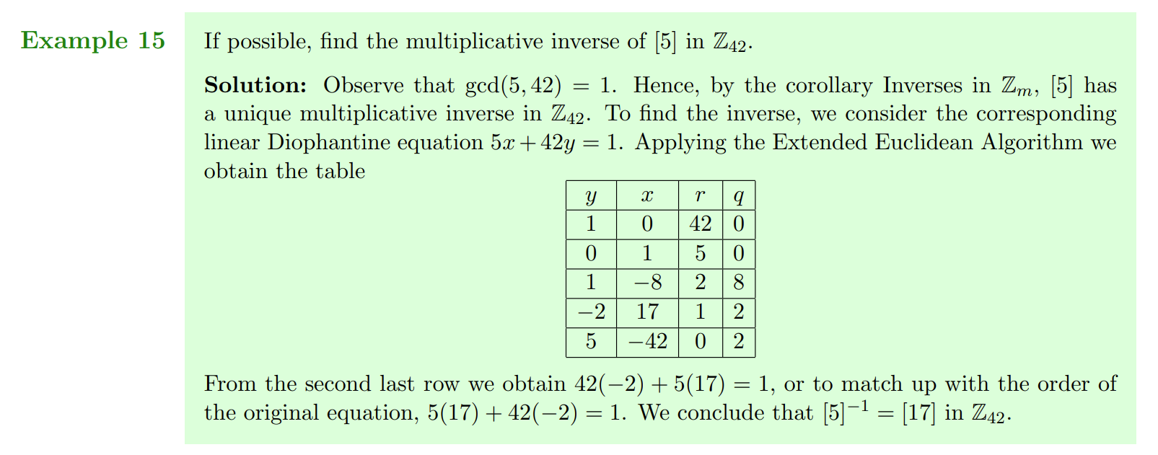

Slide 46
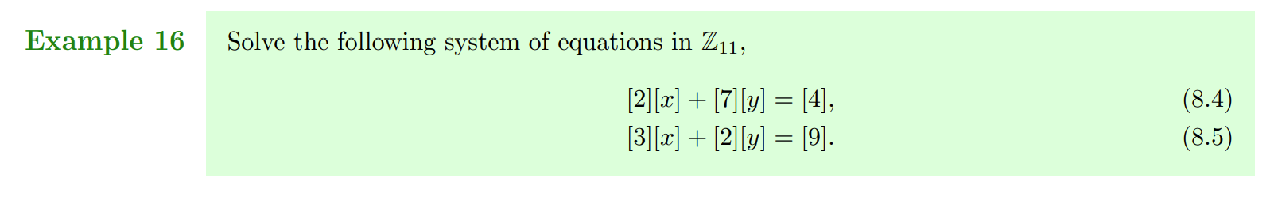

Slide 47
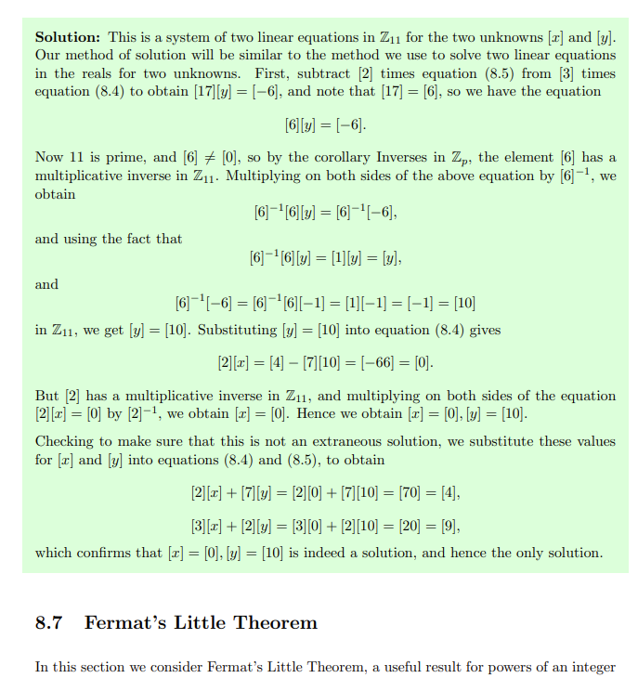

Slide 48
_{Homework:}
Read 8.6 (134-138): Thoroughly (I’m serious!)
- You don’t need 8.1-8.5 (catch up on it later!)
- Most exercises were already done today!
_{Friday:}
We’ll do Fermat’s Little Theorem and CRT

Slide 49
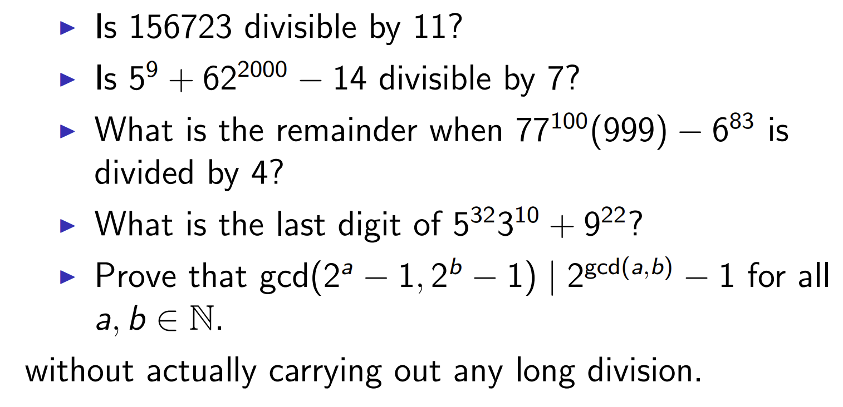
_{Extra practice:}

Slide 50
Thank you!

Slide 51
Tutor connect, if no one replied, what to do.
Jason D’Souza apology
Laith: EEA
Survey results: overall satisfaction (academia.SE page)
Survey: course notes (add that you can look at Jerry’s)
Maybe Example 2 of Chapter 8

Slide 52
Youtube channel
Q5 of WA08: Strawwng Induction

