Slide 1
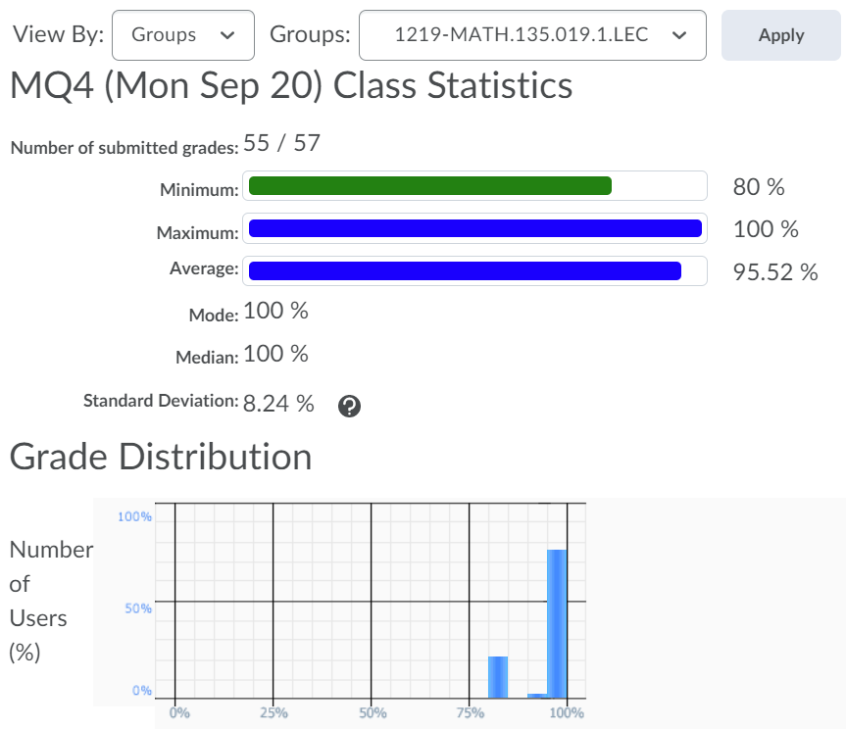


Slide 2
You should be done reading up to Chapter 3.6 of the course notes. Pages 35-57.
Wednesday 22 September:
Complete Written Assignment 2: WA2
Wednesday 22 September:
Mobius Quiz 5
Wednesday 22 September:
Look at your WA01 results thoroughly! Where did you lose marks?
Thursday 23 September:
WA02 solutions will be posted, hopefully before 12pm: Check the solutions in detail!
Friday 24 September before class:
Mobius Quiz 6
Sunday 26 September:
Complete reading up to the end of Section 0.3 (Polynomials)
Monday 27 September:
Mobius Quiz 7
Tuesday 28 September:
Complete reading from Chapter 3.6 up to 4.4 of the course notes. Pages 55-75.

Slide 3
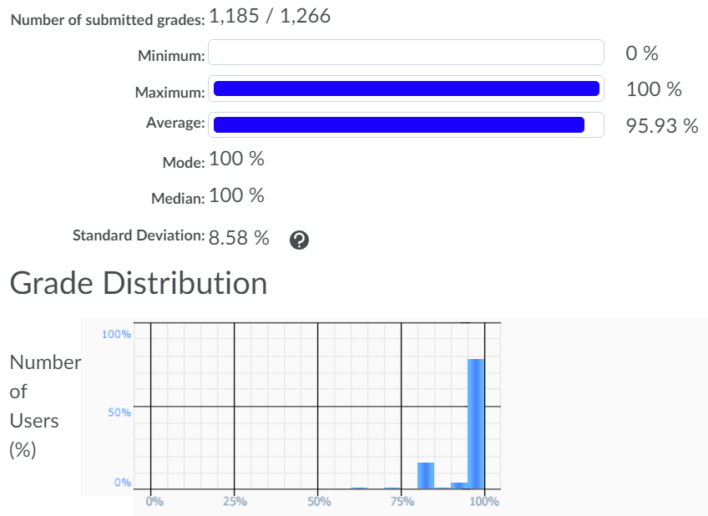

Slide 4
Office hours: Mondays and Wednesdsays 5-6pm.
MC 4059
Also: online tutorial center

Slide 5
MATH 135: Lecture 7
Dr. Nike Dattani
22 September 2021

Slide 6
Quick Review
If A then B.
A if B.
(A => B)
(B => A)

Slide 7
“Iff” is short for what?
If A then B and only if B
If A then B and only if B then A

Slide 8
Don’t consider iff to be an English term
Mathematically: A => B and B=> A (A <=> B)

Slide 9
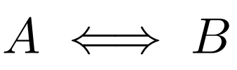
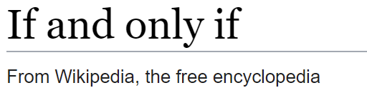
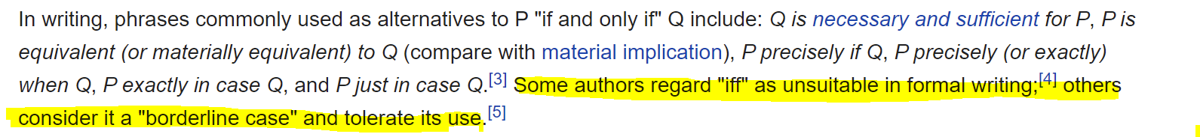
A iff B
A exactly when B
A just if B
A precisely when B
A is true whenever B is true
A is equivalent to B
A is materially equivalent to B
A is logically equivalent to B
A exactly in case B
A just in case B
A XNOR B
A is necessary and sufficient for B

Slide 10
A iff B
A exactly when B
A just if B
A precisely when B
A is true whenever B is true
A is equivalent to B
A is materially equivalent to B
A is logically equivalent to B
A exactly in case B
A just in case B
A XNOR B
A is necessary and sufficient for B: A necessary for B (B => A), A sufficent for B (A => B)

Slide 11
More Review
If the hypothesis A is false, is B true?
- No! Only (A => B) is true!

Slide 12

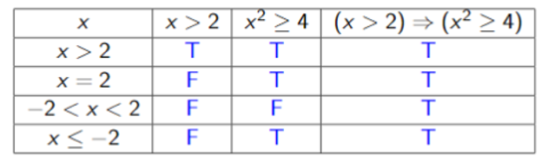
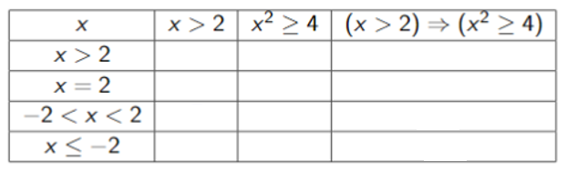
Hypothesis FALSE, but Conclusion also FALSE
Hypothesis (A)
Conclusion (B)
Implication always TRUE if Hypothesis is FALSE
Implication (A => B)
We will use the convention that (A => B) is true if A is false. In this case we say it’s “vacuously true”.
This way we don’t have to spend time checking cases that do not impact the open sentence.
This convention might not be followed in some types of non-classical logic (click for link to Wikipedia page!).

Slide 13
Converse
Contrapositive
Counter-example
Contradiction

Slide 14
Converse
Contrapositive
Counter-example
Contradiction: ( A ^ ¬A) is true

Slide 15
Converse
Contrapositive
Counter-example
Contradiction
Corollary
Conclusion
Combinations

Slide 16
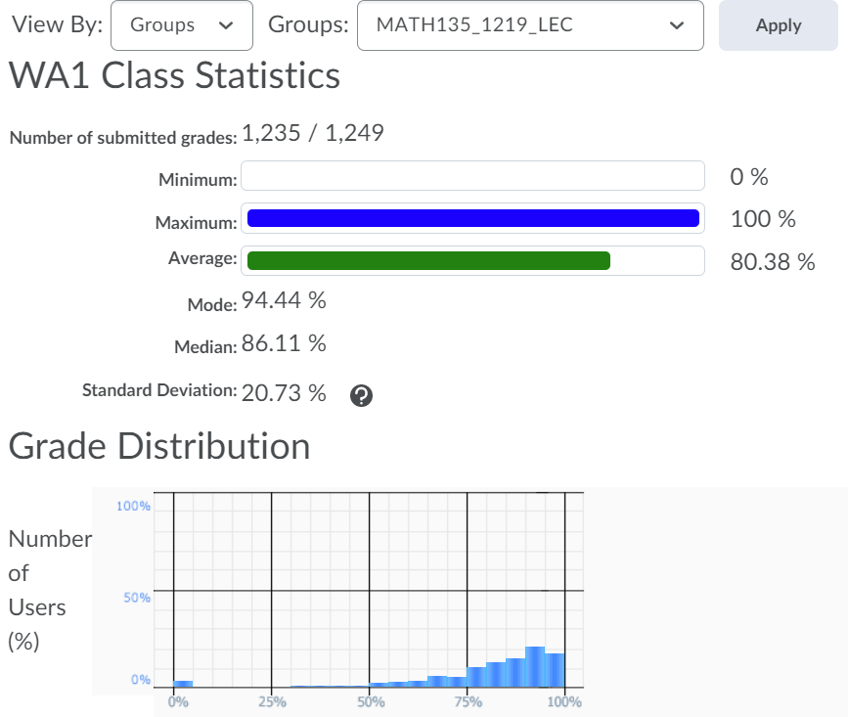

Slide 17
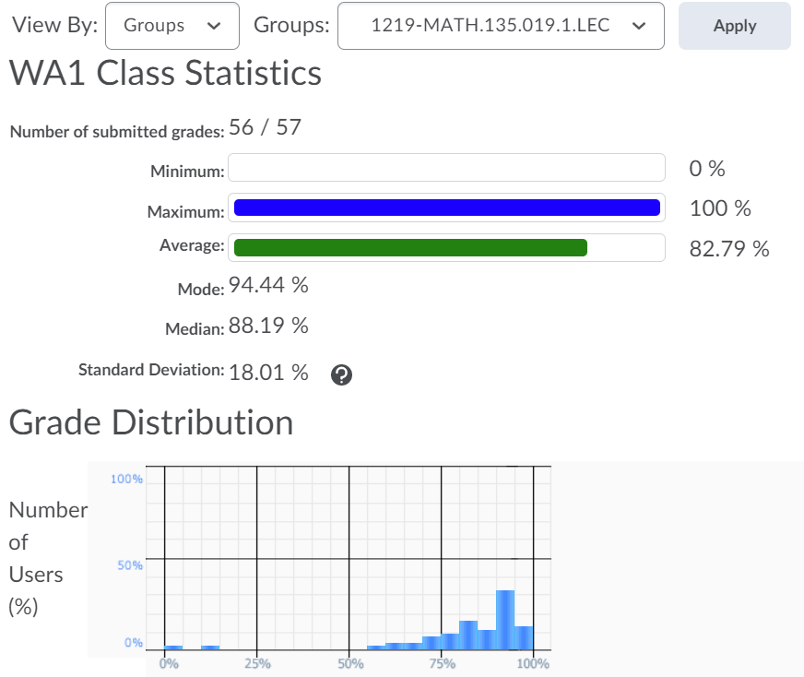
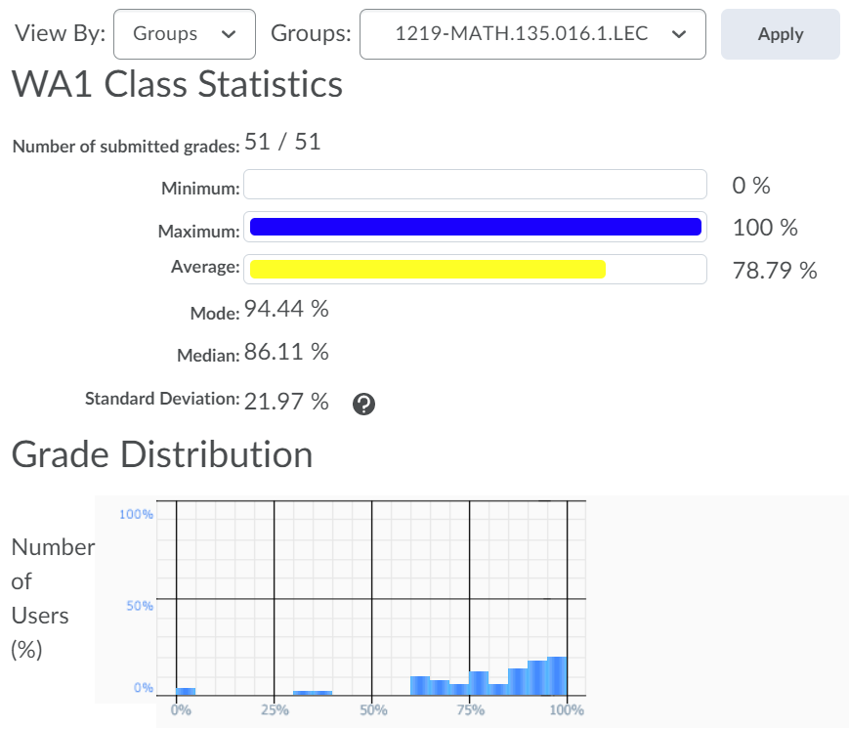

Slide 18
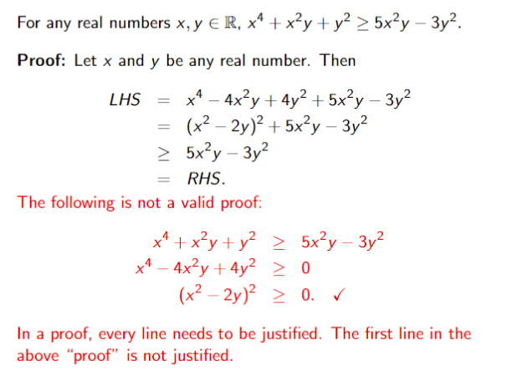

Slide 19
