Slide 1
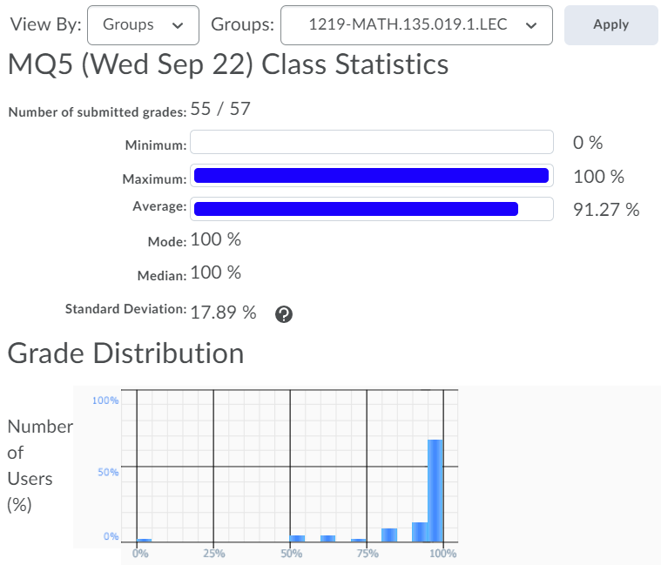
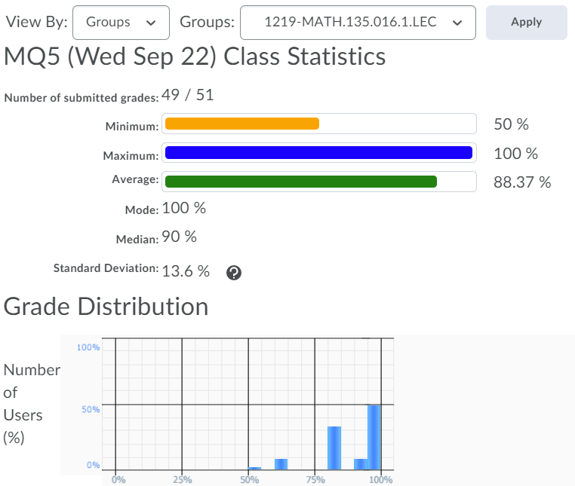
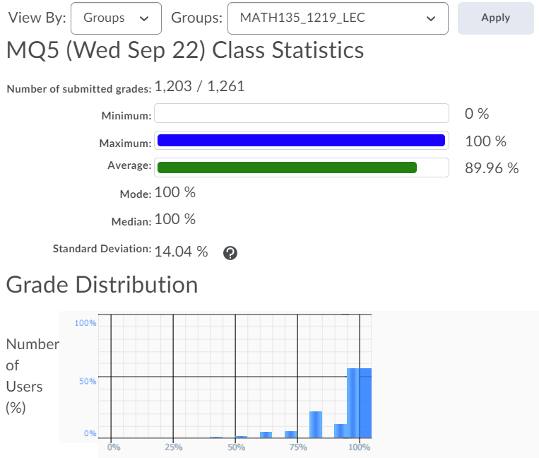

Slide 2
Friday 24 September:
Mobius Quiz 6
Sunday 26 September:
Complete reading up to the end of Section 0.3 (Polynomials)
Monday 27 September:
Mobius Quiz 7
Tuesday 28 September:
Look at your WA02 results thoroughly! Where did you lose marks?
Tuesday 28 September:
Complete reading from Chapter 3.6 up to 4.4 of the course notes. Pages 55-75.
Wednesday 29 September:
Complete Written Assignment 3: WA3
Wednesday 29 September:
Mobius Quiz 8
Thursday 30 September:
WA03 solutions will be posted, hopefully before 12pm: Check the solutions in detail!

Slide 4
Mobius quizzes are open book!

Slide 5
Don’t be afraid to get help on written assignments either!
Someone put (|x| + 1)⁰ < y, when the answer was x ≤ y
Wouldn’t have happened if you saw what others were asking at tutorial centre, office hours, Piazza, etc.
If you had to do everything entirely by yourself, then why do we offer all these resources?
If you want to challenge yourself then why not learn the whole course by yourself?

Slide 6
Office Hours: Monday/Wednesday 5-6pm in MC 4059

Slide 7
MATH 135: Lecture 8
Dr. Nike Dattani
24 September 2021

Slide 8
Before coming to UW….
How many of you have been in a math class with < 15 students?
< 20 students?
How many of you have been in a math class with < 30 students?
How many of you have been in a math class with < 40 students?
How many of you have been in a math class with 40 or more?
Now look around you, and this is half the usual MATH 135 size (COVID).
Now imagine what the next stage will be like: law school, med school? PhD?
Only 8 law schools in Ontario,
Only 6 medical schools in Ontario
The instructor to student ratio will converge to 0.
For the next 4 years, learn to read the textbook on your own!

Slide 9
Transitivity
a relates to b, b relates to c, then a relates to c.
D.I.C.
If a|b and a|c, then a|bx + cy
Is converse of D.I.C. true?
Prove it
If a|bx+cy, then a|b(1) + c(0). So a|b.

Slide 10
Converse
Contrapositive
Counter-example
Contradiction

Slide 11
Converse
Contrapositive
Counter-example
Contradiction: ( A ^ ¬A) is true

Slide 12
Converse
Contrapositive
Counter-example
Contradiction
Corollary
Conclusion
Combinations

Slide 13
Assignment 3
1a) Brute force is okay
1d) Try brute force on m, what if it starts to look like the statement is false?
negate and prove that negation is true.
∀n in Z, ¬A V ¬B.
Case 1: ¬A true.
Case 2: m² – 5 is even => ¬B true.

Slide 14
Assignment 3
For many cases:
½ the marks are for correct answer,
½ for correct argument
(even for 1-pont questions)

Slide 15
Q2a)
∀ x ϵ ℝ, P => Q V R
Case 1: Assume P=>Q is true. Then statement is true in this case.
Case 2: Assume P=>Q is false. Then R turns out implied by P.
b) Converse?
∀ x ϵ ℝ, Q V R => P

Slide 16
Q2a)
∀ x ϵ ℝ, P => Q V R
Case 1: Assume P=>Q is true. Then statement is true in this case.
Case 2: Assume P=>Q is false. Then R turns out implied by P.
b) Converse?
∀ x ϵ ℝ, Q V R => P (quantifier doesn’t change!)
c) Case 1: Assume Q. Does it imply P?
Case 2: Assume R. Does it imply P?

Slide 17
Q3)
∀ a,b ϵ ℕ , A ^ B => C V D
Converse?
∀ a,b ϵ ℕ , C V D => A ^ B
Quantifier stays same!
List all methods you use (e.g. Transitivity, D.I.C., contrapositive, etc.)

Slide 18
Q4) If it’s false:
give a correct counter-example, and explain why counter-example is correct
If it’s true:
prove it, using words!
e.g. prove c is even, then prove a and b have same parity

Slide 19
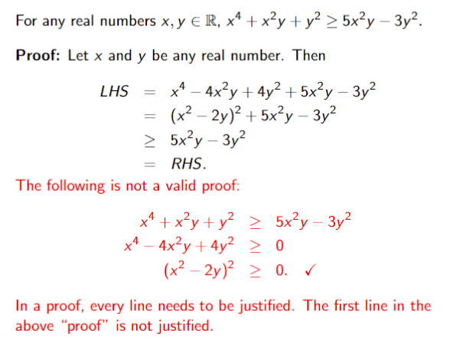

Slide 20
