Slide 1
Warm up!
Prove n! + 3 is not prime (n ≥ 3).
Prove that for every prime k,
We can find k consecutive non-primes.
What do you notice?

Slide 2
Objectives
Results from Monday’s survey
Warm-up (number theory proof)
Warm-up (GCD proof)
Motivation
Very fun modular arithmetic proof
What do you notice?

Slide 3
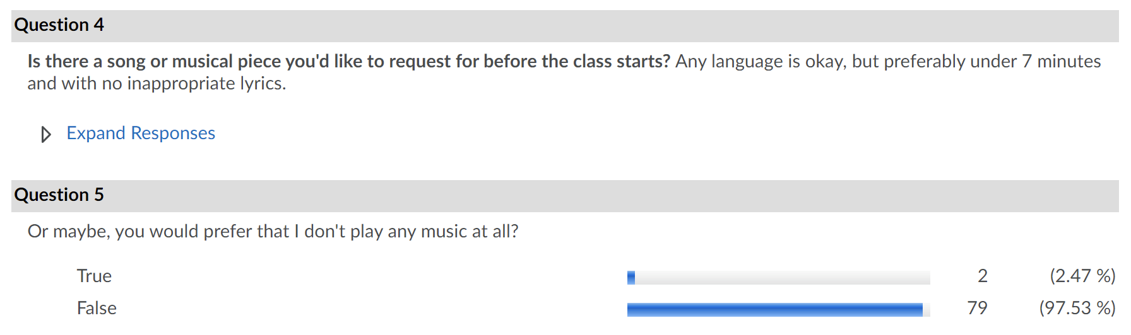
Results from survey

Slide 4
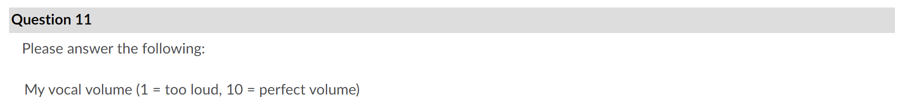
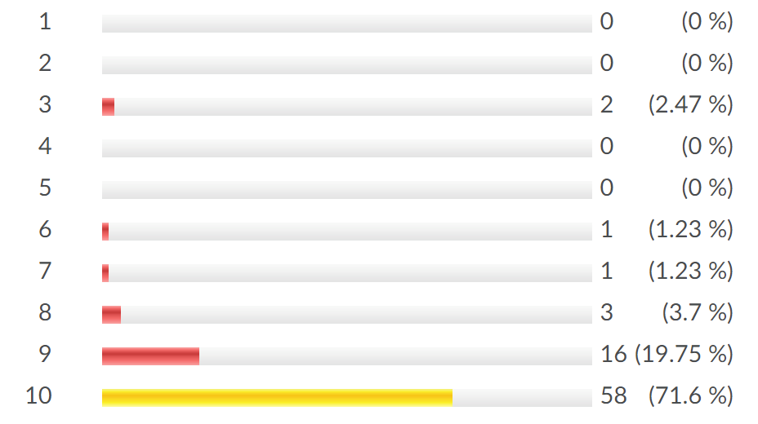

Slide 5
Warm up!
Prove n! + 3 is not prime (n ≥ 3).
Prove that for every prime k,
We can find k consecutive non-primes.
What do you notice?

Slide 6
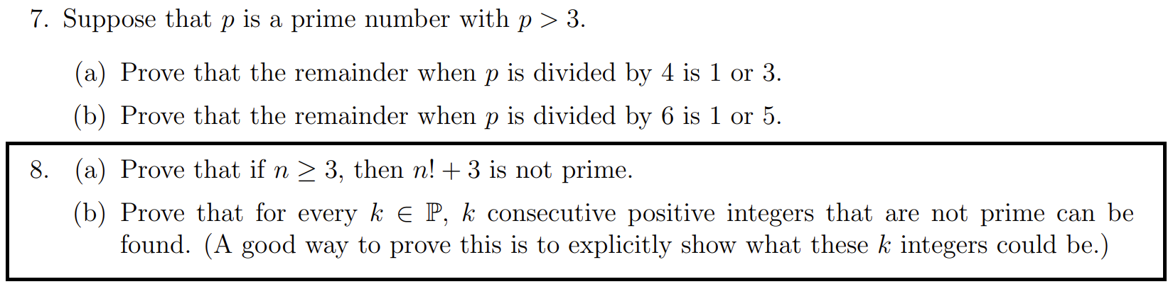
This was a MATH 135 question, from Fall 2007:

Slide 7
Prove n! + 3 is not prime (n ≥ 3).
If n! + 3 is not prime,
can you tell me a factor apart from 1 or itself ?
Try the smallest possible prime factor:
Does 2 | n! + 3 ?
What do you notice?

Slide 8

Prove n! + 3 is not prime (n ≥ 3).
If n! + 3 is not prime,
can you tell me a factor apart from 1 or itself ?
Try the smallest possible prime factor:
Does 2 | n! + 3 ? ✘ n! is even, n! +3 is odd!
Does 3 | n! + 3 ?
∴ n! + 3 = 3$\left(\frac{n!}{3}+1\right)$ , $\frac{n!}{3}$ ≥ 2 , $\frac{n!}{3}$ + 1 ≥ 3
What do you notice?

Slide 9

Prove n! + 3 is not prime (n ≥ 3).
If n! + 3 is not prime,
can you tell me a factor apart from 1 or itself ?
Try the smallest possible prime factor:
Does 2 | n! + 3 ? ✘ n! is even, n! +3 is odd!
Does 3 | n! + 3 ? ✓ 3 | n! AND 3 | 3 => 3 | n! + 3
∴ n! + 3 = 3$\left(\frac{n!}{3}+1\right)$ , $\frac{n!}{3}$ ≥ 2 , $\frac{n!}{3}$ + 1 ≥ 3
What do you notice?

Slide 10
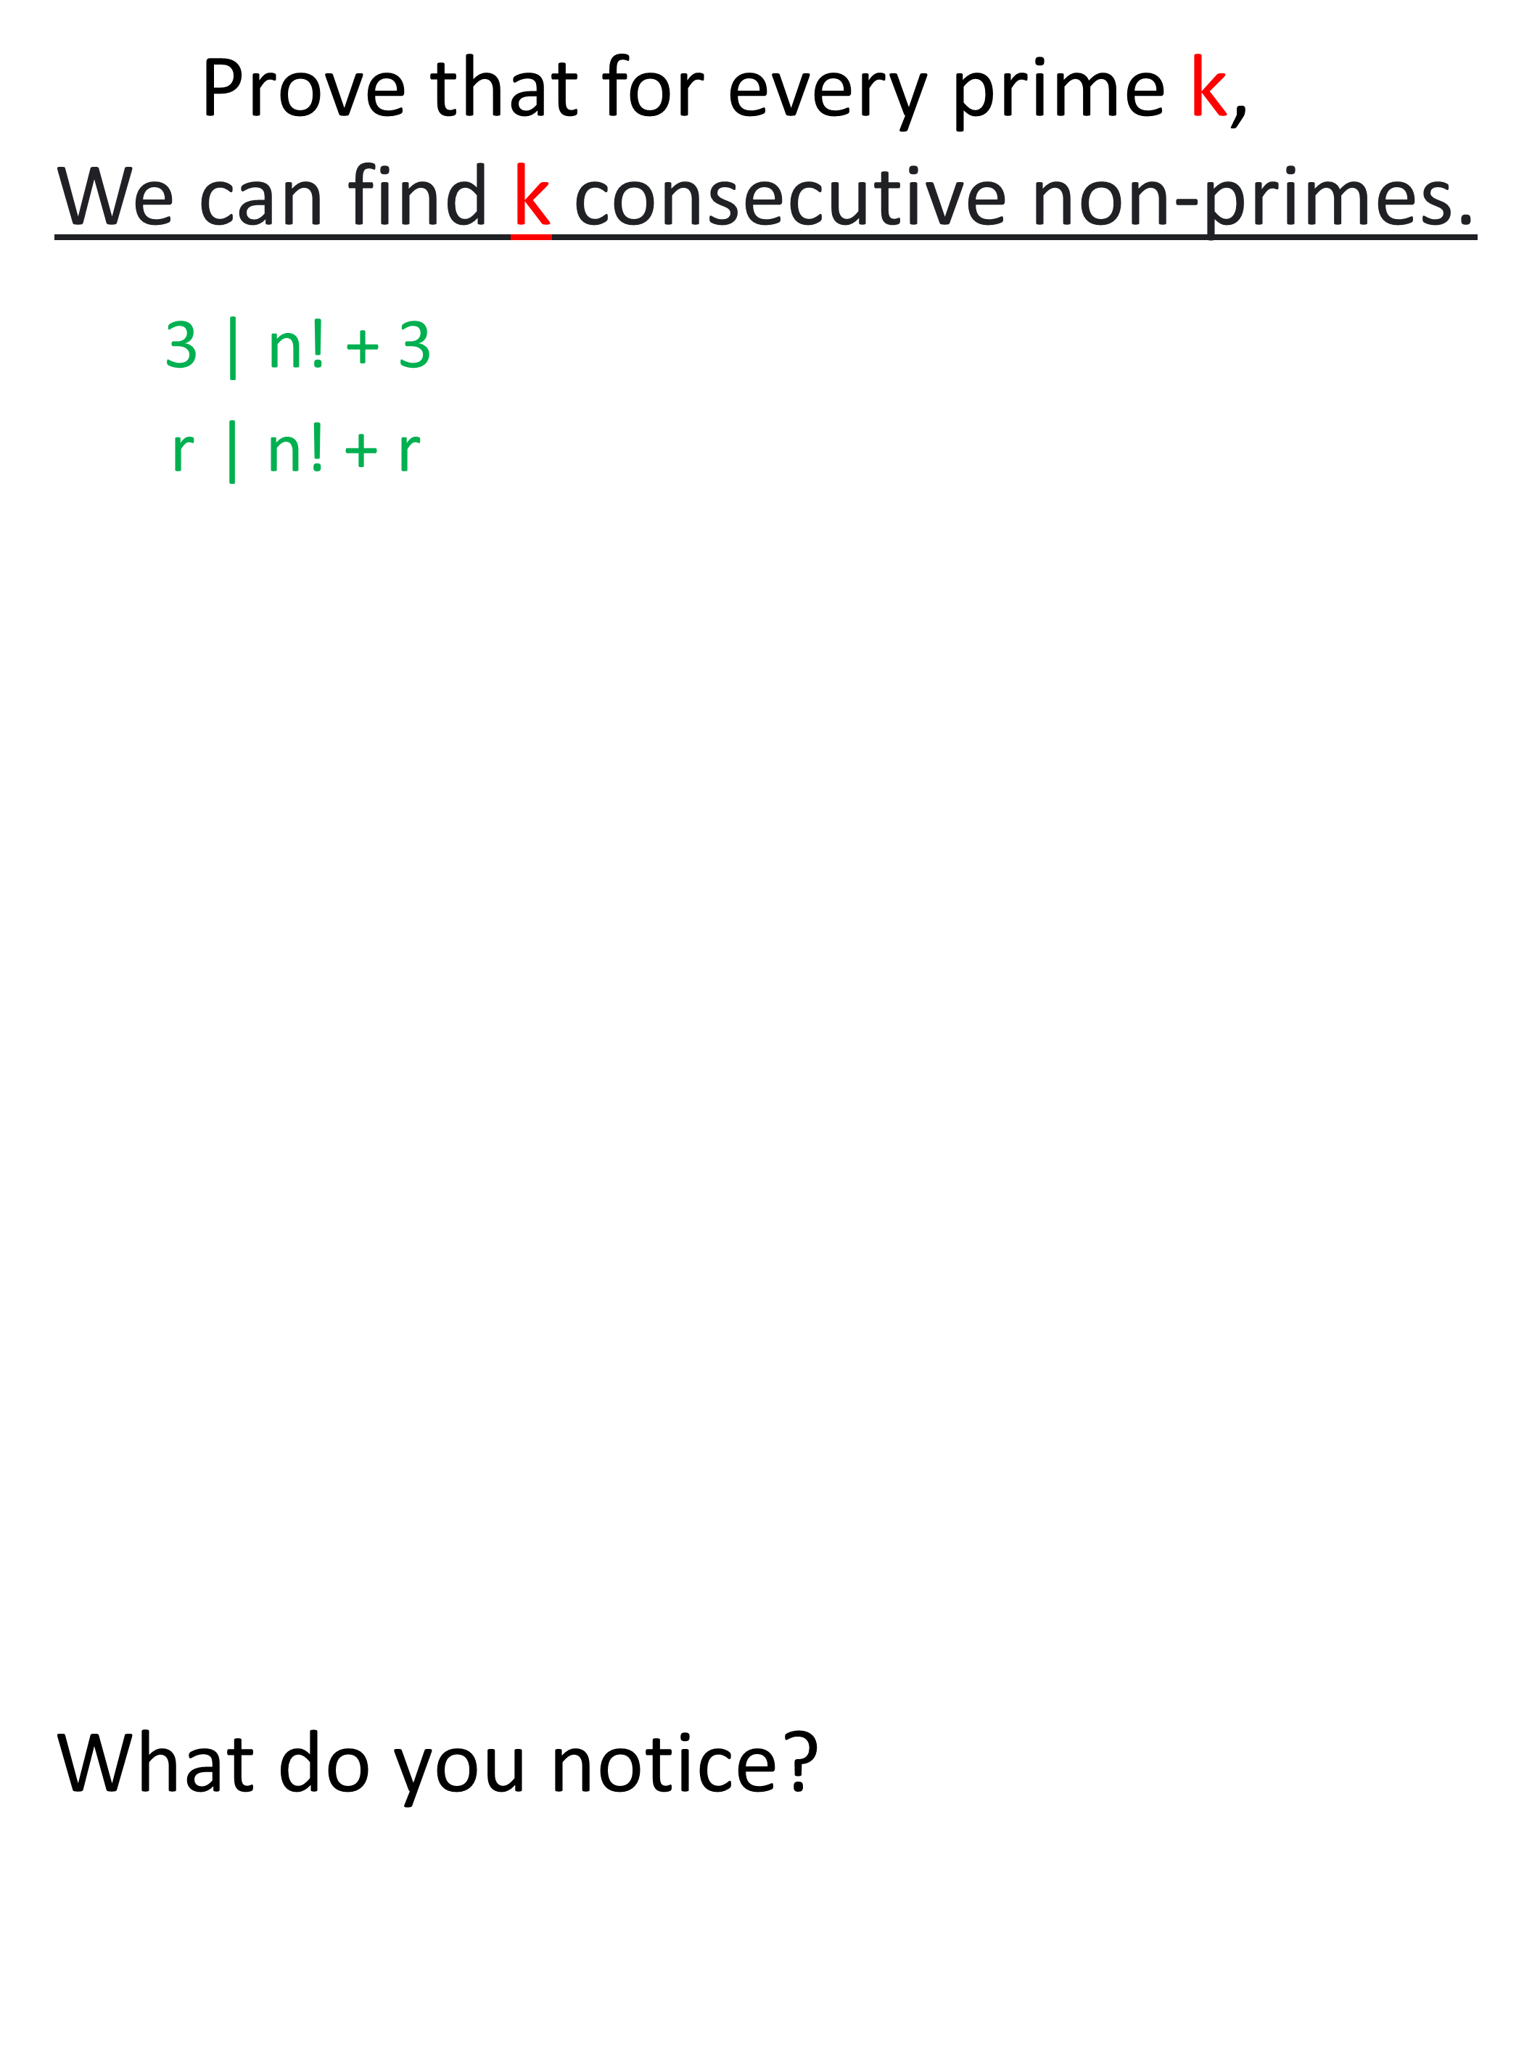
Prove that for every prime k,
We can find k consecutive non-primes.
3 | n! + 3
r | n! + r
∴ n! + 3 = 3$\left(\frac{n!}{3}+1\right)$ , $\frac{n!}{3}$ ≥ 2 , $\frac{n!}{3}$ + 1 ≥ 3
What do you notice?

Slide 11
Prove that for every prime k,
We can find k consecutive non-primes.
3 | n! + 3 3 | n! AND 3 | 3 => 3 | n! + 3
r | n! + r r | n! AND r | r => r | n! + r
k consecutive non-primes (n = k+1):
(k+1)! + 2 , (k+1)! + 3 , (k+1)! + 4 , … , (k+1)! + k+1
What do you notice?

Slide 12
Prove that for every prime k,
We can find k consecutive non-primes.
3 | n! + 3 3 | n! AND 3 | 3 => 3 | n! + 3
r | n! + r r | n! AND r | r => r | r! + r
k consecutive non-primes:
(k+1)! + 2 , (k+1)! + 3 , (k+1)! + 4 , … , (k+1)! + k+1
Divisible by r=2
Divisible by r=3
Divisible by r=k+1

Slide 13
Prove that for every prime k,
We can find k consecutive non-primes.
k consecutive non-primes:
(k+1)! + 2 , (k+1)! + 3 , (k+1)! + 4 , … , (k+1)! + k+1
k = 2. Consecutive nonprimes: 3! + 2, 3! + 3 (8,9)
k = 3. Consecutive nonprimes: 4! + 2, 4! + 3, 4! + 4 (26,27,28)
k = 5. Consecutive nonprimes: 6! + 2, 6! + 3, …, 6! + 6 (722, 723, 724, 725, 726)
723 = 3 x 241

Slide 14
For number theory proofs:
there’s no step-by-step procedure that always works,
like “product rule” in calculus
“O King, for traveling over the country there are royal roads and roads for common citizens; but in geometry there is one road for all”
Alexander the Great was told this when he asked Menaechmus for a shortcut to learning geometry (circa 330 BC).
No short-cut: practice proofs and you will get better!

Slide 15
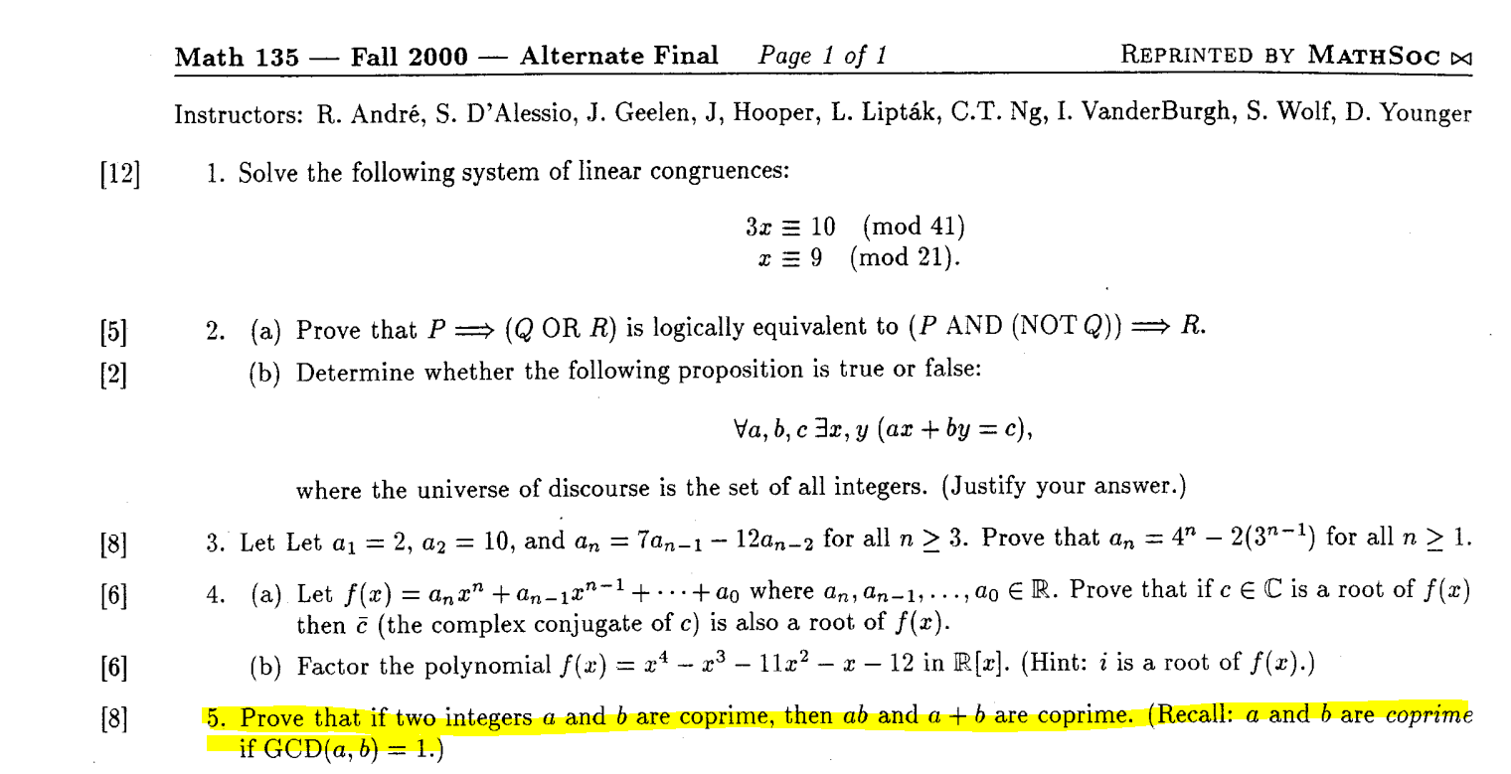
Warm up!
What do you notice?

Slide 16
Warm up!
Prove:
If gcd(a,b)=1 then gcd(a+b,ab) = 1
What do you notice?

Slide 17
Strategy
Bézout Identity: Good when GCD is in hypothesis
GCD WR: Good when terms in GCD depend on each other
GCD CT: Good when GCD is in conclusion
Definition of GCD: Good when nothing else seems to work
GCDPF: Good when you’re desperate

Slide 18
If gcd(a,b)=1 then:
ax + by = 1 (Bézout Identity)
(ax)² + (by)² + 2abxy = 1 (square both sides)
What do we need, to prove that gcd(ab,a+b)=1 ?
CCT: gcd(a+b,ab)=1 iff (a+b)p + (ab)q = 1
(a + b)(x²a + y²b) + ab(2xy – x² –y²) = 1
What do you notice?

Slide 19
Motivation!
We have proven:
gcd(22a + 7,3a +1) = 1
gcd(a,b) = 1 ⇒ gcd(ab,a+b) = 1
gcd(a,b) = 1 ⇒ gcd(an+u, bn+v) = 1
a | 2b + c ⇒ (a ∤ b -2d) ∨ (a | c + 4d)
What do you notice?

Slide 20
In calculus the motivation is clear:
Optimize profit based on revenue and cost functions
Rate of change:
How much deceleration,
does the self-driving car need, to stop before stop sign
Rate of change of COVID growth

Slide 21
Can you see why we care about whether or not:
a|2b+gcd(u,v) ⇒ (a∤b -2 gcd(e,f)) ∨ (a|gcd(u,v) + 4gcd(e,f)) ?

Slide 22
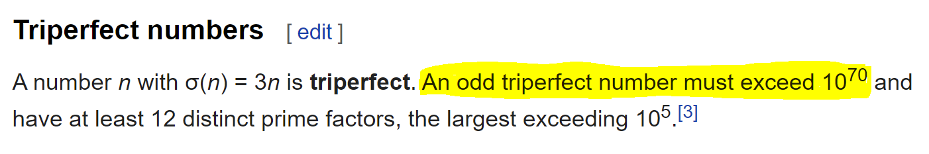
When I was an undergrad,
a friend was doing a research project with title:
“Are there any odd triperfect numbers?”
Triperfect: Sum of all divisors of N is 3N.

Slide 23
Why do we care whether or not n! +3 is prime?
Whether or not numbers with certain
properties exist, is at the heart of cryptography!
If I have pictures of me that I don’t want you to see,
or I’m sending a private message to a family member:
I encode it with secret code,
so you have to solve a puzzle to read the message.
My computers have the puzzle pieces, yours don’t!

Slide 24
Chapter 9 will be about RSA cryptography
But we have to teach you Chapter 8 first

Slide 25
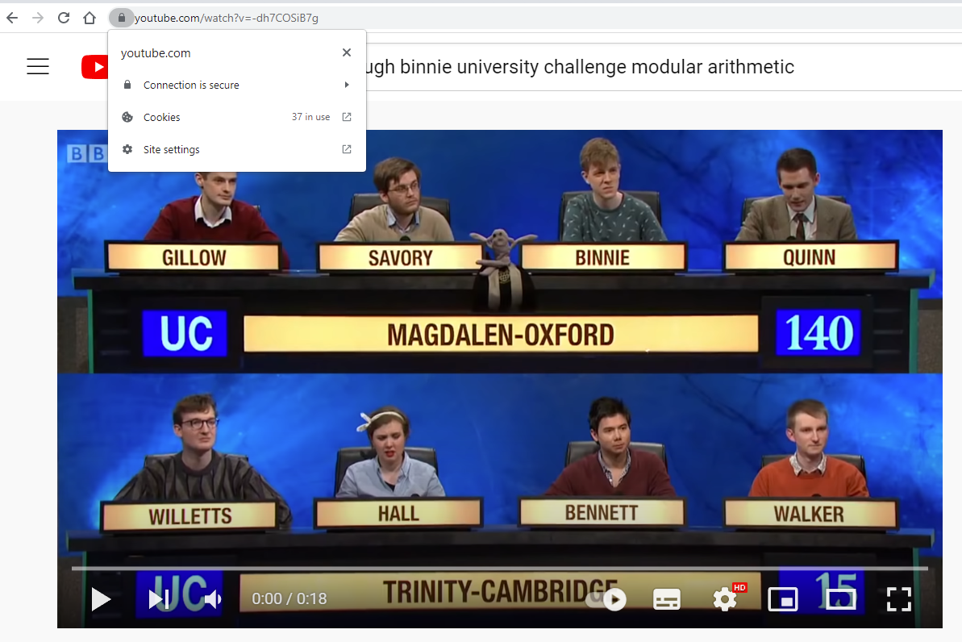
RSA cryptography is everywhere
For example, everytime you visit Youtube

Slide 26
CO 485: Mathematics of Cryptography
Requires: PMATH 334, 336, 346, or 347
Requires: MATH 235
Requires: MATH 136
Requires: MATH 135
CO 487: Applied Cryptography
Requires: MATH 135 + STAT 230 or 240

Slide 27
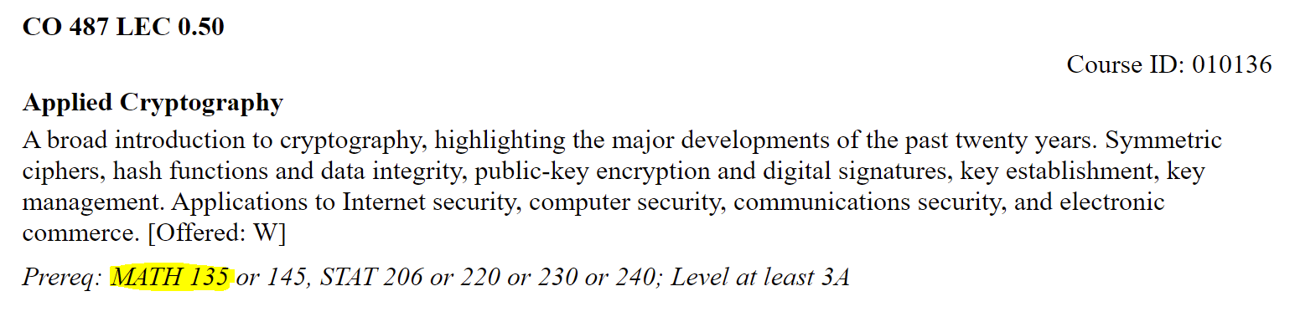
CO 485: Mathematics of Cryptography
Requires: PMATH 334, 336, 346, or 347
Requires: MATH 235
Requires: MATH 136
Requires: MATH 135
CO 487: Applied Cryptography
Requires: MATH 135 + STAT 230 or 240

Slide 28
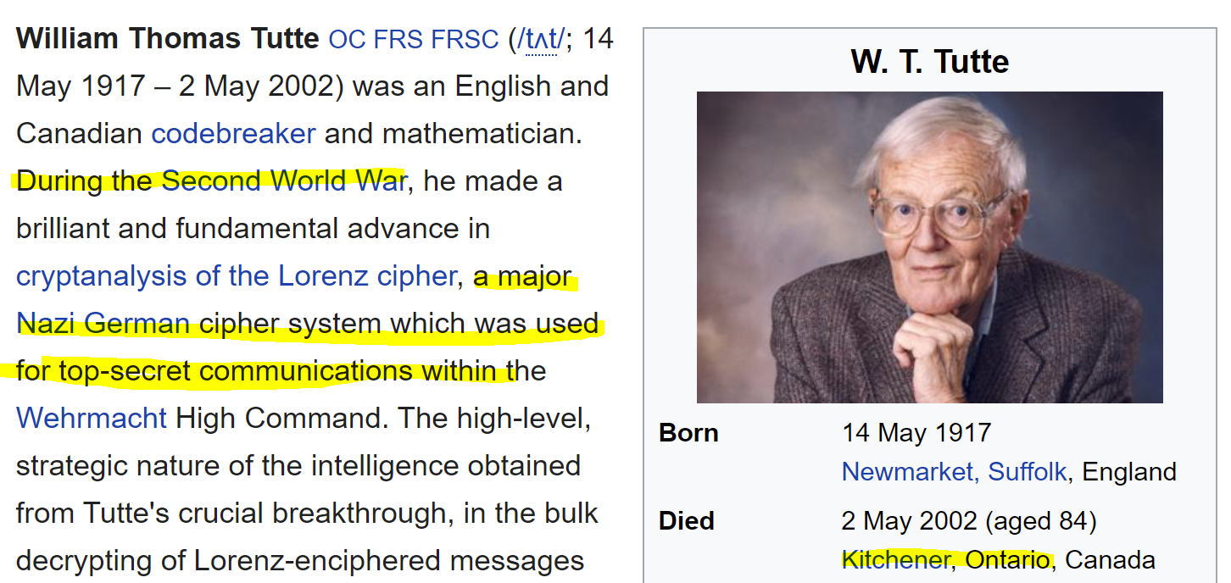
CO 485: Mathematics of Cryptography
Requires: PMATH 334, 336, 346, or 347
Requires: MATH 235
Requires: MATH 136
Requires: MATH 135
CO 487: Applied Cryptography
Requires: MATH 135 + STAT 230 or 240

Slide 29
Also, something that the course notes won’t tell you,
These gcd theorems are at the heart of algorithms that allow computers to do FAST computations.
CS 487: Introduction to symbolic computation
Requires: CS 234 or CS 240
Requires: MATH 136
Requires: MATH 135

Slide 30
18 second video:
Former student of mine I taught at Oxford University
Host: How did you know that?
Hugh Binnie: “Modular arithmetic”

Slide 31
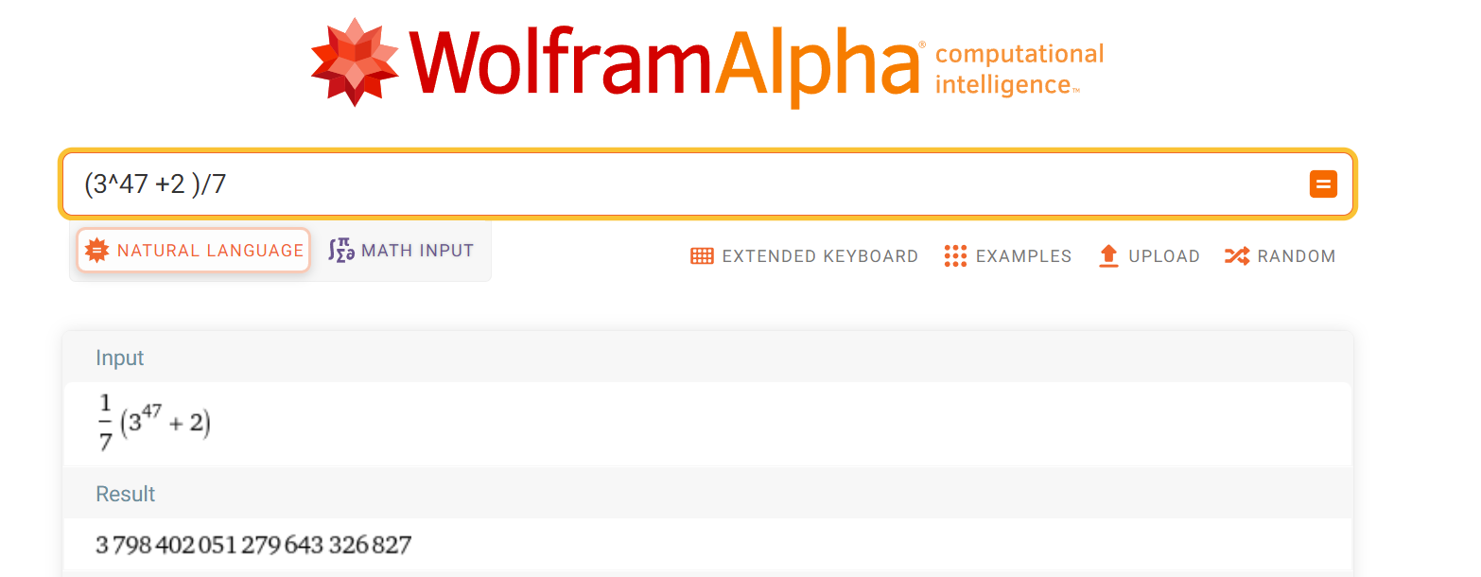

28 ≡ 0 (mod 7)
28 -1 ≡ -1 (mod 7)
27 ≡ -1 (mod 7)
3⁴⁷ ≡ ? (mod 7)
≡ $3^{2}3^{45}$ (mod 7)
≡ $3^{2}{\left(3^{3}\right)}^{15}$ (mod 7)
≡ $9{\left(27\right)}^{15}$ (mod 7)
≡ $2{\left(−1\right)}^{15}$(mod 7)
≡ $−2$ (mod 7)
3⁴⁷ + 2 ≡ 0 (mod 7). 7 | 3⁴⁷ + 2

Slide 32
2²²3³³5⁵⁵ (mod 11)

Slide 33
Thank you!

Slide 34
Wednesday 3 November:
Regrade requests for midterm (due 3 Nov)
Wednesday 3 November:
Submit Written Assignment 6: WA6
Thursday 4 November:
Read Chapters 6.7 – 7.2 (pg. 110 – 121) and 0.5 of Polynomials
Chapter 8 (hardest chapter in MATH 135, relies on pgs. 110-121)
Thursday 4 November:
Start WA07 (covers Pages 110-121).

Slide 35
MATH 135: Lecture 23
Dr. Nike Dattani
3 November 2021

Slide 36
Less time on MATH 137 (60% needed in 135)
TutorConnect: if no one replied, what to do
Jason D’Souza apology

