Slide 1
Warm up!
Let m = 3 be a modulus.
By combining set notation and congruence classes,
Express the set of all integers, ℤ.
Express the empty set ∅.

Slide 2
Reminder!
We never defined division for congruence classes.
[ a / b ] is not recommended!
[ a ] / [ b ] is not recommended!

Slide 3
MATH 135: Lecture 26
Dr. Nike Dattani
12 November 2021

Slide 4
Friday 12 November:
Moebius quiz tonight! (covers up to middle of page 121)
Friday 12 November:
Look at WA08 (covers up to end of pg 133) and solutions to WA07
Reading: Up to end of Chapter 8.
Moebius quizzes seem to have covered things out of order
Knowing Fl T, CRT and “Splitting mod” can help you on quizzes
Wednesday 17 November:
Submit Written Assignment 8: WA8 (covers up to page 133)

Slide 5
Objectives
F l T
CRT

Slide 6
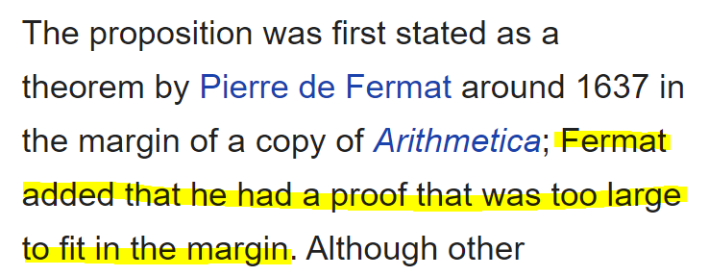
FLT: Fermat’s Last Theorem

Slide 7
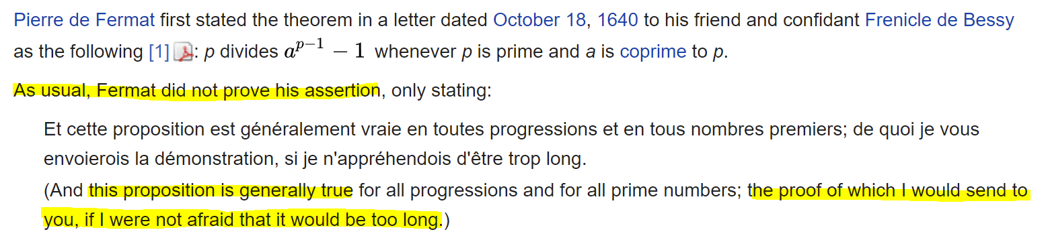
F l T: Fermat’s Little Theorem
Euler gave the first published proof (1736)
Leibniz gave the same proof as Euler in an unpublished paper (before 1683)

Slide 8
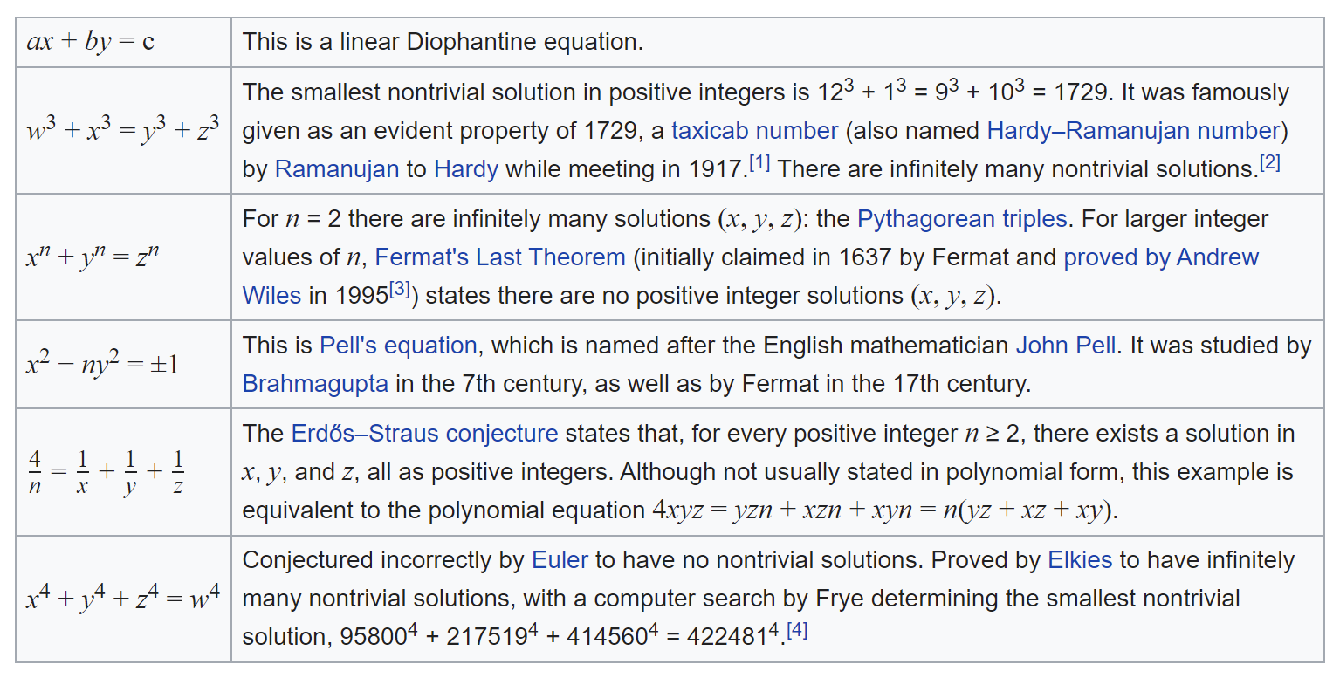
F l T: Fermat’s Little Theorem

Slide 9
F l T
∀ p ∈ ℙ, if p ∤ a, then a^{p-1} ≡ 1 (mod p)
Be careful! p must be prime!
2⁴⁻¹ ≡ ? (mod 4)
Be careful! p must not divide a!
49⁷⁻¹ ≡ ? (mod 7)

Slide 10
F l T
∀ p ∈ ℙ, if p ∤ a, then a^{p-1} ≡ 1 (mod p)
Corollaries
∀ p ∈ ℙ, if p ∤ a, then a^{p} ≡ a (mod p)
If p ∤ a, multiply both sides of Fl T by a.
If p | a, a^{p} ≡ a ≡ 0 (mod p)

Slide 11
F l T
∀ p ∈ ℙ, if p ∤ a, then a^{p-1} ≡ 1 (mod p)
Corollaries
∀ p ∈ ℙ, if p ∤ a, then a^{p} ≡ a (mod p)
∀ p ∈ ℙ, if [a] ≠ [0] in ℤ_{p}, [a]⁻¹ = [a^{p-2}]
∀ p ∈ ℙ, if p ∤ a and r ≡ s (mod p-1), a^{r} ≡ a^{s} (mod p)
∀ p ∈ ℙ, if r = s +kp, a^{r} ≡ a^{s+k} (mod p)

Slide 12
Practice!
What day of the week will it be 3³⁰² days from now?
Answer: 302 ≡ 2 (mod 6), 3³⁰² ≡ 3² ≡ 9 ≡ 2 (mod 7)
Compute 0 ≤ M < 3 such that M ≡ 35¹³ (mod 3)
Skipped since WA08 and final don’t need it

Slide 13
Practice!
Determine all solutions to x⁶¹ + 26 x⁴¹ +11 x²⁵ + 20 ≡ 30 (mod 3).
x³ ≡ x (mod 3), ∀ x ∈ ℤ (Corollary to Fl T)
x^{3∙20+1} + 26 x^{3∙13+2} + 11 x^{3∙8+1} + 20 ≡ 30 (mod 3)
x^{3∙20}x + 26 x^{3∙13}x² + 11 x^{3∙8}x + 20 ≡ 30 (mod 3)
x²⁰x + 26 x¹³x² + 11 x⁸x + 20 ≡ 30 (mod 3)
x²¹ + 26 x¹⁵ + 11 x⁹ + 20 ≡ 30 (mod 3)
x⁷ + 26 x⁵ + 11 x + 20 ≡ 30 (mod 3)
x + 26 x + 11 x + 20 ≡ 30 (mod 3)
38 x + 20 ≡ 30 (mod 3)

Slide 14
Chinese Remainder Theorem
有物不知其数，三三数之剩二，
五五数之剩三，七七数之剩二。问物几何？
There’s an unknown number x,
when counted in 3s we have 2 left over,
when counted in 5s we have 3 left over,
when counted in 7s we have 2 left over,
what is the number?

Slide 15
CRT
Problem 26, Volume 3 of:
孫子 (Sun Zi) 算經 (Mathematics Manual)
In China, it’s called:
孙子定理 (Sun Zi Theorem), or
中国剩余定理 (Chinese Remainder Theorem)
孫子兵法 (Art of War): 430-500 BC
孫子算經: 200-400 AD (~765 years difference!)

Slide 16
CRT
Sun Zi explained how to solve the problem. He noticed:
70 ≡ 1 (mod 3) ≡ 0 (mod 5) ≡ 0 (mod 7)
21 ≡ 1 (mod 5) ≡ 0 (mod 3) ≡ 0 (mod 7)
15 ≡ 1 (mod 7) ≡ 0 (mod 3) ≡ 0 (mod 5)
∴ x = 2(70) + 3(21) + 2(15) = 233 solves the problem.
Any multiple of 105 (3 x 7 x 5) is divisible by 3, 5, and 7,
∴ 233 – 2(105) = 23 is the smallest positive answer.

Slide 17
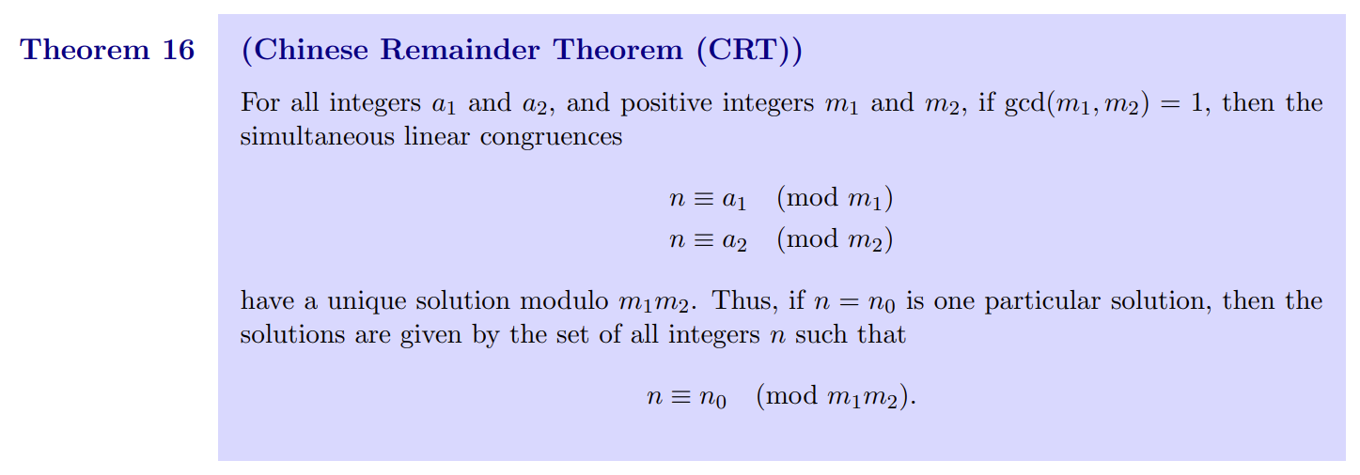
CRT

Slide 18

x = 20n + 12
(20n + 12) ≡ 11 (mod 39)
20n ≡ -1 (mod 39)
20n = 39y - 1
1 = 39y -20n [now solve the Diophantine eqn]

Slide 19
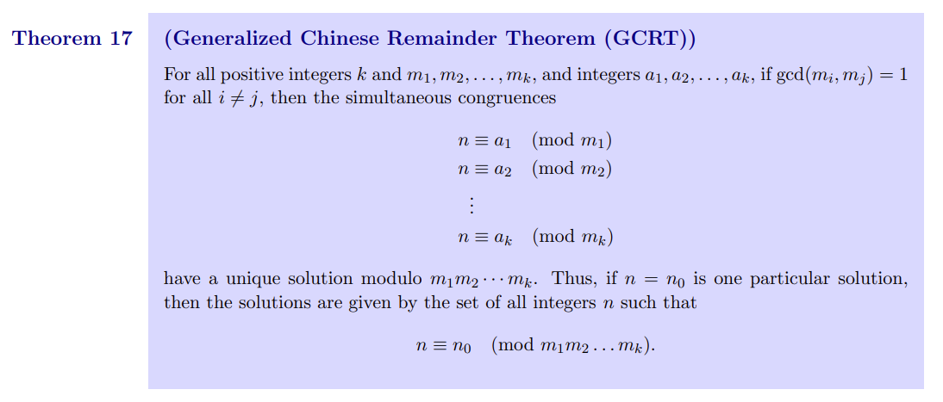

Slide 20
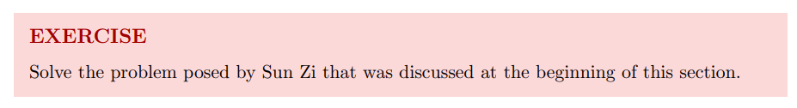
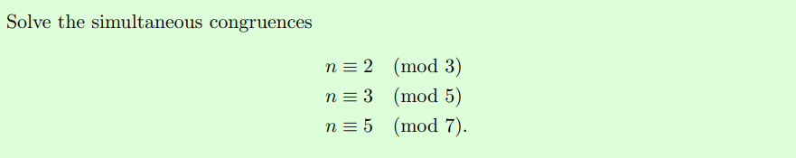

Slide 21
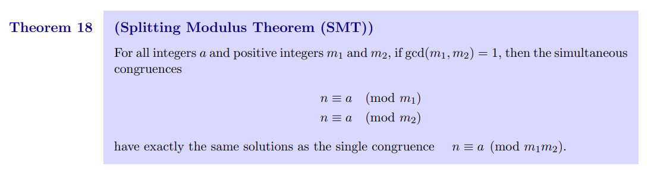
Splitting Modulus Theorem (SMT)
“Inverse Chinese Remainder Theorem”
(Do not actually call it that on the exam)

Slide 22
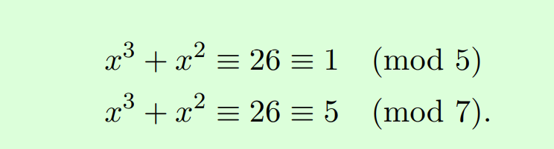
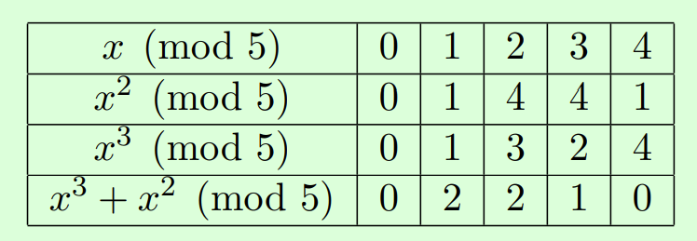
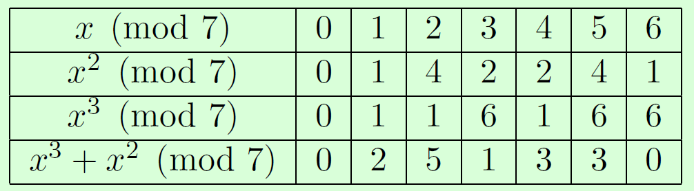
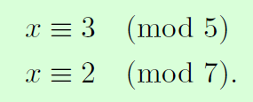

Slide 23
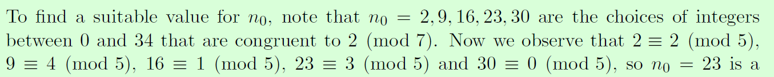


Slide 24
Thank you!

Slide 25
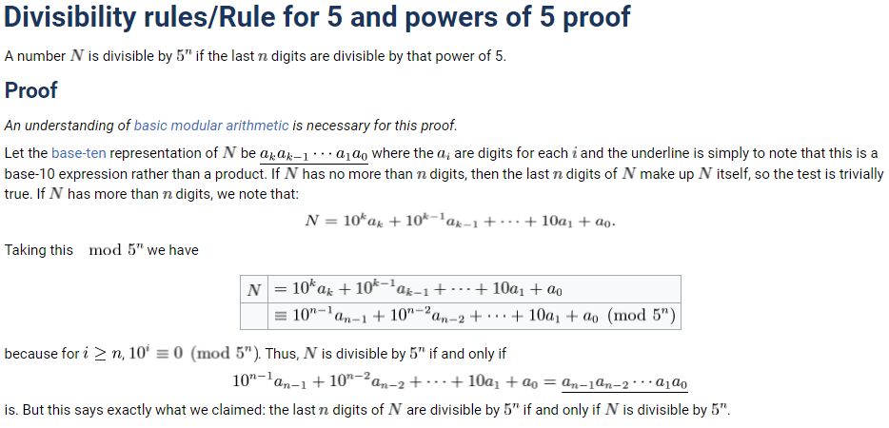
Assignment Tips:
Q2) If false: try to find a valid counter-example
Q3)

Slide 26
Assignment Tips:
Q4b) If and only if:
1 mark for <= direction
2 marks for => direction
Q5) Strawwng Induction
1 mark for setting it up properly
“Let k ∈ N be arbitrary. Assume… for 1<= r <=k
Prove for irreducible case (easy),
and reducible case (harder)

Slide 27
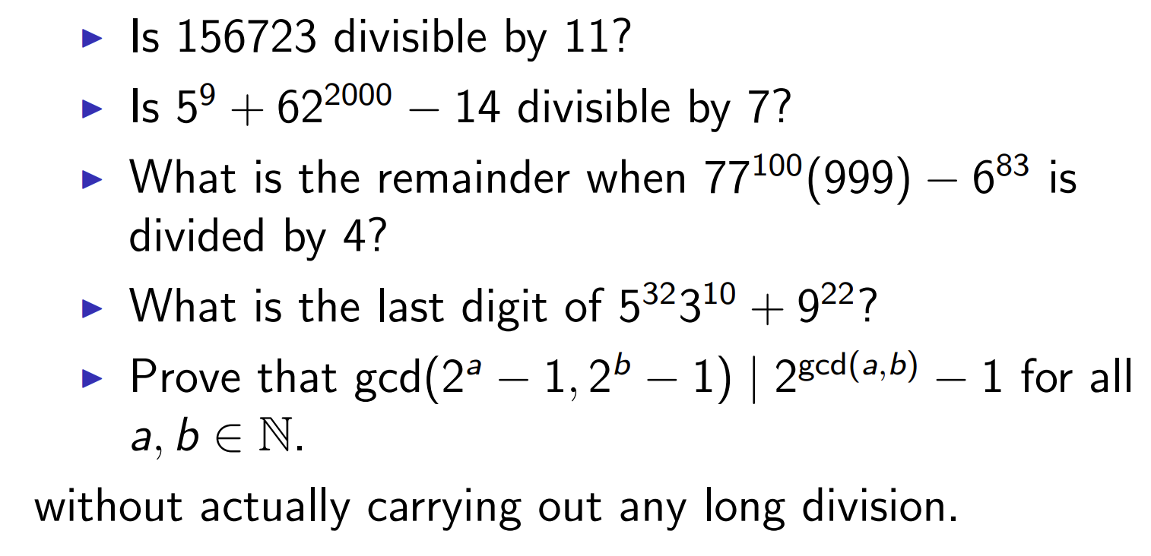
_{Extra practice:}

Slide 28
Tutor connect, if no one replied, what to do.
Jason D’Souza apology
Laith: EEA
Survey results: overall satisfaction (academia.SE page)
Survey: course notes (add that you can look at Jerry’s)
Maybe Example 2 of Chapter 8
Youtube channel

Slide 29
The following pages are intentionally left blank, for writing notes from the tablet.

