Slide 1
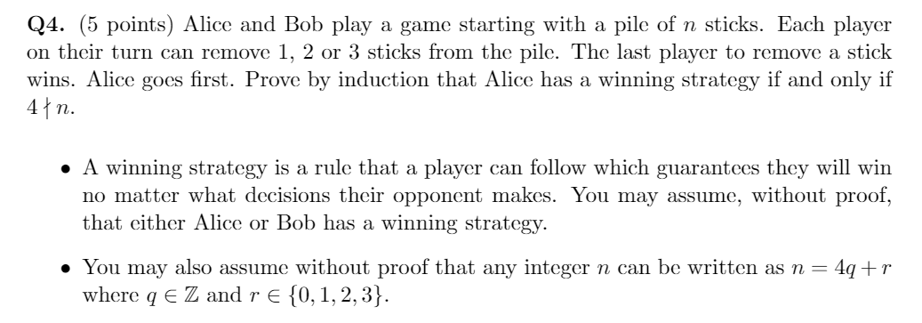
Assignment 4:

Slide 2
MATH 135: Lecture 10
Dr. Nike Dattani
29 September 2021

Slide 3
Tuesday 28 September:
Look at your WA02 results thoroughly! Where did you lose marks?
Wednesday 29 September:
Complete Written Assignment 3: WA3
Wednesday 29 September:
Mobius Quiz 8
Thursday 30 September:
Look at WA4 !!!
Thursday 30 September:
WA03 solutions will be posted, hopefully before 12pm: Check the solutions in detail!
Thursday 30 September:
Complete reading from Chapter 3.6 up to 5 of the course notes. Pages 55-81.
Friday 1 October:
Mobius Quiz 9
Sunday 3 October:
You’ll need to know more before 0.4 (Polynomials), so use this time to review Pages 55-81, and do practice problems!
Monday 4 October:
Mobius Quiz 10

Slide 4
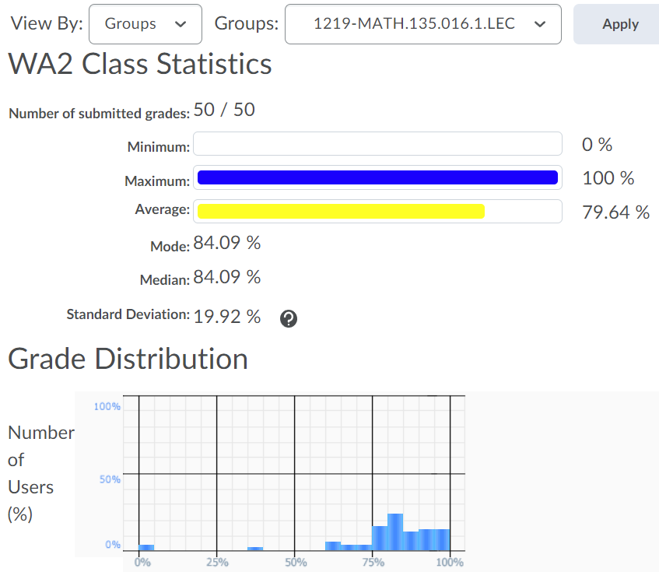
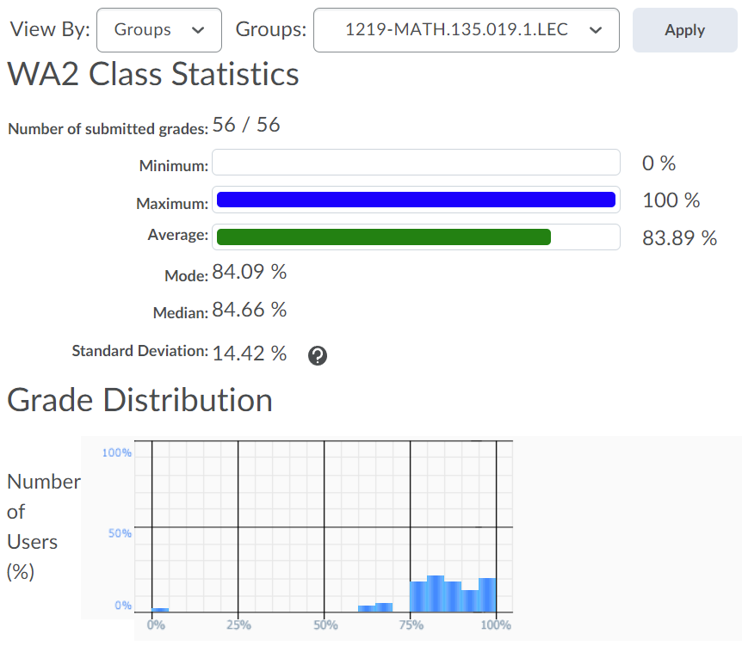


Slide 5
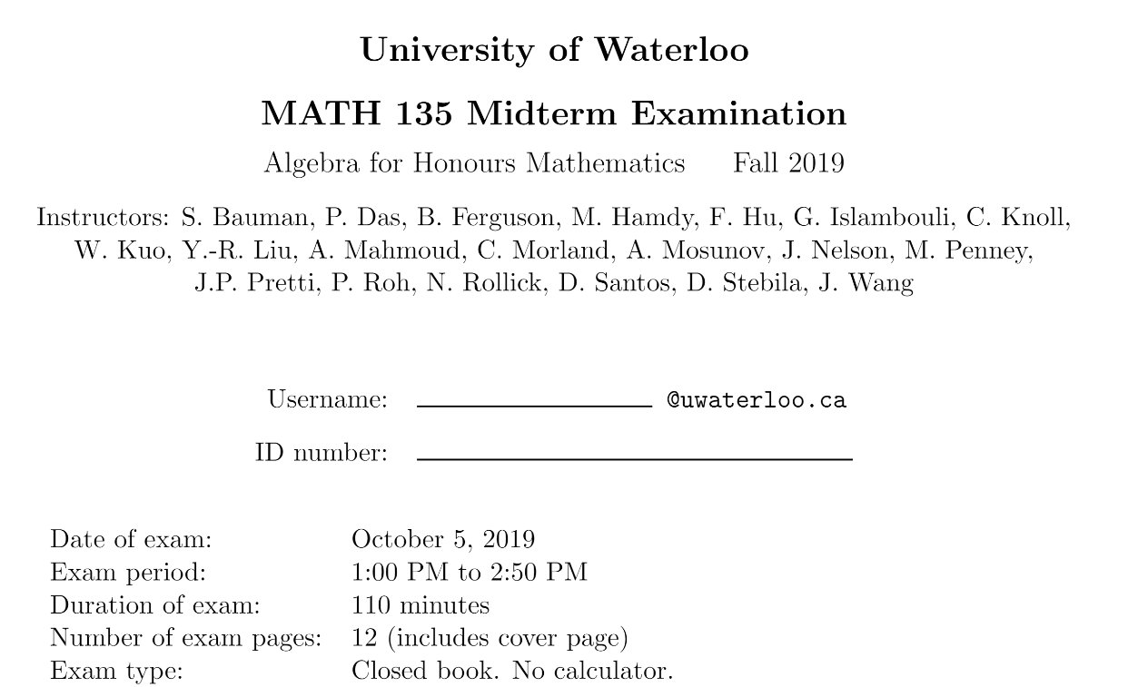

Slide 6
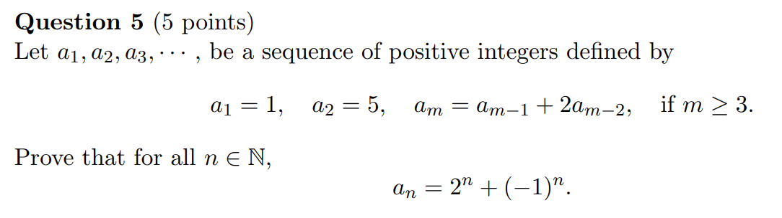
Midterm Exam, Fall 2019

Slide 7
Midterm Exam, Fall 2019
Who here has done induction before? Why or why not?

Slide 8
Midterm Exam, Fall 2019
Who here has done induction before? Why or why not?
(take note of who hasn’t done induction before)

Slide 9
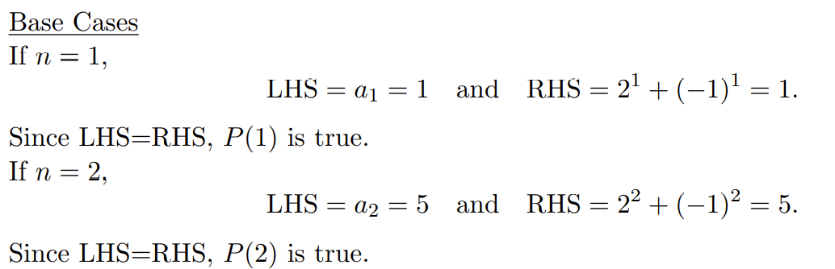
Midterm Exam, Fall 2019

Slide 10
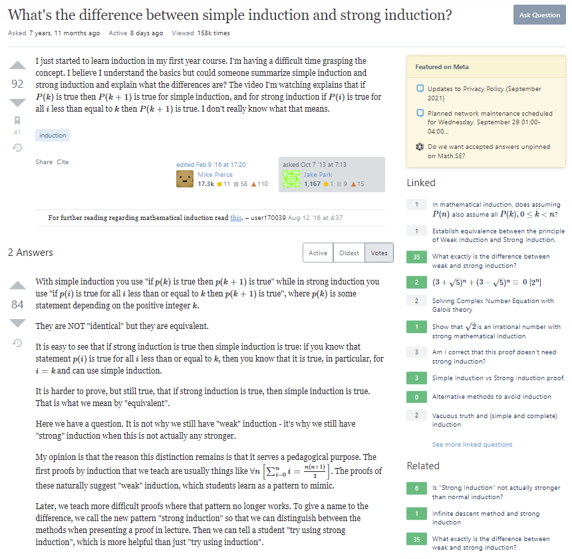

Slide 11
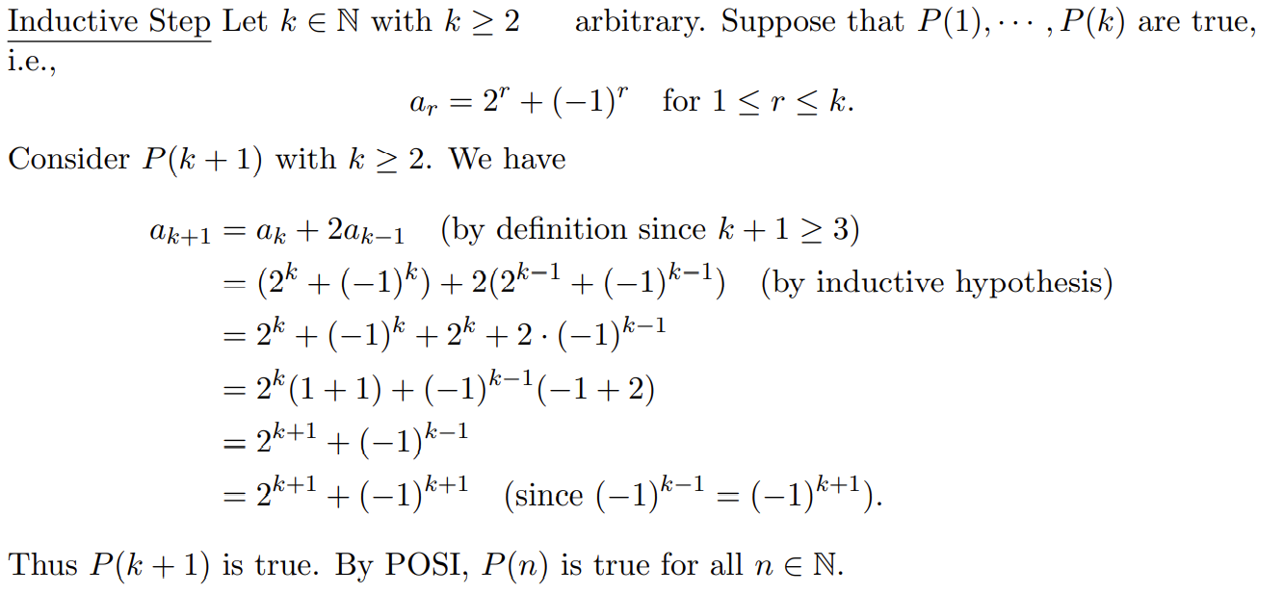

Slide 16
Time is precious. Check in WolframAlpha.

Slide 19
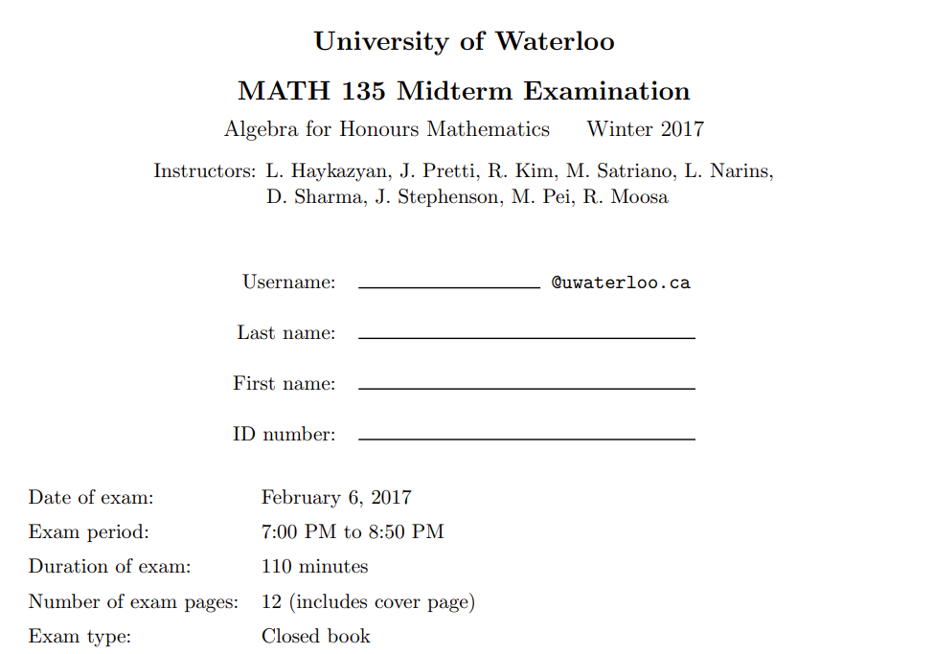

Slide 21
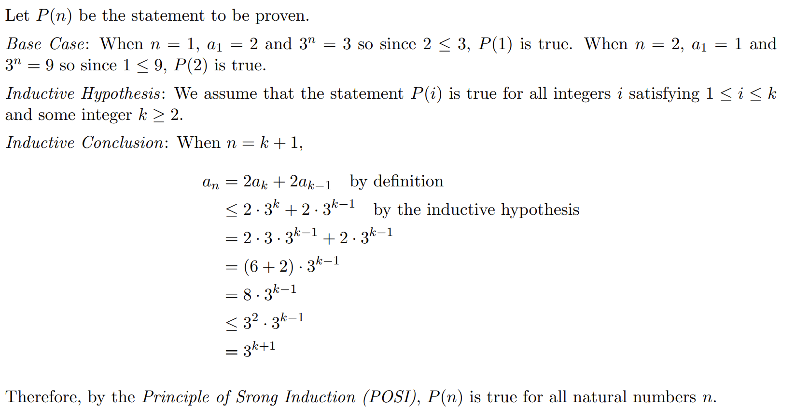

Slide 31
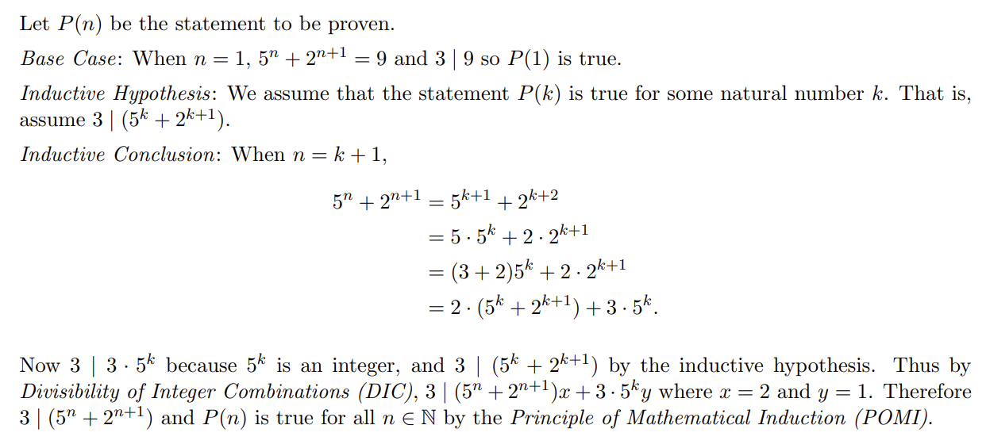

Slide 38
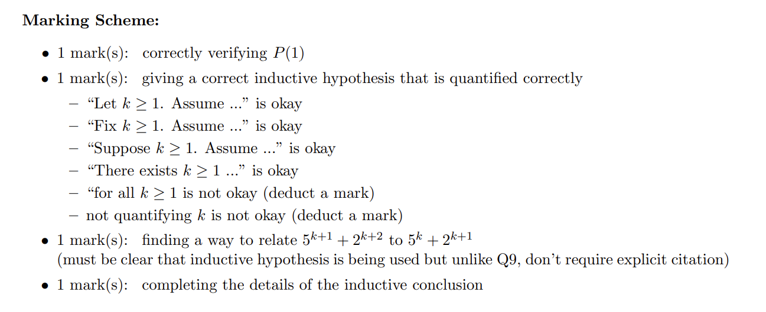

Slide 40
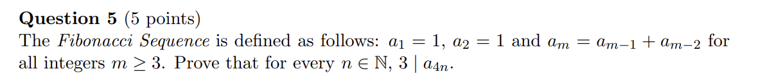
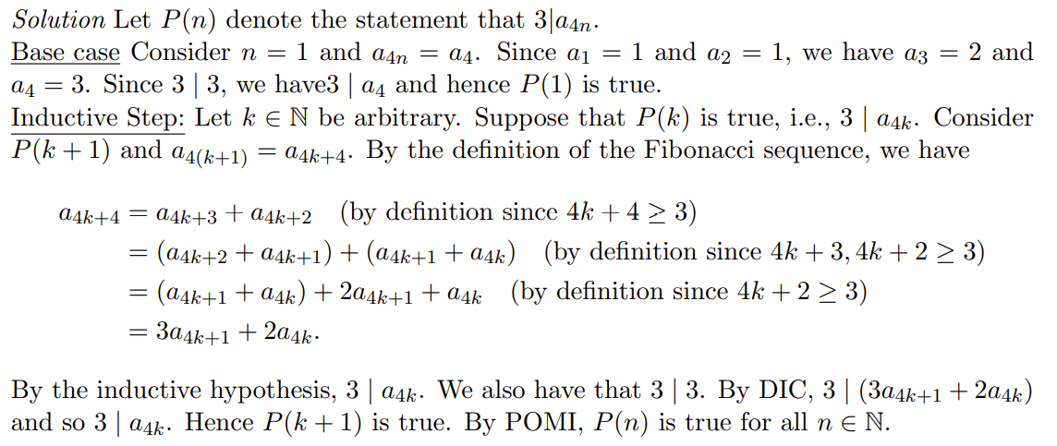

Slide 48
+4

Slide 49
+4

Slide 50
Study groups and carpooling

Slide 51
Does 0 | 0 ?
Yes
Does any integer other than 0 divide 0?
Yes! Which ones?
All
Does 0 divide anything?

Slide 52
Proof Practice!
Is the sum of two consecutive integers odd?
Let a, b in Z, where b = a+1
Consider c = a + b = a + a + 1 = 2a + 1

