Slide 1
If a number’s last digit is 5,
then is it always 5 times an odd number?
Prove it.

Slide 2
MATH 135: Lecture 4
Dr. Nike Dattani
15 September 2021

Slide 3
Upcoming responsibilities!
Thursday 16 September:
WA01 solutions will be posted, hopefully before 12pm: Check the solutions in detail!
Friday 17 September before class:
Complete reading Chapter 2 of the course notes
Friday 17 September:
Complete Mobius Quiz 3: MQ3
Sunday 19 September:
Complete reading up to the end of Section 0.2 (Polynomials)
There’s a question on next MQ based on the polynomials reading!
Monday 20 September:
Complete Mobius Quiz 4: MQ4
Wednesday 22 September:
Complete Written Assignment 2: WA2
Wednesday 22 September:
Complete Mobius Quiz 5: MQ5

Slide 4
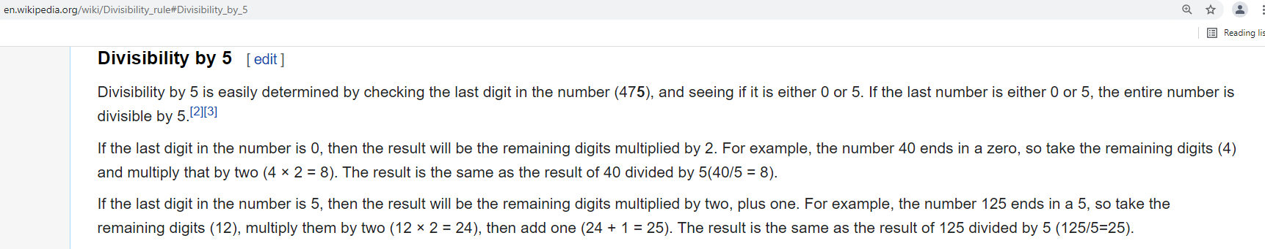
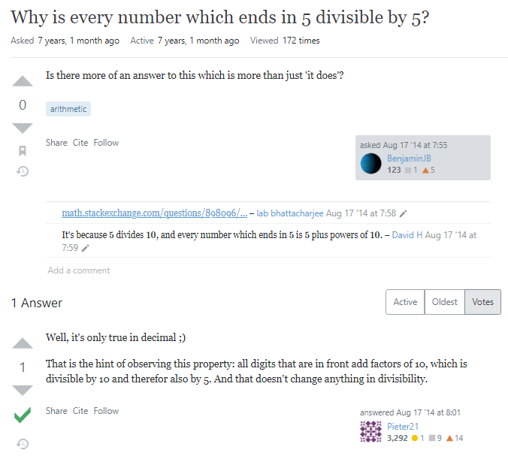
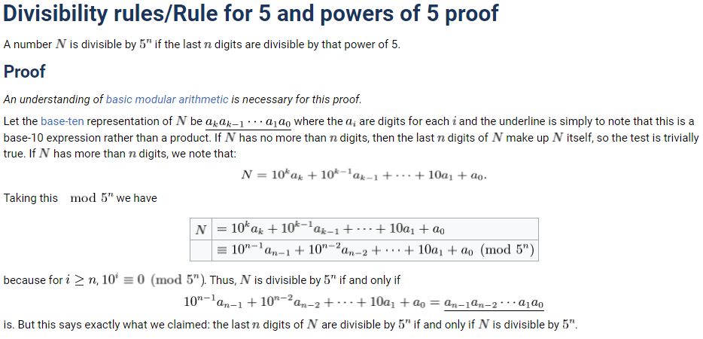

Slide 5
If a number’s last digit is 5, then is it always 5 times an odd number?
S = {Integers for which the last digit is 5}
Ɐ N ϵ S , ∃ m ϵ ℤ , N = 5(2m+1) ?
Ɐ N ϵ S, ∃ a ϵ ℤ , N = 10a + 5
N = 5(2a+1)
(2a+1) is odd!
∴ N = 5 x (odd number), Ɐ N ϵ S

Slide 6
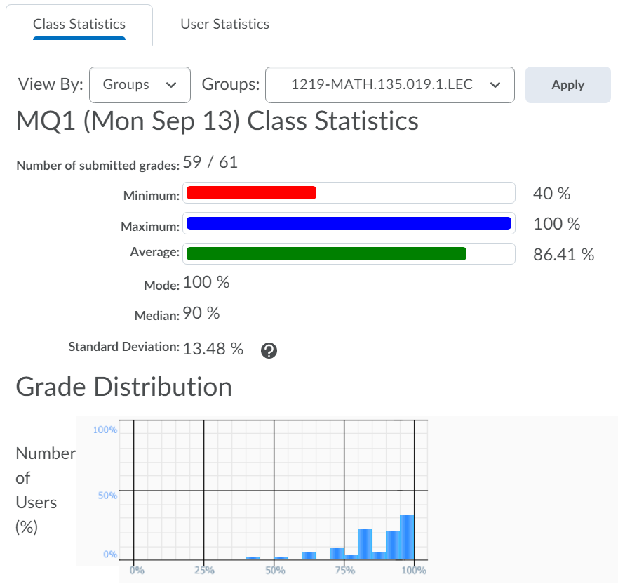
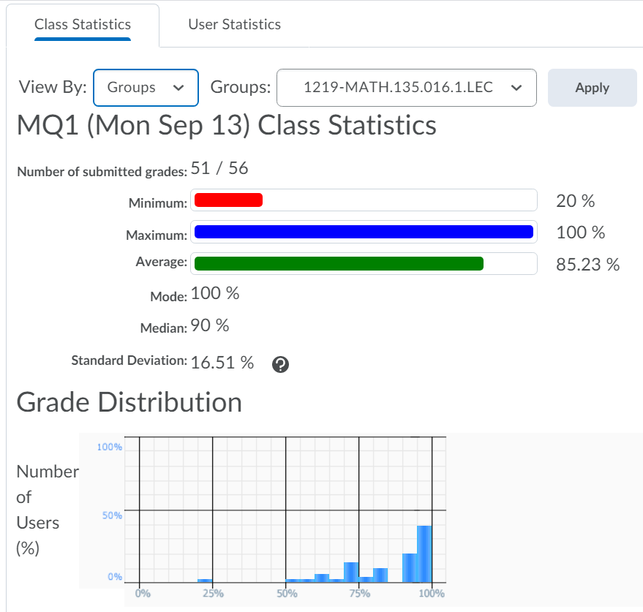

Slide 7
Tips for MATH 135!
Do not use “s.t.” but you can instead use a comma.
How many people here use GitHub?
Lecture Notes:
Github → ndattani → Lecture_Notes
https://github.com/ndattani/Lecture_Notes
Private repository: send me your username and I’ll give you access!
Tips for username: Just use your actual name!
GitHub is a portfolio of all of your academic work, and later career work

Slide 8
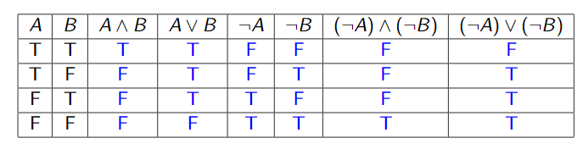
Logic
∧ = AND (∧ looks like A)
∨ = OR

Slide 9
Logic
∧ = AND (∧ looks like A)
∨ = OR

Slide 10
Logic
∧ = AND (∧ looks like A)
∨ = OR

Slide 11
Logic
∧ = AND (∧ looks like A)
∨ = OR

Slide 12
Logic
∧ = AND (∧ looks like A)
∨ = OR

Slide 13
Logic
∧ = AND (∧ looks like A)
∨ = OR

Slide 14
Logic
∧ = AND (∧ looks like A)
∨ = OR

Slide 15
Logic
∧ = AND (∧ looks like A)
∨ = OR

Slide 16
Logic
∧ = AND (∧ looks like A)
∨ = OR

Slide 17
Logic
∧ = AND (∧ looks like A)
∨ = OR

Slide 18
Logic
∧ = AND (∧ looks like A)
∨ = OR

Slide 19
Logic
∧ = AND (∧ looks like A)
∨ = OR

Slide 20
Logic
∧ = AND (∧ looks like A)
∨ = OR

Slide 21
Logic
∧ = AND (∧ looks like A)
∨ = OR

Slide 22
Logic
∧ = AND (∧ looks like A)
∨ = OR

Slide 23
Logic
∧ = AND (∧ looks like A)
∨ = OR

Slide 24
Logic
∧ = AND (∧ looks like A)
∨ = OR

Slide 25
Logic
∧ = AND (∧ looks like A)
∨ = OR

Slide 26
Logic
∧ = AND (∧ looks like A)
∨ = OR

Slide 27
Logic
∧ = AND (∧ looks like A)
∨ = OR

Slide 28
Logic
∧ = AND (∧ looks like A)
∨ = OR

Slide 29
Logic
∧ = AND (∧ looks like A)
∨ = OR

Slide 30
Logic
∧ = AND (∧ looks like A)
∨ = OR

Slide 31
Logic
∧ = AND (∧ looks like A)
∨ = OR

Slide 32
Logic
∧ = AND (∧ looks like A)
∨ = OR

Slide 33

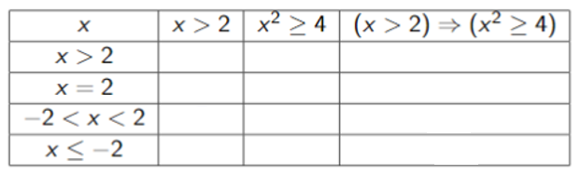

Slide 34
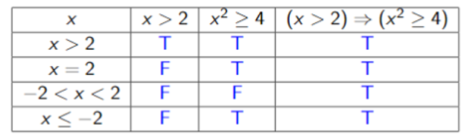
We will use the convention that (A => B) is true if A is false. In this case we say it’s “vacuously true”.
This way we don’t have to spend time checking cases that do not impact the open sentence.
This convention might not be followed in some types of non-classical logic (click for link to Wikipedia page!).

