Slide 1
Upcoming responsibilities!
Today (Friday 10 September):
Crowdmark submission practice
Submitted through Crowdmark
Monday 13 September:
Complete first quiz
Submitted through Mobius (via LEARN)
Wednesday 15 September:
Complete second quiz
Submitted through Mobius (via LEARN)
Wednesday 15 September:
Complete first Written Assignment (WA)
Submitted through Crowdmark

Slide 2
MATH 135: Lecture 2
Dr. Nike Dattani
10 September 2021

Slide 3
Quick introduction to some mathematical language!
For all
There exists / There does not exist
Such that
“Is an element of…” / “Is not an element of…”
Sets and elements: {♣,♦,♥,♠}, {1,2,3}, {1,2,{1,2,3}} , ∅ = { }
Natural numbers (in this course, {1,2,3,…}), Integers, Rational numbers, Real numbers, Complex numbers
Negation: ¬A, ¬(¬A) = A
Open sentence: sentence containing one or more variables, where truth of the sentence awaits specification of the variable(s)
P(x) is a sentence depending on x. Q(x,y) is a sentence depending on x and y.
Statement: sentence that’s true or false
Example: ∀ x ∈ S, P(x).
What are the pieces in this example?
Is this example an open sentence too?

Slide 4
Tips for Assignment 1!
Follow instructions perfectly.
If it says not to do something (for example using something that wasn’t covered in the chapter), you can lose marks
1 is not a prime number.
Expressing negations without using negation symbol: keep in mind things like: ¬ ( a = b) ➔ a ≠ b
Table 1.4.3 is important!
sin(x) = log(x)
Transcendental Equation
If you can’t figure out if a statement is True or False, consider the negation of the statement! It might be easier that way!
Don’t be afraid to plug in numbers and try to find a counter-example or example by brute force!
e.g. for the variables (m,n), try each of m=0,-1,+1,-2,+2,-3,+3 with each of n=0,-1,+1,-2,+2,-3,+3
49 in total to check on WolframAlpha, but many will be the same since things like x^2 are the same for x=-2,+2
If English isn’t your native language:
Do you know what an “inequality” is?
“With justification” vs “without justification” ?
“Truth value” of a statement is just , whether the statement is true (Truth value = “True”) or false (Truth value = “False”)
When verifying a statement like “For all m ….” you can split m in to cases (zero vs non-zero, even vs odd, etc.)

Slide 5
Please get perfect on this assignment!
How much of your final grade is it worth?
When you’re studying for the exam, you will wish you knew everything from the assignments.

Slide 6
Proof practice!
S = {Integers ending in 5}
Ɐ N ϵ S , N^2 ϵ S
Ɐ N, ∃ a ϵ ℤ ∋ N = 10a +5
(10a + 5)^2 = 100a^2 + 100a + 25
= 100a(a+1) + 25
∃ b ϵ ℤ ∋ N^2 = 100b + 25
Ɐ b ϵ ℤ, 100b + 25 ϵ ℤ
∴ N^2 ϵ S , Ɐ N ϵ S

Slide 7
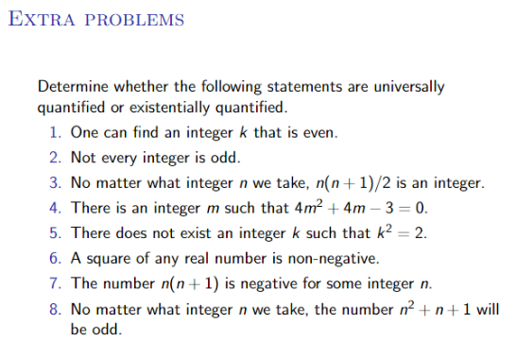

Slide 8

¬(∃ p,q ϵ ℤ ∋ sqrt(3) = p/q)
Do we have to worry about q=0?
Assume: ∃ p,q ϵ ℤ ∋ sqrt(3) = p/q
Case 1: q is even.
=> p/q is an integer.
=> sqrt(3) is an integer.
=> Prove that sqrt(3) is NOT an integer (exercise).
Case 2: q is odd.
Case 2.1: p is even
Not possible (exercise).
Case 2.2: p is odd
∃ n ϵ ℤ ∋ p = 2n+1
∃ m ϵ ℤ ∋ q = 2m+1

Slide 9
Assumption: ∃ p,q ϵ ℤ ∋ sqrt(3) = p/q)
Case 2.2: p is odd
∃ n ϵ ℤ ∋ p = 2n+1
∃ m ϵ ℤ ∋ q = 2m+1
q sqrt(3) = p
(2m + 1) sqrt(3) = (2n + 1)
(2m + 1)^2 x 3 = (2n + 1)^2
(4m^2 + 4m + 1) x 3 = 4n^2 + 4n + 1
12m^2 + 12m + 3 = 4n^2 + 4n + 1
12m^2 + 12m + 2 = 2n^2 + 2n
12(m^2 + m) + 1 = 2n(n+1)
Let n(n+1) = A, m^2 + m = B.
A ϵ ℤ , B ϵ ℤ
12A + 1 = 2B
12A + 1 is odd. 2B is even. ➔ Contradiction!
∴ ¬(∃ p,q ϵ ℤ ∋ sqrt(3) = p/q)

