Slide 1
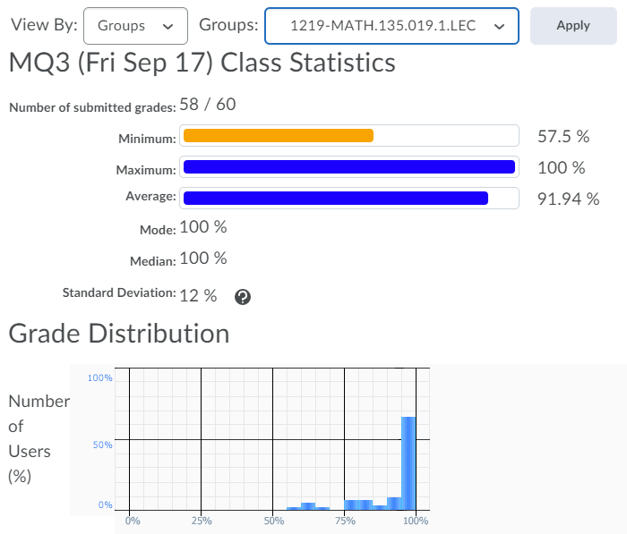
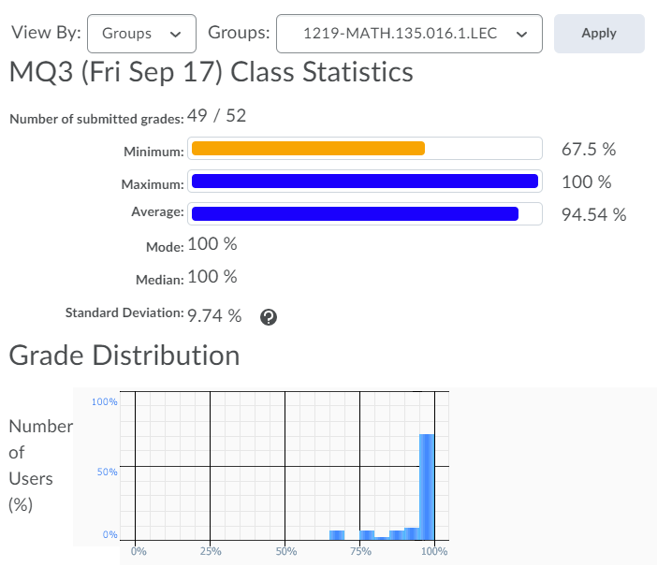

Slide 2
Monday 20 September:
Mobius Quiz 4
Tuesday 21 September:
Complete reading up to Chapter 3.6 of the course notes. Pages 35-57.
Wednesday 22 September:
Complete Written Assignment 2: WA2
Wednesday 22 September:
Mobius Quiz 5
Thursday 23 September:
WA02 solutions will be posted, hopefully before 12pm: Check the solutions in detail!
Friday 24 September before class:
Mobius Quiz 6
Sunday 26 September:
Complete reading up to the end of Section 0.3 (Polynomials)

Slide 3
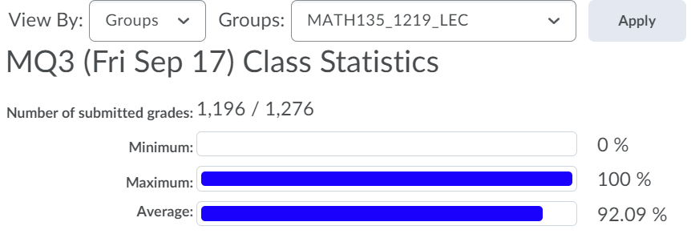

Slide 4
Office hours: Mondays and Wednesdsays 5-6pm.
MC 4059
Also: online tutorial center

Slide 5
MATH 135: Lecture 6
Dr. Nike Dattani
20 September 2021

Slide 6
How many of you find if and only if statements confusing?

Slide 8
Today I am going to confuse you.

Slide 10
Who is ready to be confused?

Slide 11
“I come to campus only if I have to teach MATH 135”
Do I come to campus if there’s no MATH 135?
If there’s MATH 135 then do I come to campus?
If I have to teach MATH 135 then I come to campus: A => B
I come to campus only if I have to teach MATH 135: B => A
I come to campus iff I have to teach MATH 135: B => A (if is from only if)
B <= A (only if is from if/then)
I have to teach MATH 135 iff I come to campus: A <= B (if is from only if)
A => B (only if is from if/then)

Slide 12
“The only positive integers are those in ℚ.”
Is this iff ?
Positive integer => ℚ
ℚ => Positive integer?
Q2c on WA02 had a typo.
It was written as only A => B, but should be A <=> B.
(it’s the only way something can be a positive integer)
(some ℚ are positive integers, but some ℚ might not be)

Slide 13
“The integers are positive exactly when they are in ℚ.”
Is this iff ?
Integer is positive => ℚ
ℚ => Positive integer?
(they’re positive when in ℚ, and never otherwise)
(Some ℚ are not integers, it says nothing about ℚ? )
Nike goes to class exactly when Charlie goes to class.
Nike goes at 2pm and 3pm
Charlie goes when?
Charlie goes to class at 2pm, 3pm, and 4pm
Nike only goes when Charlie goes (e.g. 2pm and 3pm) but does he have to got at 4pm?
Nike goes when Charlie goes, but is it only when Charlie goes?

Slide 14
A exactly when B
B => A
But previously we agreed:
“The integers are positive exactly when they are in B.”
Positive integer => B
B => Positive integer?
Now it seems to say B => positive integer, and nothing about A’s impact on B
(they’re positive when in B, and never otherwise)
(Some B are not integers, it says nothing about B? )

Slide 15
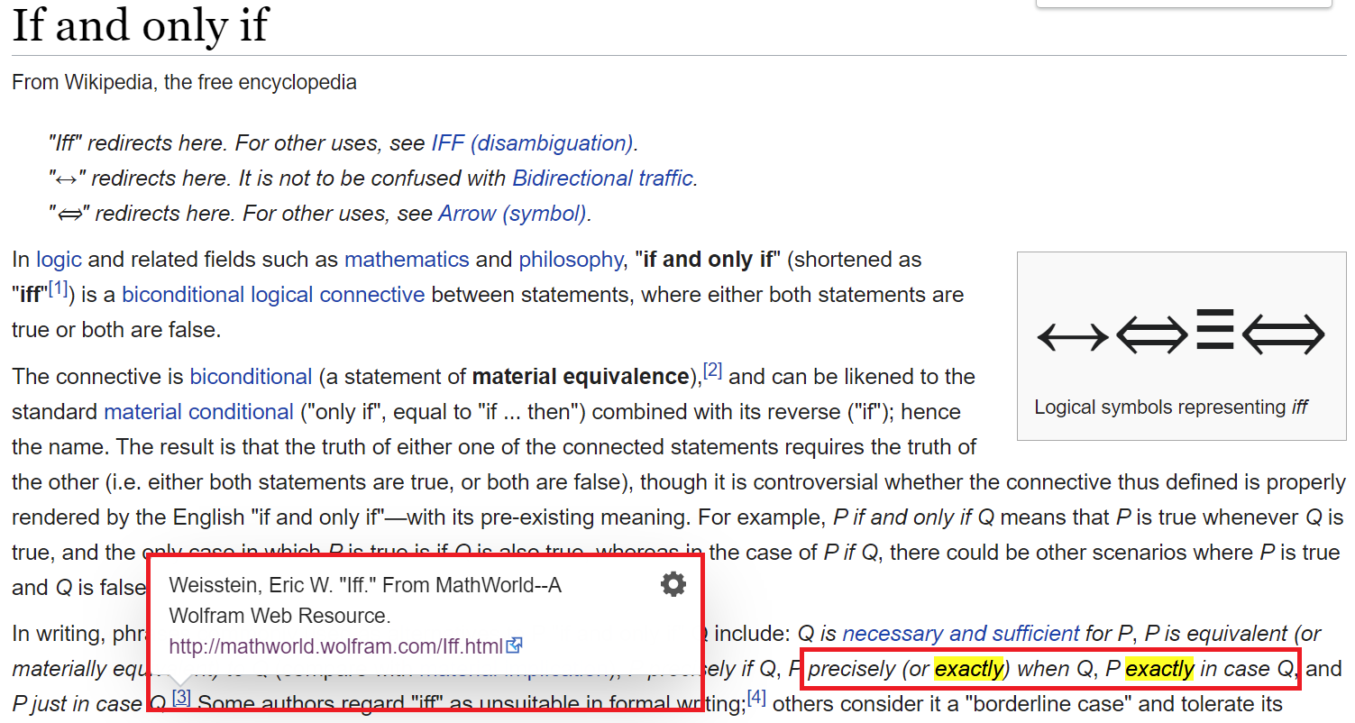

Slide 16
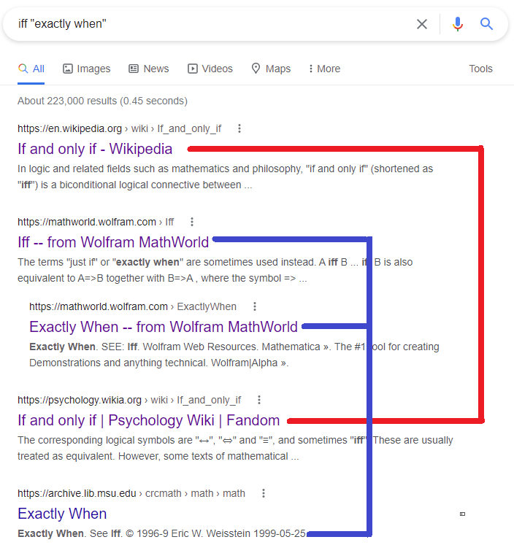
“Exactly when” sometimes means “iff” but:
(1) none of the top sources explain why
(2) all of the top sources either cite Weisstein’s MathWorld or are Mathworld
(3) MathWorld redirects “exactly when” to “iff” (i.e. “exactly when” is less significant)
(4) Above sources prefer: “P iff Q”, “P is equivalent to Q”, “P just if Q” or “P is N&C for Q”
(5) there’s not very many other sources using “exactly when” in this way
(6) etc.

Slide 17
If A then B.
A if B.
(A => B)
(B => A)
Two different meanings of the word “if” !!! Confusing!

Slide 18
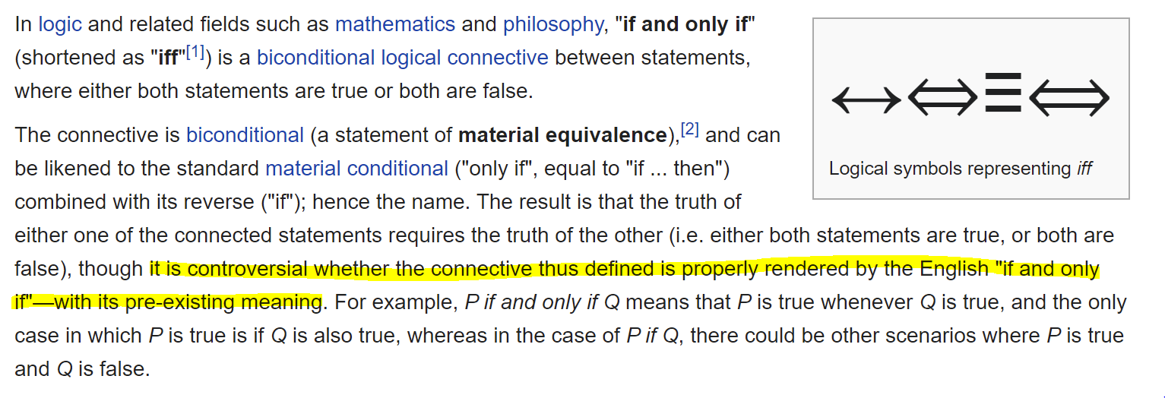

Slide 19
If it helps:
Don’t consider iff to be an English term
Mathematically: A => B and B=> A (A <=> B)

Slide 20
Treat “if and only if” as a short form
If A then B and only if B
If A then B and only if B then A

Slide 21
It has a maximum and/or a minimum
English “or” = Exclusive OR (XOR)
A and B have to be different (one true and the other false) for A XOR B to be true
MATH 135 “or” = Inclusive OR
Only one of A or B has to be true for A V B to be true.

Slide 22
Review
If the hypothesis A is false, is B true?
- No! Only (A => B) is true!

Slide 23

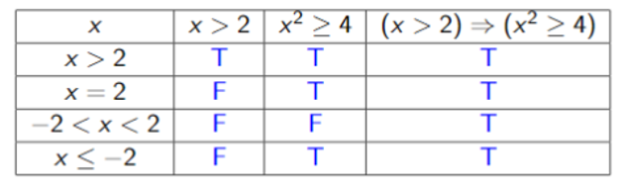
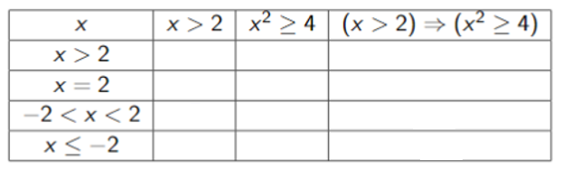
Hypothesis FALSE, but Conclusion also FALSE
Hypothesis (A)
Conclusion (B)
Implication always TRUE if Hypothesis is FALSE
Implication (A => B)
We will use the convention that (A => B) is true if A is false. In this case we say it’s “vacuously true”.
This way we don’t have to spend time checking cases that do not impact the open sentence.
This convention might not be followed in some types of non-classical logic (click for link to Wikipedia page!).

