Slide 1
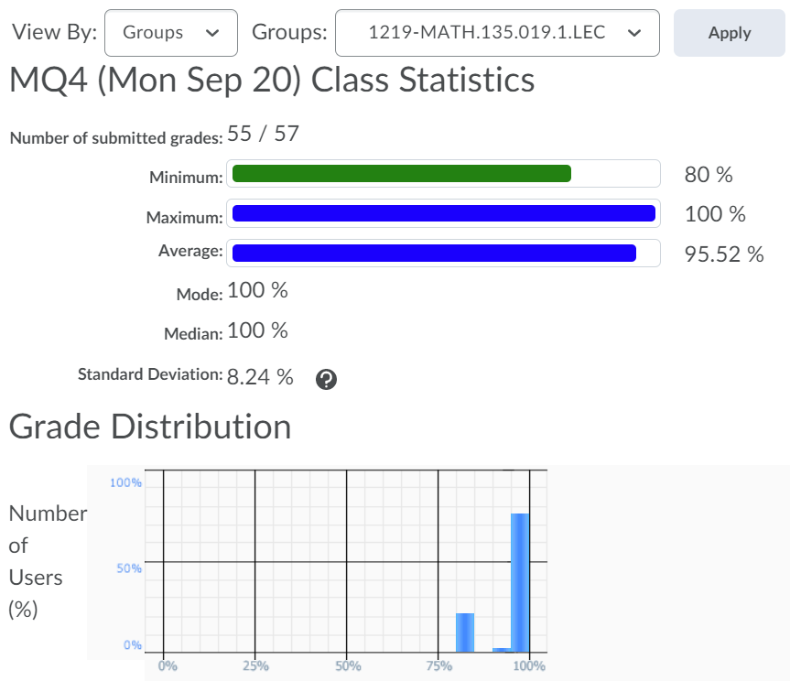


Slide 2
You should be done reading up to Chapter 3.6 of the course notes. Pages 35-57.
Wednesday 22 September:
Complete Written Assignment 2: WA2
Wednesday 22 September:
Mobius Quiz 5
Wednesday 22 September:
Look at your WA01 results thoroughly! Where did you lose marks?
Thursday 23 September:
WA02 solutions will be posted, hopefully before 12pm: Check the solutions in detail!
Friday 24 September before class:
Mobius Quiz 6
Sunday 26 September:
Complete reading up to the end of Section 0.3 (Polynomials)
Monday 27 September:
Mobius Quiz 7
Tuesday 28 September:
Complete reading from Chapter 3.6 up to 4.4 of the course notes. Pages 55-75.

Slide 3
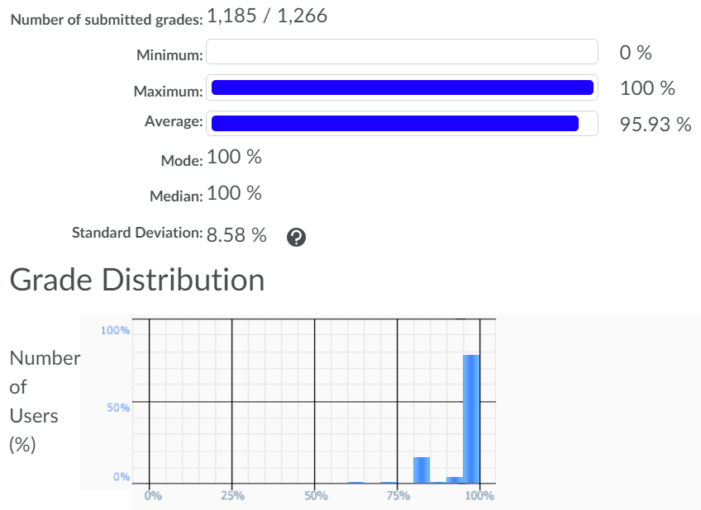

Slide 4
Office hours: Mondays and Wednesdsays 5-6pm.
MC 4059
Also: online tutorial center

Slide 5
MATH 135: Lecture 7
Dr. Nike Dattani
22 September 2021

Slide 6
Quick Review
If A then B.
A if B.
(A => B)
(B => A)

Slide 7
“Iff” is short for what?
If A then B and only if B
If A then B and only if B then A

Slide 8
Don’t consider iff to be an English term
Mathematically: A => B and B=> A (A <=> B)

Slide 9
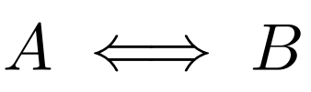
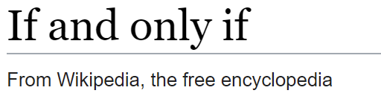
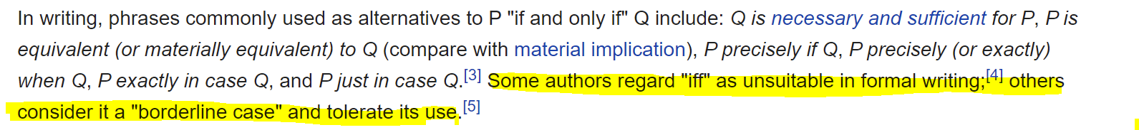
A iff B
A exactly when B
A just if B
A precisely when B
A is true whenever B is true
A is equivalent to B
A is materially equivalent to B
A is logically equivalent to B
A exactly in case B
A just in case B
A XNOR B
A is necessary and sufficient for B

Slide 10
A iff B
A exactly when B
A just if B
A precisely when B
A is true whenever B is true
A is equivalent to B
A is materially equivalent to B
A is logically equivalent to B
A exactly in case B
A just in case B
A XNOR B
A is necessary and sufficient for B: A necessary for B (B => A), A sufficent for B (A => B)

Slide 11
Converse
Contrapositive
Counter-example
Contradiction

Slide 12
Converse
Contrapositive
Counter-example
Contradiction: ( A ^ ¬A) is true

Slide 13
Converse
Contrapositive
Counter-example
Contradiction
Corollary
Conclusion
Combinations

Slide 14
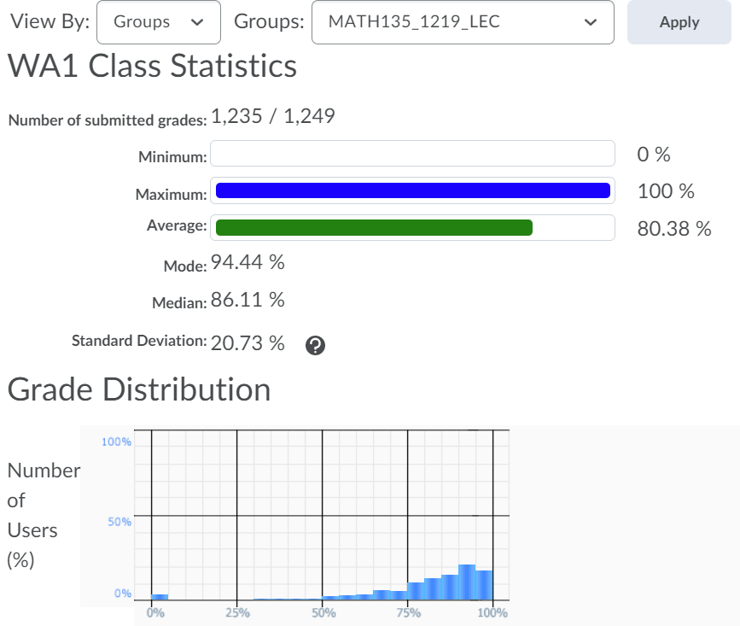

Slide 15
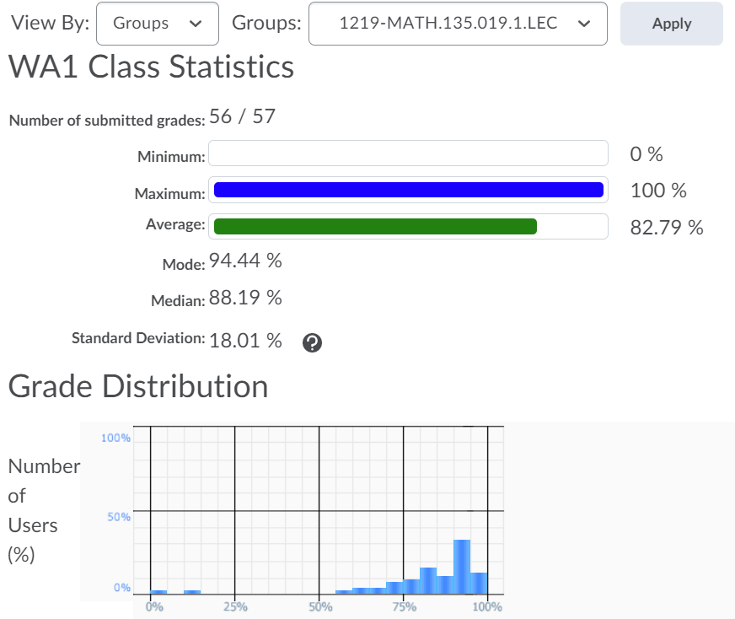
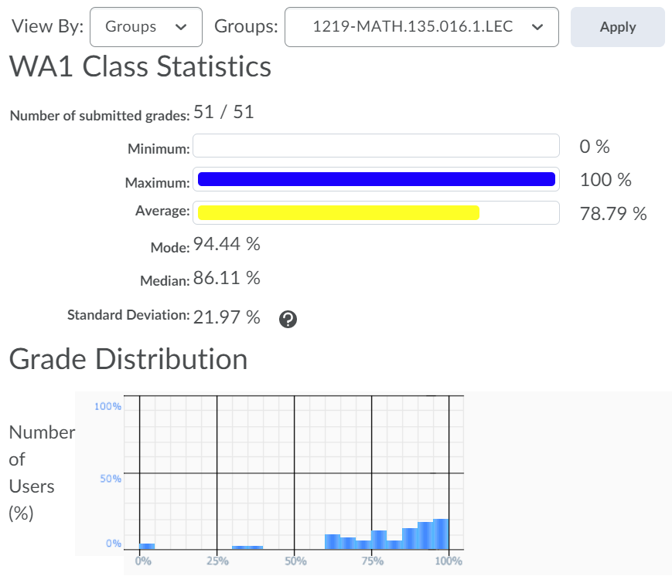

Slide 16
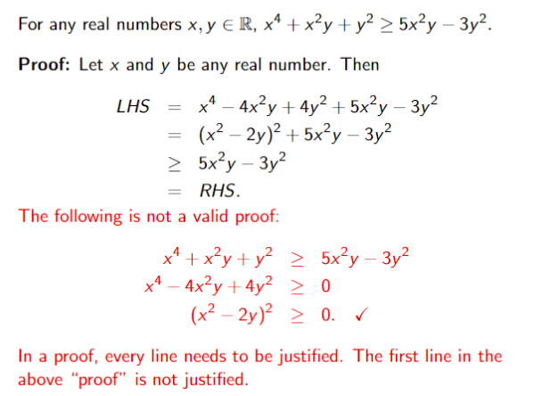
(Add and subtract 5x²y -3y²)

Slide 17
