Slide 1
Warm up!
I want to spend exactly $100
on buying 49¢ and 53¢ stamps.
In how many ways can I do it?

Slide 2
I want to spend exactly $100
on buying 49¢ and 53¢ stamps.
49x + 53y = 10000, x,y ∈ ℕ
Does gcd(49,53) | 10000 ?

Slide 3
Answer!

Slide 4
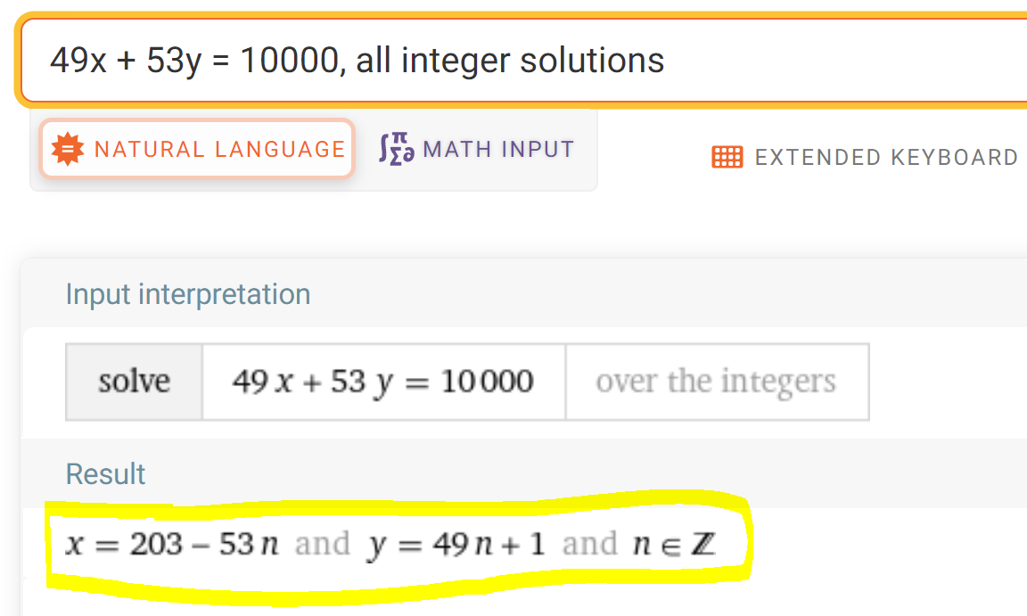

Slide 5
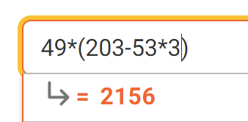
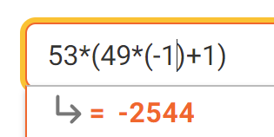
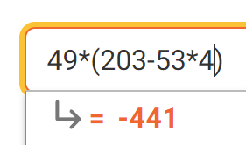

Slide 6
MATH 135: Lecture 23
Dr. Nike Dattani
5 November 2021

Slide 7
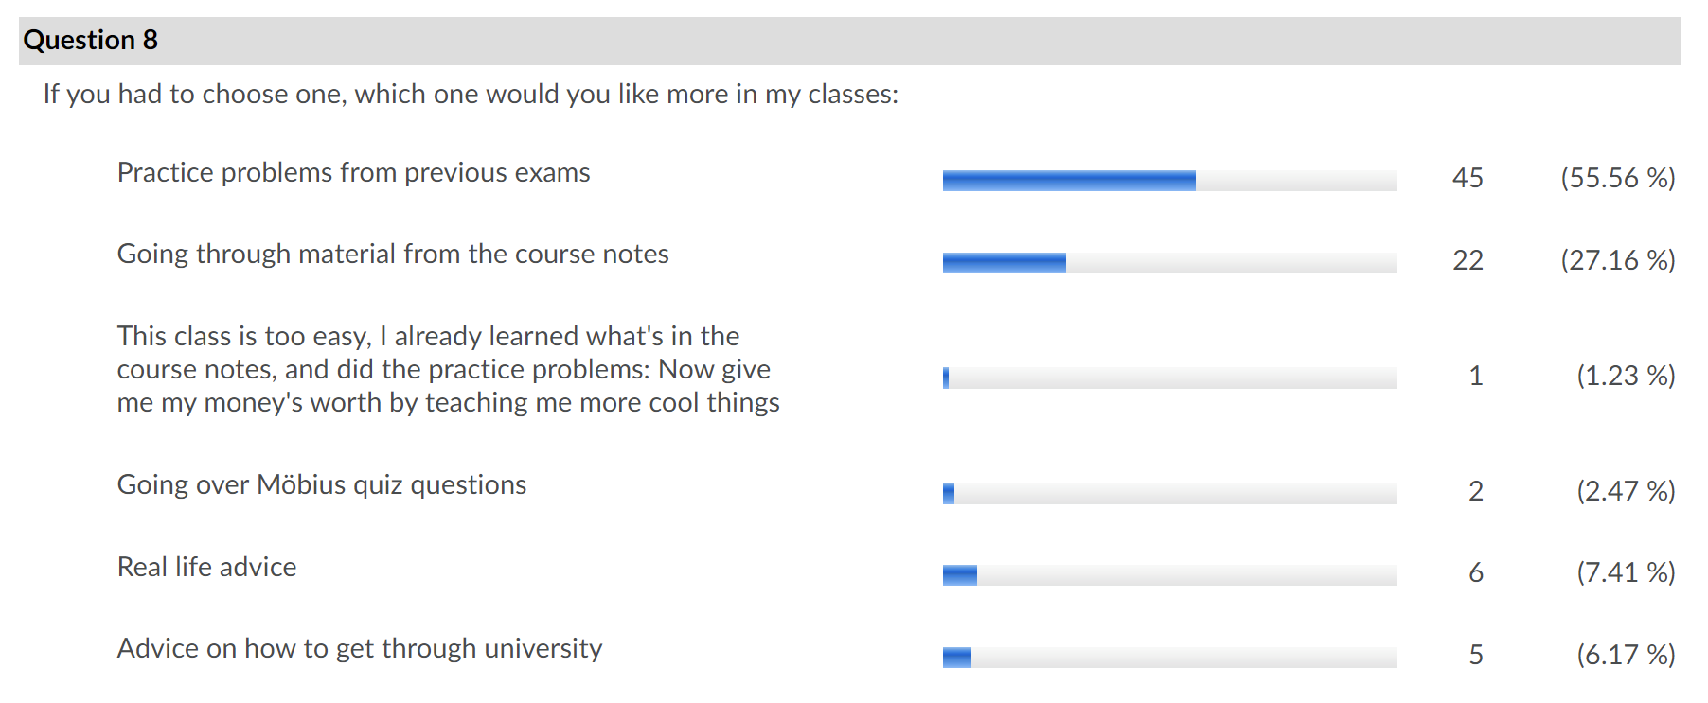
Results from survey

Slide 8
I will do previous exam questions!
Course notes: Try Piazza, office hours, tutorial centre, etc.
…or let me know in advance what part of the reading is giving you trouble
Office Hours: For real-life advice, advice for getting through university, etc.

Slide 9
18 second video:
Former student of mine I taught at Oxford University
Host: How did you know that?
Hugh Binnie: “Modular arithmetic”

Slide 10
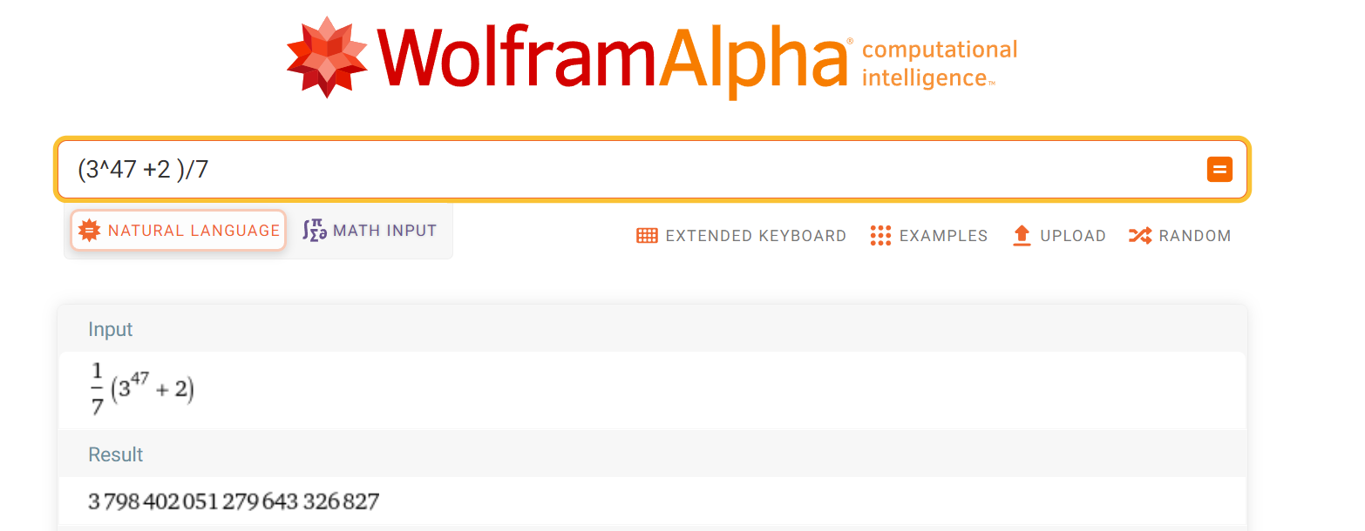

28 ≡ 0 (mod 7)
28 -1 ≡ -1 (mod 7)
27 ≡ -1 (mod 7)
3⁴⁷ ≡ ? (mod 7)
≡ $3^{2}3^{45}$ (mod 7)
≡ $3^{2}{\left(3^{3}\right)}^{15}$ (mod 7)
≡ $9{\left(27\right)}^{15}$ (mod 7)
≡ $2{\left(−1\right)}^{15}$(mod 7)
≡ $−2$ (mod 7)
3⁴⁷ + 2 ≡ 0 (mod 7). 7 | 3⁴⁷ + 2

Slide 11

x = 20n + 12
(20n + 12) ≡ 11 (mod 39)
20n ≡ -1 (mod 39)
20n = 39y - 1
1 = 39y -20n [now solve the Diophantine eqn]

Slide 12
2²²3³³5⁵⁵ (mod 11)
Powers of 2:
2, 4, 8, 16, 32, 64, 128, 256, 512, 1024, 2048, 4096, 8192, 16384, 32768,

Slide 13
2²²3³³5⁵⁵ (mod 11)
Powers of 2:
2, 4, 8, 16, 32, 64, 128, 256, 512, 1024, 2048, 4096, 8192, 16384, 32768,
Powers of 3:
3, 9, 27, 81, 243, 729, 2187, 6561

Slide 14
2²²3³³5⁵⁵ (mod 11)
Powers of 2:
2, 4, 8, 16, 32, 64, 128, 256, 512, 1024, 2048, 4096, 8192, 16384, 32768,
Powers of 3:
3, 9, 27, 81, 243, 729, 2187, 6561. 3² = 9 ≡ -2 (mod 11)
Powers of 5:
5, 25, 125, 625, 3125, 15625, 78125.

Slide 15
2²²3³³5⁵⁵ (mod 11)
Powers of 2:
2, 4, 8, 16, 32, 64, 128, 256, 512, 1024, 2048, 4096, 8192, 16384, 32768,
Powers of 3:
3, 9, 27, 81, 243, 729, 2187, 6561. 3² = 9 ≡ -2 (mod 11)
Powers of 5:
5, 25, 125, 625, 3125, 15625, 78125. 5⁵ = 3125 ≡ 1 (mod 11)

Slide 16
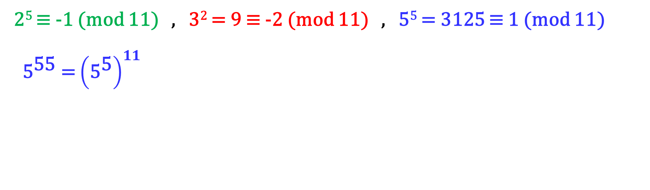
2²²3³³5⁵⁵ (mod 11)
2⁵ ≡ -1 (mod 11) , 3² = 9 ≡ -2 (mod 11) , 5⁵ = 3125 ≡ 1 (mod 11)
${\text{5}}^{\text{55}}$ = ${\left({\text{5}}^{\text{5}}\right)}^{11}$

Slide 17
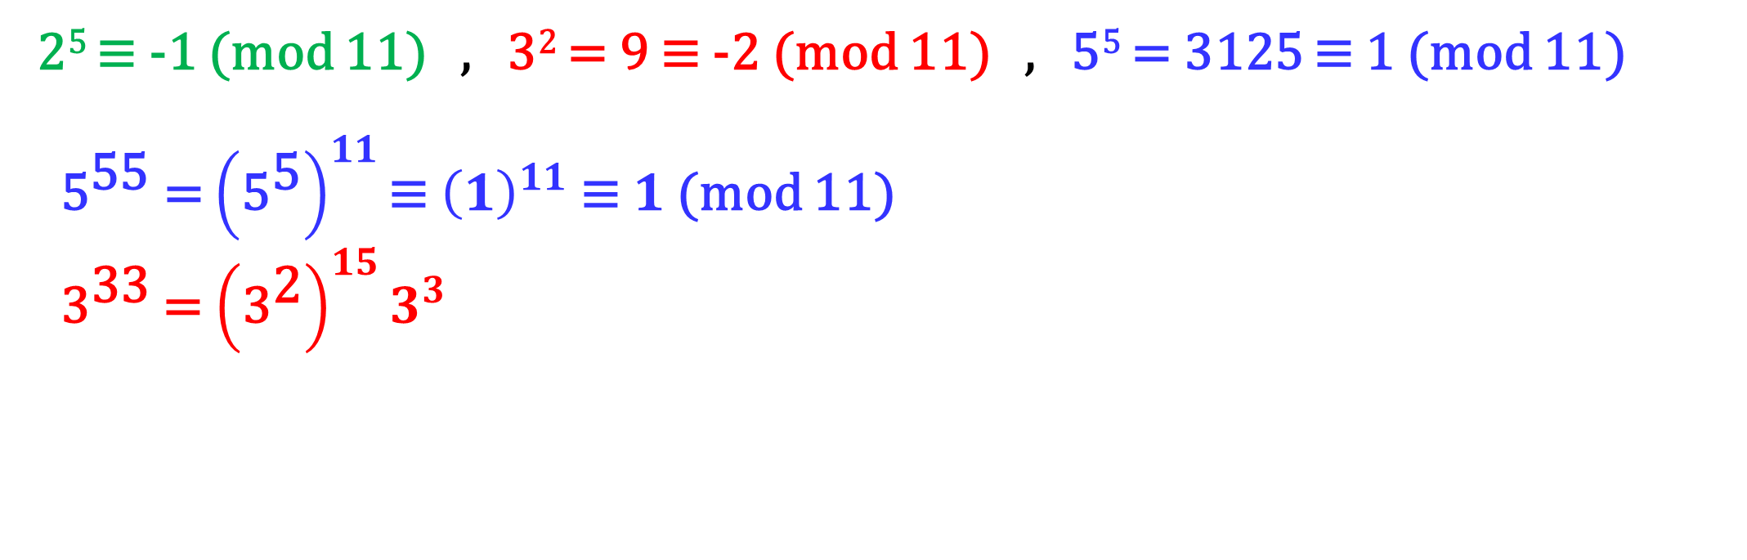
2²²3³³5⁵⁵ (mod 11)
2⁵ ≡ -1 (mod 11) , 3² = 9 ≡ -2 (mod 11) , 5⁵ = 3125 ≡ 1 (mod 11)
${\text{5}}^{\text{55}}$ = ${\left({\text{5}}^{\text{5}}\right)}^{11}\text{≡}{ \left(1\right)}^{11}$ $\text{≡} 1$ (mod 11)
${\text{3}}^{\text{33}}$ = ${\left({\text{3}}^{\text{2}}\right)}^{15}3^{3}$

Slide 18
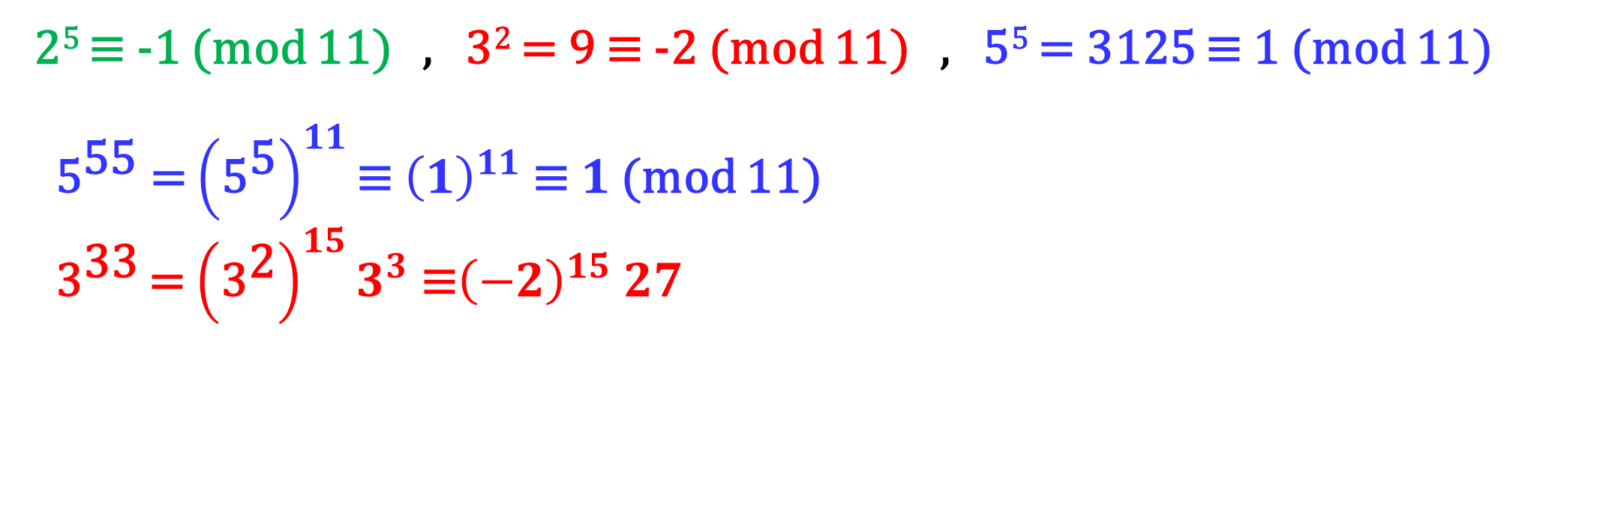
2²²3³³5⁵⁵ (mod 11)
2⁵ ≡ -1 (mod 11) , 3² = 9 ≡ -2 (mod 11) , 5⁵ = 3125 ≡ 1 (mod 11)
${\text{5}}^{\text{55}}$ = ${\left({\text{5}}^{\text{5}}\right)}^{11}\text{≡}{ \left(1\right)}^{11}$ $\text{≡} 1$ (mod 11)
${\text{3}}^{\text{33}}$ = ${\left({\text{3}}^{\text{2}}\right)}^{15}3^{3}\text{ ≡}{\left(−2\right)}^{15} 27$

Slide 19
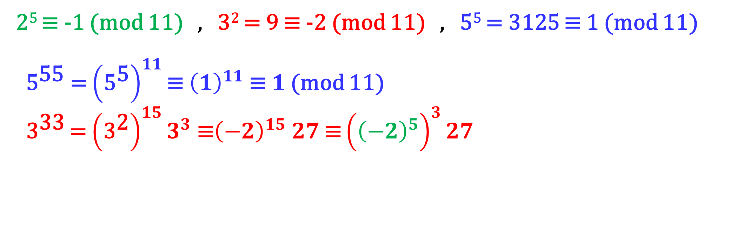
2²²3³³5⁵⁵ (mod 11)
2⁵ ≡ -1 (mod 11) , 3² = 9 ≡ -2 (mod 11) , 5⁵ = 3125 ≡ 1 (mod 11)
${\text{5}}^{\text{55}}$ = ${\left({\text{5}}^{\text{5}}\right)}^{11}\text{≡}{ \left(1\right)}^{11}$ $\text{≡} 1$ (mod 11)
${\text{3}}^{\text{33}}$ = ${\left({\text{3}}^{\text{2}}\right)}^{15}3^{3}\text{ ≡}{\left(−2\right)}^{15} 27$ $\text{≡}{\left({\left(−2\right)}^{5}\right)}^{3}27$

Slide 20
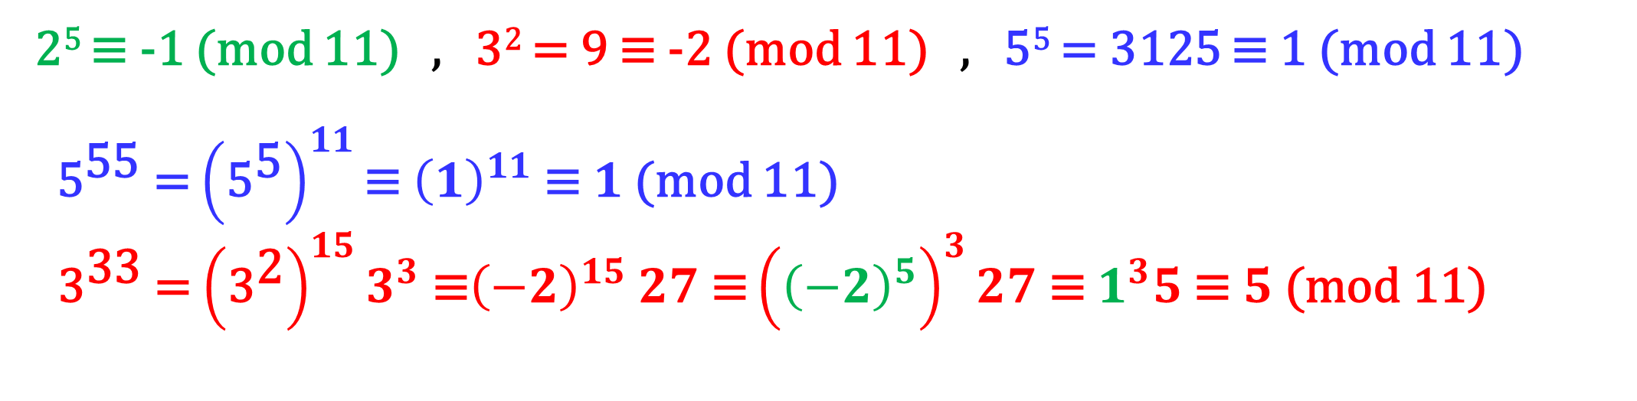
2²²3³³5⁵⁵ (mod 11)
2⁵ ≡ -1 (mod 11) , 3² = 9 ≡ -2 (mod 11) , 5⁵ = 3125 ≡ 1 (mod 11)
${\text{5}}^{\text{55}}$ = ${\left({\text{5}}^{\text{5}}\right)}^{11}\text{≡}{ \left(1\right)}^{11}$ $\text{≡} 1$ (mod 11)
${\text{3}}^{\text{33}}$ = ${\left({\text{3}}^{\text{2}}\right)}^{15}3^{3}\text{ ≡}{\left(−2\right)}^{15} 27$ $\text{≡}{\left({\left(−2\right)}^{5}\right)}^{3}27 \text{≡} 1^{3}5\text{ ≡ }5\text{ (}\text{mod}\text{ 11)}$

Slide 21
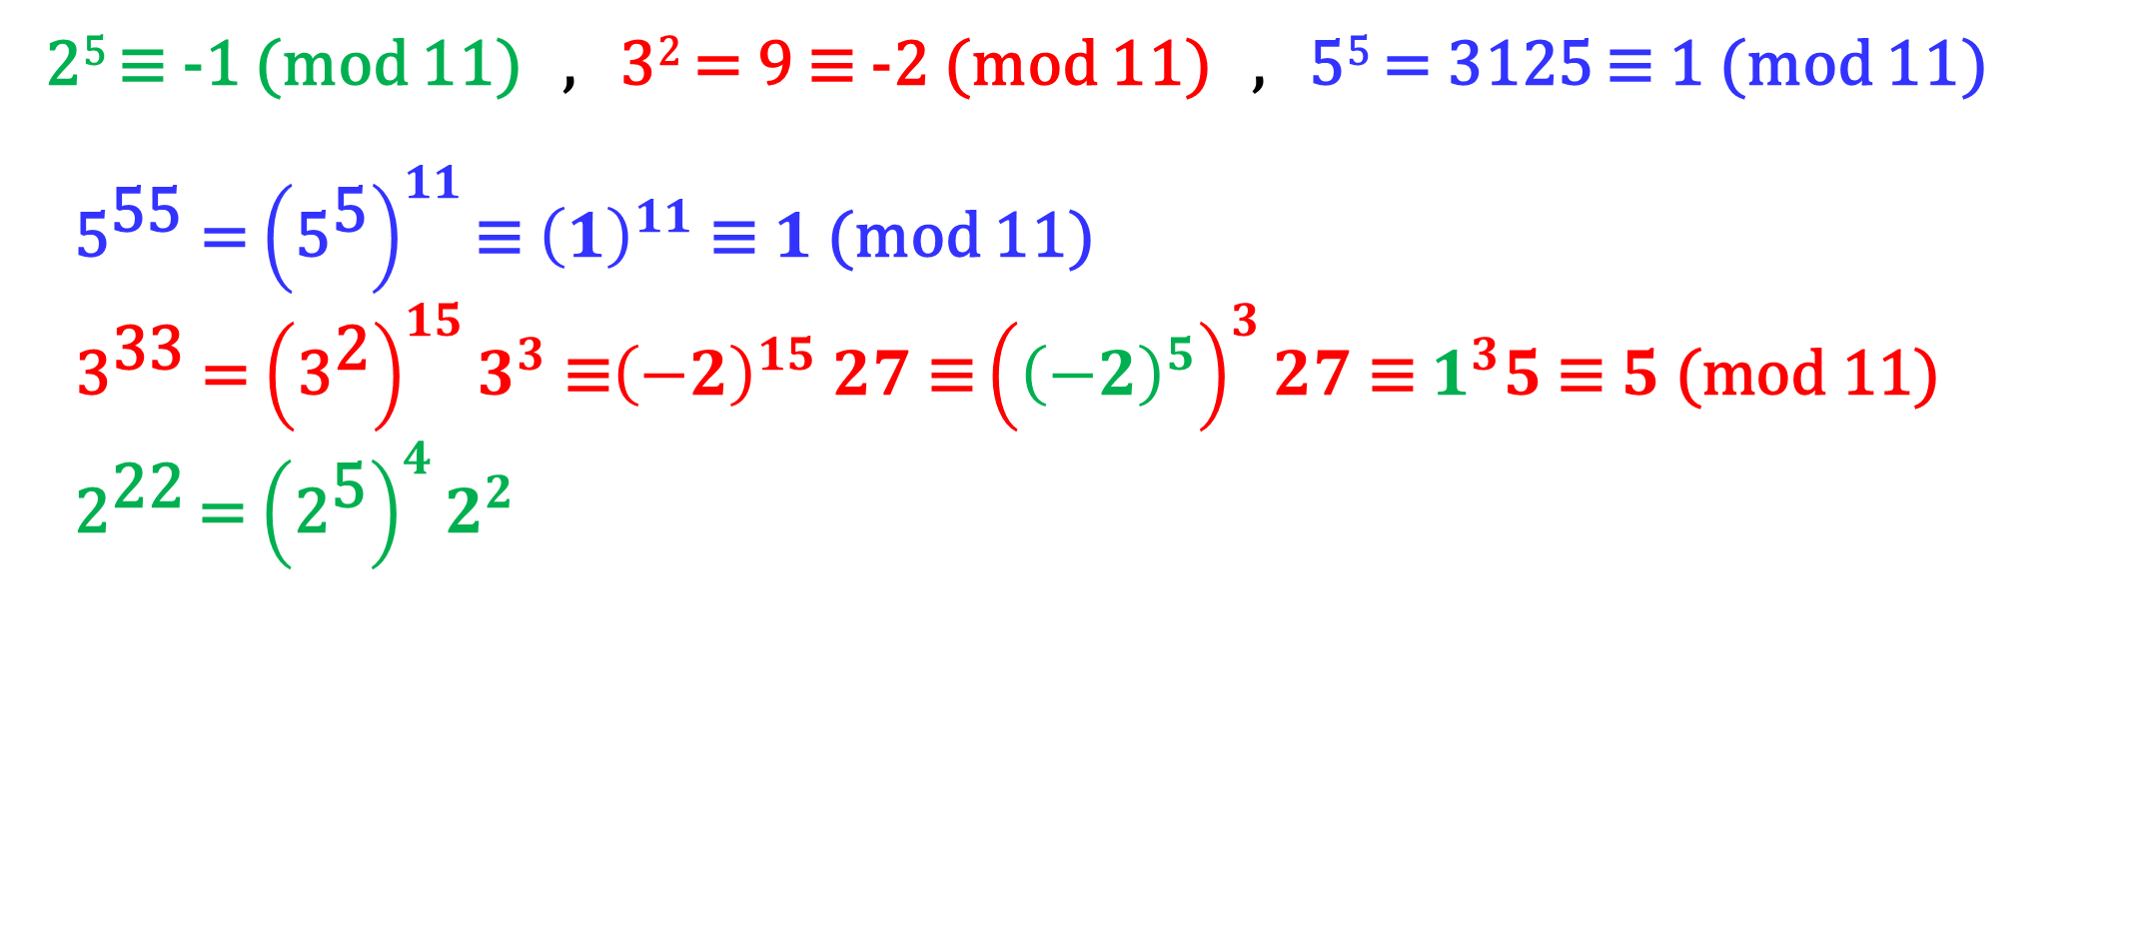
2²²3³³5⁵⁵ (mod 11)
2⁵ ≡ -1 (mod 11) , 3² = 9 ≡ -2 (mod 11) , 5⁵ = 3125 ≡ 1 (mod 11)
${\text{5}}^{\text{55}}$ = ${\left({\text{5}}^{\text{5}}\right)}^{11}\text{≡}{ \left(1\right)}^{11}$ $\text{≡} 1$ (mod 11)
${\text{3}}^{\text{33}}$ = ${\left({\text{3}}^{\text{2}}\right)}^{15}3^{3}\text{ ≡}{\left(−2\right)}^{15} 27$ $\text{≡}{\left({\left(−2\right)}^{5}\right)}^{3}27 \text{≡} 1^{3}5\text{ ≡ }5\text{ (}\text{mod}\text{ 11)}$
${\text{2}}^{\text{22}}$ = ${\left({\text{2}}^{\text{5}}\right)}^{4}2^{2}$

Slide 22
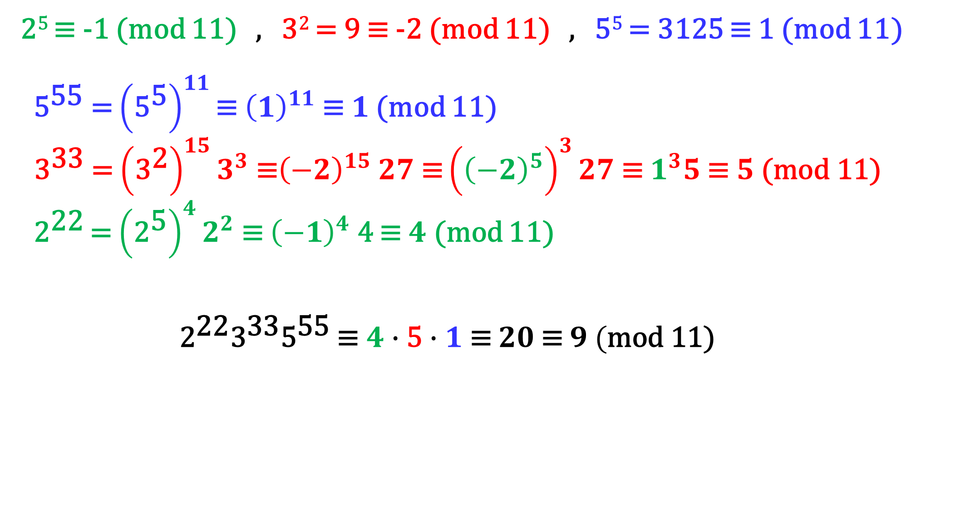
2²²3³³5⁵⁵ (mod 11)
2⁵ ≡ -1 (mod 11) , 3² = 9 ≡ -2 (mod 11) , 5⁵ = 3125 ≡ 1 (mod 11)
${\text{5}}^{\text{55}}$ = ${\left({\text{5}}^{\text{5}}\right)}^{11}\text{≡}{ \left(1\right)}^{11}$ $\text{≡} 1$ (mod 11)
${\text{3}}^{\text{33}}$ = ${\left({\text{3}}^{\text{2}}\right)}^{15}3^{3}\text{ ≡}{\left(−2\right)}^{15} 27$ $\text{≡}{\left({\left(−2\right)}^{5}\right)}^{3}27 \text{≡} 1^{3}5\text{ ≡ }5\text{ (}\text{mod}\text{ 11)}$
${\text{2}}^{\text{22}}$ = ${\left({\text{2}}^{\text{5}}\right)}^{4}2^{2} \text{≡} {\left(−1\right)}^{4}$ 4 $\text{≡} 4$ (mod 11)
${{\text{2}}^{\text{22}}{\text{3}}^{\text{33}}\text{5}}^{\text{55}}$ $\text{≡}$ $4∙\text{5}∙1 \text{≡ }20 \text{≡ }9 (\text{mod}\text{ 11)}$

Slide 23
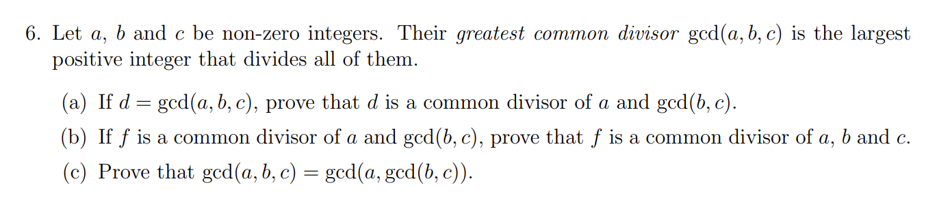
This tests whether you understand how the course notes proved the basic GCD theorems

Slide 24
Regrade requests:
If you disagree with your regrade, let me know by end of Tuesday
Friday 5 November:
Mobius quiz tonight! (covers up to middle of page 109)
Wednesday 10 November:
Submit Written Assignment 7: WA7 (covers up to page 121)

Slide 25
Thank you!

Slide 26
Less time on MATH 137 (60% needed in 135)
TutorConnect: if no one replied, what to do
Jason D’Souza apology
Laith: EEA
Survey results for overall satisfaction
Privacy and videos

