Slide 1
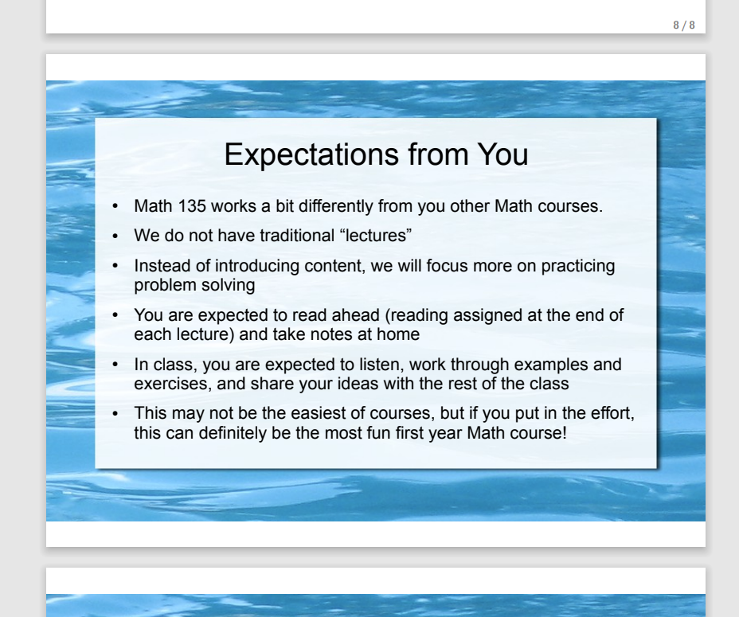
Lecture 1 slide from a different MATH 135 instructor:

Slide 2
MATH 135: Lecture 24
Dr. Nike Dattani
8 November 2021

Slide 3
Assignment 4 Tips
Q2)
After applying unique factorization,
you’re allowed to use an Exercise from Section 6.8 to get the d(n) formula.
You’re asked to prove that d(n) is odd iff n is a perfect square.
If d(n) is odd, can the variables in d(n) be odd?
1 mark for determining the answer.
Q3) Two cases: n = 1, n > 1.
If n = st², what does the prime factorization look like?
In a prime factorization, what’s a condition on the exponents in order for the number to be square free?
Q4)
a) 1 mark for finding w and explaining how you got it.
b and c) 1 mark for finding each w, 1 mark for explaining how you got them.
LDET1
LDET2
Use part a and b
Q5) Use the degree of products formula
1 mark for setting up the proof by contradiction
You can use the quadratic formula (I hope you saw that on Piazza!)
Is f(x) reducible when f(x) = g(x)h(x) for deg g(x) = deg h(x) = 1? 1 mark for answering this right.

Slide 4
Q3)
Two cases: n = 1, n > 1.
If n = st², what does the prime factorization look like?
In a prime factorization, what’s a condition on the exponents in order for the number to be square free?
Q4)
a) 1 mark for finding w and explaining how you got it.
b and c) 1 mark for finding each w, 1 mark for explaining how you got them.
LDET1
LDET2
Use part a and b
Q5) Use the degree of products formula
1 mark for setting up the proof by contradiction
You can use the quadratic formula (I hope you saw that on Piazza!)
Is f(x) reducible when f(x) = g(x)h(x) for deg g(x) = deg h(x) = 1? 1 mark for answering this right.

Slide 5
Q4)
a) 1 mark for finding w and explaining how you got it.
b and c) 1 mark for finding each w, 1 mark for explaining how you got them.
LDET1
LDET2
Use part a and b

Slide 6
Q5) Use the degree of products formula
1 mark for setting up the proof by contradiction
You can use the quadratic formula (I hope you saw that on Piazza!)
Is f(x) reducible when f(x) = g(x)h(x) for deg g(x) = deg h(x) = 1?
1 mark for answering the latter question correctly

Slide 7
How many people have not noticed Phil recording these lectures?
These were only for specific students (e.g. those who had to quarantine after arriving in Canada at beginning of term).
How many people would like these videos to be posted for you to review for the final exam?
Vote:
MS Streams (requires 2-factor authentication) ?
LEARN (requires 2-factor authentication, and compression) ?
Youtube (public) ?

Slide 8
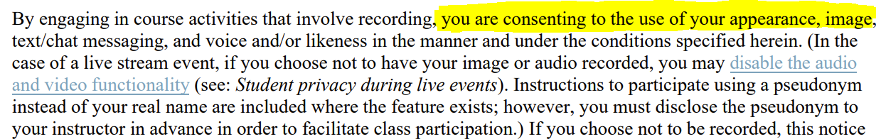
Videos don’t contain any students
There is no PII (e.g. last names). Anything you want out, can be removed (will take time / video-editing).
Anyone with questions, don’t hesitate to get in touch with me!
Do not worry about:
Because no students will be in recordings
(and we’ll take things out if needed).

Slide 9
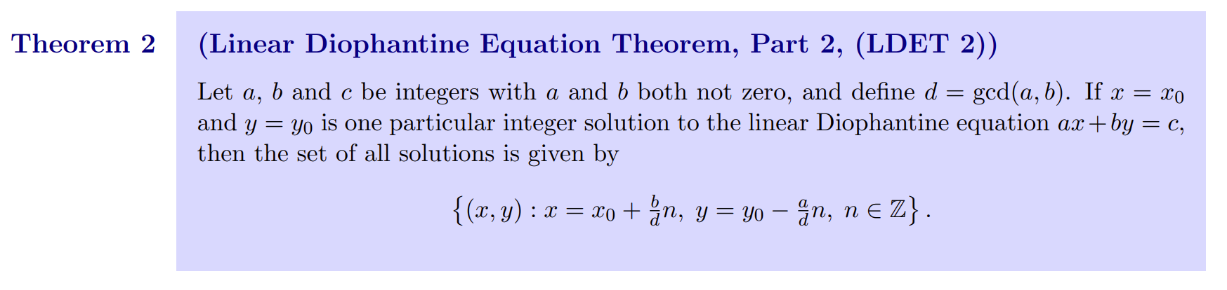
Does anybody not know how to find the general solution to an LDE?
Chapter 7 was only 5 pages long (2 simple theorems).

Slide 10
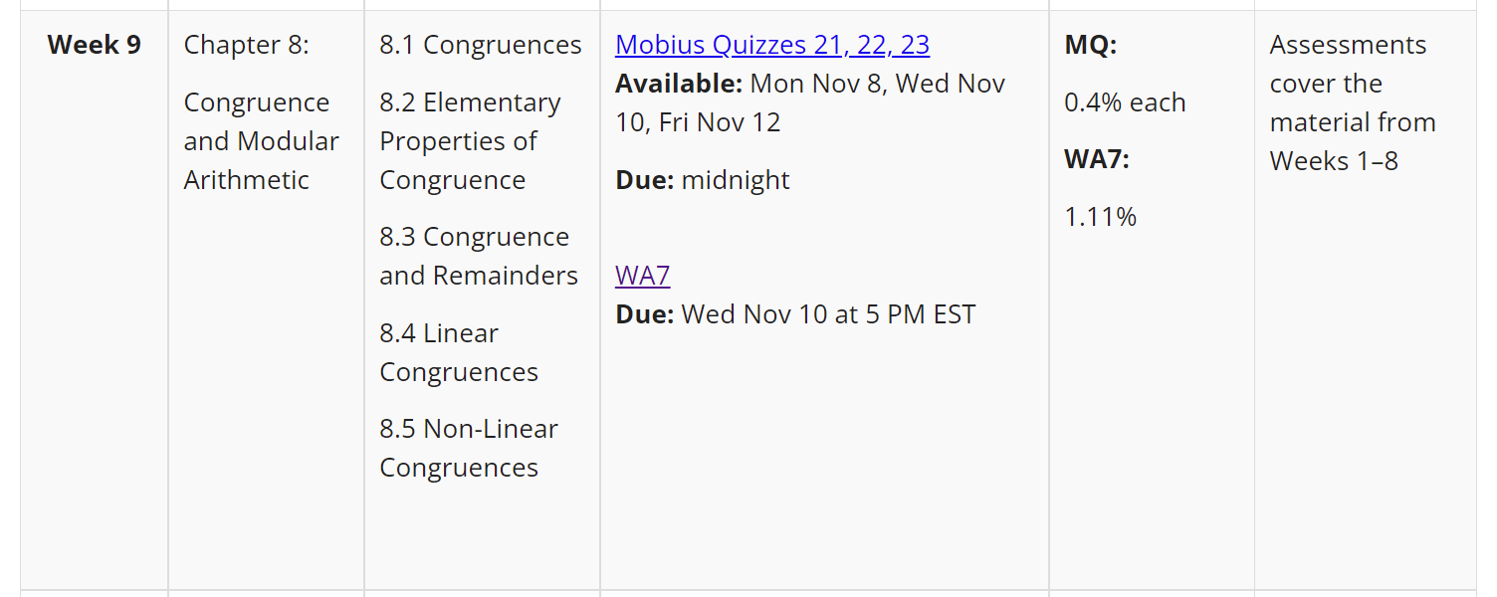
This week we’re supposed to be doing Chapter 8
Usually I wait until Wednesday, to maximize assignment help
But end of Ch6 was just prime factorization. Ch7: not much content
I started Ch8 early because…

Slide 11
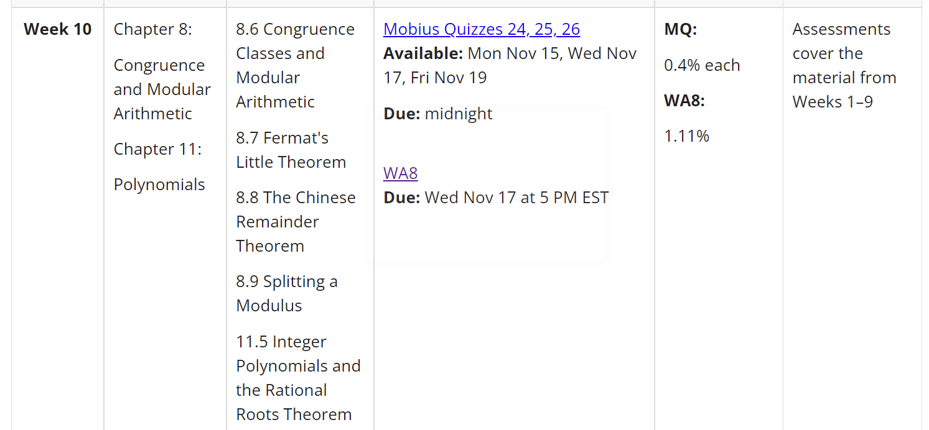
The proofs will be complex: Must know EVERYTHING.
(divisibility, gcd, Diophantine, modular arithmetic, congruence classes, FLT, CRT, polynomials, etc.)

Slide 12
Regrade requests:
If you disagree with your regrade, let me know by end of Tuesday
Monday 8 November:
Mobius quiz tonight! (covers up to middle of page 121)
Wednesday 10 November:
Submit Written Assignment 7: WA7 (covers up to page 121)
Reading: 8.1-8.4 (122-133) won’t take long (I’ve covered it already!)
Reading: 8.5-8.9 (122-148) worth getting a head start!

Slide 13
What’s the last digit of 7³³³³?
Latin: digiti = fingers
Latin: decem = 10.
Binary “digit” is a bit
In quantum computing: qubit
Powers of 7:
7, 49, 343, 2401, 16807

Slide 14
What’s the last digit of 7³³³³?
Latin: digiti = fingers
Latin: decem = 10.
Binary “digit” is a bit
In quantum computing: qubit
Powers of 7:
7, 49, 343, 2401, 16807
7² ≡ -1 (mod 10)
7³³³³ ≡ 7^{2 ∙ 1666} 7¹ (mod 10)
≡ (-1)^{2 ∙ 1666} 7 (mod 10)
≡ 7 (mod 10)

Slide 15
How do you know if a number is divisible by 3?
Proposition 8 in Chapter 8.3.
How do you know if a number is divisible by 11?
Proposition 9 in Chapter 8.3:
Check if 11 | A – B,
A = sum of 1st, 3rd, 5th, 7th, etc. digits
B = sum of 2nd, 4th, 6th, 8th, etc. digits
Does 11 | 6455874532635 ?

Slide 16

x = 20n + 12
(20n + 12) ≡ 11 (mod 39)
20n ≡ -1 (mod 39)
20n = 39y - 1
1 = 39y -20n [now solve the Diophantine eqn]

Slide 17


x = 20n + 12

Slide 18


Slide 19

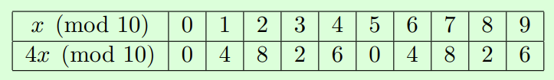
Small modulus! Skip the EEA:

Slide 20

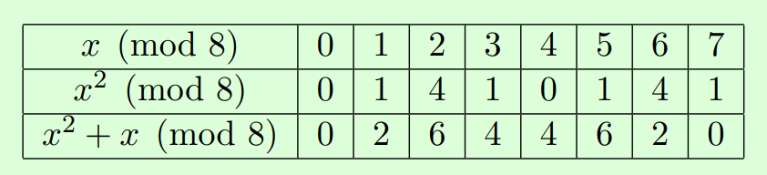

Slide 21
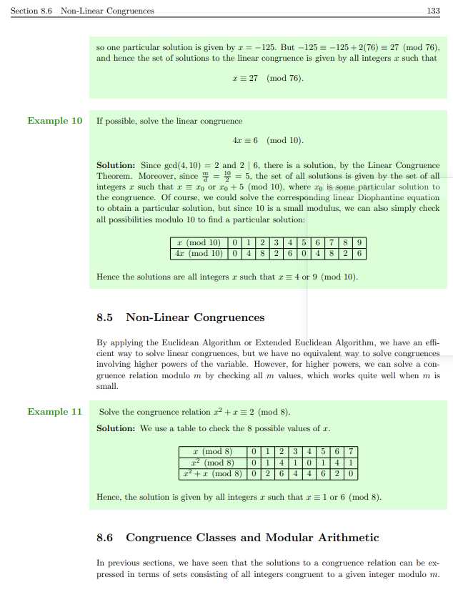

Slide 22
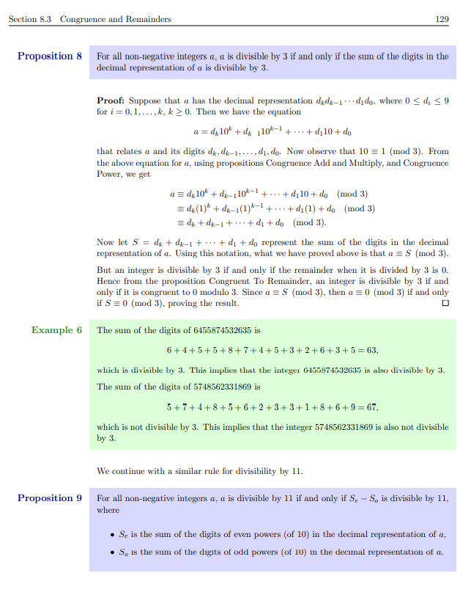

Slide 23
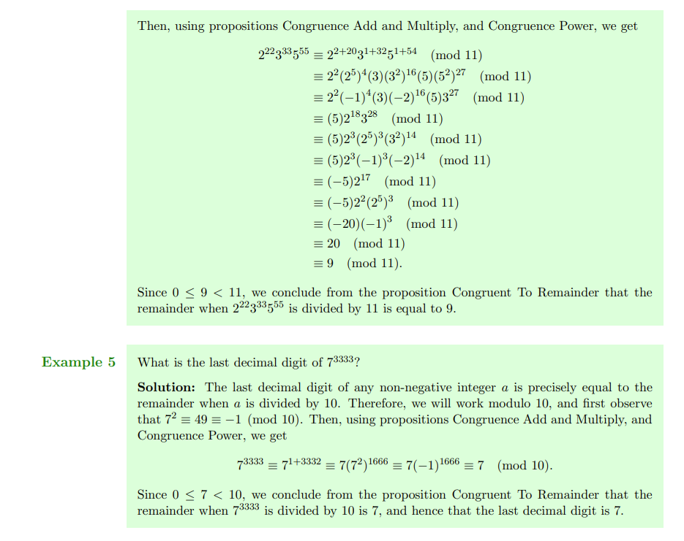

Slide 24
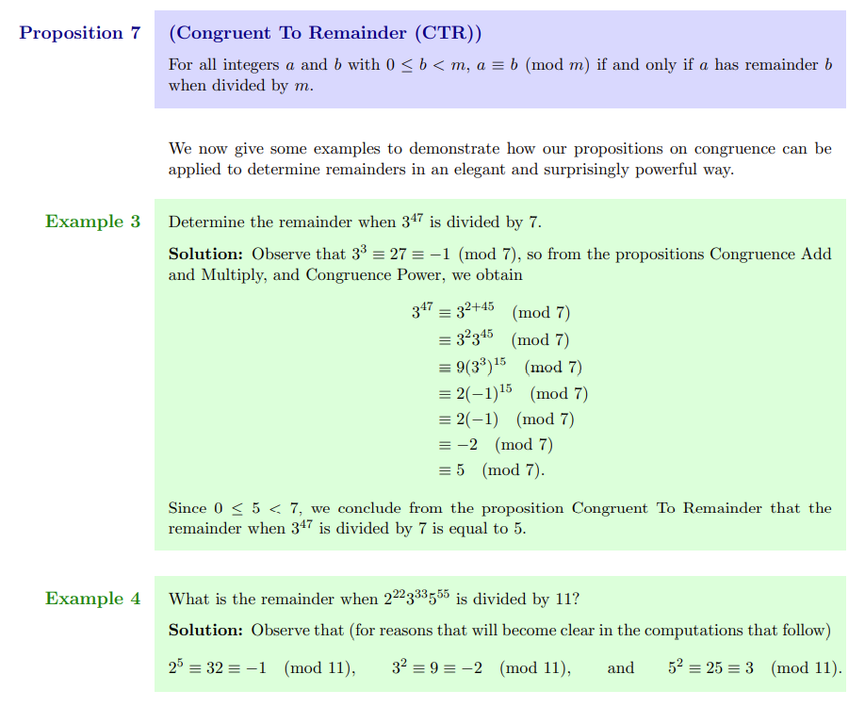

Slide 25
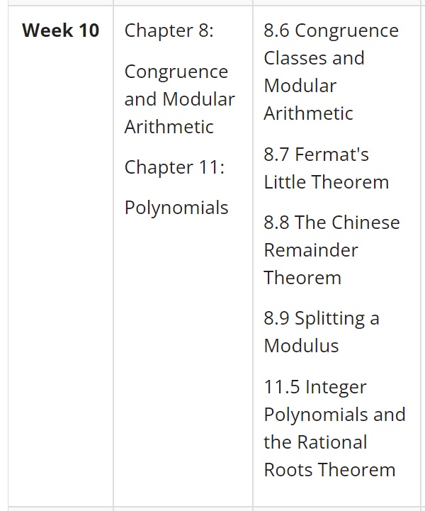
I’d like to do more examples but:
There’s not much sense in doing more examples until you’ve learned all this
Why practice proving things without these theorems,
if on the exam you’ll be allowed to use them?
The faster we get there,
the sooner we can start doing practice exams more seriously / realistically.

Slide 26
If I went through 8.1 to 8.5 too fast:
Tell me what you need me to go through more slowly, and I will do it.
- Read the course notes to fill in the gaps
- Ask on Piazza.
- Ask at office hours
- Go to online tutorial centre
- If you really think you’ll learn what’s in the course notes better if “lectured”,
Look at lecture notes of other instructors on LEARN
→ no assignment tips, no previous exam problems, but content covered
But be careful: Lectures don’t tend to be as “refined” as the course notes. One mistake could be very costly.

Slide 27
Thank you!

Slide 28
Tutor connect, if no one replied, what to do.
Jason D’Souza apology
Laith: EEA
Survey results: overall satisfaction (academia.SE page)
Survey: course notes (add that you can look at Jerry’s)
Maybe Example 2 of Chapter 8

