Slide 1


Computer Spectrometers
Nike Dattani
Harvard Smithsonian Center for Astrophysics

Slide 2
Computer Spectrometers
_{and}
Image processing for genetics
Nike Dattani
Harvard Smithsonian Center for Astrophysics

Slide 3

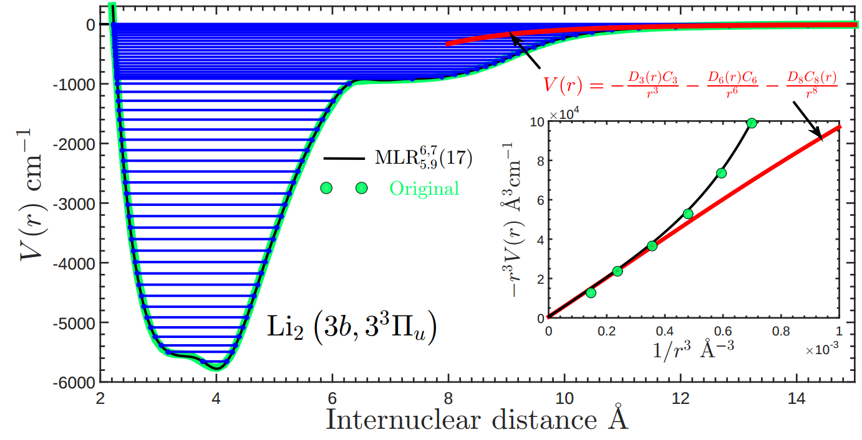
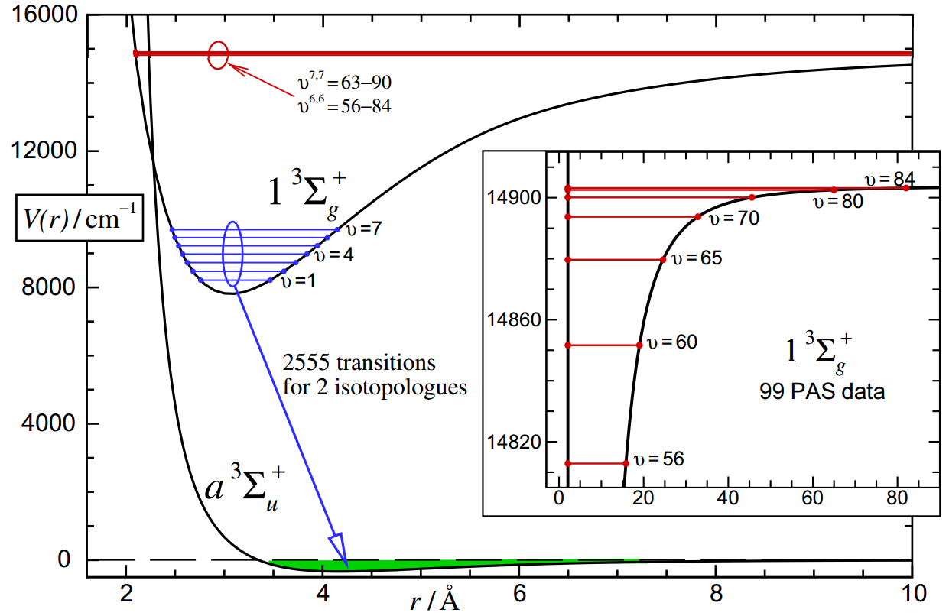
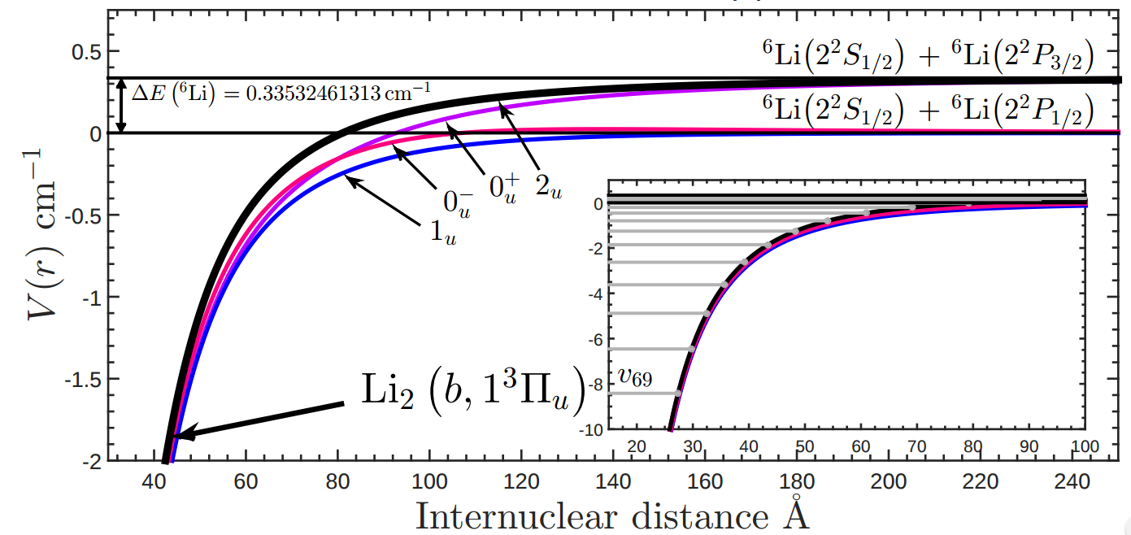

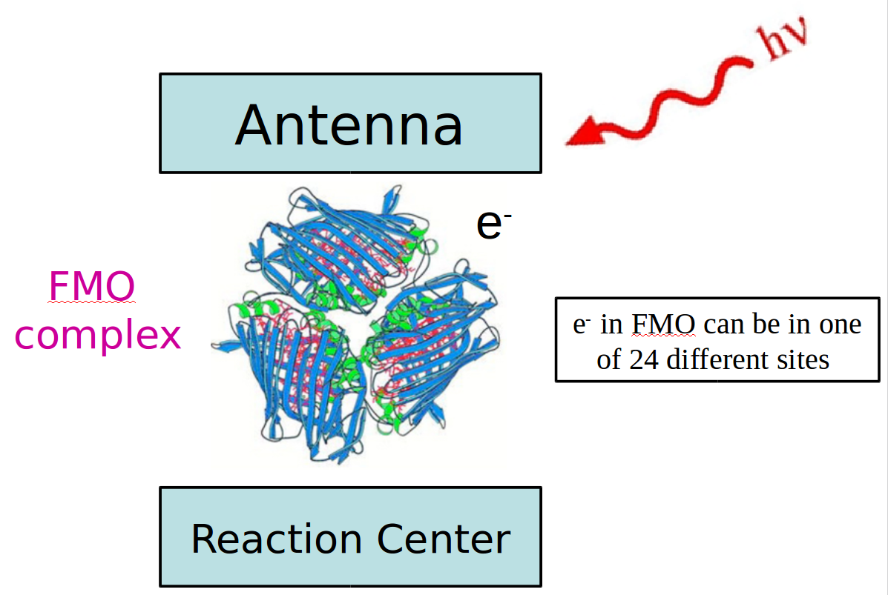
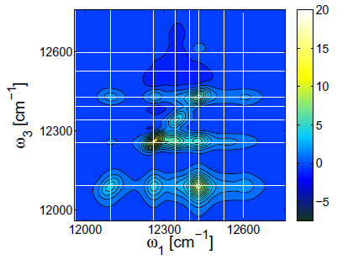
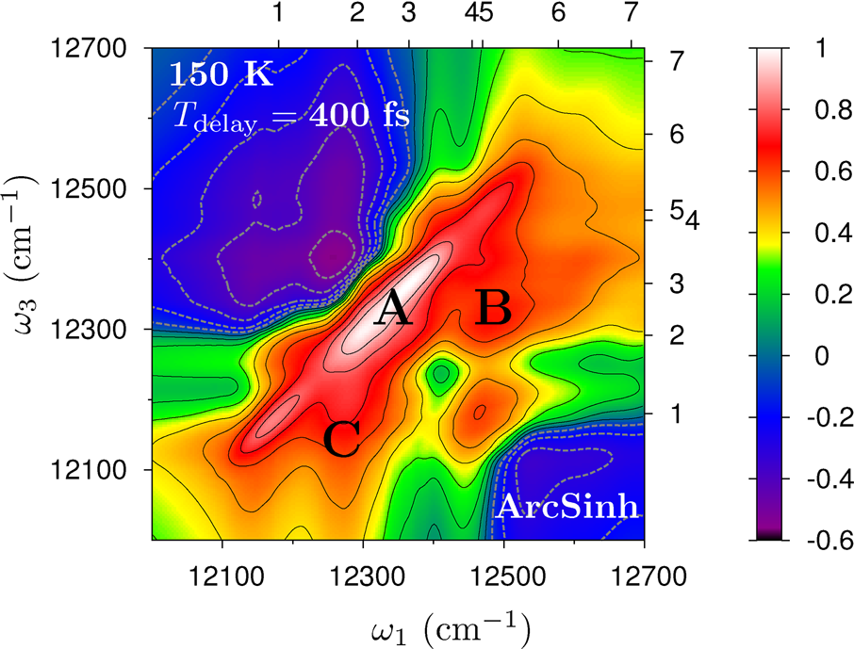
2005 – 2009: University of Waterloo, Canada
Ultra-high precision spectroscopy
2009 – 2013: Oxford University, UK
Ultra-high precision dynamics

Slide 4

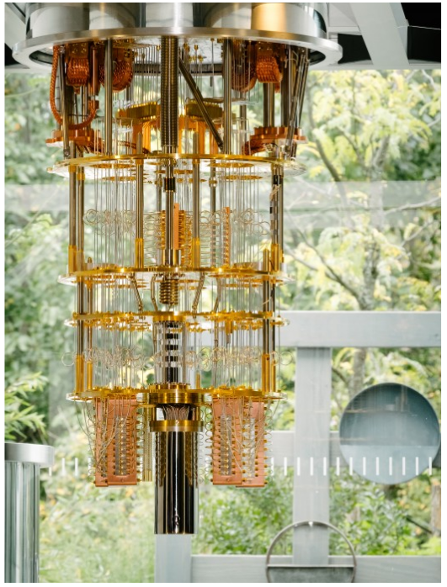
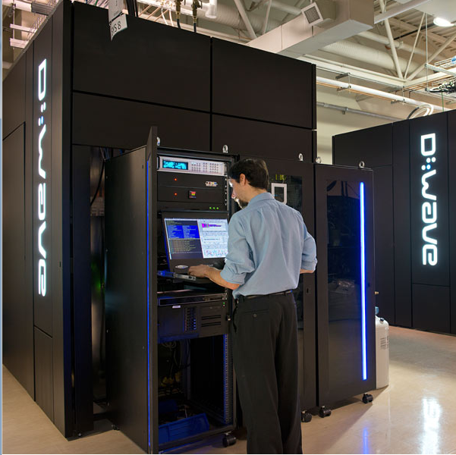
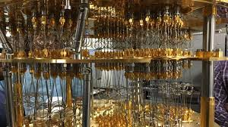

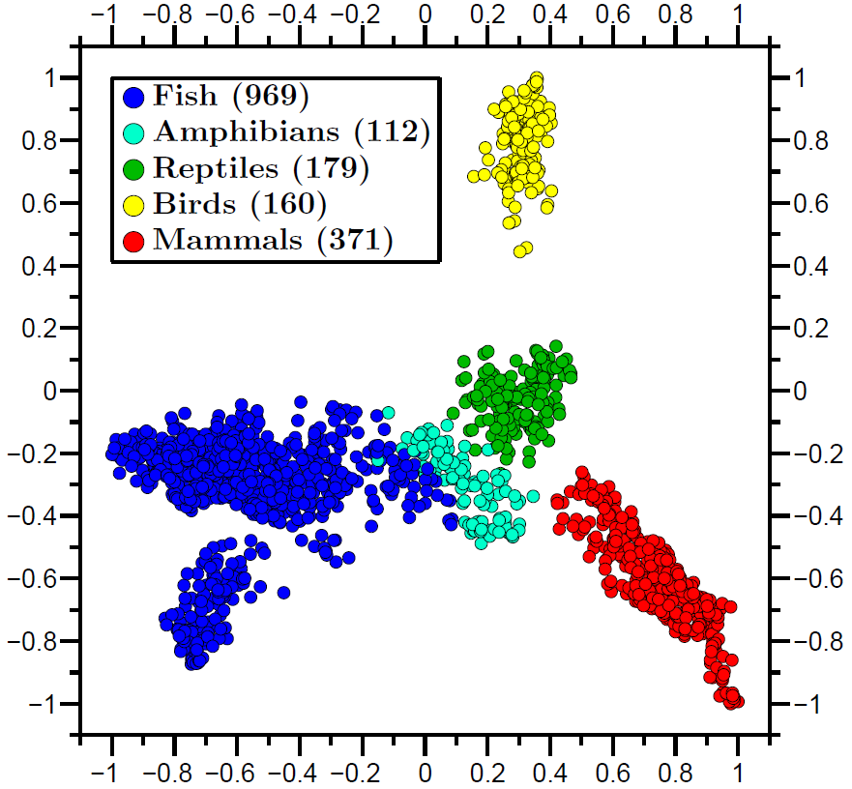
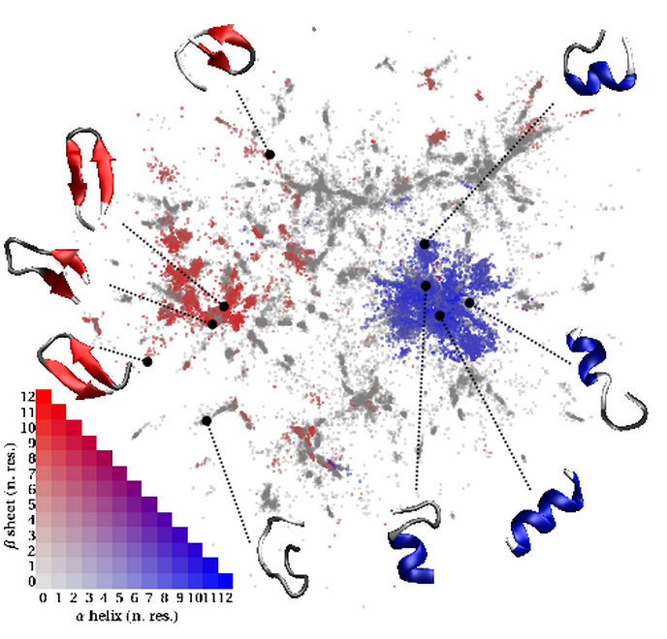
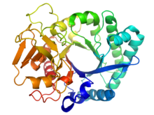
2013 – 2015: Kyoto University, Japan
New World Record in Quantum Computing
2015 – 2017: Nanyang Technological
University, Singapore
Genetics and Protein Folding

Slide 5
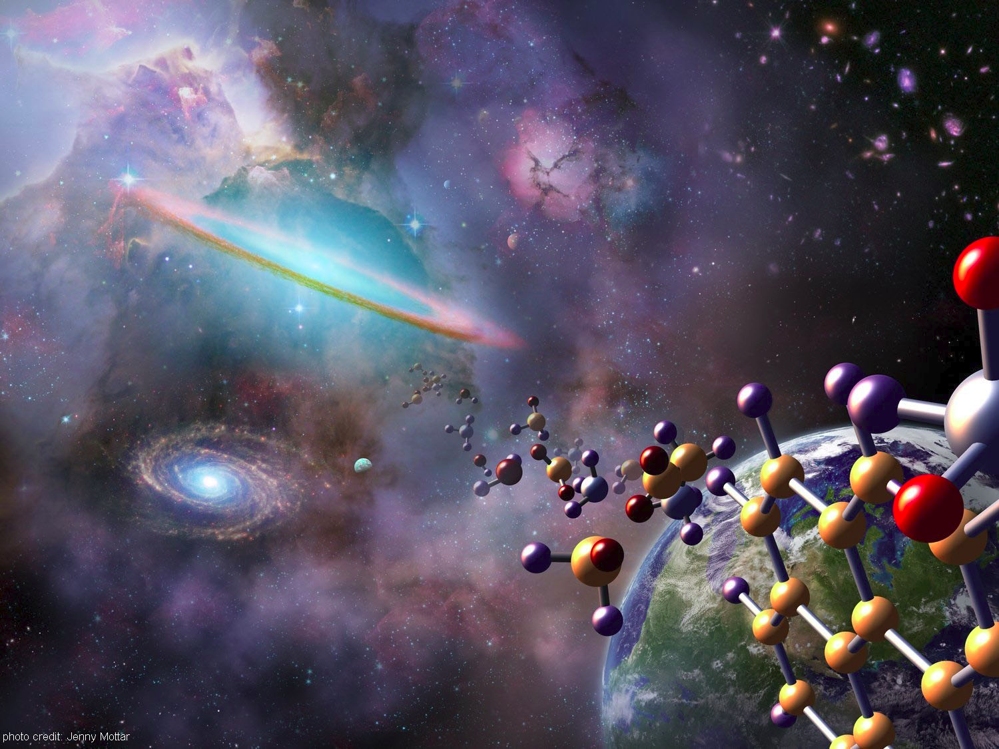
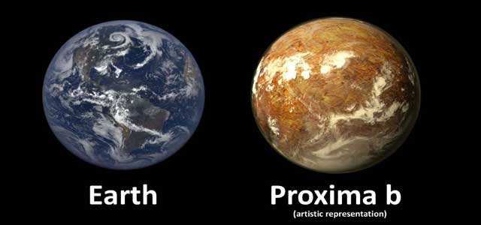
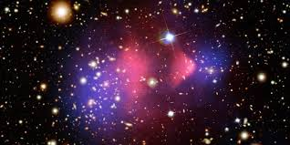
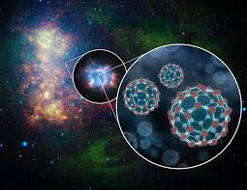
2017 – 2018: Harvard University
ab initio Astrochemistry

Slide 6

Chaos Game Representation of DNA

Slide 7
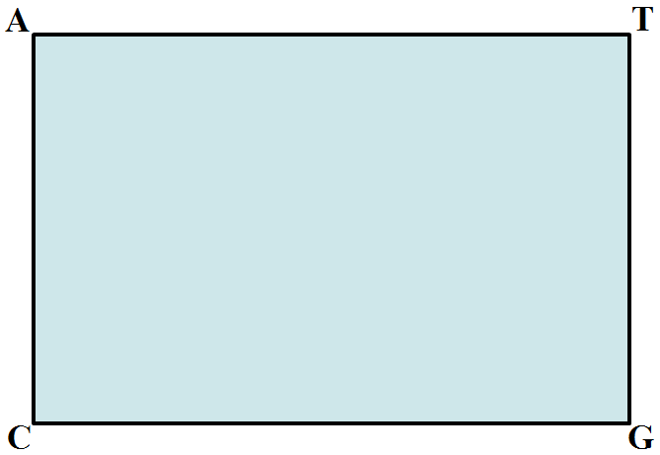
Chaos Game Representation of DNA

Slide 8
ATGGTAAG…
ATGGTAAG…
ATGGTAAG…
ATGGTAAG…

Slide 9
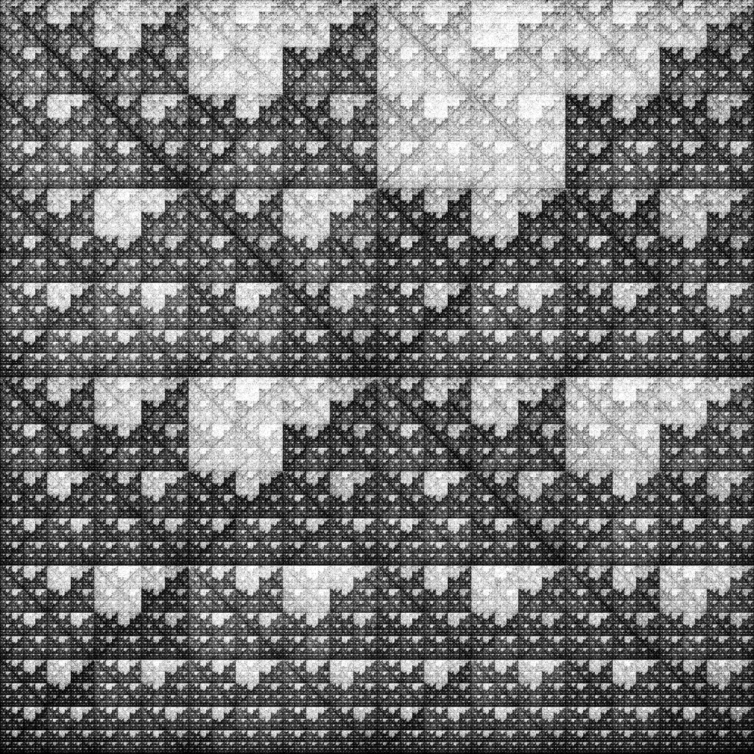
Человек разумный

Slide 10
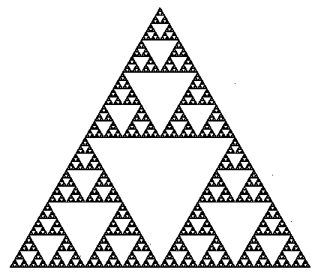
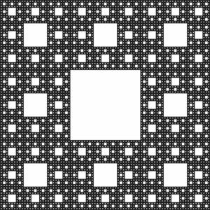
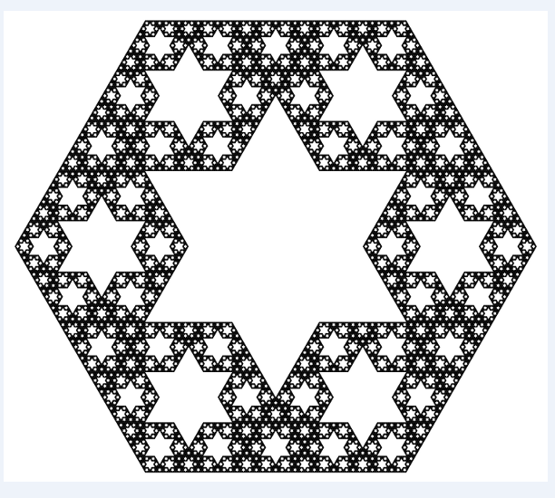

Slide 12
C
GC
GG
GA
GTAGC
A
T

Slide 14

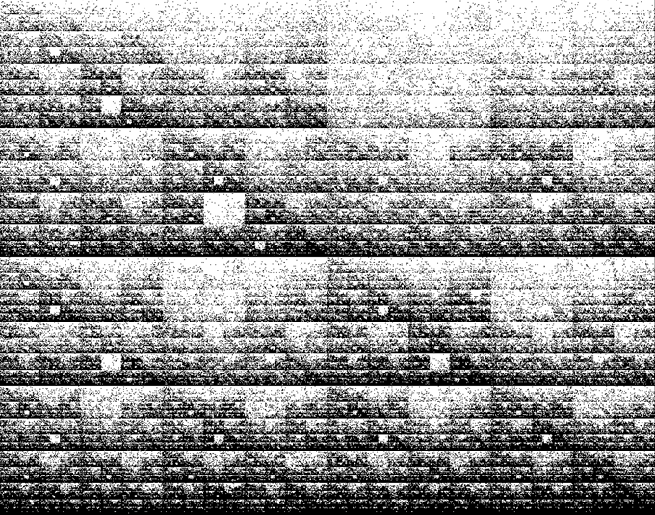
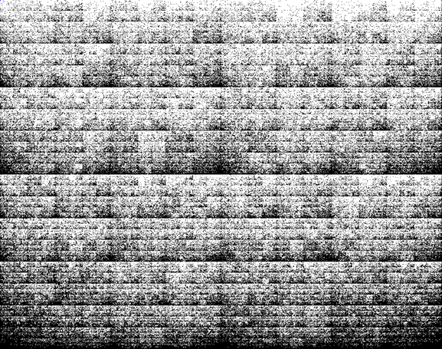
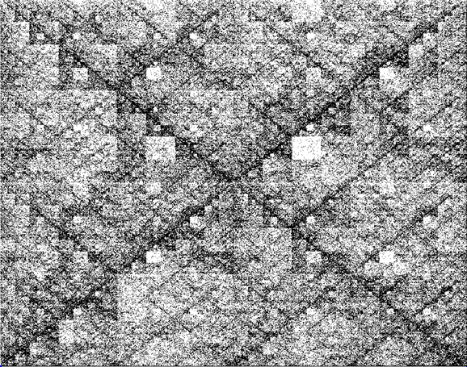
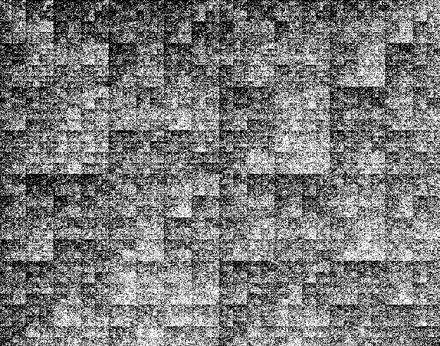
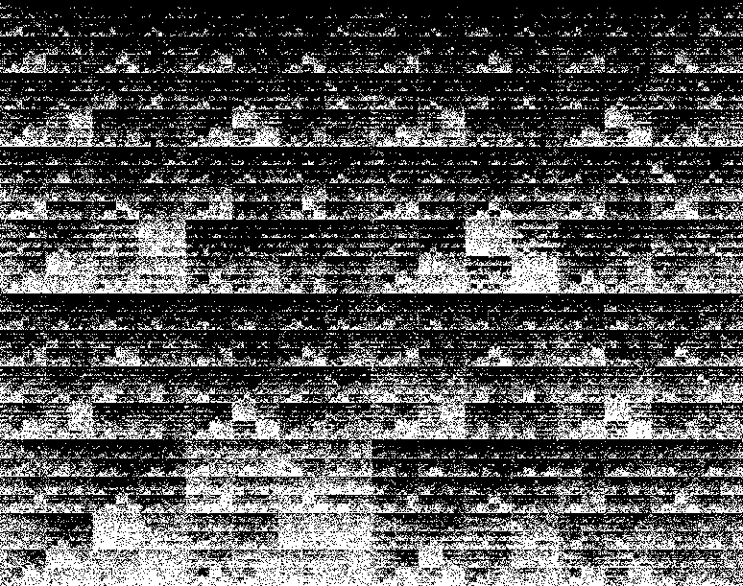
Human
Flavobacterium
psychrophilium JIP2/86
Clostridium
difficile CD196
Archaeoglobus
fulgidus DSM 4303
Alcanivorax
Borkumensis SK2
Rhodobacter
Sphaeroides KD131

Slide 15
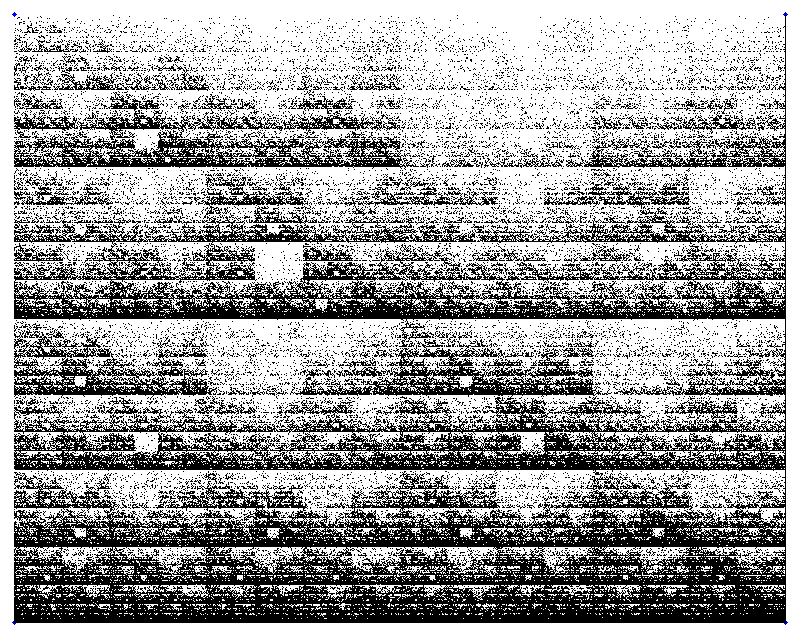
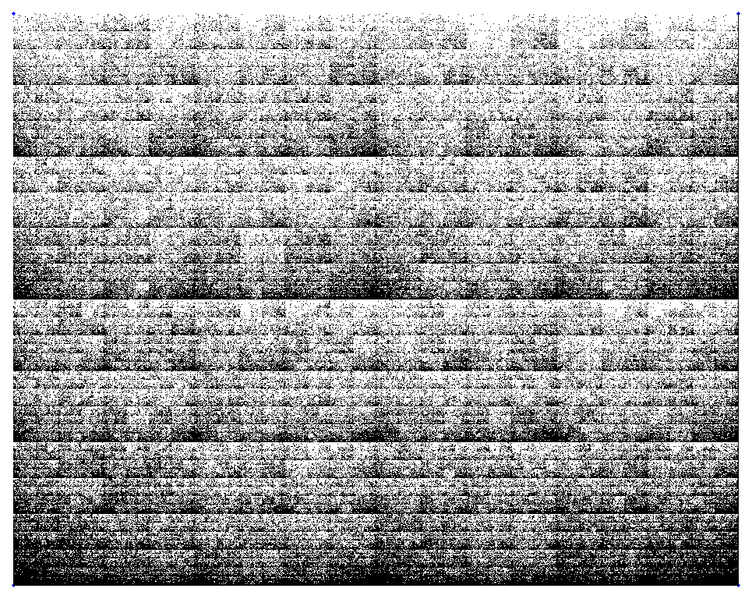
Compare images
1
VS
0
VS
VS
0.732

Slide 16
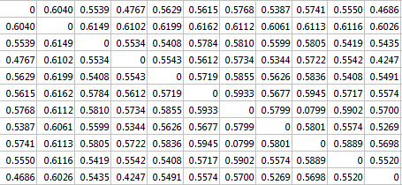
Distance Matrix

Slide 17
All sequenced vertebrates
→
Рыбы • амфи́бии • репти́лии • Пти́цы • Млекопита́ющие

Slide 18
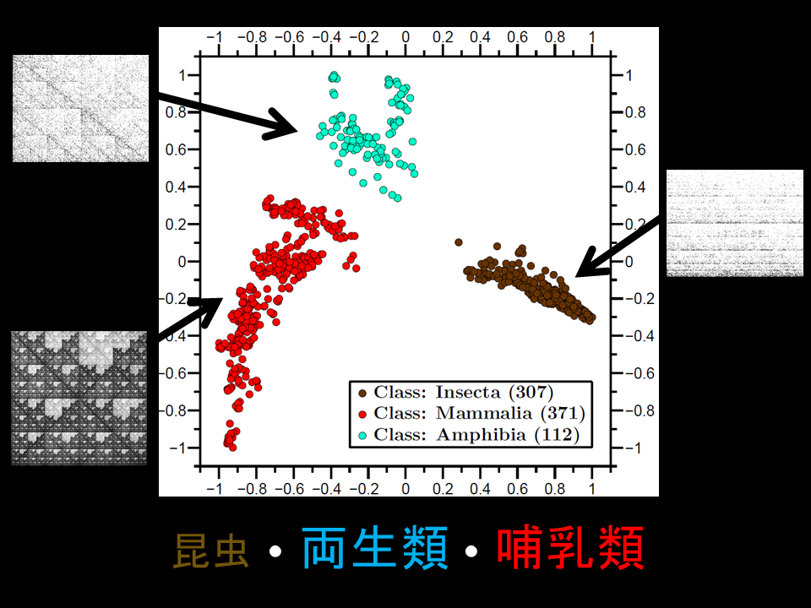
ダーウィンはファッションデザイナーでした

Slide 19
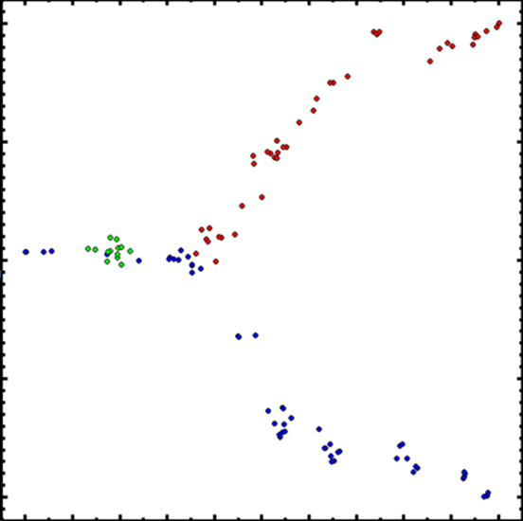
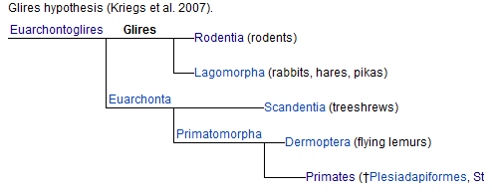
Evolution
Грызуны́
Прима́ты
Грызуны́ • Прима́ты

Slide 20
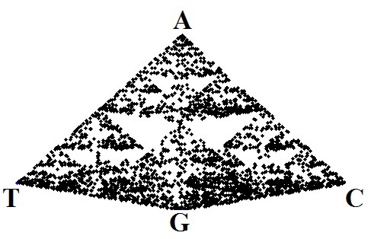
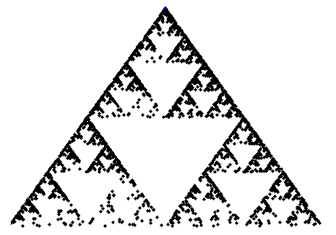
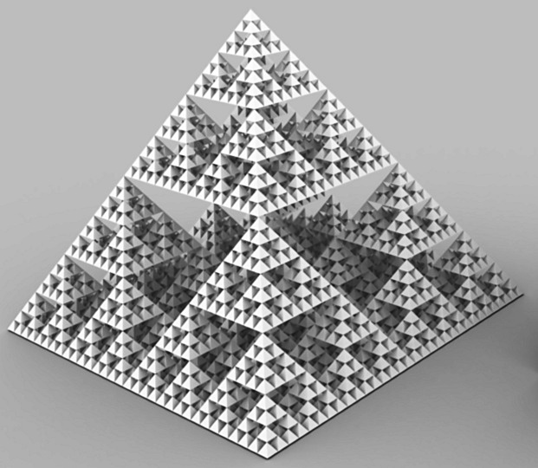
3D Chaos Game
2D Projection
2D-проекция

Slide 21
Protein structure

Slide 22
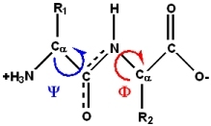
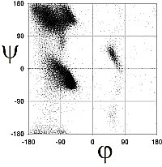
Dipeptide (1963)
Protein (2018)

Slide 23
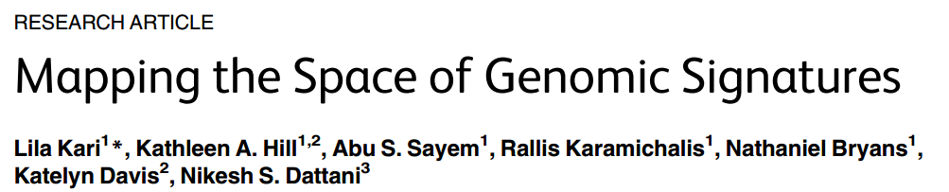
- Plants
- Viruses
- Human populations
- Archaeological samples
- Nuclear chromosomal DNA
- Chloroplast DNA
- RNA
- Taxonomic studies
Comparisons:
- MDS vs PCA vs Isomap, etc.
- Different image procesing algorithms
- 3D multi-dimensional scaling
- Comparisons against alignment based methods
- Various clustering algorithms
- APPLICATIONS
https://github.com/ndattani/genomicMDS

Slide 24
Part II
Computer Spectrometers!
Notes:
Muonium Experimental energy gap is hyperfine structure according to table 19 of: http://arxiv.org/pdf/hep-ph/0509010.pdf
He (from Table VIII of http://www.fuw.edu.pl/~krp/papers/hfs_theory_v2.pdf): Experimental: 6 739 701.177(16)
Theoretical: 6 739 699.93
Fourth order means: alpha^4

Slide 25
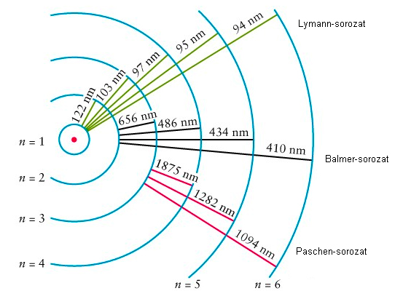
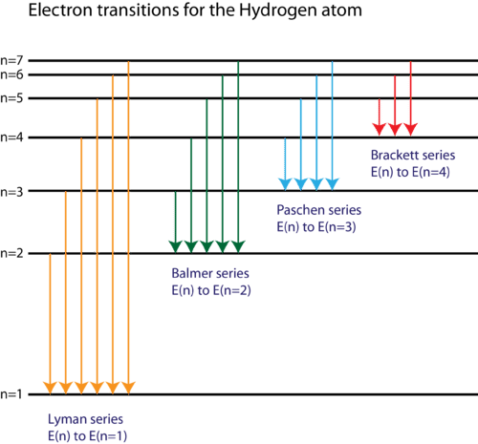
Hydrogen Spectroscopy
Notes:
Muonium Experimental energy gap is hyperfine structure according to table 19 of: http://arxiv.org/pdf/hep-ph/0509010.pdf
He (from Table VIII of http://www.fuw.edu.pl/~krp/papers/hfs_theory_v2.pdf): Experimental: 6 739 701.177(16)
Theoretical: 6 739 699.93
Fourth order means: alpha^4

Slide 26
Hydrogen Spectroscopy
P
S
Nobel Prize 1922: Bohr
Nobel Prize 1933: Schrödinger
Notes:
Muonium Experimental energy gap is hyperfine structure according to table 19 of: http://arxiv.org/pdf/hep-ph/0509010.pdf
He (from Table VIII of http://www.fuw.edu.pl/~krp/papers/hfs_theory_v2.pdf): Experimental: 6 739 701.177(16)
Theoretical: 6 739 699.93
Fourth order means: alpha^4

Slide 27
Hydrogen Spectroscopy
P_{3/2}
P
P_{1/2}
S
S
Nobel Prize 1922: Bohr
Nobel Prize 1933: Schrödinger
Nobel Prize 1933: Dirac
Notes:
Muonium Experimental energy gap is hyperfine structure according to table 19 of: http://arxiv.org/pdf/hep-ph/0509010.pdf
He (from Table VIII of http://www.fuw.edu.pl/~krp/papers/hfs_theory_v2.pdf): Experimental: 6 739 701.177(16)
Theoretical: 6 739 699.93
Fourth order means: alpha^4

Slide 28
Hydrogen Spectroscopy
P_{3/2}
2P_{3/2}
P
2P_{1/2}
P_{1/2}
2S_{1/2}
S
S
1S_{1/2}
Nobel Prize 1922: Bohr
Nobel Prize 1933: Schrödinger
Nobel Prize 1933: Dirac
Nobel Prize 1955: Lamb
Nobel Prize 1965: Feynman
Nobel Prize 1965: Schwinger
Nobel Prize 1965: Tomonaga
Notes:
Muonium Experimental energy gap is hyperfine structure according to table 19 of: http://arxiv.org/pdf/hep-ph/0509010.pdf
He (from Table VIII of http://www.fuw.edu.pl/~krp/papers/hfs_theory_v2.pdf): Experimental: 6 739 701.177(16)
Theoretical: 6 739 699.93
Fourth order means: alpha^4

Slide 29
Hydrogen Spectroscopy
P_{3/2}
2P_{3/2}
2P_{3/2,1}
2P_{3/2,0}
2P_{1/2,1}
2P_{1/2,0}
2S_{1/2,1}
2S_{1/2,0}
P
2P_{1/2}
P_{1/2}
2S_{1/2}
S
S
1S_{1/2}
1S_{1/2,1}
1S_{1/2,0}
Nobel Prize 1922: Bohr
Nobel Prize 1933: Schrödinger
Nobel Prize 1933: Dirac
Nobel Prize 1955: Lamb
Nobel Prize 1965: Feynman
Nobel Prize 1965: Schwinger
Nobel Prize 1965: Tomonaga
Notes:
Muonium Experimental energy gap is hyperfine structure according to table 19 of: http://arxiv.org/pdf/hep-ph/0509010.pdf
He (from Table VIII of http://www.fuw.edu.pl/~krp/papers/hfs_theory_v2.pdf): Experimental: 6 739 701.177(16)
Theoretical: 6 739 699.93
Fourth order means: alpha^4

Slide 30
Hydrogen Spectroscopy
P_{3/2}
2P_{3/2}
2P_{3/2,1}
2P_{3/2,0}
2P_{1/2,1}
2P_{1/2,0}
2S_{1/2,1}
2S_{1/2,0}
P
0.000045 eV
2P_{1/2}
P_{1/2}
2S_{1/2}
0.0000044 eV
10.2 eV
S
S
1S_{1/2}
1S_{1/2,1}
1S_{1/2,0}
Nobel Prize 1922: Bohr
Nobel Prize 1933: Schrödinger
Nobel Prize 1933: Dirac
Nobel Prize 1955: Lamb
Nobel Prize 1965: Feynman
Nobel Prize 1965: Schwinger
Nobel Prize 1965: Tomonaga
Notes:
Muonium Experimental energy gap is hyperfine structure according to table 19 of: http://arxiv.org/pdf/hep-ph/0509010.pdf
He (from Table VIII of http://www.fuw.edu.pl/~krp/papers/hfs_theory_v2.pdf): Experimental: 6 739 701.177(16)
Theoretical: 6 739 699.93
Fourth order means: alpha^4

Slide 31
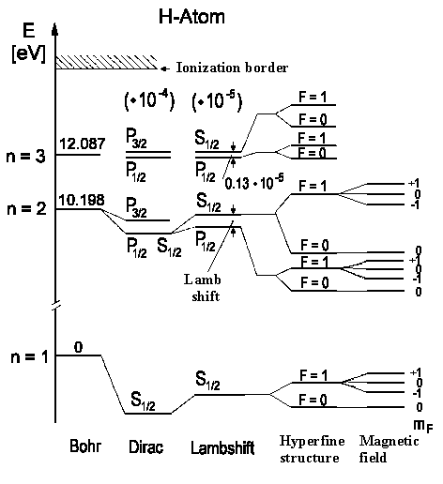
Mu (p⁺ in H is replaced by μ⁺)
0.000018458736973(1) eV (experiment)
0.000018458736973 eV (theory)
P_{3/2}
2P_{3/2}
2P_{3/2,1}
2P_{3/2,0}
2P_{1/2,1}
2P_{1/2,0}
2S_{1/2,1}
2S_{1/2,0}
P
2P_{1/2}
P_{1/2}
2S_{1/2}
S
S
1S_{1/2}
1S_{1/2,1}
1S_{1/2,0}
Nobel Prize 1922: Bohr
Nobel Prize 1933: Schrödinger
Nobel Prize 1933: Dirac
Nobel Prize 1955: Lamb
Nobel Prize 1965: Feynman
Nobel Prize 1965: Schwinger
Nobel Prize 1965: Tomonaga
Notes:
Muonium Experimental energy gap is hyperfine structure according to table 19 of: http://arxiv.org/pdf/hep-ph/0509010.pdf
He (from Table VIII of http://www.fuw.edu.pl/~krp/papers/hfs_theory_v2.pdf): Experimental: 6 739 701.177(16)
Theoretical: 6 739 699.93
Fourth order means: alpha^4

Slide 32
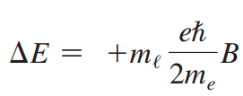
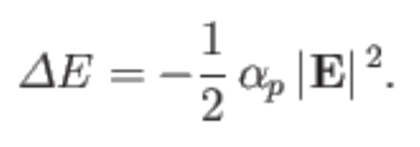
Mu (p⁺ in H is replaced by μ⁺)
0.000018458736973(1) eV (experiment)
0.000018458736973 eV (theory)
1S_{1/2,1,+1}
1S_{1/2,1,0}
1S_{1/2,1,-1}
1S_{1/2,0,0}
S
1S_{1/2,1}
1S_{1/2,0}
3S_{1/2,1,2}
3S_{1/2,1,1}
3S_{1/2,1,2}
3S_{1/2,0,1}
S
3S_{1/2,1}
3S_{1/2,0}
Notes:
Muonium Experimental energy gap is hyperfine structure according to table 19 of: http://arxiv.org/pdf/hep-ph/0509010.pdf
He (from Table VIII of http://www.fuw.edu.pl/~krp/papers/hfs_theory_v2.pdf): Experimental: 6 739 701.177(16)
Theoretical: 6 739 699.93
Fourth order means: alpha^4

Slide 33

Mu (p⁺ in H is replaced by μ⁺)
0.000018458736973(1) eV (experiment)
0.000018458736973 eV (theory)
1S_{1/2,1,+1}
1S_{1/2,1,0}
1S_{1/2,1,-1}
1S_{1/2,0,0}
S
1S_{1/2,1}
1S_{1/2,0}
3S_{1/2,1,2}
3S_{1/2,1,1}
3S_{1/2,1,2}
3S_{1/2,0,1}
S
3S_{1/2,1}
3S_{1/2,0}
S
3S_{1/2,1}
3S_{1/2,0}
Notes:
Muonium Experimental energy gap is hyperfine structure according to table 19 of: http://arxiv.org/pdf/hep-ph/0509010.pdf
He (from Table VIII of http://www.fuw.edu.pl/~krp/papers/hfs_theory_v2.pdf): Experimental: 6 739 701.177(16)
Theoretical: 6 739 699.93
Fourth order means: alpha^4

Slide 34
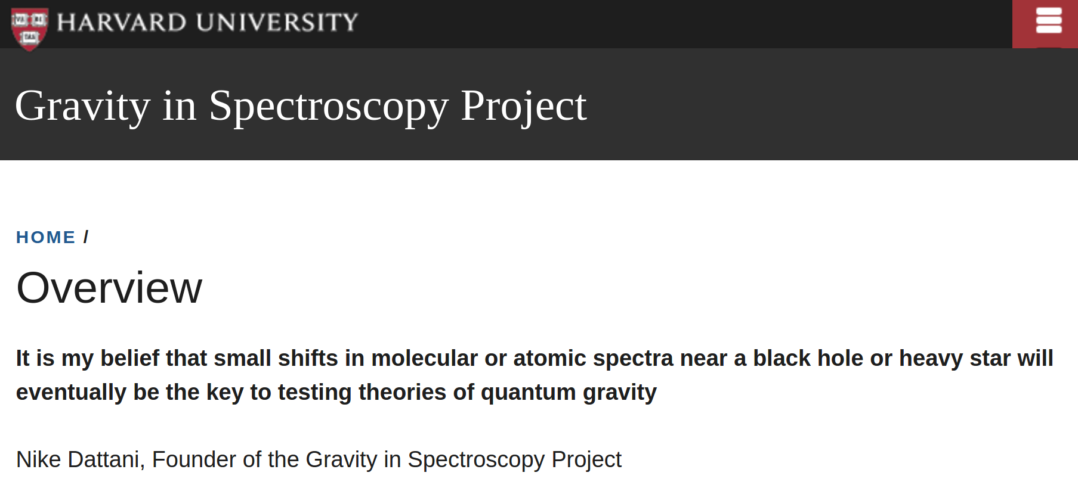

Slide 35
3e⁻ : Li
Experiment: 14903.632061014 +/- 0.0000005003 cm⁻¹
Theory: 14903.631765 +/- 0.000667 cm⁻¹
Experiment: 1.84781486 eV
Theory: 1.84781482(8) eV
Notes:
Experimental energy gap is hyperfine structure according to table 4 of: http://arxiv.org/pdf/hep-ph/0509010.pdf
He (from Table VIII of http://www.fuw.edu.pl/~krp/papers/hfs_theory_v2.pdf): Experimental: 6 739 701.177(16)
Theoretical: 6 739 699.93
Fourth order means: alpha^4

Slide 36
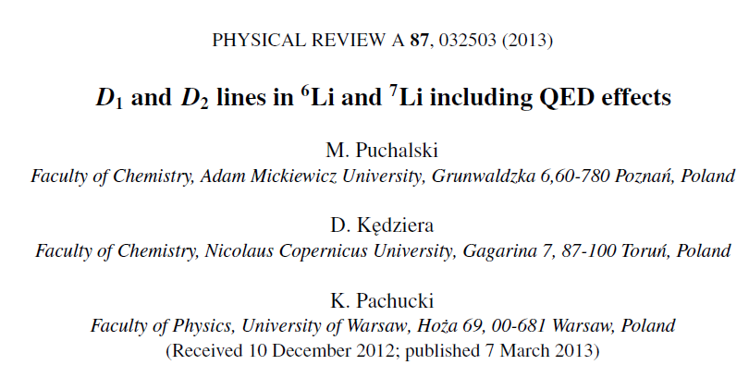
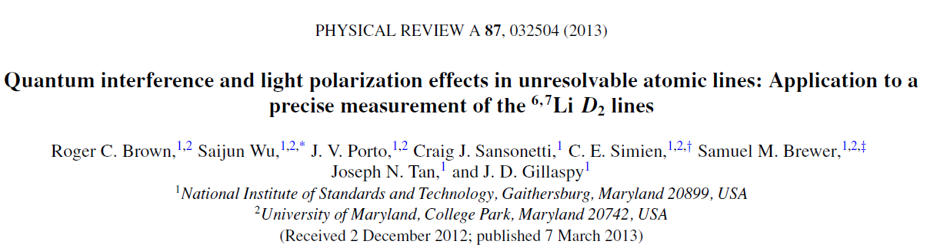
Theory:
Experiment:
Notes:
Experimental energy gap is hyperfine structure according to table 4 of: http://arxiv.org/pdf/hep-ph/0509010.pdf
He (from Table VIII of http://www.fuw.edu.pl/~krp/papers/hfs_theory_v2.pdf): Experimental: 6 739 701.177(16)
Theoretical: 6 739 699.93
Fourth order means: alpha^4

Slide 37
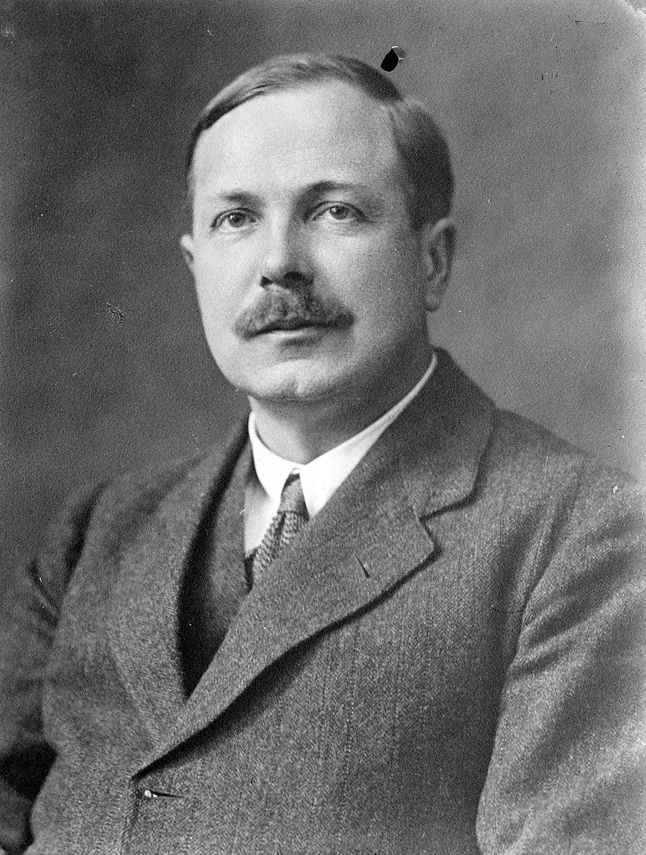
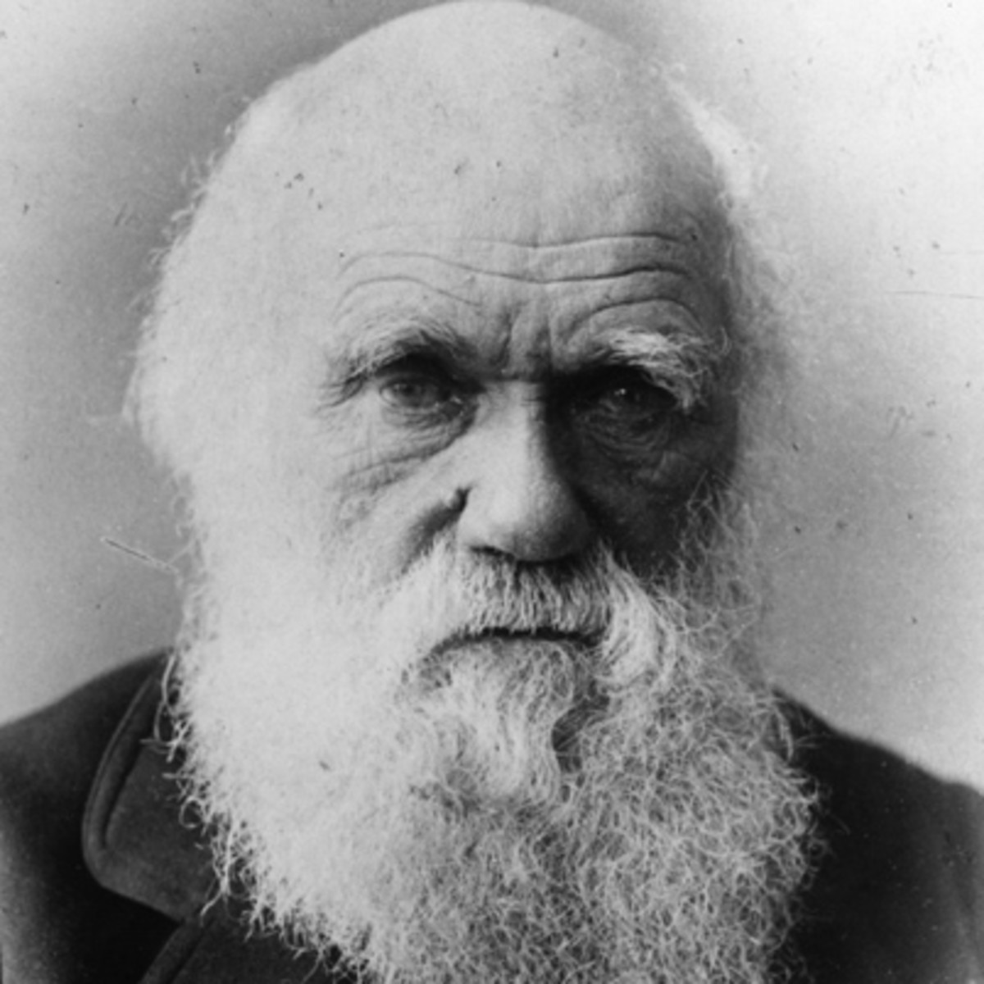
Darwin, Mass velocity, spin-spin, spin-orbit, orbit-orbit
Dirac-Coulomb-Breit
Schrodinger Eqn
Lamb shift
α²H₂ + α⁴H₄ + α⁵H₅ + α⁶H₆ + α⁷H_{7 ..}
QED Electromagnetism
QFD Weak nuclear
QCD Strong nuclear

Slide 38
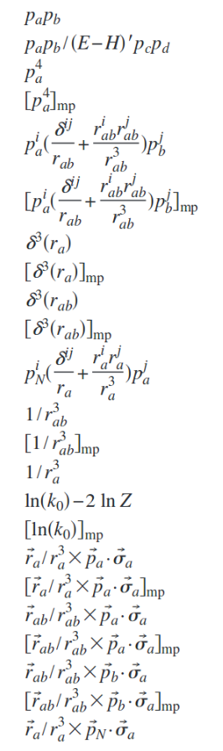
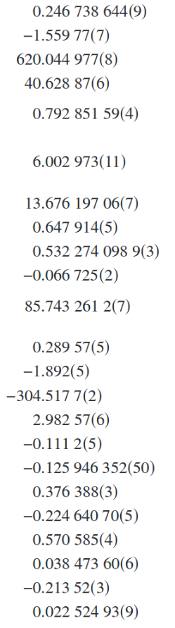
Notes:
Experimental energy gap is hyperfine structure according to table 4 of: http://arxiv.org/pdf/hep-ph/0509010.pdf
He (from Table VIII of http://www.fuw.edu.pl/~krp/papers/hfs_theory_v2.pdf): Experimental: 6 739 701.177(16)
Theoretical: 6 739 699.93
Fourth order means: alpha^4

Slide 39

Ionization energies in cm⁻¹
Notes:
Experimental energy gap is hyperfine structure according to table 4 of: http://arxiv.org/pdf/hep-ph/0509010.pdf
He (from Table VIII of http://www.fuw.edu.pl/~krp/papers/hfs_theory_v2.pdf): Experimental: 6 739 701.177(16)
Theoretical: 6 739 699.93
Fourth order means: alpha^4

Slide 40
Ionization energies in cm⁻¹
We don’t need experiments anymore
Notes:
Experimental energy gap is hyperfine structure according to table 4 of: http://arxiv.org/pdf/hep-ph/0509010.pdf
He (from Table VIII of http://www.fuw.edu.pl/~krp/papers/hfs_theory_v2.pdf): Experimental: 6 739 701.177(16)
Theoretical: 6 739 699.93
Fourth order means: alpha^4

Slide 41



Notes:
Experimental energy gap is hyperfine structure according to table 4 of: http://arxiv.org/pdf/hep-ph/0509010.pdf
He (from Table VIII of http://www.fuw.edu.pl/~krp/papers/hfs_theory_v2.pdf): Experimental: 6 739 701.177(16)
Theoretical: 6 739 699.93
Fourth order means: alpha^4

Slide 42

Notes:
Experimental energy gap is hyperfine structure according to table 4 of: http://arxiv.org/pdf/hep-ph/0509010.pdf
He (from Table VIII of http://www.fuw.edu.pl/~krp/papers/hfs_theory_v2.pdf): Experimental: 6 739 701.177(16)
Theoretical: 6 739 699.93
Fourth order means: alpha^4

Slide 43



Application 1: Computer generated databases

Slide 44


Slide 45


Slide 46




Application 2: Custom-made molecules
Notes:
Used 1000 digits for maple calculation

Slide 47


What we need to know
# of
atoms
50 kHz
Energy of
laser
∆E

Slide 48
What we need to know
If we know energy to +/- 1 cm⁻¹
+/- 30,000 MHz
120,000 measurements
1.8 years
# of
atoms
50 kHz
∆E

Slide 49

Best ab initio for Li₂ (6e⁻)
(H.B. Schlegel, Gordon Drake)

Slide 50
Vibrational Energies in cm⁻¹
r [Å] | Schlegel & Drake | Present (FCI QMC) | Empirical BO ∞Li₂ | Diff.
5.0 | -254.59 | -255.08(14) | -255.22 | 0.14 cm⁻¹
6.0 | -135.88 | -137.54(32) | -137.66 | 0.12 cm⁻¹
6.5 | -94.46 | -96.39(12) | -96.51 | 0.12 cm⁻¹
7.0 | -64.68 | -66.61(14) | -66.51 | 0.10 cm⁻¹
8.0 | -30.20 | -31.70(12) | -31.72 | 0.02 cm⁻¹
9.0 | -14.73 | -15.51(15) | -15.55 | 0.04 cm⁻¹
15 | -0.63 | -0.59(88) | -0.64 | 0.05 cm⁻¹
20 | -0.11 | -0.07(170) | -0.11 | 0.04 cm⁻¹
30 | -0.00935 | -0.0065(1100) | -0.00939 | 0.003 cm⁻¹
Semczuk, Dattani, et al. (2013) PRA, 87, pg. 052505
Gunton, Dattani et al. (2013) PRA, 88, 062510
Dattani et al. ISMS 2013: FB-11

Slide 51
Application 3: Fundamental Constants

Slide 52


Change in SI definitions
Current SI units:
SI units will soon change:
26th General Conference on Weights and Measures (18-20 November 2018)

Slide 53

Measuring the Boltzmann constant
Dipole polarizability
Avagadro constant (known accurately)
pressure
(held fixed)
refractive index
(measured accurately)
vaccuum permitivity
(defined)
New definition of k_{B} , more rigorous temperature scale
Notes:
Formula rearranged from http://arxiv.org/pdf/1309.2202.pdf
It’s of course not actually radiative lifetime it’s just polarizability, but radiative lifetime will come up for Lithium later

Slide 54
HeH⁺
Dipole polarizability of He
A⁺
Rydberg
atom
HeH⁺
e⁻
He
p⁺
Notes:
Used 1000 digits for maple calculation

Slide 55

Experimentally
Measure energies and fit potential
Notes:
Used 1000 digits for maple calculation

Slide 56
Li₂
V(r) = - C₃ / r³ – C₆ / r⁶ – C₈ / r⁸ …
Radiative lifetime of Li (2p) : τ = ( 3ħ / 2C₃ ) ( λ / 2 π )³
Le Roy & Dattani (2009) JCP, 131, 204309
C₃ = 357829(8)
“most accurate C₃ value for any molecule ever determined,
by an order of magnitude” (2011 Mitroy et al.)
“landmark in diatomic spectral analysis” (2011 Mitroy et al.)
Notes:
Experimental energy gap is hyperfine structure according to table 4 of: http://arxiv.org/pdf/hep-ph/0509010.pdf
He (from Table VIII of http://www.fuw.edu.pl/~krp/papers/hfs_theory_v2.pdf): Experimental: 6 739 701.177(16)
Theoretical: 6 739 699.93
Fourth order means: alpha^4

Slide 57
Li₂
V(r) = - C₃ / r³ – C₆ / r⁶ – C₈ / r⁸ …
Radiative lifetime of Li (2p) : τ = ( 3ħ / 2C₃ ) ( λ / 2 π )³
HeH⁺
V(r) = - C₄ / r³ – C₆ / r⁶ – C₇ / r⁷ …
Dipole polarizability of He : α = 2C₄
Notes:
Experimental energy gap is hyperfine structure according to table 4 of: http://arxiv.org/pdf/hep-ph/0509010.pdf
He (from Table VIII of http://www.fuw.edu.pl/~krp/papers/hfs_theory_v2.pdf): Experimental: 6 739 701.177(16)
Theoretical: 6 739 699.93
Fourth order means: alpha^4

Slide 58

Present best experimental value: α = 1.383759 +/- 1300
Present best theoretical value: α = 1.38376079 +/- 23
Two orders of magnitude more precise than the Boltzmann constant k_{B} !
Notes:
Used 1000 digits for maple calculation

Slide 59


Notes:
Used 1000 digits for maple calculation

Slide 60
A bit about how we calculate energies:
 |  | Total non-relativistic energy [Hartree] | Method
H | 1 | -1/2 | Exact
He | 2 | -2.903 724 377 034 119 598 311 159 245 194 404 446 696 925 309 838 | Hylleraas
Li | 3 | -7.478 060 323 910 134 843 | Hylleraas
Be | 4 | -14.667 356 494 9 | ECG
B | 5 | -24.653 867 537 | ECG
C | 6 | -37.84 | ECG

Slide 61
 |  | Total non-relativistic energy [Hartree] | Method | Error
H | 1 | -1/2 | Exact
He | 2 | -2.903 724 377 034 119 598 311 159 245 194 404 446 696 925 309 838 | Hylleraas
Li | 3 | -7.478 060 323 910 134 843 | Hylleraas
 |  | -7.478 | FCIQMC / aug-cc-pCV8Z | 215 μE_{h}
Be | 4 | -14.667 356 494 9 | ECG
 |  | -14.667 | FCIQMC / aug-cc-pCV8Z | 285 μE_{h}
B | 5 | -24.653 867 537 | ECG
 |  | -24.653 | FCIQMC / aug-cc-pCV8Z | 308 μE_{h}
C | 6 | -37.84 | ECG
 |  | -37.844 229(2) | FCIQMC / aug-cc-pCV8Z

Slide 62
 | # e⁻ | Total non-relativistic energy | Method | Error
Ga | 31 | -1924.683(1) | FCI QMC / aug-cc-pCV5Z | -
 |  | -1924.679 | CCSD(T) | 4 mE_{h}
Ge | 32 | -2076.790(1) | FCI QMC | -
 |  | -2070. | CCSD(T) | 6 E_{h}
As | 33 | -2235.274(19) | FCI QMC | -
 |  | -2070. | CCSD(T) | 5 E_{h}
Se | 34 | -2401.205(14) | FCI QMC | -
 |  | -2400. | CCSD(T) | 1 E_{h}
Br | 35 | -2573.737(58) | FCI QMC | -
 |  | -2572. | CCSD(T) | 1 E_{h}
Kr | 36 | -2753.597(88) | FCI QMC | -
 |  | -2753.591 | CCSD(T) | 6 mE_{h}
For Kr atom, FCI is like CCSD..TQPH.. 18.. 36

Slide 63

FeMoco ( 54e⁻ )

Slide 64
FeMoco ( 54e⁻ )
- Active site in nitrogenase enzyme
- Does nitrogen fixation in ambient conditions
- Compare to Haber-Bosch process:
→ T = 700-800 K , P = 150-250 atm
→ 2% of the world’s annual energy supply

Slide 65



FeMoco ( 54e⁻ )

Slide 66

FeMoco ( 54e⁻ )
With FCIQMC:
- Currently running on 2048 nodes (40 000 cores)
- Oak Ridge National Laboratory (DoE award)
Finished before Microsoft made a quantum computer

Slide 67
Part III
Computer-predicted
quantum dynamics

Slide 68
Quantum dynamics is hard!
Recent attemps for the FMO:
2008 Jang et. al : Small polaron
2008: Piilo, et. al : NMQJ
2009 Palmieri, Abramavicius, Mukamel : Extended Lindblad approach
2009 Ishizaki & Fleming : Redfield equation
2009 Ishizaki & Fleming : Doctor equations
2009 Roden, Eisfeld, Strunz: Quantum state diffusion
2009 Rebentrost & Aspuru-Guzik: NMQJ
2010 Huo & Coker : Linearized Feynman integral
2010 Huo & Coker : Iterative Linearized Feynman integral
2010 Tao & Miller : Semi-classical Feynman integral
2010 Prior, Chin, Huelga, Plenio: t-DMRG - for 2 site sub-system
2010 Wu, ... , Silbey: generalized Bloch-Redfield
2011 Zhu, Kais, Rebentrost, Aspuru-Guzik: Scaled doctor equations
2011 Lloyd : time non-local quantum master equation
2011 Nalbach & Thorwart : Quasiadiabatic Feynman integral – for 7 site sub-system
2011 Ritschel, Roden, Strunz, Eisfeld : NMQSD-ZOFE , 7-level, arb. Temp. , arb. J(w)
2011 Pachon & Brumer : NIBA, 2-level, ohmic J(w)
2011 Alicki & Miklaszewski : Wigner-Weisskopf-type model (not a typical model)
2012 Reichman, Markland, Berkelbach: RDM-hybrid
2012 Markland, Berkelbach, Reichman: Ehrenfest Trajectories
......... and more (stochastic Liouville equations, generalized master equations, etc. )
Notes:
This is based on slide 22 of Tanimura’s presentation on his website. I can’t say I really know this stuff

Slide 69








Notes:
Now if we want to search the space of many different hamiltonians, to see which one gives us the density operator dynamics that we desire, We need an easy and quick way to see what density matrix dynamics arise from a given hamiltonian, and hopefully we can automate the process of searching through the space.

Slide 70

Huo & Coker JCP ( 2010 )
Notes:
This is based on slide 22 of Tanimura’s presentation on his website. I can’t say I really know this stuff

Slide 71


Notes:
This is based on slide 22 of Tanimura’s presentation on his website. I can’t say I really know this stuff

Slide 72
NUMERICALLY EXACT METHODS!
MCTDH
QUAPI
HEOM
t-DMRG
Notes:
This is based on slide 22 of Tanimura’s presentation on his website. I can’t say I really know this stuff

Slide 73
History Lesson
Feynman & Vernon (1963):
Notes:
This is based on slide 22 of Tanimura’s presentation on his website. I can’t say I really know this stuff

Slide 74

History Lesson
Feynman & Vernon (1963): couldn’t calculate anything !
Leggett & Caldeira (1983): 2 sites: approximations
Makri et. al. (1995): 3 sites: numerical algorithm (exact)
Sim & Kim (2006): 5 sites: filtering technique
FMO has 24 sites (!!!)
Notes:
This is based on slide 22 of Tanimura’s presentation on his website. I can’t say I really know this stuff

Slide 75

Feynman & Vernon (1963): couldn’t calculate anything !
Leggett & Caldeira (1983): 2 levels: approximations
Makri et. al. (1995): 3 sites: numerical algorithm (exact)
Sim & Kim (2006): 5 sites (DNA): filtering technique
2010: Dattani: double mesh (exponential reduction of RAM)
2012: Dattani, Pollock, Wilkins: analytic influence functional , 900x speedup
2012: Dattani: GPUs , > 4000x speedup
Feynman Dynamics on GPUs (https://github.com/ndattani/FeynDyn)
Notes:
This is based on slide 22 of Tanimura’s presentation on his website. I can’t say I really know this stuff

Slide 76
History Lesson
Feynman & Vernon (1963)
Leggett & Caldeira (1983): 2 levels
Makri et. al. (1995): 3 levels
Sim & Kim (2006): 5 levels
Kim & Sim (2010): 10 levels
Wilkins, Dattani, Manolopoulos (2011): 24 levels - FMO
Strumpfer, Schulten (2012): 50 levels - LH2+LH1
Tsuchimoto, Tanimura (2014): 512 levels - Ising
Jones, Dattani (2014): 600 levels - Molecular aggregate
Dattani, Chen, Gelin, Domcke (2014): 800 levels - Conical intersection
Dattani, Bryans (2014): 1024 levels - 10 qubit quantum computer
Notes:
This is based on slide 22 of Tanimura’s presentation on his website. I can’t say I really know this stuff

Slide 77
Quantum Factoring
n | Number of qubits used | Year | Algorithm
15 | 7 | 2001 | Shor (1994)
 | 4 | 2007 | Shor (1994)
 | 4 | 2007 | Shor (1994)
 | 5 | 2009 | Shor (1994)
 | 3 | 2012 | Shor (1994)
21 | 2.09 | 2012 | Shor (1994)
Notes:
Need to work out what the actual number is that would take longer than age of universe

Slide 78
Quantum Factoring
n | Number of qubits used | Year | Algorithm
15 | 7 | 2001 | Shor (1994)
 | 4 | 2007 | Shor (1994)
 | 4 | 2007 | Shor (1994)
 | 5 | 2009 | Shor (1994)
 | 3 | 2012 | Shor (1994)
21 | 2.09 | 2012 | Shor (1994)
143 | 4 | 2012 | Burges (2002)
Notes:
Need to work out what the actual number is that would take longer than age of universe

Slide 79
Quantum Factoring
n | Number of qubits used | Year | Algorithm
15 | 7 | 2001 | Shor (1994)
 | 4 | 2007 | Shor (1994)
 | 4 | 2007 | Shor (1994)
 | 5 | 2009 | Shor (1994)
 | 3 | 2012 | Shor (1994)
21 | 2.09 | 2012 | Shor (1994)
143 | 4 | 2012 | Burges (2002)
56153 | 4 | Present Work
Notes:
Need to work out what the actual number is that would take longer than age of universe

Slide 80


Factoring 143
Notes:
Need to work out what the actual number is that would take longer than age of universe

Slide 81

Notes:
Need to work out what the actual number is that would take longer than age of universe

Slide 82
The solution to:
Is the same as the input that minimizes the function:
( p₁ + q₁ - 1)²
The solution to:
Is the same as the input that minimizes the function:
( p₂ + q₂ - 1)²
Notes:
Need to work out what the actual number is that would take longer than age of universe

Slide 83
Hamiltonian for factoring numbers
The solution to:
Is the same as the minimum of the function:
( p₁ + q₁ - 1)² + ( p₂ + q₂ - 1)² + ( p₂q₁ + p₁q₂ - 1)²
So the solution is given by the ground state of the Hamiltonian:
H = ( p₁ + q₁ - 1)² + ( p₂ + q₂ - 1)² + ( p₂q₁ + p₁q₂ - 1)²
Notes:
Need to work out what the actual number is that would take longer than age of universe

Slide 84

Factoring 143
So the solution is given by the ground state of the Hamiltonian:
H = ( p₁ + q₁ - 1)² + ( p₂ + q₂ - 1)² + ( p₂q₁ + p₁q₂ - 1)²
p_{i} / q_{i}= ½ (1- σ_{z} )²
Notes:
Need to work out what the actual number is that would take longer than age of universe

Slide 85
Factoring 143
So the solution is given by the ground state of the Hamiltonian:
H = ( p₁ + q₁ - 1)² + ( p₂ + q₂ - 1)² + ( p₂q₁ + p₁q₂ - 1)²
p_{i} / q_{i}= ½ (1- σ_{z} )²
p = 11, q=13
p = 13, q=11
Notes:
Need to work out what the actual number is that would take longer than age of universe

Slide 86

Notes:
This is based on slide 22 of Tanimura’s presentation on his website. I can’t say I really know this stuff

Slide 87




Notes:
This is based on slide 22 of Tanimura’s presentation on his website. I can’t say I really know this stuff

Slide 88


Notes:
Need to work out what the actual number is that would take longer than age of universe

Slide 89


Notes:
Now if we want to search the space of many different hamiltonians, to see which one gives us the density operator dynamics that we desire, We need an easy and quick way to see what density matrix dynamics arise from a given hamiltonian, and hopefully we can automate the process of searching through the space.

Slide 90
D-Wave One (2011) – 128 qubits
- World’s first commercial quantum computer
- sold for $10 million to Lockheed Martin
D-Wave Two (2012) – 512 qubits
- sold for $10 million to NASA and Google
(Quantum Artificial Intelligence lab)
D-Wave Three (2015) - 1152 qubits
- sold for $20 million to Los Alamos Nat. Lab.
D-Wave Four (2017) – 2048 qubits
- sold for $20 million to Volkswagen,
Temporal Defense Systems Inc, Virginia Tech,
Denso Corp, Oak Ridge Nat. Lab, USC, etc.
Notes:
This is based on slide 22 of Tanimura’s presentation on his website. I can’t say I really know this stuff

Slide 91

Google Hardware Lab:
9 qubits: O’Malley et al. PRX 6, 031007 (2016)
IBM:
5 qubits (May 2016)
16 qubtis (May 2017)
Notes:
This is based on slide 22 of Tanimura’s presentation on his website. I can’t say I really know this stuff

Slide 92

Notes:
This is based on slide 22 of Tanimura’s presentation on his website. I can’t say I really know this stuff

Slide 93
Opportunities for collaboration:
- 100 QPU hours per month on D-Wave 2000Q
- 30 QPU hours on IBM 50-qubit machine
- 30 QPU hours on Rigetti 8-qubit machine
Alternatively:
- IBM’s 5-qubit and 16-qubit chips are available to the public
Notes:
This is based on slide 22 of Tanimura’s presentation on his website. I can’t say I really know this stuff

Slide 94



For another day:
1) MLR potential
Notes:
This is based on slide 22 of Tanimura’s presentation on his website. I can’t say I really know this stuff

Slide 95




For another day:
2) Halo nucleonic molecles
Notes:
This is based on slide 22 of Tanimura’s presentation on his website. I can’t say I really know this stuff

Slide 96

For another day:
2) Halo nucleonic molecles
Notes:
This is based on slide 22 of Tanimura’s presentation on his website. I can’t say I really know this stuff

Slide 97
Thank you!
All slides available:
dattani.nike@gmail.com
Notes:
Now if we want to search the space of many different hamiltonians, to see which one gives us the density operator dynamics that we desire, We need an easy and quick way to see what density matrix dynamics arise from a given hamiltonian, and hopefully we can automate the process of searching through the space.

