Slide 1
BeepMe!
Final Project Presentation
September 2013

Slide 2
Introduction and concept
You are waiting for your Dentist appointment [located at the Mall].
It is scheduled for 13:30 PM, and unfortunately you have skipped lunch.
The time is 13:20, and there are 2 patients pending before you.
Your mouth will be numbed after the appointment so you will not be able to eat for at least three more hours…

Slide 3
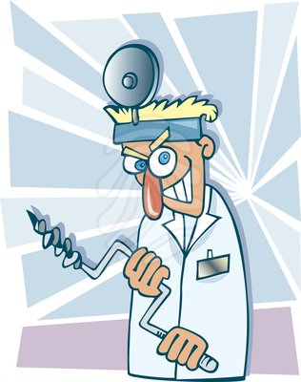
Introduction and concept
Do you have enough time to grab a quick lunch???

Slide 4
Introduction and concept
BeepMe! [Business] application will allow multi-queues maintenance and care for businesses [Kupat Holim, Pelephone, etc].
Using BeepMe! [Client], one could queue without physically stand in line and get constant status updates.
BeepMe! application serves like a beeper at money time: Beeps when turn is about to arrive, when user is too far [location], etc.

Slide 5
Business Model
BeepMe! : Downloadble
  One screen to rule them all!
BeepMe! for Business: Purchasable
  Admin console
  Employee console
  Entrance Machine
“Backward Compatibility” : users without Android…

Slide 6
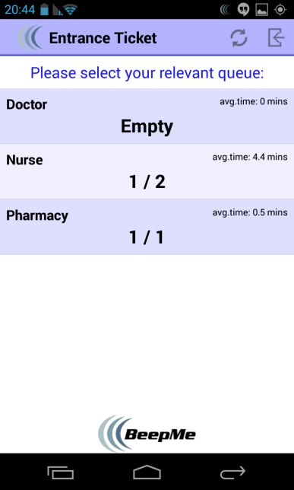
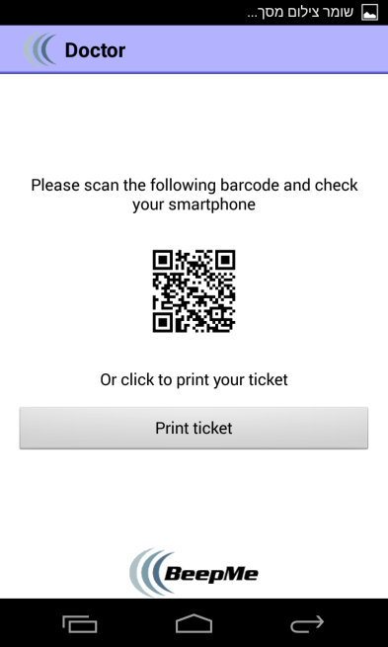
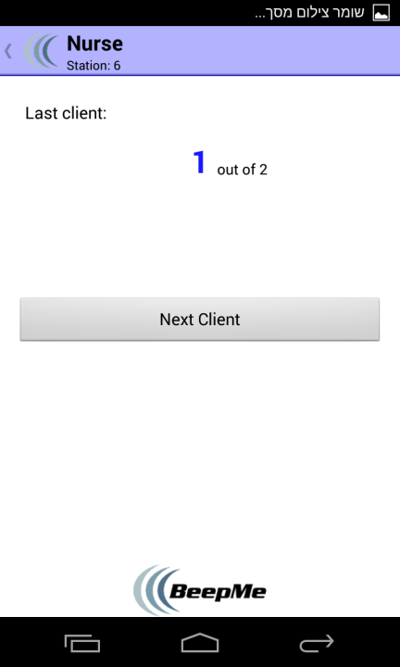
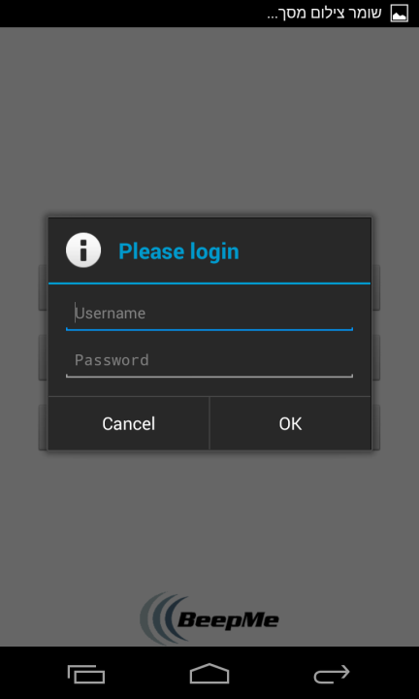
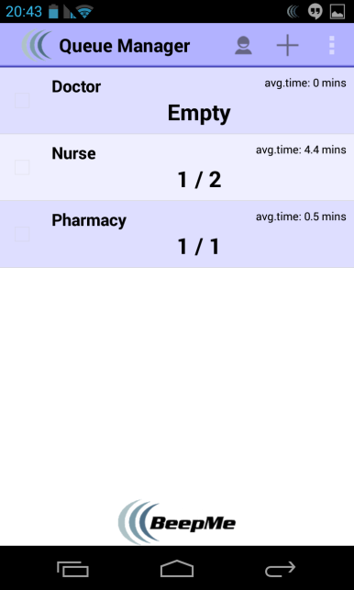
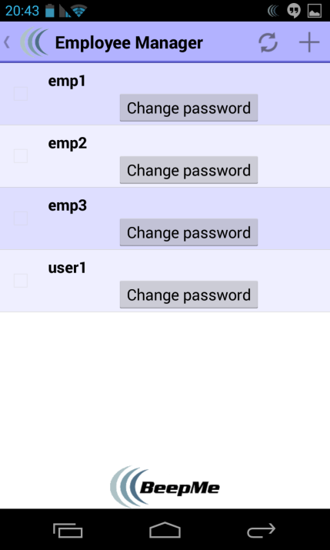
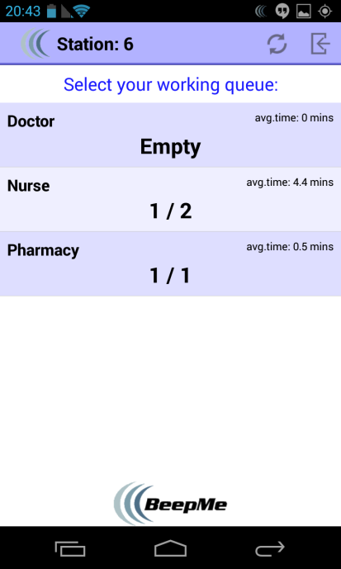
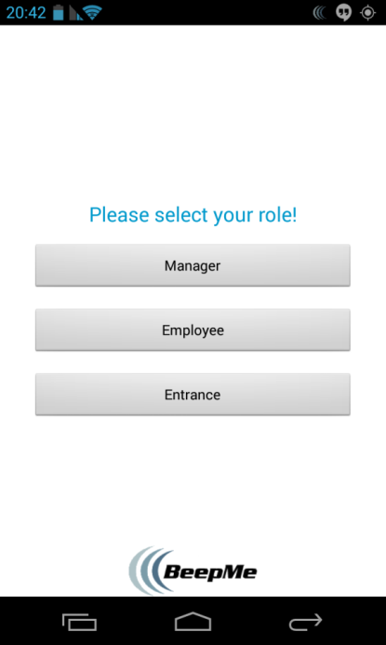
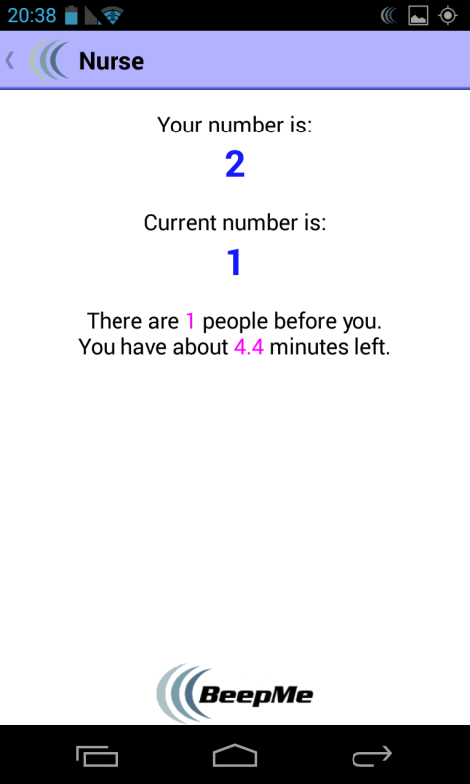
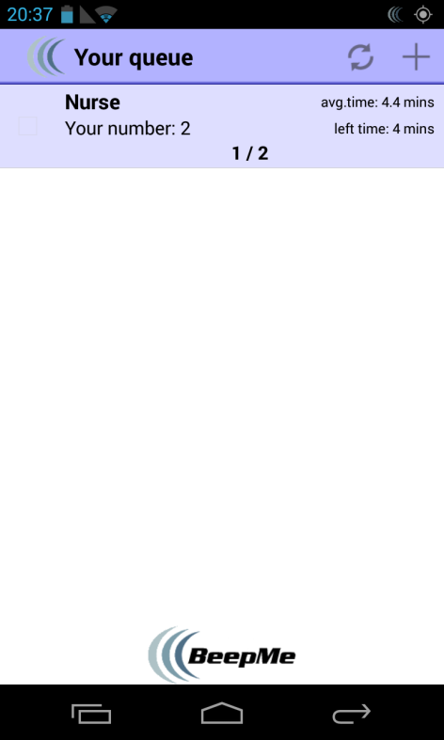
Demo
[Screen shots]
[GPS Video]

Slide 7
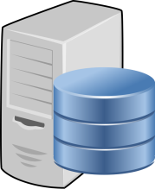

Architecture: Business (Flow)
Admin
App launch
login
Queue Manager (screen)
Save & logout
Entrance Machine
App launch
Get Ticket
Parse DB
Push Notifications
Give service
Switch queue
(Using the
button)
Queue screen
Login (ID, station)
Receptionist App launch
Main screen (all queues)

Slide 8
Architecture: Business
DAL: Parse entities & DB wrapper
BLL: ParseBroadcastReceiver, Printer (Google Cloud Print), Update services (queues & employees), activities
UI: All UI seen in Demo
External Libraries:
  ActionBar (common with Customer)
  ZXing

Slide 9
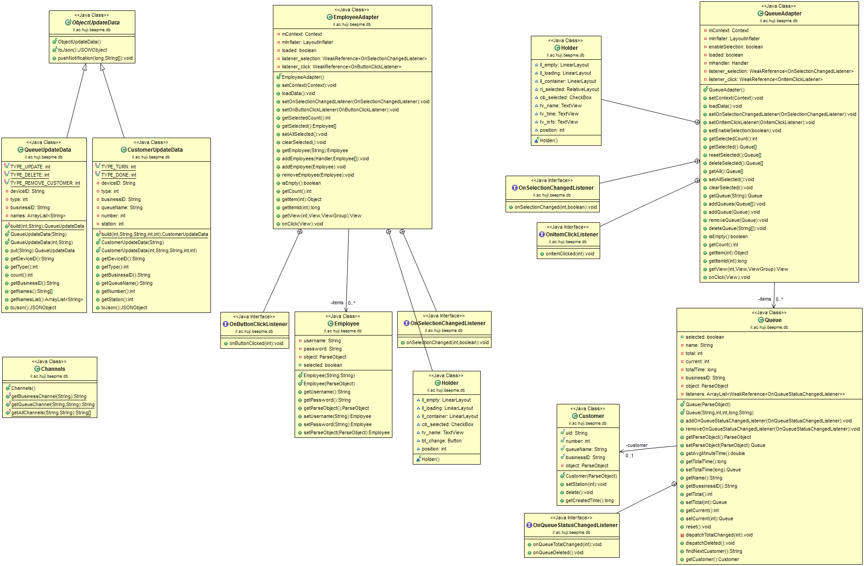
Architecture: Business (DB UML)

Slide 10
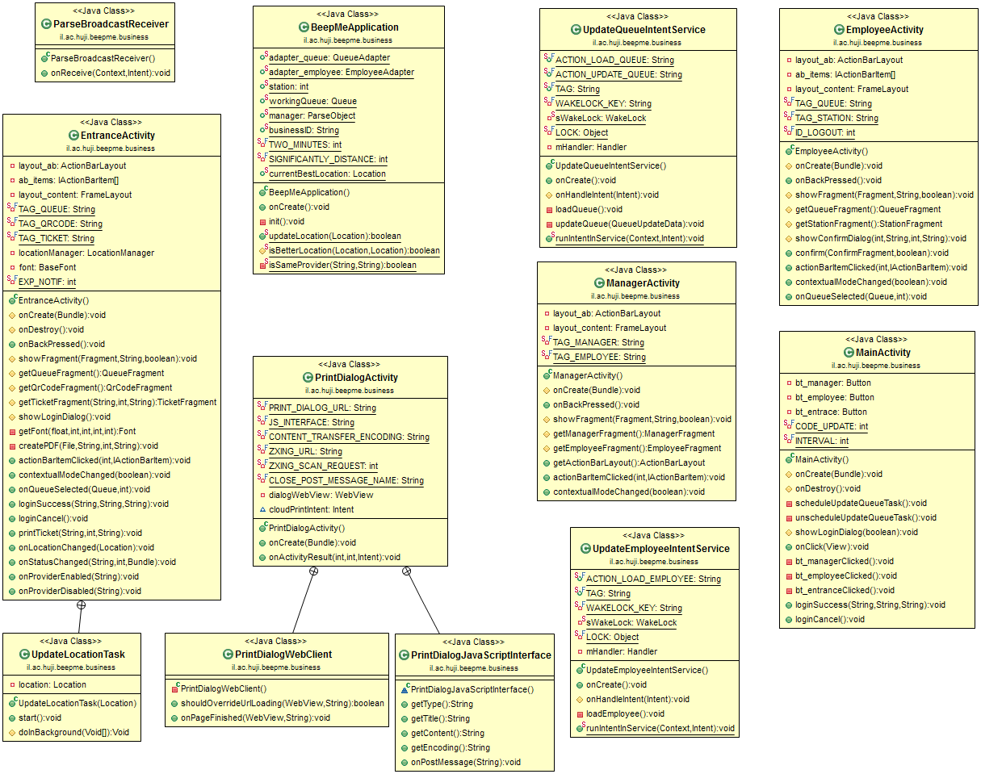
Architecture: Business (Model UML)

Slide 11
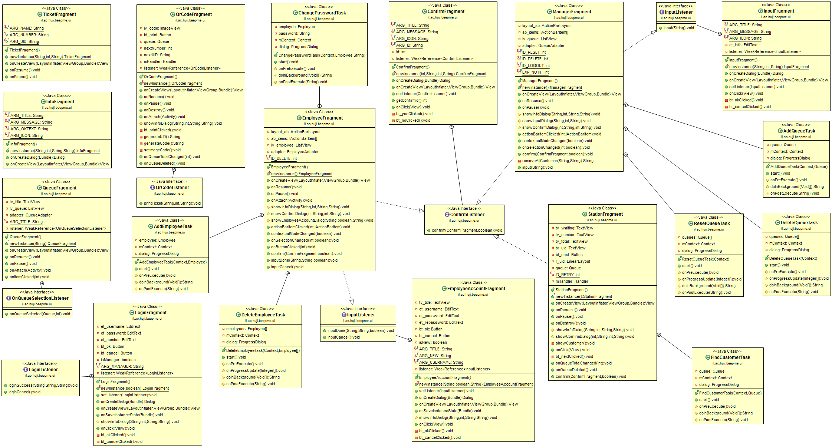
Architecture: Business (UI UML)

Slide 12
Architecture: Customer
DAL: Parse entities & DB wrapper
BLL: ParseBroadcastReceiver, LocationWatcher, Update services (queues & customer), activities
UI: All UI seen in Demo
External Libraries:
  ActionBar (common with Customer)

Slide 13
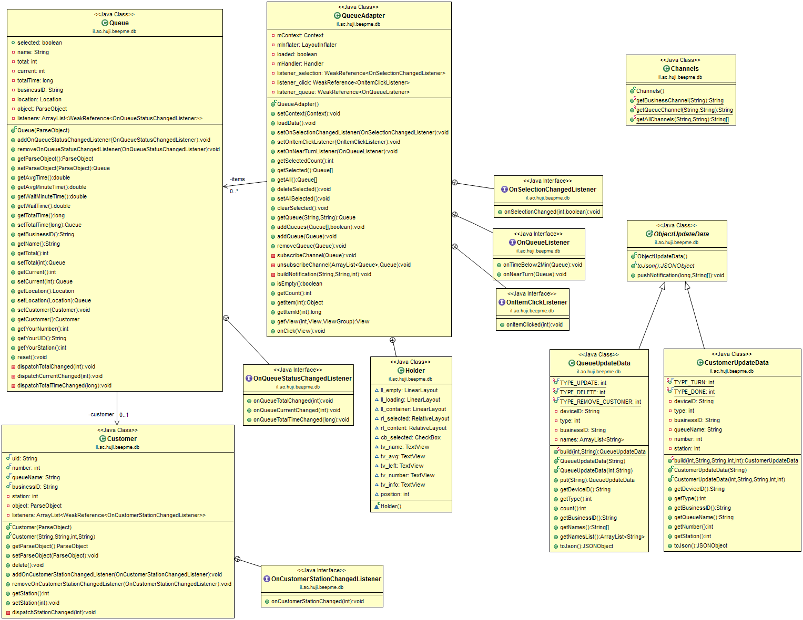
Architecture: Customer (DB UML)

Slide 14
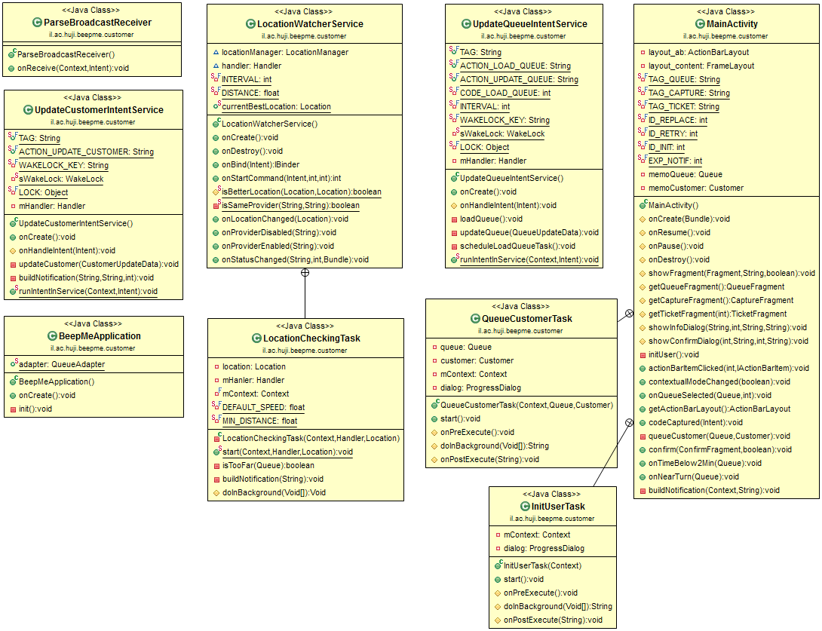
Architecture: Customer (Model UML)

Slide 15
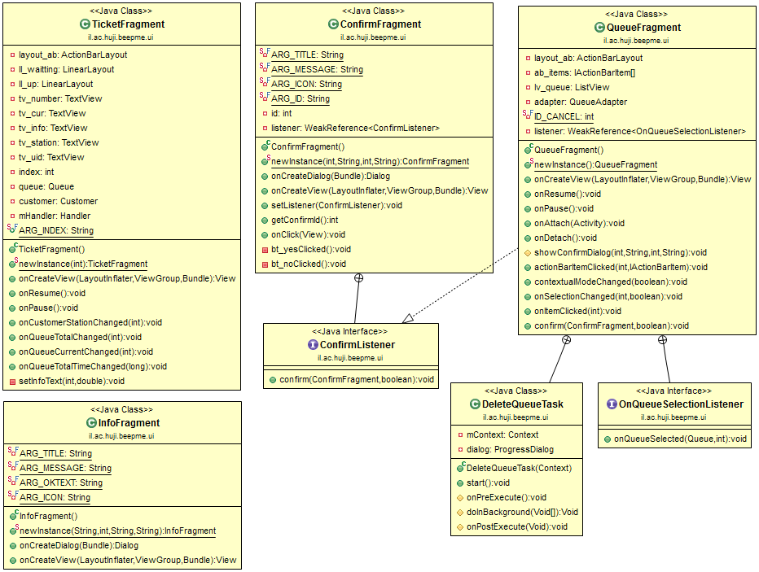
Architecture: Customer (UI UML)

Slide 16
Architecture: Customer (Flow)
User arrives at shop and approaches a computer
BeepMe user?
Select a queue
YES
NO
Application Main Page
User scans a barcode
User prints a ticket
Update time & counters
Turn is approaching
Application beeps
Wait till turn arrives
Turn has
arrived
“Go to station” notification
Show device to receptionist
Get service

Slide 17
Questions?

