Slide 1
Telephony & SMS
Android dev.
Ofir Marcus, Alona Basovich,
Netanel Kaufman, Nili Davidor-Elbert
May 2013

Slide 2
Overview
Telephone API is used to monitor phone information
  States of phone
  Connection
Available in package android.telephony
Classes like: SmsManager, Telephony

Slide 3
TelephonyManager
Class to determine telephony services and states:
  IDLE
  RINGING
  DATA_CONNECTED
  Etc.

Slide 4
TelephonyManager
App can register to receive notiﬁcations of state changes
Some telephony information needs permissions to be set in the manifest:
<uses-permission android:name= "android.permission.READ_PHONE_STATE" />

Slide 5
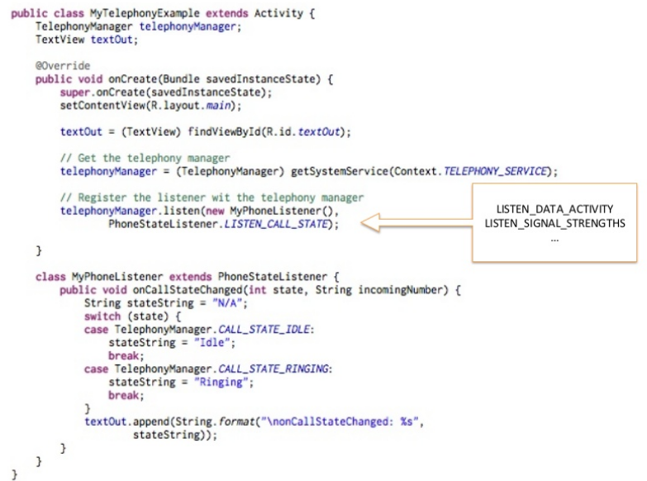

Slide 6
SmsManager
Manages SMS operations such as sending data, text, and pdu SMS messages.
Get this object by calling the static method SmsManager.getDefault().
Add permission: android.permission.SEND_SMS

Slide 7
Sending Sms
(SmsManager.getDefault()).
sendTextMessage("+3585012345", null, “message”, null, null);

Slide 8
Receiving SMS
<receiver android:name=".SmsReceiver">
<intent --ﬁlter>
<action android:name=
"android.provider.Telephony.SMS_RECEIVED“ />
</intent-­‐ﬁlter>
</receiver>

Slide 9
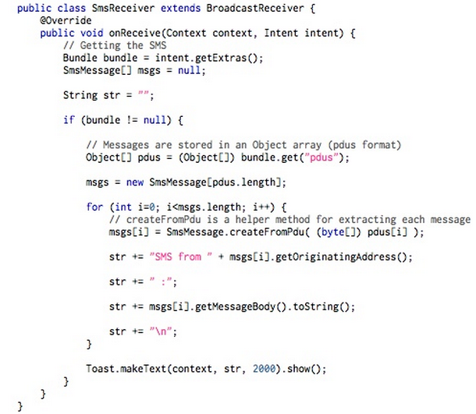

Slide 10
Thank you!
Q & A

