Slide 1

EPHESIANS 5:15-21
A LIFE LIVED WELL

Slide 2


Live wisely...
Be very careful, then, how you live.

Slide 3
Live wisely...
Not as unwise but
as wise

Slide 4

Live wisely...
Not as unwise but
as wise
As those who know and understand the redemption in Christ's blood.

Slide 5
Live wisely...
...where you are...

Slide 6
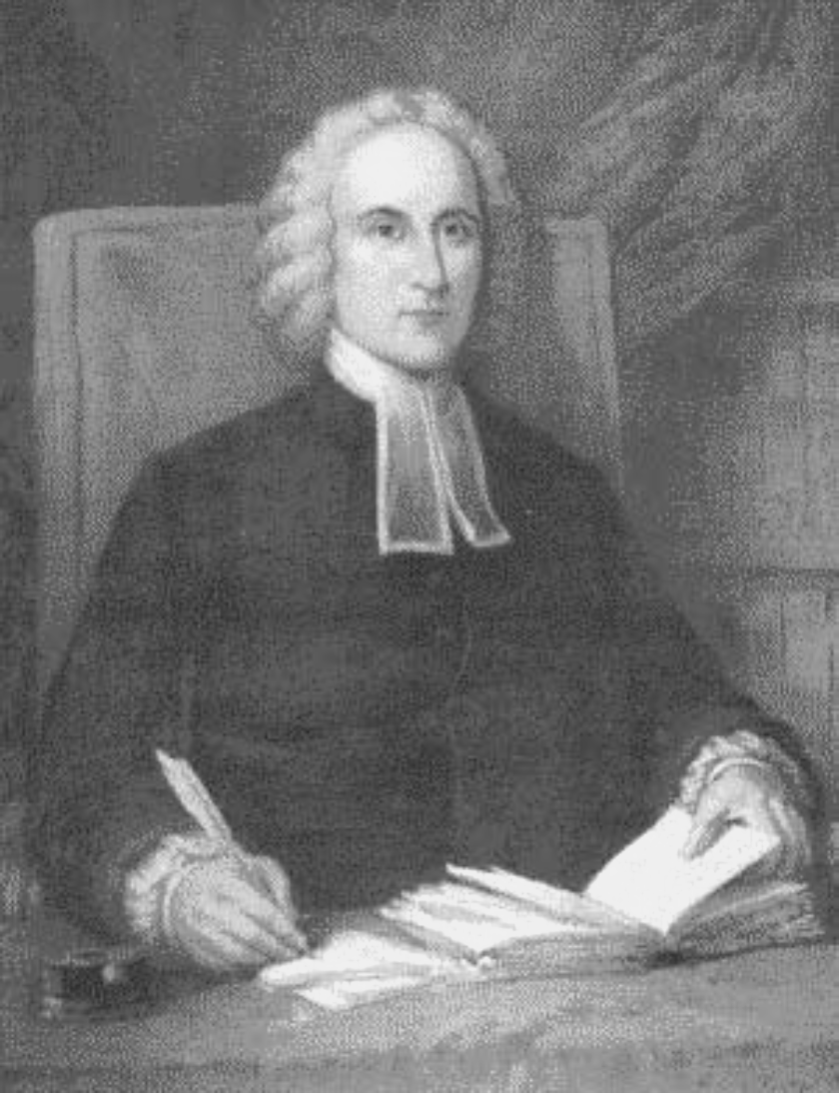
Resolved, never to lose one moment of
time; but improve it the most profitable way I possibly can.

Slide 7
Live wisely...
...where you are...

Slide 8
Live wisely...
...where you are...
It is never the Lord's will for someone to be drunk.

Slide 9
Live wisely...
...where you are...
Do not get drunk on wine, which leads to debauchery. Instead, be filled with the spirit.

Slide 10
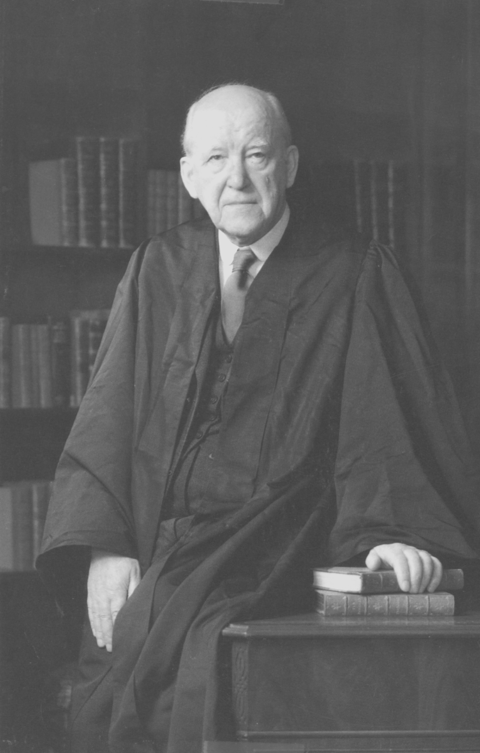
Alcohol is not a stimulant – it is a depressant. ... What the Holy spirit does, however is the exact opposite. ... He really does stimulate.

Slide 11
Live wisely...
...where you are...
...being filled
by the spirit.

Slide 12
…being filled by the spirt
SPEAKING
SINGING
To one another with psalms, hymns, and songs from the Spirit.
Making music from the heart to the Lord.
GIVING THANKS
SUBMITTING
Always, to God the Father for everything.
to one another out of reverence for Christ.

Slide 13
Live wisely where you are; being filled by the spirit.
EPHESIANS 5:15-21

