Slide 2
OV与python在竞赛数据中的效果
OV在竞赛数据IV 2008 2a 左右手MI二分类 A01T-A09T
 | 去眼电 |  |  |  |  | 未去眼电
竞赛数据 | 8-30Hz |  | 8-14Hz |  |  | 8-30Hz |  | 8-14Hz
 | LDA | SVM | LDA | SVM | AVG | LDA | SVM | LDA | SVM | AVG
A01T | 79.23% | 80.72% | 75.78% | 75.78% | 77.88% | 78.94% | 81.18% | 77.68% | 76.95% | 78.69%
A02T | 67.70% | 68.68% | 67.12% | 69.42% | 68.23% | 70.97% | 70.14% | 69.74% | 70.07% | 70.23%
A03T | 90.67% | 91.52% | 91.14% | 91.94% | 91.32% | 90.51% | 91.17% | 91.30% | 92.13% | 91.28%
A04T | 74.69% | 75.01% | 76.12% | 76.06% | 75.47% | 76.19% | 75.83% | 78.64% | 78.60% | 77.32%
A05T | 65.06% | 64.35% | 65.60% | 66.60% | 65.40% | 68.92% | 67.86% | 67.39% | 69.28% | 68.36%
A06T | 71.30% | 71.32% | 74.22% | 73.92% | 72.69% | 72.65% | 72.85% | 73.28% | 73.45% | 73.06%
A07T | 77.12% | 77.52% | 77.90% | 78.10% | 77.66% | 79.89% | 79.73% | 79.46% | 79.40% | 79.62%
A08T | 89.20% | 88.98% | 90.93% | 90.70% | 89.95% | 91.14% | 91.27% | 92.23% | 91.80% | 91.61%
A09T | 75.85% | 72.66% | 75.86% | 75.76% | 75.03% | 73.25% | 73.28% | 76.65% | 76.82% | 75.00%
AVG | 76.76% | 76.75% | 77.19% | 77.59% | 77.07% | 78.05% | 78.15% | 78.49% | 78.72% | 78.35%
python(CAR+5折交叉验证)
 | 8-30Hz |  | 8-14Hz
 | LDA | SVM | LDA | SVM | AVG
A01T | 82.42% | 84.56% | 75.22% | 75.93% | 79.53%
A02T | 61.77% | 65.42% | 46.98% | 49.92% | 56.02%
A03T | 94.13% | 94.87% | 94.87% | 94.87% | 94.69%
A04T | 75.14% | 74.37% | 71.94% | 71.20% | 73.16%
A05T | 58.89% | 58.09% | 54.18% | 54.98% | 56.54%
A06T | 62.73% | 63.52% | 62.73% | 63.69% | 63.17%
A07T | 72.86% | 72.86% | 75.32% | 77.54% | 74.65%
A08T | 90.93% | 93.19% | 93.13% | 95.44% | 93.17%
A09T | 78.59% | 76.85% | 76.85% | 78.59% | 77.72%
AVG | 75.27% | 75.97% | 72.36% | 73.57% | 74.29%
python(5折交叉验证)
 | 8-30Hz |  | 8-14Hz
 | LDA | SVM | LDA | SVM | AVG
A01T | 80.00% | 83.74% | 76.70% | 75.16% | 78.90%
A02T | 58.04% | 59.52% | 45.50% | 43.31% | 51.59%
A03T | 92.75% | 94.17% | 93.49% | 94.92% | 93.83%
A04T | 73.57% | 75.91% | 64.98% | 66.58% | 70.26%
A05T | 58.89% | 55.82% | 54.98% | 57.29% | 56.75%
A06T | 66.38% | 68.90% | 69.07% | 68.20% | 68.14%
A07T | 72.80% | 75.02% | 71.50% | 71.50% | 72.71%
A08T | 95.44% | 95.44% | 95.44% | 95.44% | 95.44%
A09T | 76.88% | 76.85% | 81.16% | 77.68% | 78.14%
AVG | 74.97% | 76.15% | 72.54% | 72.23% | 73.97%

Slide 3
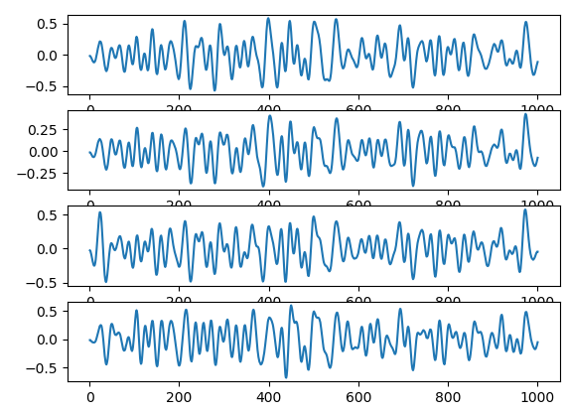
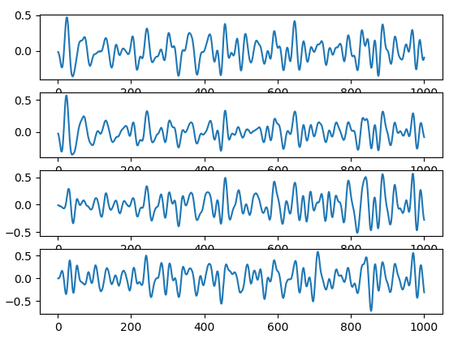
DM-python 8-30Hz滤波后

Slide 4
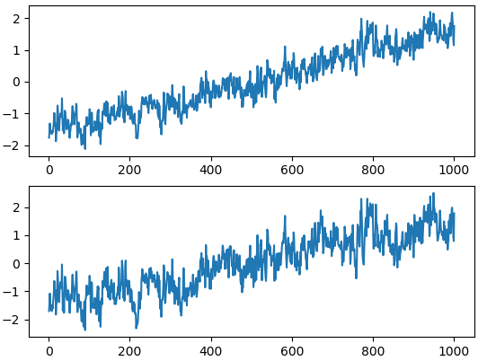
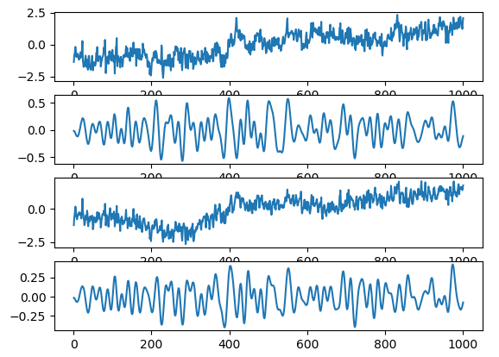
ch2
ch3
DM-原始数据读取-归一化之后
带通滤波前后

