Slide 1
中风康复BCI实验范式
分享人：周晴

Slide 2
机械手与openvibe解析结果是否一致、是否有延迟、是否采样精度不同？
实验范式：MI时长比例
运动想象
2s
1s
4s
1s
2s
Beep音
Cue出现
Feedback
Rest

Slide 3
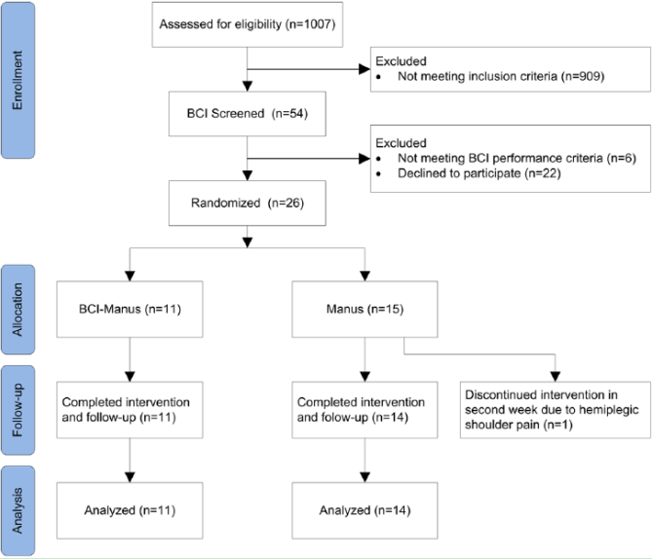
A Randomized Controlled Trial of EEG-Based Motor Imagery Brain-Computer Interface Robotic Rehabilitation for Stroke
Kai Keng Ang, Singapore, 2014

Slide 4
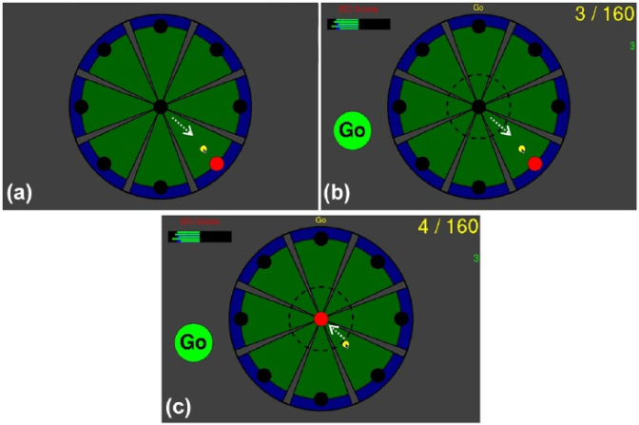
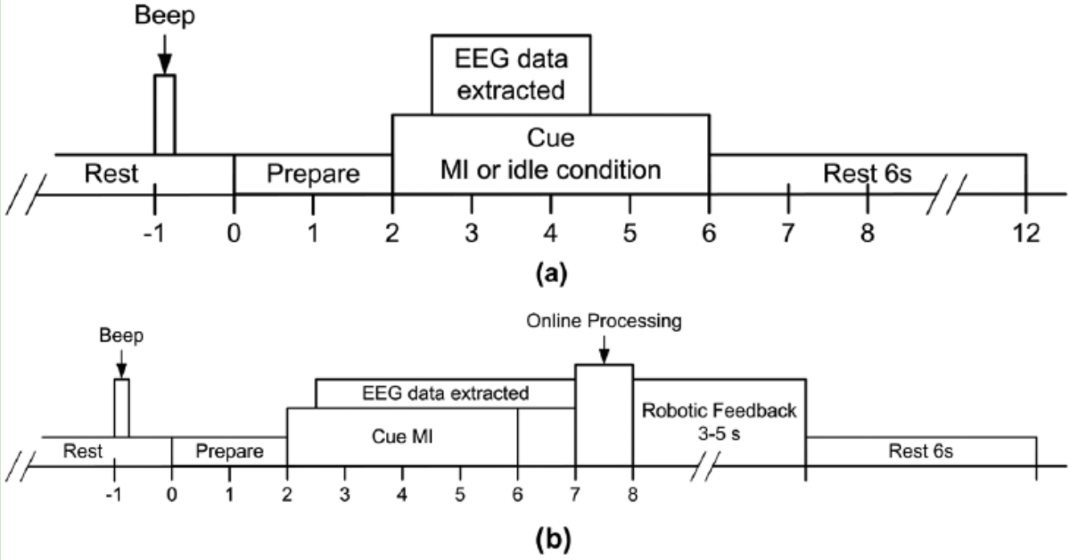
A Randomized Controlled Trial of EEG-Based Motor Imagery Brain-Computer Interface Robotic Rehabilitation for Stroke
Kai Keng Ang, Singapore, 2014
Manus Intervention
12 therapy sessions(3 times per week over 4 weeks)
3 robot-assisted runs of 320 trials
5 nonassisted runs of 16 trials
amounting to 1,040 trials, lasted approximately 1.5 hours
BCI-Manus Intervention
A calibration session
4 runs of 40 trials
20 trials of MI & 20 trials of idiling
+ 12 therapy sessions
4 runs of 40 trials
break of 3 to 5 minutes after each run
Notes:
Manus：4周 3次/周，1 session/次，共12session，1.5小时/session，3+5runs/session

Slide 5
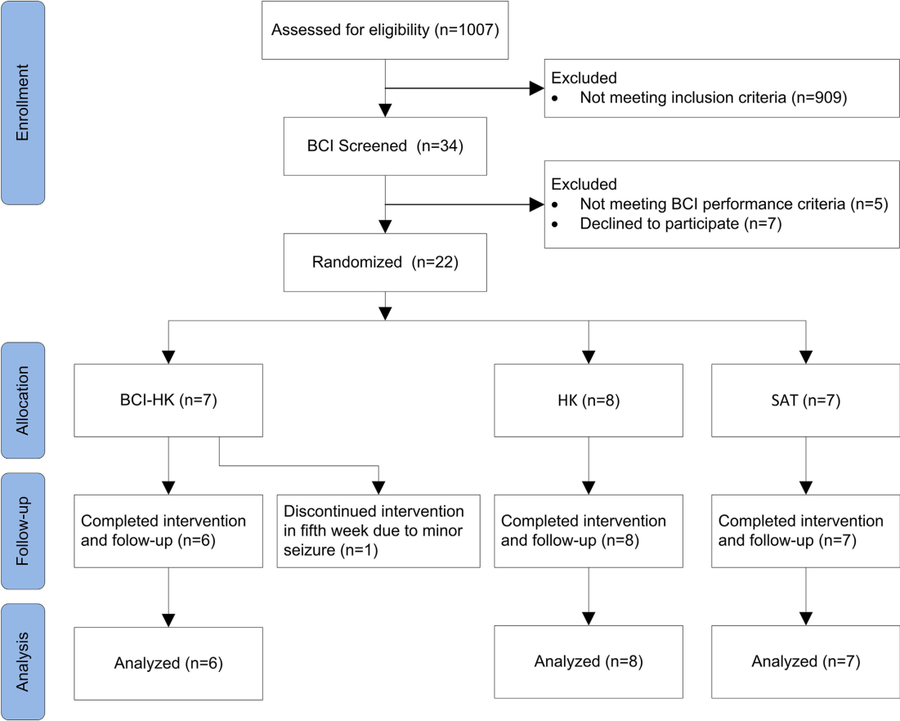
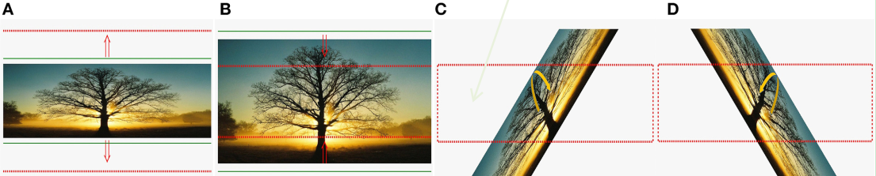
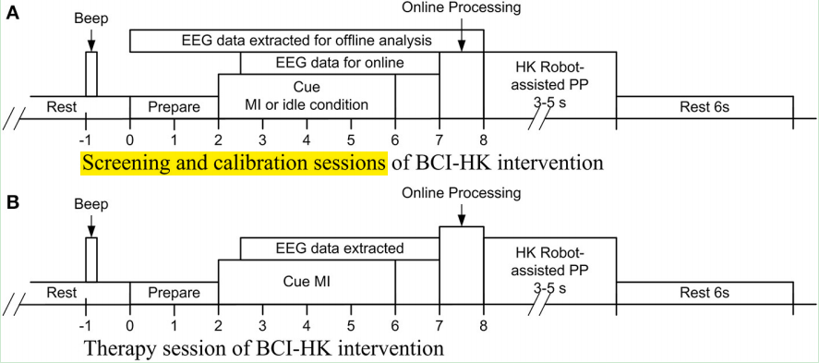
Brain-computer interface-based robotic end effector system for wrist and hand rehabilitation results of a three-armed randomized controlled trial for chronic stroke
Kai Keng Ang, Singapore, 2014

Slide 6
Brain-computer interface-based robotic end effector system for wrist and hand rehabilitation results of a three-armed randomized controlled trial for chronic stroke
Kai Keng Ang, Singapore, 2014
BCI-HK Intervention
MI-BCI coupled with HK robot-assisted PP therapy(60 min)
therapist-assisted arm mobilization(30 min)
a calibration session(4 runs) and 18 therapy sessions
HK Intervention
HK robot-assisted PP therapy (60 min)
therapist-assisted arm mobilization(30 min)
SAT Intervention
distal arm training of forearm pronation-supination movements incorporating wrist control and grasp-release of various objects (60 min)
therapist-assisted arm mobilization(30 min)

Slide 7
Brain-computer interface-based robotic end effector system for wrist and hand rehabilitation results of a three-armed randomized controlled trial for chronic stroke
Kai Keng Ang, Singapore, 2014
BCI-HK intervention
a calibration session
MI in the first 2 runs (80 trials MI + 80 trials idle)
PM in the subsequent 2 runs (80 trials/run)
18 therapy sessions (six weeks)
1 evaluation run of 40 trials with feedback (20 trials MI +20 trials idle class)
4 rehab runs of 30 trials with feedback (MI + PP) total of 120 trials (none idle class)
first 2 runs perform kinesthetic MI of hand grasping action subsequent 2 runs perform kinesthetic MI of knob manipulation action
If MI was not detected in 2 consecutive trials, then the HK robot-assisted PP would be automatically initiated

Slide 8
Brain-computer interface-based robotic end effector system for wrist and hand rehabilitation results of a three-armed randomized controlled trial for chronic stroke
Kai Keng Ang, Singapore, 2014
HK intervention
18 therapy sessions
the setup for the HK intervention is the same as the BCI-HK intervention
4 runs of 30 PP trials / session
first 2 runs hand grasping PP
subsequent 2 runs knob manipulation PP
If no movements from the subject were detected, the HK would initiate fully assisted PP after 2 s

Slide 9
Brain-computer interface-based robotic end effector system for wrist and hand rehabilitation results of a three-armed randomized controlled trial for chronic stroke
Kai Keng Ang, Singapore, 2014
SAT intervention
18 therapist-assisted sessions
60 min of repetitive task training focusing on forearm pronation-supination movements incorporating wrist control and grasp-release of various objects
Therapist-assisted arm mobilization
included tone management and facilitation toward normal arm movement patterns via various closed-chain functional reach activities

Slide 10
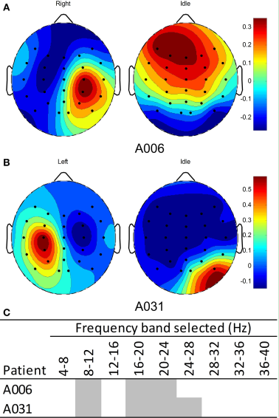
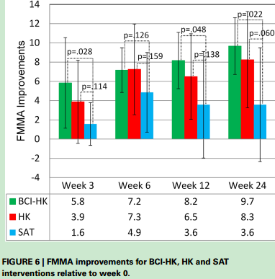
Brain-computer interface-based robotic end effector system for wrist and hand rehabilitation results of a three-armed randomized controlled trial for chronic stroke
Kai Keng Ang, Singapore, 2014

Slide 11
EEG-Based Strategies to Detect Motor Imagery for Control and Rehabilitation

Slide 12
EEG-Based Strategies to Detect Motor Imagery for Control and Rehabilitation
Kai Keng Ang, Singapore, APRIL 2017
Three strategies using BCI to detect MI from EEG
operant conditioning —— a fixed model
(the parameters on the EEG features to extract, the features to select, and how to translate the selected features to provide feedback to the BCI user)
machine learning —— a subject-specific model computed from calibration
address the issue of subject training, and the high variability in EEG for single-trial data
facilitated largely by the common spatial pattern (CSP) algorithm
--filter bank common spatial pattern(FBCSP)
adaptive strategy —— continuously compute the subject-specific model
Parameters are computed from a calibration session and subsequent feedback sessions
Notes:
operant conditioning包含了脑电图特征提取的参数，选择的特征，以及如何翻译所选的特征来为BCI用户提供反馈。因此，研究对象必须学会控制特定的脑电图特征
CSP algorithm requires several parameters, such as the temporal frequency band-pass filtering of the EEG signals and the time segment of the EEG extracted relative to the instruction cue to the subject 自适应BCI不适合全部BCI应用，在SMR效果好，在P300等不完全适用

Slide 13
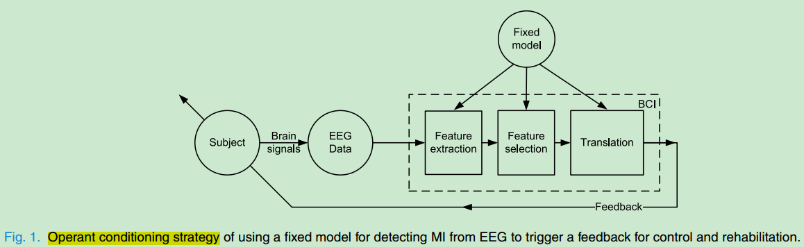
EEG-Based Strategies to Detect Motor Imagery for Control and Rehabilitation
Kai Keng Ang, Singapore, APRIL 2017

Slide 14
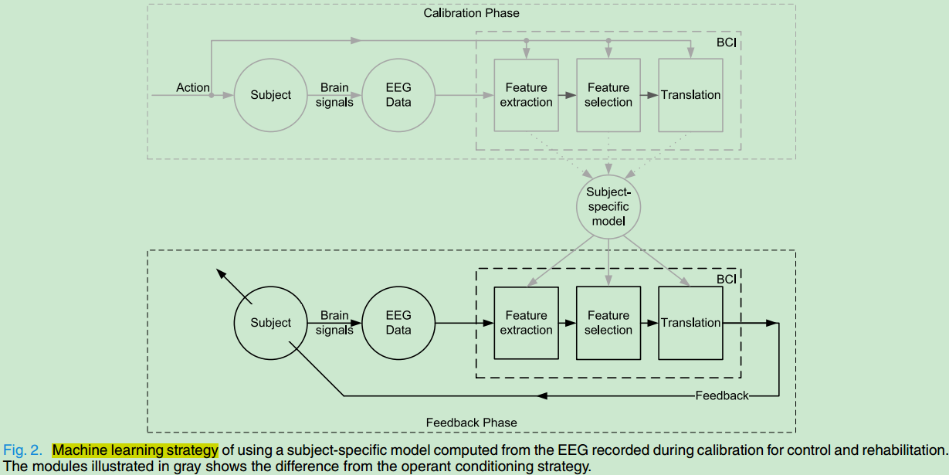
EEG-Based Strategies to Detect Motor Imagery for Control and Rehabilitation
Kai Keng Ang, Singapore, APRIL 2017

Slide 15
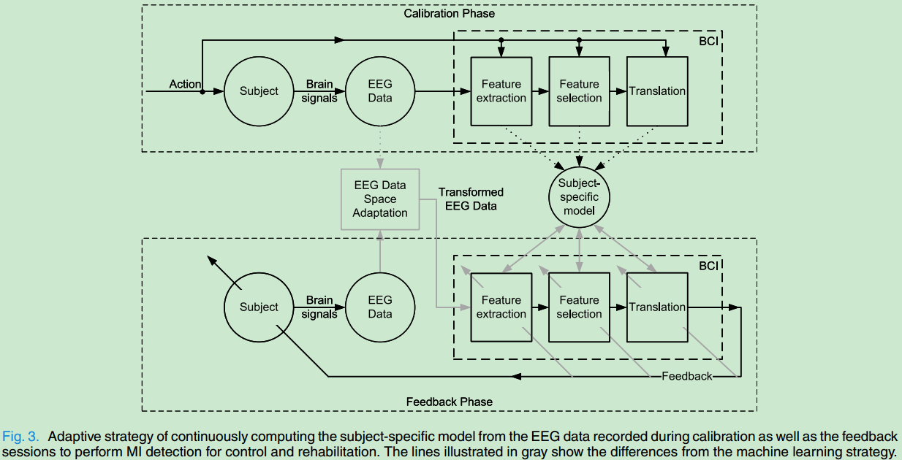
EEG-Based Strategies to Detect Motor Imagery for Control and Rehabilitation
Kai Keng Ang, Singapore, APRIL 2017

Slide 16
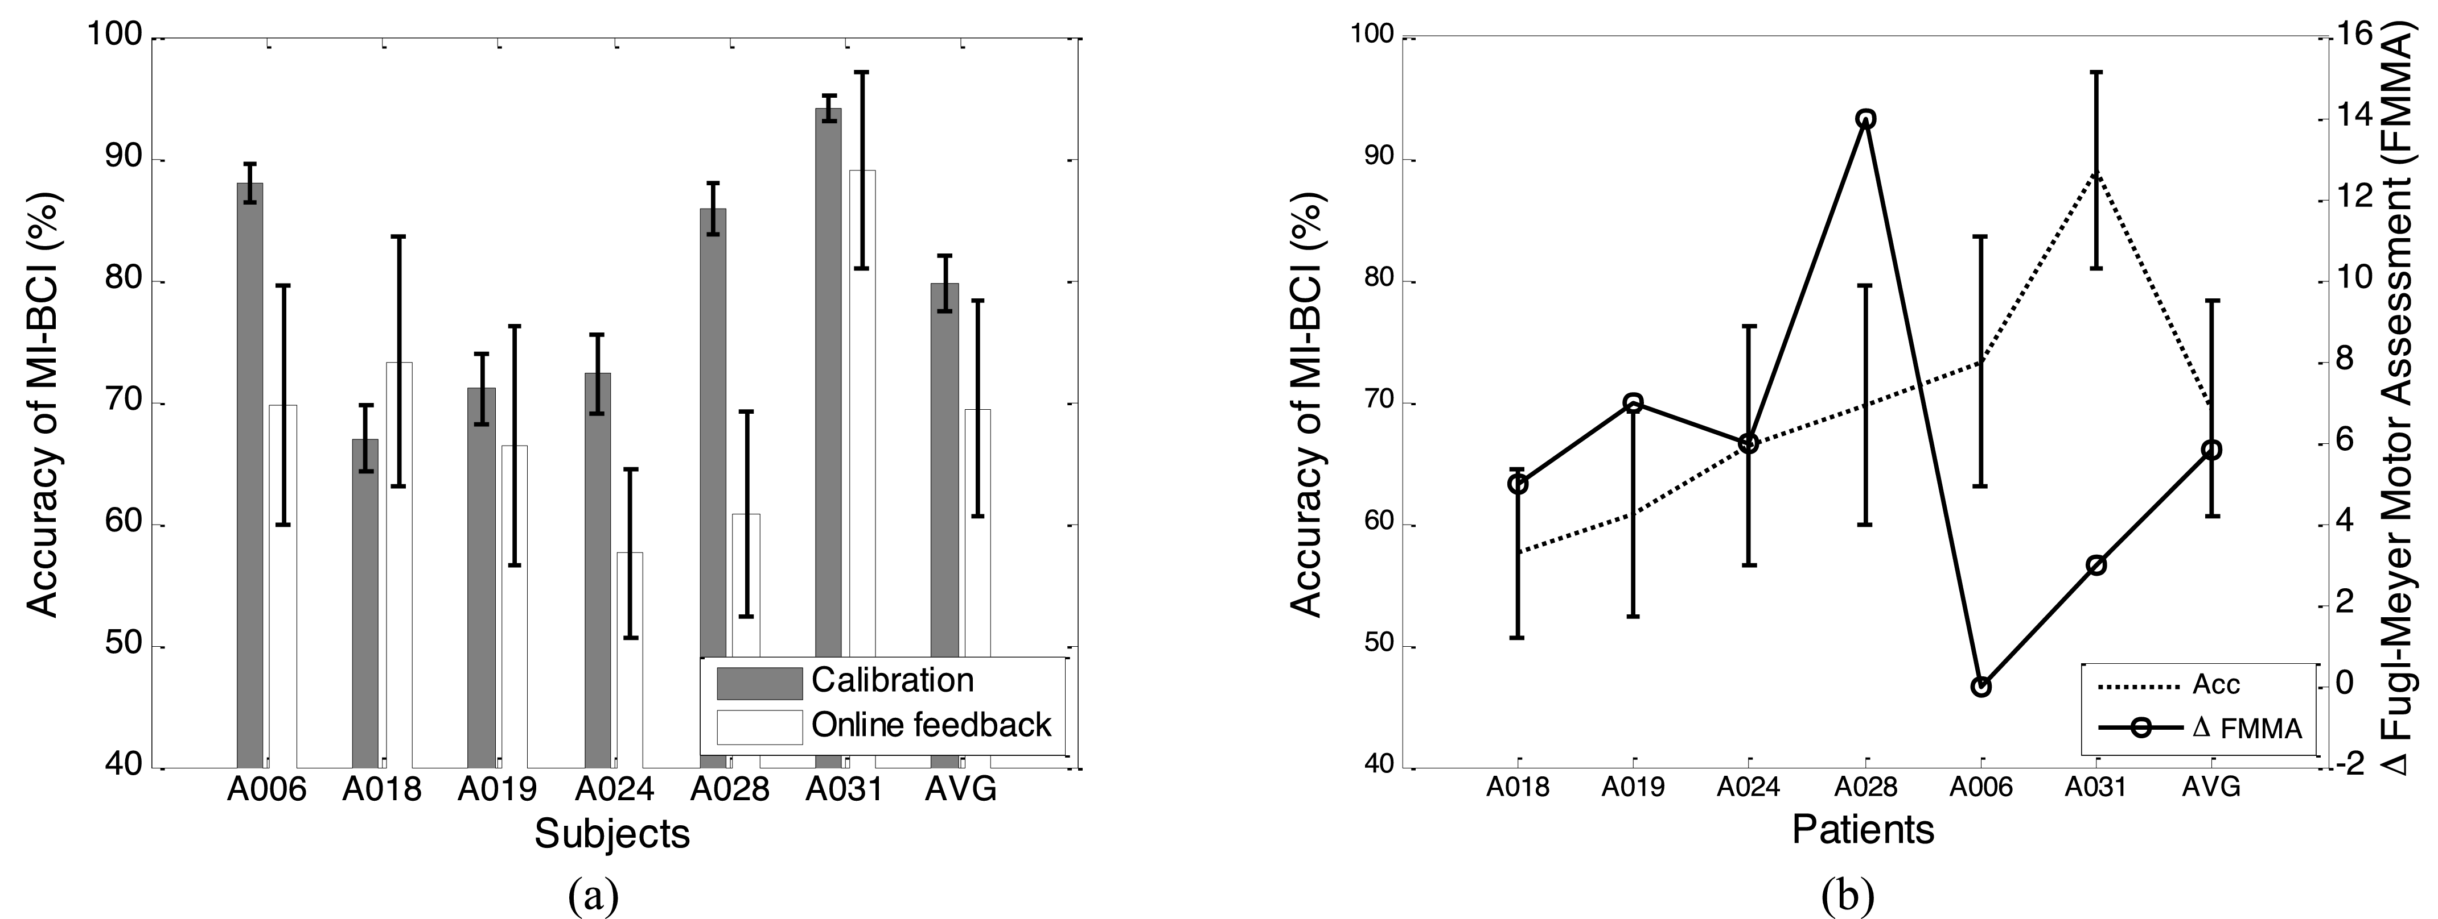
EEG-Based Strategies to Detect Motor Imagery for Control and Rehabilitation
Kai Keng Ang, Singapore, APRIL 2017
machine learning strategy(a) accuracy与FMMA对照(b)
Notes:
随机对照试验只做了ML组

Slide 17
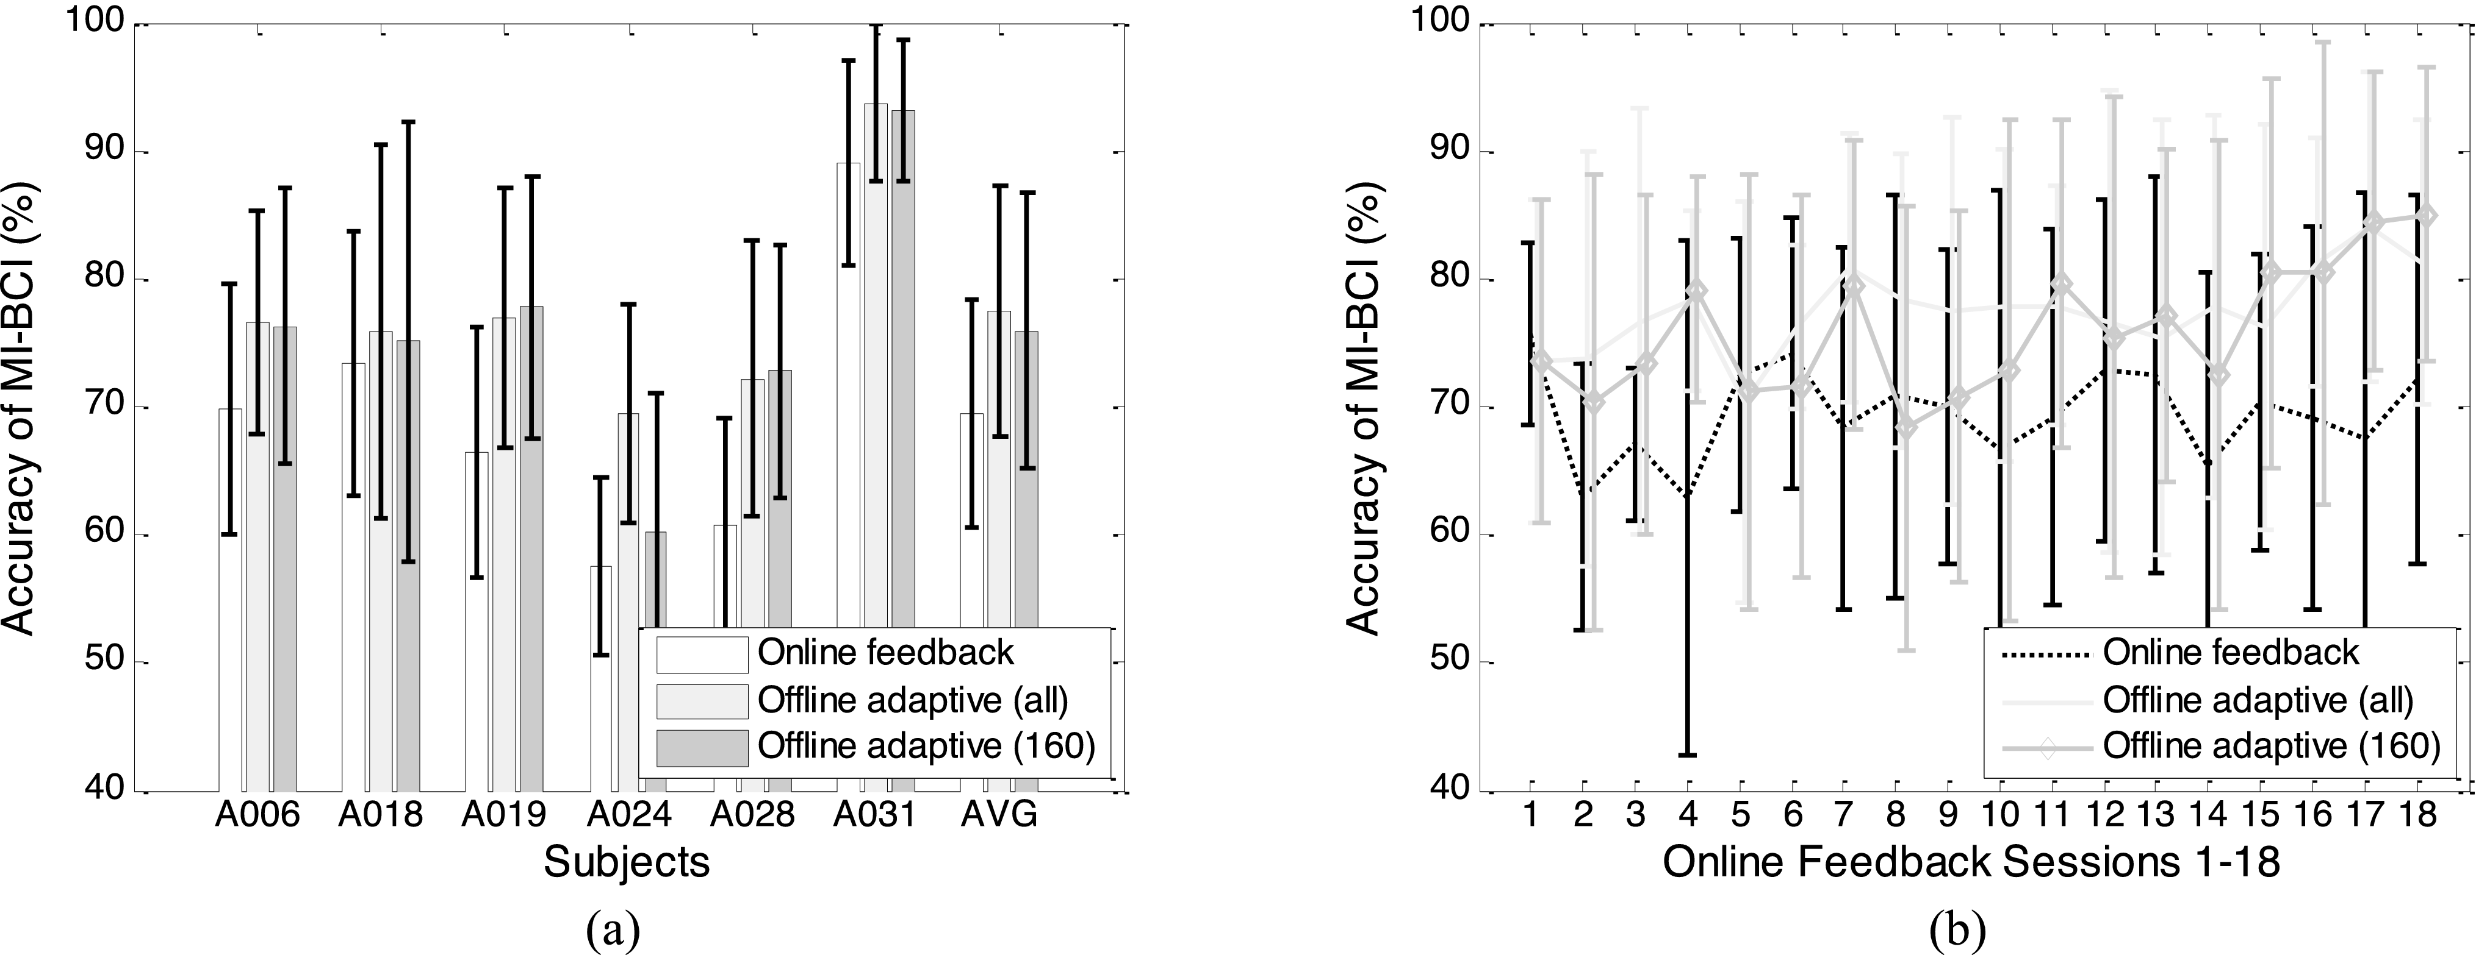
EEG-Based Strategies to Detect Motor Imagery for Control and Rehabilitation
Kai Keng Ang, Singapore, APRIL 2017
Online：machine learning Offline：adaptive strategy
Notes:
自适应策略离线分类精度的提高不一定能转化为在线分类精度的提高

