Slide 1
Cyber Security
Keeping Information Safe

Slide 2
What is Security?
White Hat vs. Black Hat
White box vs Black box
Malicious vs Accidental

Slide 3

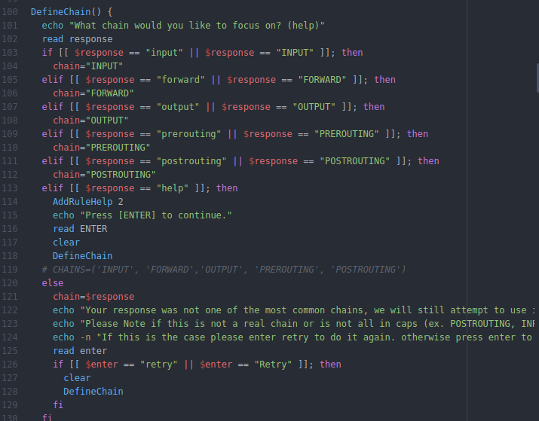
Start to Goal
Script Kiddie
  Higher Risk
Hacker
  Experience

Slide 4
What can I do?
Network Hijacking
Network Sniffing/Spoofing
Moderate Reverse Engineering
Kali-Scripts

Slide 5
Non-Computing Hacking
Computer Security
  Malware
  Worms
  Network Hijacking
Social Engineering
  Phishing
  Identity Theft
  Kevin Mitnick

Slide 6
Basic Ideas
Usr: Admin
Pass: Admin
Unlocked Wifi
Unlocked Computer

