Slide 1
Research Presentation
(1) Introduction/Motivation
(2) Background/Related Work
(3) Research
(4) Implementation/Experiments/Evaluation
(5) Results/Conclusion

Slide 2




Introduction/Motivation
Introduction/Motivation
-Detecting and classifying attacks
-Threatens availability and confidentiality of network
-How to rule out anomalies that are not attacks?
Jamming Attack
Distributed Denial of Service Attack (DDoS)
Man in the Middle Attack

Slide 3
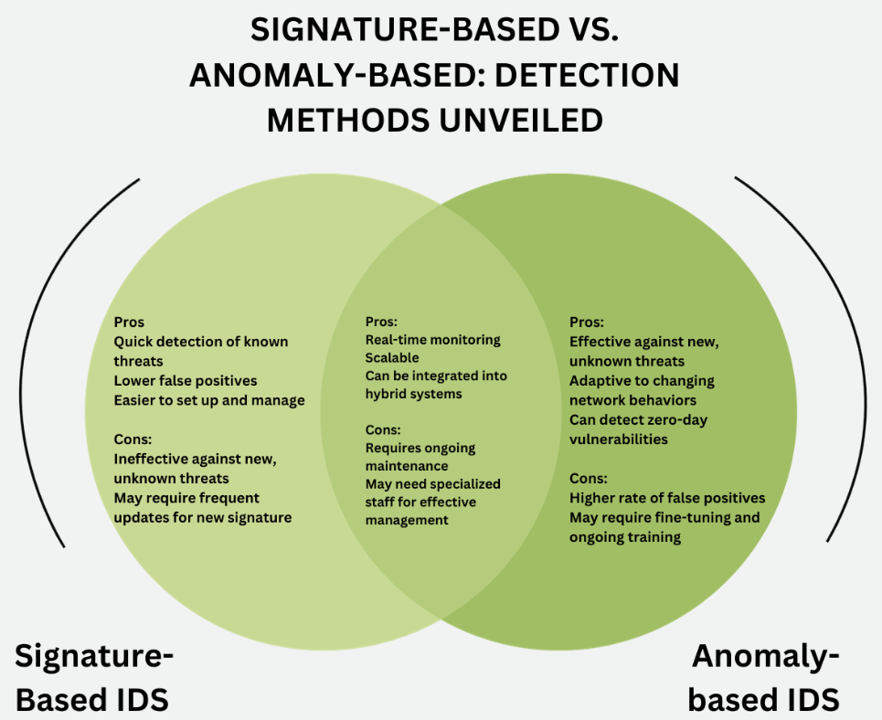
Background/Related Work
Intrusion Detection Systems
-Can be host-based or network based (hardware/software)
-Evaluates various metrics or thresholds to determine if an attack is probable
-Alerts administrators for follow on actions
Non-ML Methods
Anomaly
-No known profile
-Any deviation from a known baseline of network traffic
-Examples could be increased/decreased packet rates, increase in signal noise,
spurious traffic
-Usually involves a learning/training stage that monitors “normal” traffic –
Baselining
-Tendency to increase false alarms
Signature
-Known attack patterns or profiles
-If the threshold reaches a certain value/level, then the alert is triggered
-Ongoing updated rule-based system
-High precision

Slide 4
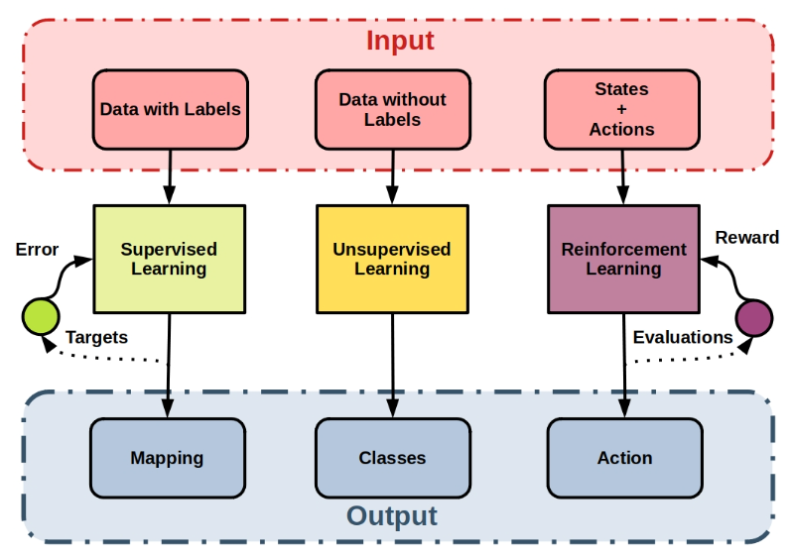
Background/Related Work
Common Metrics for Attack ID
-Cross-layer protocols (physical, data-link,
network, transport)
-Received Signal Strength, Packet Delivery
Ratio (PDR), Dropped Packet Rate,
Clear Channel Assessment
ML Models/Algorithms
Supervised
-Model receives features/labels that will
be trained/evaluated
-Learns to identify specific attributes;
if something is or is not (Boolean based)
Reinforcement
-Learn from previous states
-Continual learning from a reward system (positive or negative)
Unsupervised
-
-
Table Here
Find new diagram

Slide 5
Background/Related Work
Types of Supervised, Unsupervised, Reinforcement Methods
Neural Network
-Layers of neurons that classify data based on weights/values
-Each layer has a weight assigned with connections to the layers above
and below
-As the weights are summed or multiplied through the layers, a final
result will form in the output layer
Support Vector Machine (SVM)
-Hyperplanes are formed to attempt to classify data
-The optimal hyperplane is chosen with maximum distance between different classes of data
Decision Trees
-Binary Tree
-Input features start with the Root Node, pass through decision trees, and result in the leaf nodes
-Decisions made by conditional statements
Random Forest
-Many Decision Trees that work together to produce a final result via voting
-Weaker models can become stronger models via Boosting
Reinforcement Algorithm
Q-Learning/Q-Tables
-Finds best decision, given current conditions
-An agent interacts with environment, chooses actions and receives
reward if action is desirable
-Q value results based on the state and action
Keep/Add what you need

Slide 6
Research
Flow of Research
Paper Comparisons
- Solution (what model or variation of model was used)
- System/Threat Model (How it works and environment factors)
- Experimentation: How solutions were evaluated, what metrics were considered, and what models were used as comparison
Our Research Hypothesis
- ML algorithms are more precise and accurate to determine actual threat activity, but also are more expensive in terms of computation, and time, or overhead than traditional IDS.
- Anomaly based intrusion systems may produce a higher false alarm rate, but statistically perform better at detecting more malicious activity. Furthermore, we hypothesize that anomaly based systems are more suited for ML adaptations.

Slide 7
Implementation/Experiments/Evaluation
Paper Categorization |  | Application (Environment)
Paper Name | Non-ML Type | Application (Environment) | Threat Model(s) | Metrics for Attack Detection
An intrusion detection system for wireless sensor networks | Anomaly | Wireless Sensor Network (WSN) | Denial of Service | Packet Rate Received Signal Strength Indication (RSSI)
Intrusion detection model of wireless sensor networks based on game theory and an autoregressive model | Hybrid (Anomaly and Signature) | WSN | Denial of Service | Packet Size
A multi-level intrusion detection system for wireless sensor networks based on immune theory | Hybrid (Anomaly and Signature) | WSN | Denial of Service (2) Selective Forwarding (2) Blackhole | Energy depletion Packet Rate Packet Duration
Designing collaborative block-chained signature-based intrusion detection in IoT environments | Signature | 802.11 | Flooding Attack Wormhole Attack | Energy depletion

Slide 8
Non-ML Paper Comparison
Paper Name and IDS Type | An intrusion detection system for wireless sensor networks (Anomaly) | Intrusion detection model of wireless sensor networks based on game theory and an autoregressive model (Anomaly, Signature) | A multi-level intrusion detection system for wireless sensor networks based on immune theory (Anomaly, Signature) | Designing collaborative block-chained signature-based intrusion detection in IoT environments (Signature)
Threat Models Quantity | 1 | 1 | 5 | 2
Attack Detection (Metric Quantity) | 3 | 1 | 3 | 2
Cost -Training/Learning -CPU overhead -Bandwidth overhead -Memory overhead | Learn: -100 runs (RSSI) -1000 runs (Packet Rate) Memory: Buffer Space Size N (smaller buffer => better detection) | Learn: 10 min (100 iterations) CPU Consumption: 55% (Game Theory) 65% (CH centric) 85% (Node centric) | Learn: 600 seconds Memory (Storage): 14% = Anomaly 7.5% = Signature CPU consumption: 50% = 40 nodes 45% =30 nodes 30% = 20 nodes | Bandwidth Overhead: N1-N2 N1=Number of Node With Rules N2=Nodes that don’t have Rules
Evaluation Parameter Variation | Power/Jam Anomaly (5-10dBm) Buffer Space (N=1,2,3,4,5) | Packet Sizes Nodes=100 | Nodes in the network: (20,30,40) | One attacker vs two attacker
Metrics for Evaluation | 3 | 3 | 2 | 2
Outcome (Accuracy) | 64.5%=Average RSSI anomaly: 12dB 98% (N=2) 70% (N=3) 50% (N=4) 40% (N=5) Packet Rate Anomaly: 98% (High Threshold) 78% (Low Threshold) | Game Theory: 75% Node Centric: 30% CH Centric: 50% | 85%=Average 90% = DDOS and Blackhole 80% = Selective Forwarding | 95%=Average 90% accuracy within 40sec 100% accuracy after 60sec
Paper Name: An intrusion detection system for wireless sensor networks
Key Insights:
-False Alarm decreases at ~10% per N (buffer size) used
-As anomaly rate increases by 25%, N decreases by 5% with same detection
-More buffer space can detect anomalies of less deviation
-Stable, static environment helps to alleviate variables in attack measurements
Paper Name: Intrusion detection model of wireless sensor networks based on game theory and an autoregressive model
Key Insights:
-Game theory algorithms can achieve accuracy and energy performance results
-An additional ~15% energy consumption occurs when game theory is not used
Paper Name: Adaptive Federated reinforcement learning for intelligent jamming defense in FANET
Key Insights:
-Network traffic can be reduced by as much as 50% when known attacks occur
-CPU consumption rate increases linearly with number of nodes that increase in the network
Paper Name: Designing collaborative block-chained signature-based intrusion detection in IoT environments
Key Insights:
-Signature based scheme improves accuracy by at least 15% compared to other papers
-Cost of this solution is the network bandwidth that increases linearly to the number of nodes in the network
Notes:
Include notes on system model and simulation setup down here:

Slide 9
Paper Comparison
Our Take-Aways:
- Resources consumption increases when ML algorithms are not used
- Hybrid (Signature and Anomaly) non ML systems can improve efficiency in learning by cutting down on ~50% CPU and energy usage
- To preserve resources, Non-ML IDS should invest in signature based solutions, acknowledging that some threats may be missed
Graph (Fill in from Summary Tables – Quantify results)

Slide 10
Jamming Paper Comparison
-System Model
-Results
-Differences in other Research

Slide 11
Results/Conclusions
- Differences
- Similarities
- Overall Takeaways

