Slide 1
CompTIA Security+ Study Guide (SY0-501)
Chapter 3:
Understanding Devices and Infrastructure

Slide 2
Chapter 3: Understanding Devices and Infrastructure
Install and Configure Network Components, both Hardware- and Software-based to Support Organizational Security
  {the Policies, Guidelines and Procedures = “Security Posture”}

Slide 3
Designing with Security in Mind
Firewalls
  Simple Definition:
    Selective / “Picky” Firewall
  Network Security System that Monitors and Controls Incoming and Outgoing network Traffic based on Predetermined Security Rules.
VPNs and VPN Concentrators
  VPN:
    Programming that Creates a Safe, Encrypted Connection over a Less Secure Network, such as the public internet
    Uses Tunneling Protocols to Encrypt Data
Intrusion Detection Systems

Slide 4
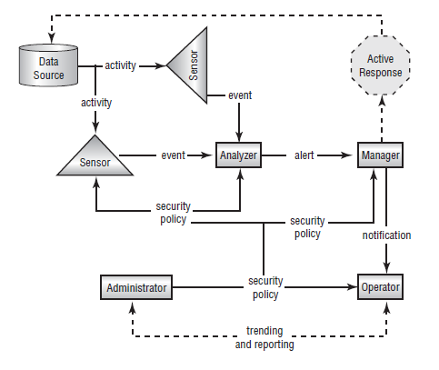
Intrusion Detection Systems

Slide 5
Intrusion Detection Systems
An Intrusion Detection System (IDS) is Software that runs on either Individual Workstations or Network Devices to Monitor and Track network Activity.
Intrusion Detection Systems (IDSs) are becoming Integral parts of Network Monitoring.
Intrusion detection (ID) is the Process of Monitoring events in a system or network to determine whether an intrusion is occurring
An Intrusion is defined as any activity or action that attempts to undermine or compromise the Confidentiality, Integrity, or Availability of resources
  CIA Triad

Slide 6
Chapter 3: Protecting Networks
IDSs use Four primary approaches
  Behavior-based detection
  Signature-based detection, also commonly known as Misuse-Detection IDS (MD-IDS)
  Anomaly-detection IDS
  Heuristic IDS

Slide 7
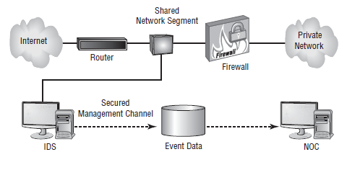
Network-Based IDS

Slide 8
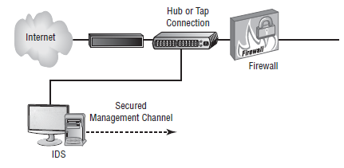
Using a Hub to Attach NIDS to the Network

Slide 9
Implementing a Passive Response
Passive Response :
The most common type of response to many intrusions
In general, passive responses are the Easiest To Develop and implement.
Some passive response strategies
Logging
Notification
Shunning

Slide 10
Implementing an Active Response
Active Response
  Involves taking an action based on an attack or threat
An Active Response will include one of these Reactions:
  Terminating Processes or Sessions
  Network Configuration changes
  Deception

Slide 11
Host-Based IDs
A host-based IDS (HIDS) is designed to run as software on a host computer system.
HIDSs are popular on Servers that use Encrypted Channels or Channels to other Servers.

Slide 12
Chapter 3: Protecting Networks
Network Intrusion Prevention Systems (NIPSs) focus on Prevention.
  These systems focus on Signature Matches and then take a course of action.

Slide 13
Security-Related Devices
Router – L3
Switch – L2
Proxy – L4 (and above)
Load balancer – L4 (and above)
Access point
SIEM – Security Information & Event Management
DLP – Services-Based
NAC
Mail gateway
Bridge – L2
SSL/TLS accelerators – L5 (and above)
SSL Decryptors – L5
Media Gateway

