Slide 1
CompTIA Security+ Study Guide (SY0-501)
Chapter 7:
Host, Data, and Application Security

Slide 2
Chapter 7: Host, Data, and
Application Security
Explain Threat Actor Types and Attributes
Explain the Impact associated with Types of vulnerabilities
Explain the security implications of Embedded Systems
Summarize secure application development and deployment concepts

Slide 3
Hacking
Performing activities on a computer system in an Unauthorized Manner
  Today, considered an Infringement of Protected Data and Property and thus constitutes a Malicious Act
    Originally (prior to the time of Kevin Mitnik), was “to learn” or “demonstrate a point”
      Kevin Mitnik:
        American computer security consultant,
        Author
        Convicted Hacker
        Best known for his high-profile 1995 arrest and Five Years in Prison for various computer and communications-related crimes

Slide 4
Threat Actors and Attributes
Script Kiddies:
  Unskilled Individual
  Uses Scripts or Programs developed by others to
    Attack Computer Systems
    Networks
    Deface Websites
Hacktivist – always a “Political Motivation”
Organized Crime - Criminal groups that engage in cyber organized crime
Nation-States – State-Sponsored Cyber Attacks
  APT (Advanced Persistent Threat)
Greatest Sources of Threat:
  Insiders:
    Most Breaches (70% + ) Unreported {Skews Results Higher}
    2018 – 30% of all attacks are Insiders (but that represents only the 30% of Reports that ARE Reported)
    Therefore, the actual number of inside attacks may be well over 75 – 80%
      {{This is why we can only ESTIMATE the value}}
  Competitors
  {{ Some or any combination of those objects above }}

Slide 5
Use of Open Source Intelligence
Helpful Web References:
  ThreatCrowd
    Search Engine for Threats – {{ Show }}
  OpenPhish
    Threat Intelligence
  OSINT Framework
    Focused on gathering information from free tools or resources
      Framework = series of Documented, Agreed and Understood Policies, Procedures, and Processes that Define How Information is Managed in a business, to Lower Risk and Vulnerability, and increase confidence in an ever-connected world
  Shodan
    a search engine of Service Banners
    Shows Types of Computers Connected to the Internet (IoT)
  The Hacker news
  Threat Post
  E Hacking News

Slide 6
Types of Vulnerabilities
Configuration issues
  Most common
  Countermeasures:
    Hardening
    Monitoring
    Periodic Re-Evaluation of Hardening Efforts
User issues
  Countermeasure:
    Educate, Educate then Educate yet again
Zero-day exploits
Other issues

Slide 7
Embedded Systems Security
Embedded System:
  Focused, Programmable Hardware Component with a Minimal Operating System and Software.
IoT: Internet of Things
  Refrigerators
  TV
  Thermostats
  Lighting Units
  Alarm Systems
    Video Surveillance
    Door Locks
      {{ Combo = “Ring” }}

Slide 8
Application Vulnerabilities
Input Vulnerabilities
  A major contributor to Security Breaches
  Insufficient Input Validation Checks and Unhandled / Improperly-Handled Exceptions
Virtual Memory Vulnerabilities
  Improper use of Virtual Memory by Developers

Slide 9
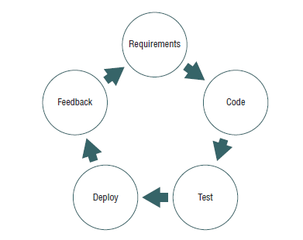
Secure Programming
Best Security = Designed-In, Early-On
Prototyping:
  Incomplete Versions of the software program being developed
  “Learning Exercise”, therefore potentially Throw-away

Slide 10
Specific Types of Software Testing
Unit Testing
  Input and Output Testing
    Fuzz Testing
      Data Format (Type), Range, Patterns
Unhandled Exception Testing
Integration Testing
System Testing
User Acceptance Testing
  AKA, “UI/UX Testing”
    Repeated during different Testing Contexts:
      Unit, Fuzz, Integration, System, UI/UX
      Alpha
      Beta
Regression Testing

Slide 11
Patch Management
Hotfix
  small piece of code developed to correct a major software bug or fault and released as quickly as possible
Patch
  set of changes to a computer program or its supporting data designed to update, fix, or improve it.
Service pack
  collection of updates, fixes, or enhancements to a software program delivered in the form of a single installable package

Slide 12
Database Tier Models
One-tier Model – “Monolith”
Two-tier Model – “Client-Server”
Three-tier Model :
  MVC
  {{ Discuss “Level 2 Server Diag.pptx”}}

Slide 13
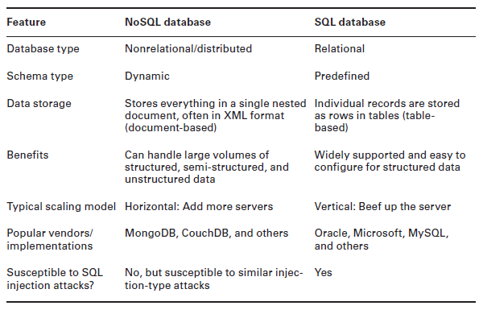
NoSQL vs. SQL

