Slide 1
CompTIA Security+ Study Guide (SY0-501)
Chapter 9:
Threats, Attacks, and Vulnerabilities

Slide 2
Chapter 9: Threats, Attacks, and Vulnerabilities
Given a scenario, analyze indicators of compromise and determine the type of malware
Compare and contrast types of attacks

Slide 3
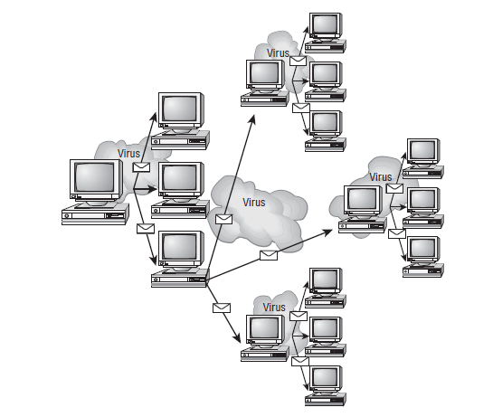
Living in a World of Viruses
Symptoms of a Malware Infection

Slide 4
Malware and Crypto-Malware
Virus – must attach to a “hosting application / Utility”
Worm – Standalone Application
Trojan – Enters your System via Deception
Rootkit – Strong Malware that invades and locks-down the “Root” of the File System (used at Bootstrap time
Keylogger – Copies (later sends) every character typed
Adware
Spyware
BOT – short for “Robot” Software
  BOTNET
DoS and DDoS
RAT (Remote Access Trojan):
  includes a back door for administrative control over the target computer
Logic Bomb
Backdoor

Slide 5
Types of Viruses
Armored:
  Designed to be very difficult to reverse engineer and analyze
  Overly large, because it contains a large amount of misleading logic
Companion:
  Stores itself in a file that is named similar to another program file that is commonly executed
Macro:
  Written in the same macro language used for software programs
Multipartite:
  Infects and spreads in multiple ways
Phage:
  Rather than attaching to host files, will modify host file programs. It usually modifies the beginning of the executable code, destroying files in the process.
Polymorphic:
  Self-encrypted virus designed to avoid detection by a scanner
  duplicates itself by creating usable, albeit slightly modified, copies of itself
Retrovirus:
  Attempt to disable and infect the antivirus software in order to avoid detection in the computer system
Stealth:
  Hidden computer virus that attacks operating system processes and averts typical anti-virus or anti-malware scans

Slide 6
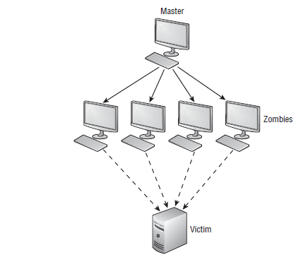
DDoS
“Bots”

Slide 7
Other Attacks
Man-in-the-Middle
Buffer Overflow
Injection
Cross-site scripting (XSS):
  Web application is sent a script that activates when it is read by an unsuspecting user's browser or by an application that has not protected itself against cross-site scripting
Cross-site Request Forgery(XSRF):
  One-click attack or Session Riding and
  Unauthorized commands are transmitted from a user that the web application trusts
Privilege Escalation

Slide 8
Other Types of Attacks
ARP poisoning
Amplification
DNS poisoning
Domain hijacking
Man-in-the-browser
Zero-day exploits
Replay attacks

Slide 9
Other Types of Attacks
Pass the Hash:
  Allows an attacker to Authenticate to a remote server or service using the underlying NTLM or LanMan Hash of a User's Password
Hijacking and related attacks
Driver Manipulation

Slide 10
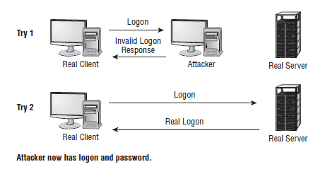
MAC and IP Spoofing Attacks

Slide 11
Five Tasks for Finding Threats
Passively Testing security controls
  Means, “Analytically”
Interpreting results
Identifying Vulnerability
Identifying lack of Security Controls
Identifying common Misconfigurations

Slide 12
Security Tools
Vulnerability Scanners
Honeypots And Honeynets
Port Scanner
Banner Grabbing:
  Gain information about a computer system on a network and the services running on its open ports
  Administrators can use this to take inventory of the systems and services on their network

Slide 13
Risk Calculations/Assessment Types
Baseline Reporting
Code Review
Determine Attack Surface
Architecture
Design Review

