Slide 1
CompTIA Security+ Study Guide (SY0-501)
Chapter 10: Social Engineering and Other Foes

Slide 2
Chapter 10: Social Engineering and Other Foes
Compare and contrast types of attacks
Explain the importance of physical security controls
Compare and contrast various types of controls
Given a scenario, carry out data security and privacy practices

Slide 3
Social Engineering
Social Engineering
  The Process by which Intruders gain access to your Facilities, your Network, and even to your Employees by Exploiting the Generally Trusting Nature of People.
Social engineering attacks (types of)
  Shoulder surfing
  Dumpster diving
  Tailgating
  Impersonation
  Hoaxes
  Phishing
    Spear Phishing
    Whaling (Phising)
    Vishing

Slide 4
Principles Behind Social Engineering
Authority
Intimidation
Consensus/Social Proof
Scarcity
Urgency
Familiarity/Liking
Trust

Slide 5
Physical Security
Access Controls
  A critical part of physical security
Physical Barriers
  Objective: to prevent access to computers and network systems
Multiple Barrier System (related to DID)
  Having more than one physical barrier to cross
  Systems should have a minimum of Three Physical Barriers

Slide 6
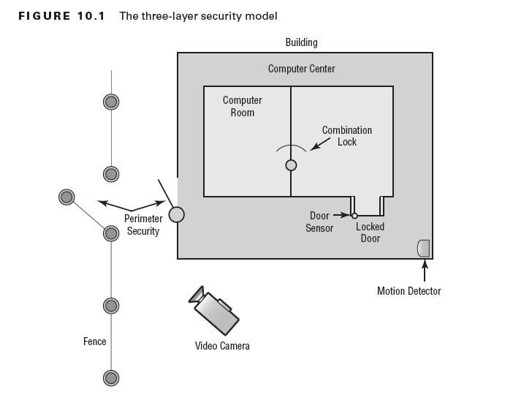

Slide 7
Chapter 10: Social Engineering and Other Foes
Hardware Locks and Security
  Involves applying physical security modifications to secure the system(s)and prevent them from leaving the facility
Mantraps
  Require visual identification, as well as authentication, to gain access
    {See Next 2 Images}

Slide 8
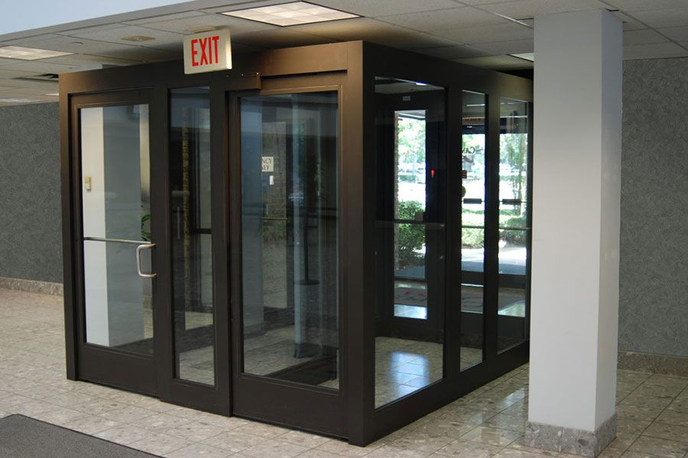
Mantrap…

Slide 9
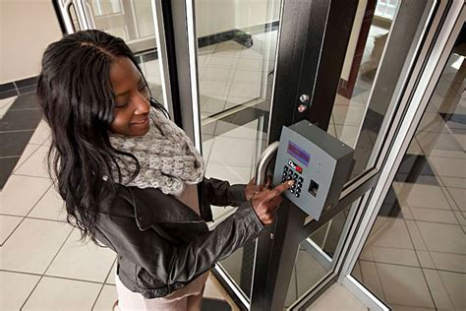
Mantrap…

Slide 10
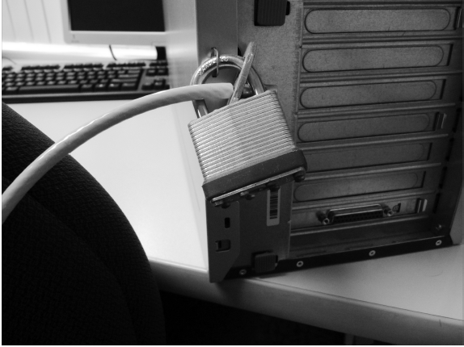
Hardware Locks

Slide 11
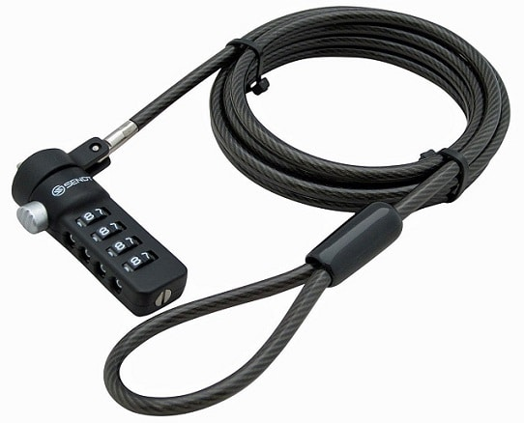
Computer Locks…

Slide 12
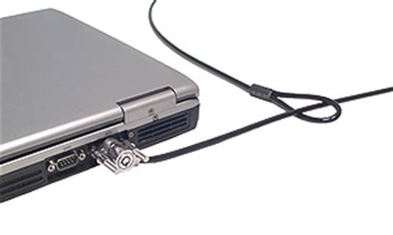
Computer Locks …

Slide 13
Combating Social Engineering
Best:= Training, Training, and Re-Training
Video surveillance
Camera vs. guard
Fencing/perimeter security
Access list
Proper lighting
Signs
Guards
Barricades

Slide 14
Chapter 10: Social Engineering and Other Foes
Biometrics
  Use some kind of unique biological trait to identify a person:
    Fingerprints
    Patterns on the Retina or Iris
    Handprints
Protected Distribution
Alarms
Motion Detection

Slide 15
Chapter 10: Social Engineering and Other Foes
Environmental controls
  HVAC
  Fire Suppression
  EMI Shielding

Slide 16
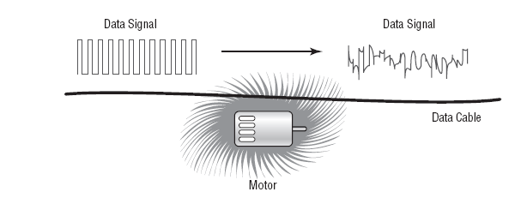
EMI Interference

Slide 17
Products that Solve Most Electrical Line Problems:
Surge Protectors
  Protect electrical components from momentary or instantaneous increases (called spikes) in a power line
Power Conditioners
  Active devices that effectively isolate and regulate voltage in a building
Backup Power
  Generally used in situations where continuous power is needed in the event of a power loss

Slide 18
Chapter 10: Physical and
Hardware-Based Security
EMI Shielding
  Electromagnetic interference (EMI)
  frequency interference (RFI)
The process of preventing electronic emissions from your computer systems from being used to gather intelligence and preventing outside electronic emissions from disrupting your information-processing abilities
Hot and Cold Aisles

Slide 19
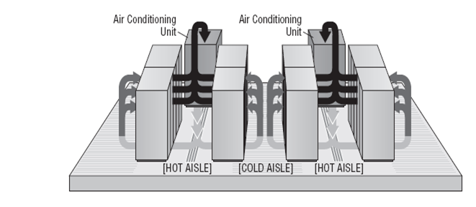
Hot and Cold Aisles

