Slide 1
CompTIA Security+ Study Guide (SY0-501)
Chapter 11:
Security Administration

Slide 2
Chapter 11: Security Administration
Given a scenario, deploy mobile devices securely
Given a scenario, differentiate common account management practices

Slide 3
Connection Types
Cellular
Bluetooth:
  Faster, Longer distance than ANT+, but less than normal WI-FI
  2.4 GHz
Wi-Fi
  2.4 GHz or 5 GHz
ANT (Advanced/Adaptive Network Tech.):
  Ultra-Low Power (ULP) wireless networking protocol:
    2.4 GHz, Low Bit-Rate Xfer from Sensors
    Distance = typically less than 5 feet
  Allows you to view your Sport, Fitness and Health Monitoring data in Real-Time on your mobile device
  Proprietary to __, but Open Access
  ~2003 by Daystream:
    ANT+ ~ 2004
      Daystream purchased by Garmin in 2006
Infrared
  Can’t penetrate solid objects (walls)
  Generally less than 5 to 10 feet (tops)
SATCOM

Slide 4
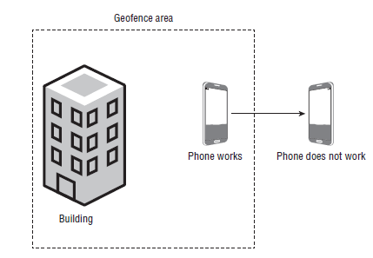
Mobile Devices
Geofencing:
  Use of GPS or RFID technology to create a Virtual Geographic Boundary enabling software to trigger a response when a mobile device enters or leaves a particular area

Slide 5
Account Management Concepts
Account Types
  User
  Group
  Role
  Computer
General concepts
  Usage Audits
  Privilege Audits
  Onboarding
  Offboarding

