Slide 1
Comptia security Plus
Foundational Topics
Textbook + Extra References

Slide 2
Color Code…
Main Point {Know these – they are Testable}
{ Rick’s Notes of Importance } {Definitely something to know}
Standard or Best Practice {You are expected to know these}
Scheme/a, Design
Hardware, Technology
Function / Action
Documentation
Critical, Control, Highest Security
Data, Criteria, Context
Information, Software
Pictorial, Artistic, Graphic
Systems
Individuals
Classification, Type
Damage, Loss, Negative
Asset, Business-Related
Facts
Time Frame, Dates, Temporal
Measurement, Mathematical, Relationships
…

Slide 3
topics
Basic security Concepts / Terminology:
  CIA Triad
  Risks, Threats, Vulnerabilities
  Security Controls
  Events and Incidents
How to calculate and manage risks
How to find vulnerabilities
…

Slide 4
CIA Triad
A Model to Guide the formation and enforcement of Information Security Policies
  FYI – “Model” definition:
    A Scheme (usually Pictorial ) for:
      Specifying
      and Enforcing Policies
Policy (2 “uses” of this Term):
  A Document describing Compliance Criteria
  A Collection of Application Settings Controlling some Software or Service
  “Security Policy”
    Set of Policies used to Ensure Compliance with Rules and Guidelines related to Information Security
CIA TRIAD MODEL - 3 Main Components, which must be Balanced, Given a specific Information Security Policy:
  Confidentiality
  Integrity
  Availability

Slide 5
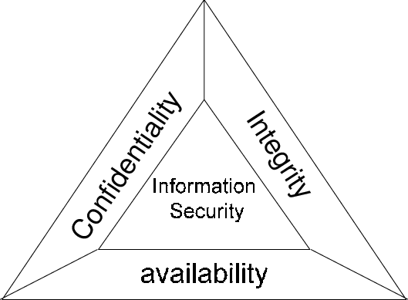
CIA Triad

Slide 6
CIA triad
Confidentiality:
  Ensuring Information is Viewable by Properly-Authorized:
    Systems
    Individuals
    Applications
  Most Important for the Higher-Sensitivity Information
    Point – not all Information needs to be Maximally-Protected
      Requires (as a Pre-Cursor) an Effective Information Classification Scheme
Integrity:
  Ensuring Information remains Accurate & Complete throughout its lifetime
  2 Categories of Importance:
    At Rest – on Storage Media
    In Transit – during Communication
Availability:
  Ensuring Information Accessibility to Authorized Users

Slide 7
A starting point – what are assets
Anything of Value:
  Data, Information, Intellectual Property (IP), People, Facilities, Computers, Business Relationships
  Implies (logically) a “Value” be applied to the Asset
Failure to protect Assets is the heart of Information Security:
  Loss of the Asset could result in Irreparable Damage to:
    An Individual
    The Company
    The Company Image
    The Company’s Relationships
    The Company’s Products / Services

Slide 8
Info. Security Terms
Threat:
  Anything that can Potentially Harm an Asset
  Categories of Threats:
    Malicious Actors (Hackers)
    Human Error
    Device Failure
    Natural Disaster
    Terrorism

Slide 9
Info. Security Terms
Vulnerability:
  Any Weakness / Exposure of an Asset to a Threat
    Represents the Actual Weakness / Exposure that USUALLY becomes the Threat Vector (more later)
  Categories:
    Hardware
    Software
    Human
    Design Deficiencies / Flaws

Slide 10
Risk, threat and vulnerability relationships…
Risk:
  Analyzed & Measured Potential for Loss, Damage, Destruction of an Asset
  Have “Risk” when:
    A Threat Exploits a Vulnerability
  Categories:
    Hardware
    Software
    Human Induced
    Design Flaws

Slide 11
Threat Terms
Threat Vector (or Attack Vector) {“HOW”}
  The Actual Method used to Activate the Threat
  Originates from 3 Primary Sources:
    External (outsiders)
    Internal (insiders)
      FYI – {Something to consider}
        60% of all Companies experienced Insider Attacks
          Most often – dissatisfied / disgruntled Employee
    Supply Chain (suppliers)
The Mechanism of “How”

Slide 12
Threat Terms…
Threat Actor – “Who”
  Broad Term for any individual or group of individuals that attempts to or successfully conducts malicious activities against enterprises, whether intentionally or unintentionally

Slide 13
Threat Terms…
Threat Profile –{“WHAT”}- Context (Attendant / Known Data)
  Information about:
    Critical Assets
    Threat Actors:
      broad term for any individual or group of individuals that attempts to or successfully conducts malicious activities against enterprises, whether intentionally or unintentionally.
    Threat Scenarios:
      an illustration in which one or more threat actors can mount one or more threat actions in an attempt to compromise an identified critical asset by exploiting both vulnerabilities and inadequate safeguards
  An Organization's Threat Profile includes:
    All the Above Information
    Presents a Clear and Detailed Illustration of How Each of these Components are Used Together

Slide 14
Reference-Standards Organizations
CIS: Center for Internet Security - https://www.cisecurity.org/
NIST: National Institute of Standards and Technology - https://www.nist.gov/
ISOC: Internet Society - https://www.internetsociety.org/
NSA: National Security Agency - https://www.nsa.gov/
W3C: World Wide Web Consortium - https://www.w3.org/
IEEE: Institute of Electrical and Electronic Engineers - https://www.ieee.org/
ISO: International Standards Organization - https://www.iso.org/home.html
IETF: Internet Engineering Task Force - https://ietf.org/
ITU: International Telecommunication Union - https://www.itu.int/en/Pages/default.aspx - UN-aligned

Slide 15
Some Research Websites
The Hacker New - https://thehackernews.com/
Daniel Miessler - https://danielmiessler.com/blog/
CSO Online - https://www.csoonline.com/news/
Dark Reading - https://www.darkreading.com/
Adam Shostack & Friends - https://adam.shostack.org/blog/
Cybersecurity Insiders - https://www.cybersecurity-insiders.com/
The Last Watchdog on Privacy & Security - https://www.lastwatchdog.com/

Slide 16
controls
The “Countermeasures” needed to:
  Avoid
  Mitigate
  Counteract
  Lessen
  … Security Risks resulting from:
    Threats
    Attacks:
      Actually Exploiting a Vulnerability in some way
Countermeasures - High-Level Types (based on potential Actions of the Controls):
  Prevention – (Locks , Access Controls)
  Detection – (Video Surveillance, IDS)
  Correction – (IPS)

Slide 17
Controls…
More – Detailed List of Control Types, based on their Application:
  Administrative: (Password Policies, Employee Screening, Training)
  Technical / Logical: (Firewalls, Authentication Systems, Encryption Protocols)
  Operational: ( Security Assessment, Incident Response, DR, Backup)
  Physical: (Fences / Gates, Locks, Guards, Video Surveillance)
  Detective: ( Cameras, Motion Detectors, Alarms, Auditing Policies)
  Preventative: (Gates / Doors, Firewalls, Policies (documents) to minimize weaknesses)
  Corrective: (Backup Restoration, Changing Compromised Passwords, Patching Compromised Systems)
  Deterrent: ( Signs / Posters / Warnings, LED on a Fake Camera, Locked Door)

Slide 18
Identification, Authentication
Identification
  Simply a “Claim” to an Identity:
    Username (most common)
    Process ID
  Can be made “Guaranteed”
    Smart Card Data
      Anything else that can Uniquely ID a Subject:
        Object – An Entity that contains Information
        Subject – an Object that is Granted / Denied Access to an Object
Authentication
  Process of Determining whether Someone / Something is (In FACT) Who or What they Claim To be
  Are you Who / What you Claim (ID) to Be?

Slide 19
Authorization, Guaranteed ID
Authorization:
  Mechanism used to Determine User / Client:
    Privileges:
      Delegation of Authority to Perform Security-Related Functions
        These Functions must be well defined within some System
    Permissions:
      Access Levels related to System Resources:
        Resources = Computer Programs, Files, Services, Data and Application Features
Guaranteed ID:
  More than a simple “Claim” (like a username)
  A Persistent Context (set of Data) that is Publicly Registered to Known Entity
  Verified by the Issuer of the Context Data itself
  Can be Verified / Checked in near Real Time
  Most commonly:
    Certificates or Certificate-Style Large, Unique Keys “Registered” to a Specific Entity
      Person, Group, Company, Application, System, Service

Slide 20
Non-Repudiation and “Login”
Associated with one’s Identity
IF (Guaranteed ID)
  {Can provide Non Repudiation}
Login:
  Can be Simple (we use daily) or Complex
  At a minimum, can be the Ordered Combination of:
    Identity:
      Simple or Guaranteed
      IF (Guaranteed) { NR is also Provided }
    Authentication
    Authorization

Slide 21
integrity
Mechanism that Guarantees the Contents of a Message / Transfer was not altered In-Transit
Is post-Login…
  … but can be used to check the automated communication of the Guarantee ID Context Information
    EXAMPLE: To indicate if the Certificate has been altered (tampered-with)
Hash:
  Generating a Unique Value or values from a String of Text (Input)
  Uses a Mathematical Function
  Is One Way
  “Fingerprint” number

Slide 22
Authentication System Types {How we Login}
DAC – Discretionary Access Control:
  “Need-to-Know”
  Process involves:
    Granting default Rights, per user
    Hiding / Limiting-Access to Unauthorized Users
MAC – Mandatory Access Control:
  “Fully-enforced Least Privilege”
  Process:
    Users only given minimum Rights to get their job accomplished
RBAC – 2 Sub-Types:
  Role Based:
    “Separation of Duties, based on the Role one plays in the Organization”
  Rule Based:
    “Heuristics based”

Slide 23
Access Restriction Methods
Restrict Access by combinations of the Following:
  UP_TO-5 Authentication Factors (Identification Data)
    Know
    Have
    Are / Biometrics
    Do
    Geolocation
  Various Degrees of Encryption (only for the most Sensitive / Restricted Resources / Assets)
  Hiding / Secreting:
    “Steganography”
      Often known as “Security Through Obscurity”
        Is a Good STARTING POINT, but should not be a major Access Control on its own
  Hashing – Associated with Integrity
  Digital Signatures – Algorithms that provide Guaranteed ID
  Version Control

Slide 24
Single-Point-of-failure
Fact:
  Number & Complexity of Security Controls is a two-edged sword:
    On one Hand, Can certainly Enhance Security (Good)
    On the other hand, Can prove to be either:
      Too much overhead to maintain for the chosen level of Control
      “Single Point of Failure” (SPOF)
Therefore:
  Must BALANCE:
    C,I,A needs against:
      Information Security Policy
      Desired Level of Access
      Degree of Privacy
      Capability of Access Controls Chosen

Slide 25
Availability Ratings for Sys/ Svc / app:
High Availability:
  Keeping Assets (Data, Programs, Systems) available for a Measured-Amount of Time
(Asset and Access Dependent):
  Measured as a Percentage of Time the Prescribed Asset is Available, as Policy indicates
  Common values today:
    For “Availability Measures” – 4 9’s = 99.99 % Availability = 52.56 minutes / yr
      5 9’s = 99999 = 5.256 minutes / yr.
    For “Data Durability Measures” – 11 9’s = 99.999999999
      {this would mean they are not statistically likely to EVER loose the Data comprising the Asset}
Must work to avoid Single Points of Failure

Slide 26
Increasing Availability
Redundancy:
  More Resources to use in the event another Replica should Fail or become Overloaded
  NOTE – this also provides yet another Measure, important in some applications:
    Fault Tolerance
      Ability to encounter a Failure and yet Keep Providing the Asset
  If the “primary resource” becomes unusable, users can be automatically “Failed-Over” to one of the Alternate (Redundant) Resources
    Failover can be:
      Automatic (Clusters of Systems)
      Manual (Requires Human Intervention to restore the Asset to Availability)

Slide 27
Fault tolerance implementation-examples
Storage Systems:
  RAID – Redundant Array of Independent Disks
Compute Engines:
  Clusters
    Tightly-Coupled Computers (Compute Engine, Memory, Storage and Network) working as a Single (often Massive) Unit (as a single Computer)
Data Base Systems:
  Mirrored Servers (usually Geographically Distributed)
    Live Connection with near real time updates between remote Installations
  Log File Shipping
    {Briefly explain “Transaction Log” versus “Event Log”}
      Generally, more “mechanical process” to keep the Source DBMS Changes “In-Sync” with a Remote Instance

Slide 28
Update & Patch management
Critical to Access Controls
Must keep the following “up-to-date” / Patched:
  Firmware / UEFI / BIOS {old term, but still popular}
  Operating System and its Common Components:
    Device Drivers
    OS Services
      NOTE – both of the above Categories of SW are OS Extensions that run under 2 Vary8ing degrees of OS Control
    Third-Party SW:
      Off The Shelf (OOTB – Out-Of-The-Box)
      Vendor Supplied
    Custom SW (Developed In-House)
Patching:
  Must be Ongoing
  Should Not Interrupt Normal Operation, where at all possible

Slide 29
Update & Patch management…
Categories of SW Changes (most of which relate to Threat Mitigation)
  Full Update:
    A Properly & Securely Packaged & Distributed Collection of individual Patches or Hotfixes
    Is an automated process, once started (it works to completion)
  Patch:
    Represents a focused, Automated, Packaged, Individual Fix for a specific Issue
    Usually, these are the newly-discovered issues that have NOT YET MADE IT INTO a Full Update Distribution Package
  Hotfix:
    A (most-usually) Manual set of Instructions along with the various SW Changes to address a single issue.
    Are not yet part of an Automated & Packaged Patch
      May represent merely “something to try”, meaning, very little Testing has occurred (as happens when the changes are properly Packaged for Distribution)

Slide 30
Security – RULE #1
Least Privilege
  NO EXCEPTIONS
  Full Documentation
    Usually your Access Control Services provide the necessary:
      P & P Documentation and
      Logging of changes

Slide 31
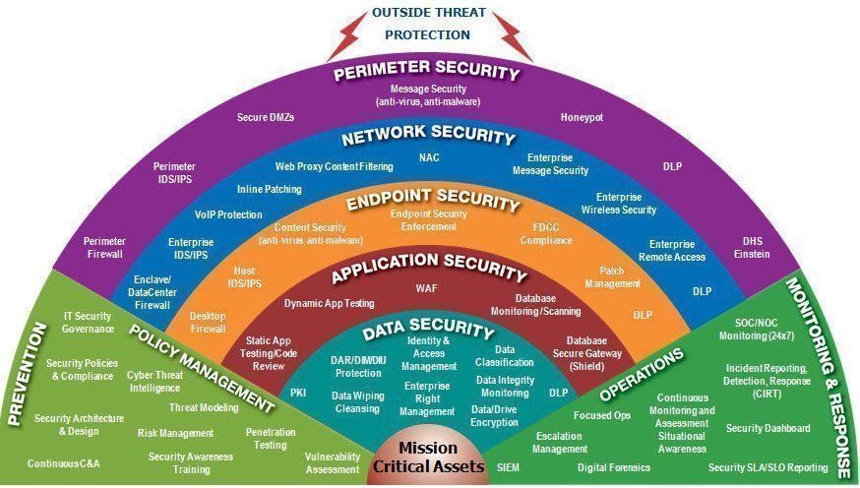
Security Rule #2-“defense in depth”
Point:
  Don’t rely on a Single Access Control
  Plan Security to be:
    An Inter-related Combination of Access Controls that OVERLAP

Slide 32
Security Rule #3-“Defense By Design”
Best Systems / SW are those where Security was “Designed-in” from the beginning, using DiD
FACT:
  “Bandaid-ing” or “Retrofitting” Security to a System that did not consider modern Security Issues (Threats) is FAR LESS DESIRABLE and MUCH HARDER TO MAINTAIN

Slide 33
Security events & incidents
Event:
  Any Meaningful Change in a Systems Normal (Operational) State
  Must indicate potential for a problem and…
    That it occurred at a Specific Time
  Are neither Good nor Bad, but must ALWAYS BE LOGGED (for later Analysis)
Incident:
  Unexpected, Unusual Events that Pose a Meaningful Threat!
  Include:
    Attacks / Breaches, Disasters, Policy Violations, Misuse of Assets
  Alerts are generated in an effort to Evoke Near Real-Time Response

Slide 34
Security events & incidents…
Determining if an Event is truly an Incident:
  True Positive:
    Problem DID Occur
    Problem was Properly Detected
  True Negative:
    No Problem Actually occurred
    No Alert was generated (therefore, no problem Detected)
  False Positive:
    Alert Generated (as though something Negative may have occurred)
    Actual cause was Benign
  False Negative:
    A Real Problem Existed in the System
    But went UNDETECTED

Slide 35
Questions ?

