Slide 1


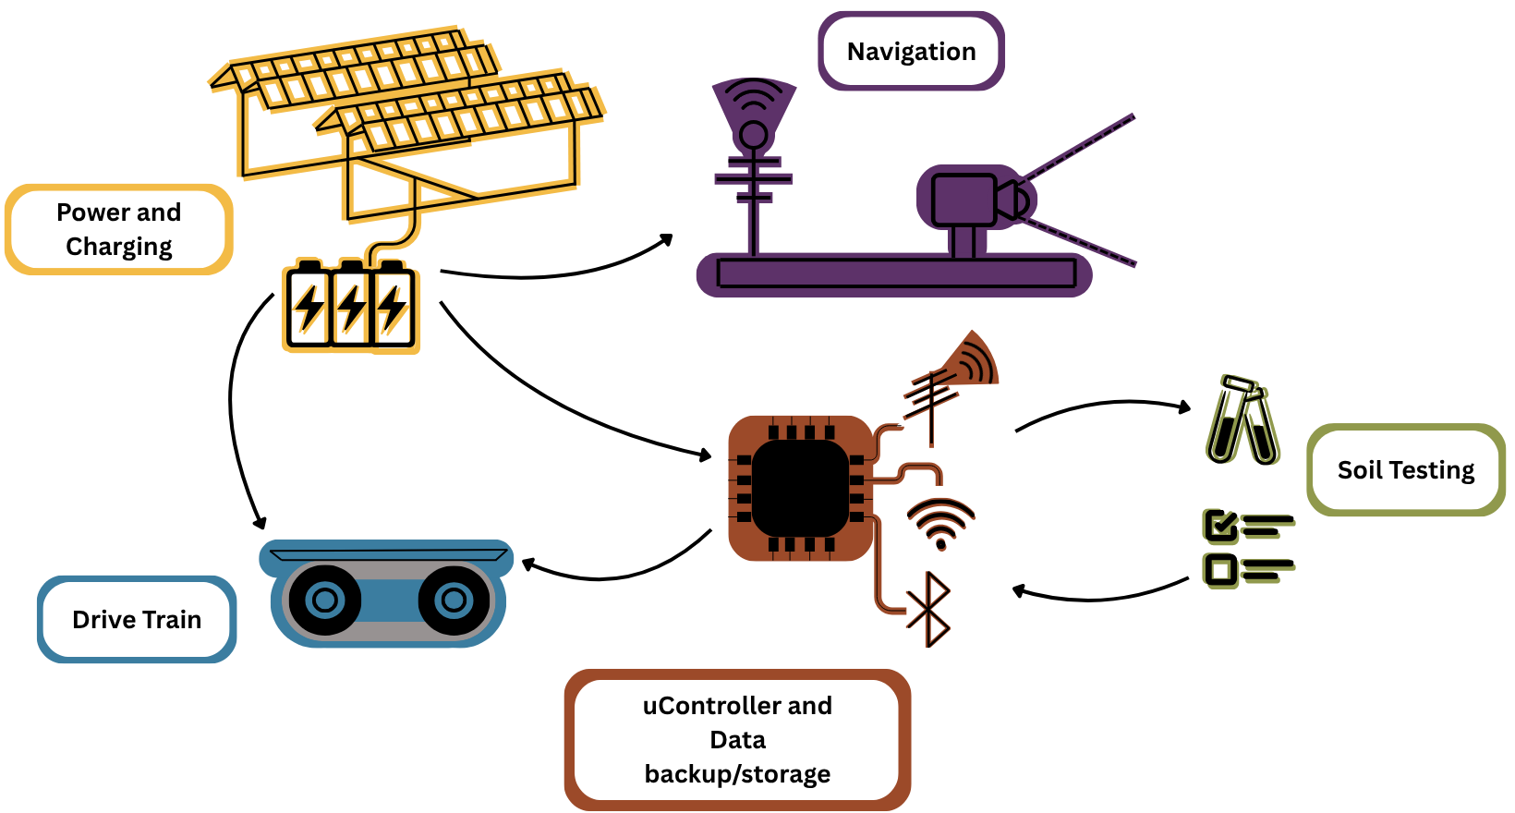


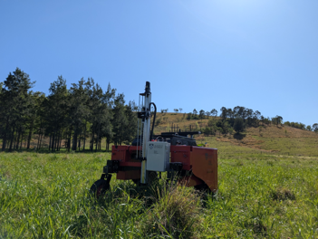
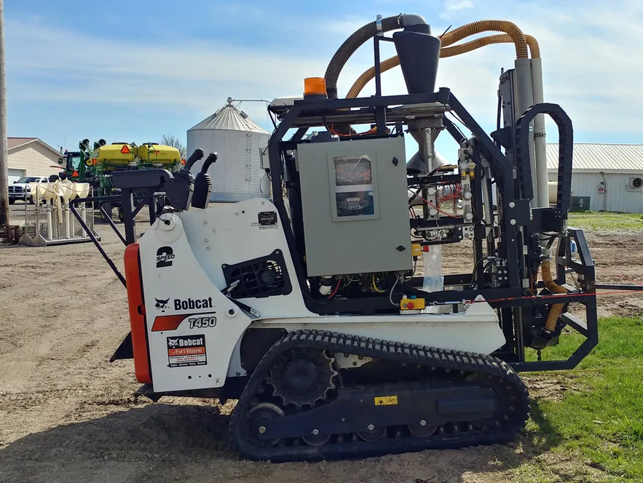
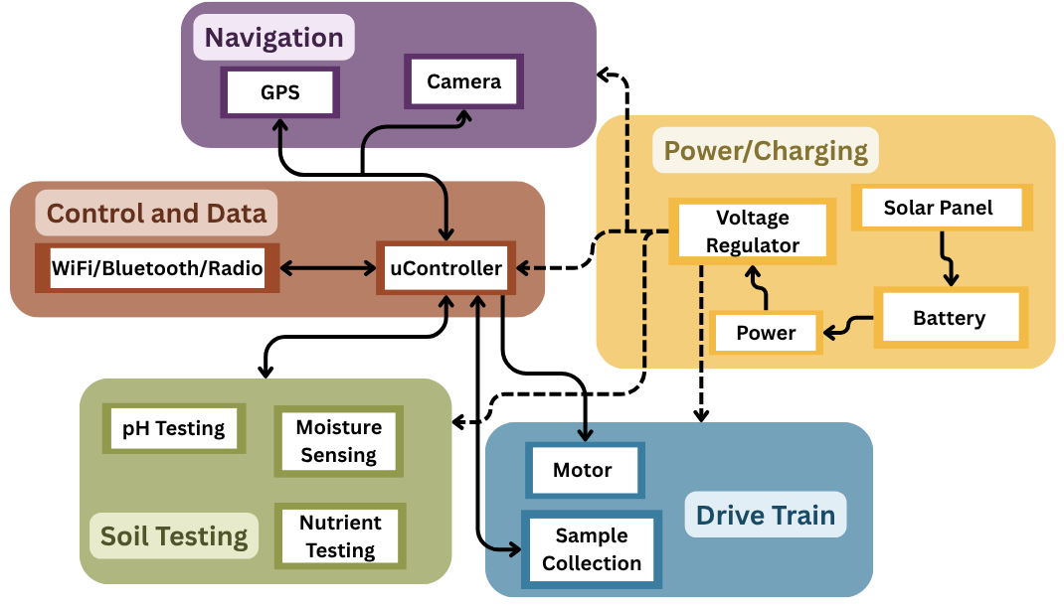

D.I.R.T.T. by Dirty Dawgs
Nolan Brechtel (Project Manager), George Utz (Chief Scientist),
Cara Belew, Zachary Morrow, Rebecca Ueltschey
Department of Electrical and Computer Engineering
Mississippi State University
Problem and Target User
Solution (Simple Infographic)
Broader Impact
Official MSU Colors
SoilHawk
Approximately 25,000 people, including more than 10,000 children, die every day due to starvation [1]
Agricultural imports in the U.S. exceed its exports by $41 billion each year [2]
49% of U.S. crop fields struggle with poor health and resource concerns like nutrient imbalances [3]
Customer Impact
  Allows for testing both more quickly and around the clock
Broader Impact
  Gives farmers the tools to make better food
Future Expansion
  Swappable sensor to test for whatever users may want
Previous Solutions
ROGO Soil Sampling Robot
Agrobot Lala
System Diagram
0.5” Square that can be
used for measuring
margins and spacing
Large, requires fuel to operate
Expensive and is typically rented
Requires lab area set up to test soil
Competitive Advantages
References
Inexpensive
Price is less than $1,000
Small and Compact
Can easily be stored when out of use
Solar Powered
No need for gas or any other power source
Self-Contained
Can test soil without needing to go to a set lab
J. Holmes. “Losing 25,000 to Hunger Every Day.” un.org. Accessed: Sep. 9, 2026. [Online.] Available: Losing 25,000 to Hunger Every Day | United Nations
J. Kaufman. “Ag and Food Statistics Charting the Essentials.” ers.usda.gov. Accessed: Sep. 9, 2026. [Online.] Available: Ag and Food Statistics: Charting the Essentials - Agricultural Trade | Economic Research Service
A. B. Rosenberg and S. Wallander “Farmers Report Soil Related Resource Concerns on About Half of Soybean Wheat Cotton and Oat Fields.” ers.usda.gov. Accessed: Sep. 9, 2026. [Online.] Available: Farmers Report Soil-Related Resource Concerns on About Half of Soybean, Wheat, Cotton, and Oat Fields | Economic Research Service

