Slide 1

BUSINESS INTELLIGENCE
Theft: What did happen at Chicago
from 2012 to 2017 year
Team 1

Slide 2
Table of Contents
1
Motivation
2
Data warehouse architecture
3
Theft behaviors analysis
4
Predict theft cases

Slide 3
Motivation

Slide 4
Data warehouse architecture

Slide 5






Data warehouse architecture
Metadata
Full reload
Incremental
Incremental
Flat files
Stage
NDS
DDS
Daily
Weekly
Monthly

Slide 6
Theft behaviors analysis

Slide 7
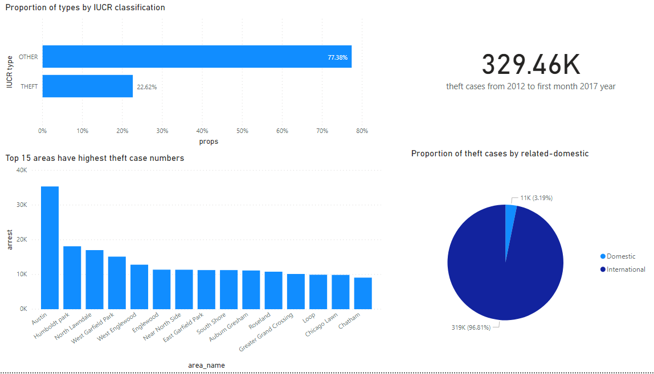
Overview

Slide 8
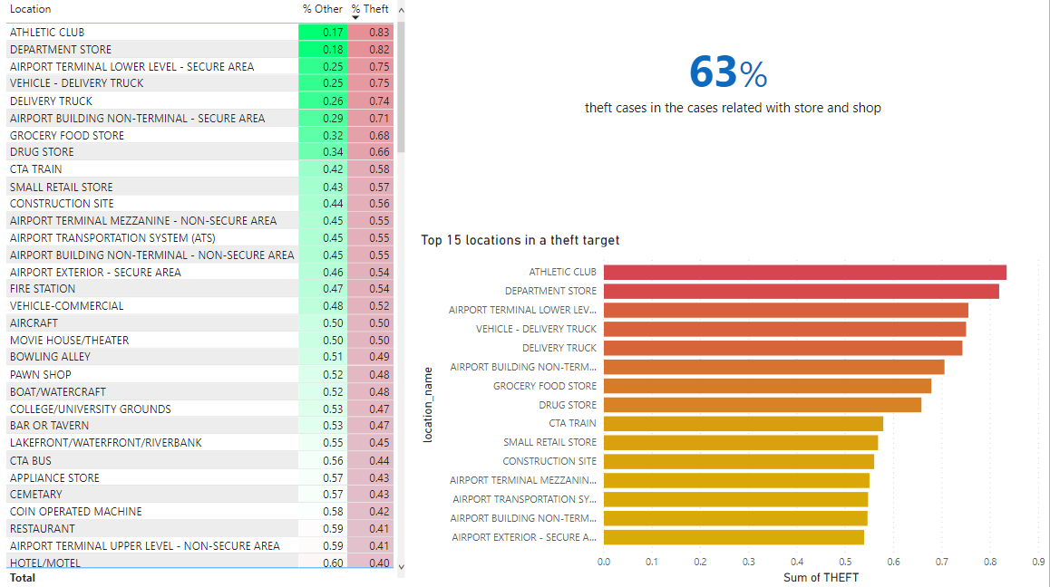
Location

Slide 9
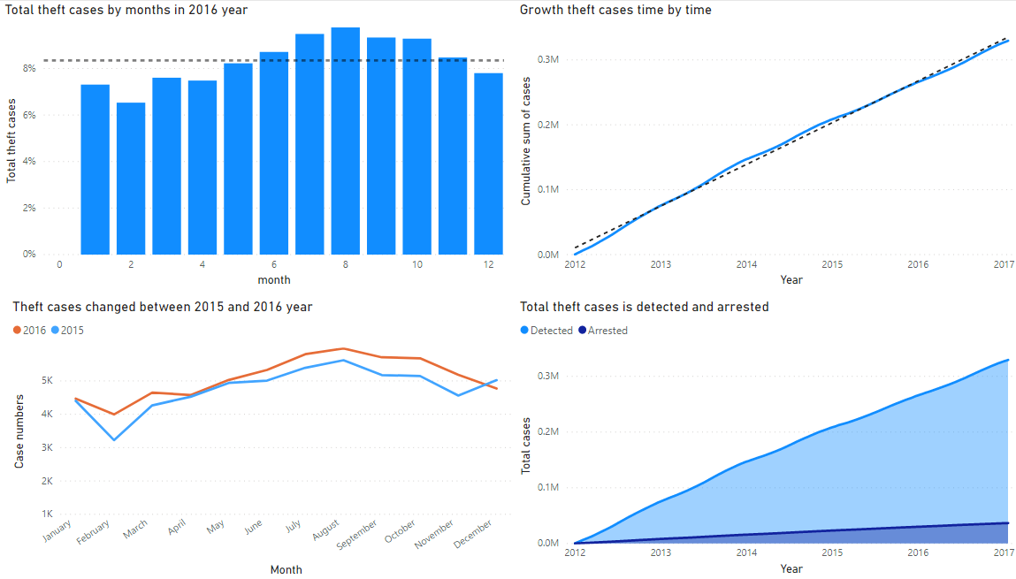
Time-series

Slide 10
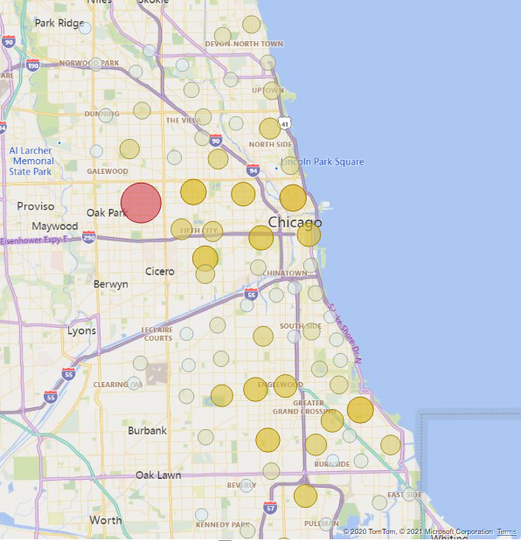
Community area
Which factors affect to theft behaviors?
Income
Education
Population
Employed
Use method:
Use PCA to reduce dimensions
Use linear regression to explain meaning of variables.

Slide 11
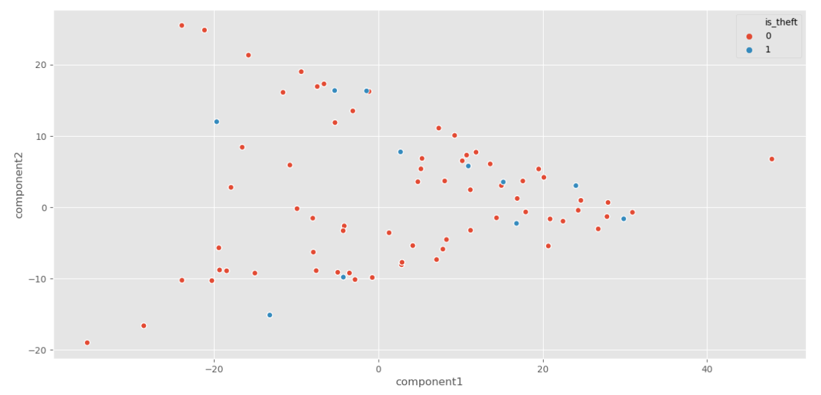
Community area
Use PCA to reduce number of dimensions to 2

Slide 12
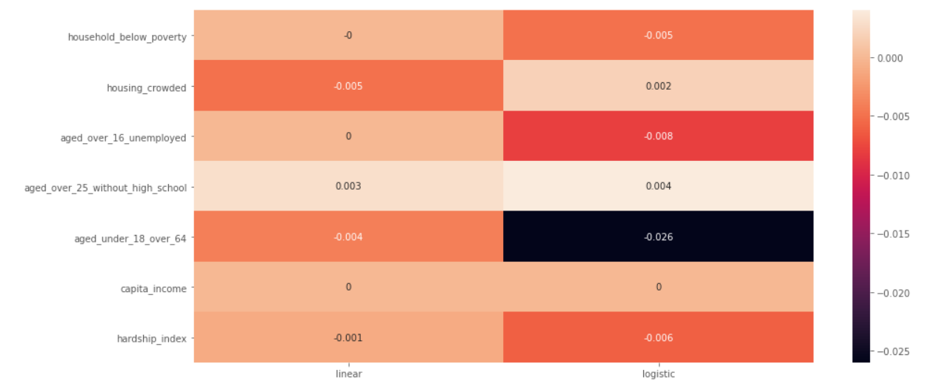
Community area
-0.026 * aged_under_18_over_64 - 0.008 * aged_over_16_unemployed – 0.006 * hardship_index – 0.005 * household_below_poverty + 0.002 * housing_crowded + 0.004 * aged_over_25_without_high_school

Slide 13
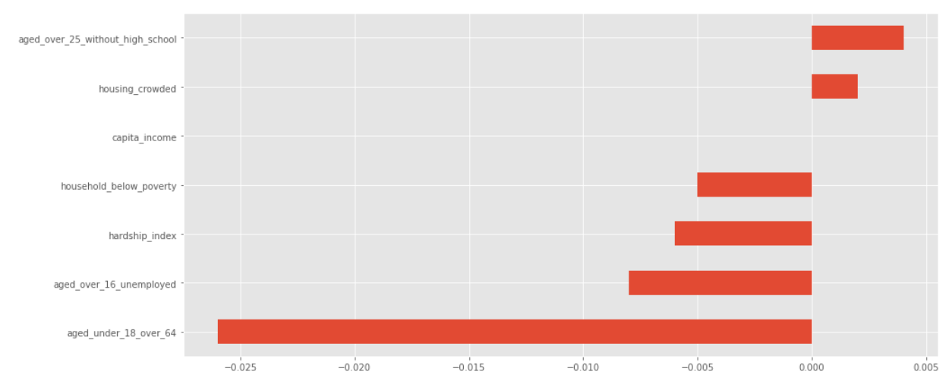
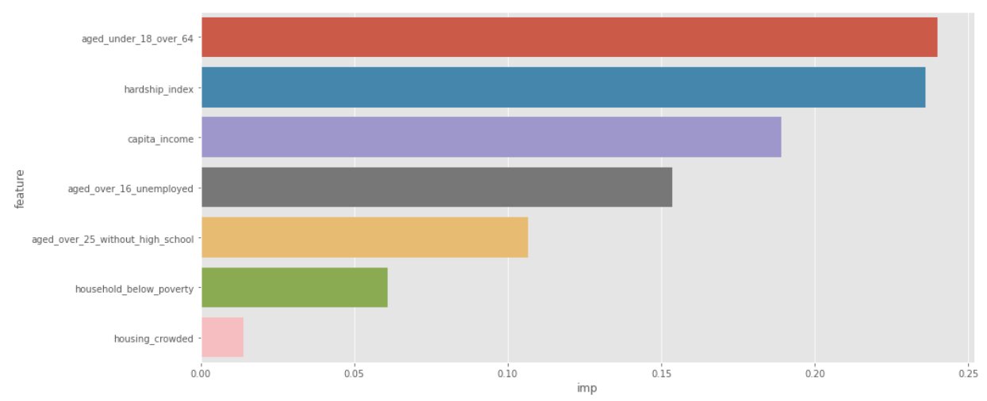
Community area

Slide 14
Data modeling

Slide 15
Data modeling methodologies
Build a baseline model
Feature selection & engineering
Model selection
Random forest
is_shop variable
polynomial variables
Random forest
KNN

Slide 16
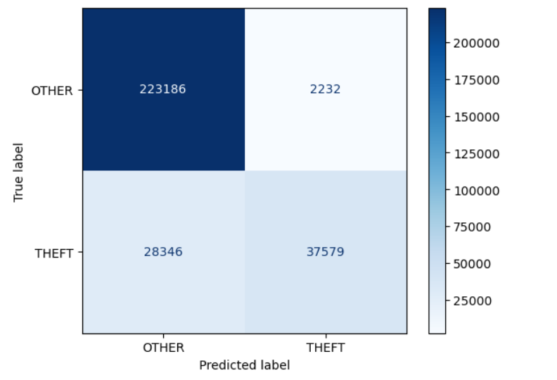
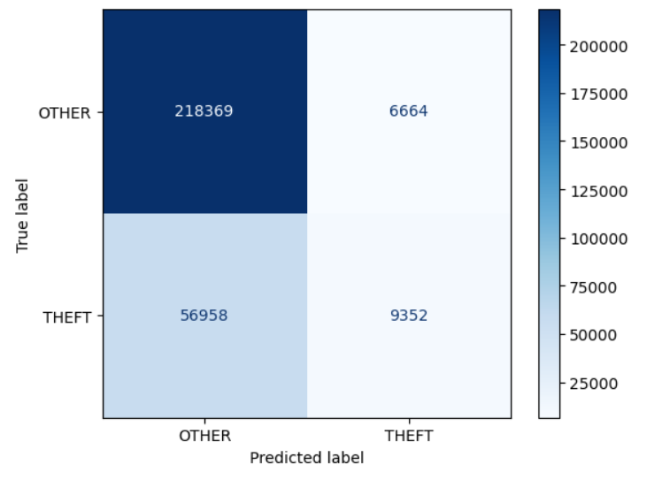
Predict theft cases
recall = 0.57
precision = 0.94
f1_score = 0.71
Data leak from IUCR_sk variable
recall = 0.14
precision = 0.58
f1_score = 0.22

Slide 17
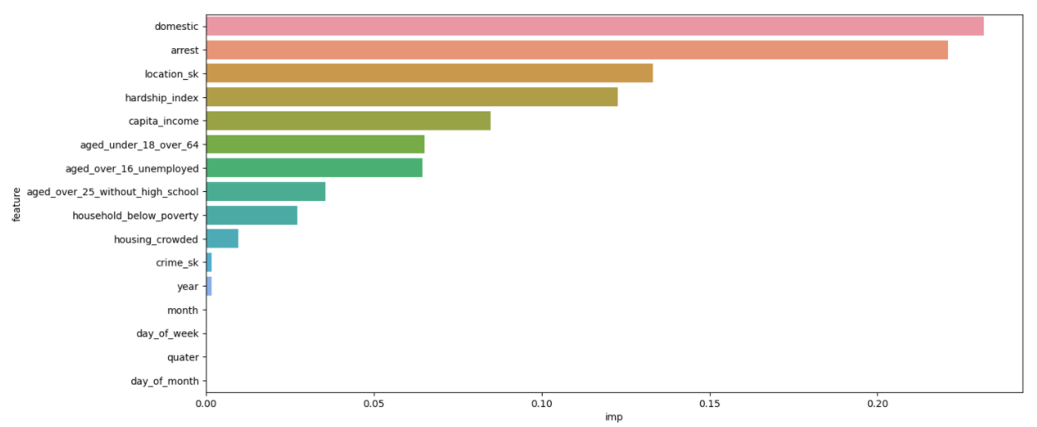
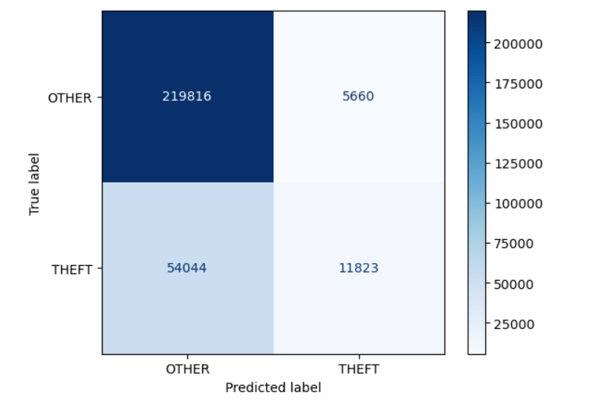
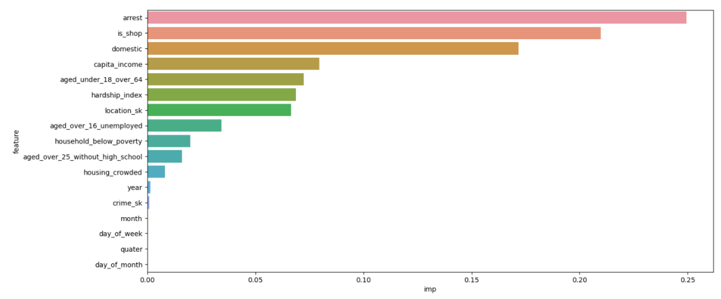
Add new feature to model

Slide 18
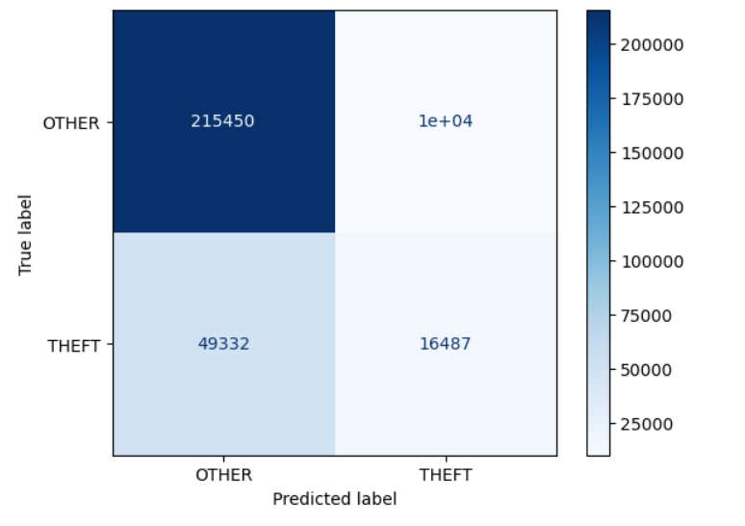
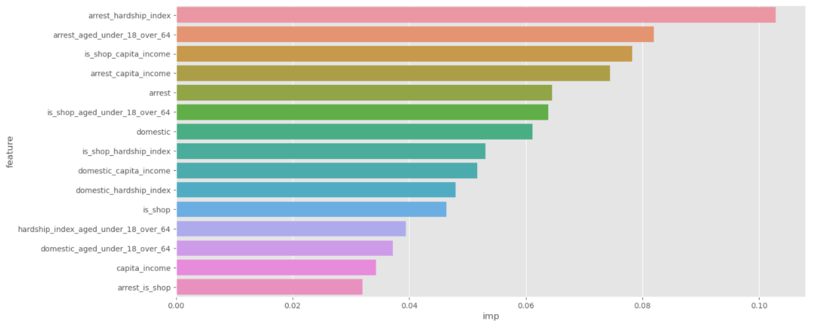
Feature engineering

