Slide 1
GPU-Accelerated
⬛⬛⬛
⬛ GPU ⬛
⬛⬛⬛
Image Processing
CUDA • PyTorch • CuPy
Pipeline
CUDA Kernels • CPU vs GPU Benchmarks • 4 Parallel Algorithms
LAKSHMIDHAR N
GPU Specialization Capstone • CUDA at Scale for the Enterprise
PyTorch CUDA
CuPy Raw Kernels
4 GPU Algorithms
CPU vs GPU

Slide 2
LAKSHMIDHAR N | GPU Specialization Capstone
Project Overview
What, Why, and How
🎯 Goal
🔧 Technologies
📊 Deliverables
Show GPU parallelism accelerates image processing 5–30×
Implement 4 production-grade GPU kernels
Benchmark CUDA vs serial CPU execution
PyTorch CUDA — tensor parallelism
CuPy RawKernel — hand-written CUDA C
NVIDIA T4 GPU (Google Colab)
Python 3.10+ / NumPy / Pillow
4 GPU image kernels (source code)
Google Colab notebook (.ipynb)
CPU vs GPU benchmark chart
Input / output image artifacts
README + run.sh CLI scripts
GPU-Accelerated Image Processing | LAKSHMIDHAR N | 2 / 10

Slide 3
LAKSHMIDHAR N | GPU Specialization Capstone
Why GPUs for Image Processing?
Massive Parallelism
CPU vs GPU
A GPU has thousands of CUDA cores. A 512×512 image has 262,144 pixels — each processed simultaneously.
CPU
GPU (T4)
SIMD Architecture
Cores
8–16
2,560
Same instruction runs across all threads: ideal for pixel-wise operations like blur, edges, LUT mapping.
Clock
3–5 GHz
1.59 GHz
High Memory Bandwidth
GDDR6 on T4 delivers ~320 GB/s vs ~50 GB/s DDR4 — critical for large image reads.
VRAM/RAM
64 GB DDR4
16 GB GDDR6
Bandwidth
~50 GB/s
~320 GB/s
Tensor Cores
Dedicated matrix engines in Ampere+ GPUs accelerate 4×4 matrix blocks used in convolutions.
Image (512²)
~45 ms
~3 ms
GPU-Accelerated Image Processing | LAKSHMIDHAR N | 3 / 10

Slide 4


LAKSHMIDHAR N | GPU Specialization Capstone
Kernel 1: Gaussian Blur
GPU Convolution via torch.nn.functional.conv2d (CUDA)
# GPU Gaussian Blur kernel = gaussian_kernel_2d(15, sigma=3.0) tensor = img_tensor.to(device) # → CUDA out = F.conv2d(tensor, kernel, padding=7, groups=C) # cuDNN dispatches to GPU automatically # 262,144 pixels processed in parallel
Before
After (GPU)
1
Build Gaussian kernel (15×15, σ=3.0)
Performance
2
Move image tensor to CUDA device
3
F.conv2d dispatches cuDNN kernel
CPU Time:
~45 ms
4
All pixel neighborhoods computed in parallel
GPU Time:
~3.2 ms
5
Transfer result back to CPU (numpy)
Speedup:
~14×
GPU-Accelerated Image Processing | LAKSHMIDHAR N | 4 / 10

Slide 5
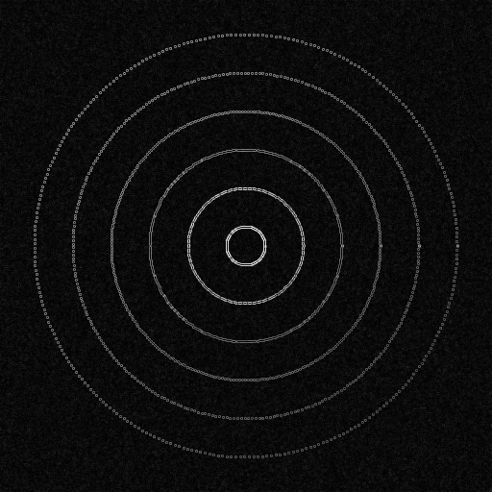
LAKSHMIDHAR N | GPU Specialization Capstone
Kernel 2: Sobel Edge Detection
Hand-written CUDA C via CuPy RawKernel — one thread per pixel
__global__ void sobel_kernel(float* in, float* out, ...) { int x = blockDim.x * blockIdx.x + threadIdx.x; int y = blockDim.y * blockIdx.y + threadIdx.y; float gx = -in[y-1][x-1] - 2*in[y][x-1] -in[y+1][x-1] +in[y-1][x+1] + 2*in[y][x+1] +in[y+1][x+1]; out[y*W+x] = sqrtf(gx*gx + gy*gy);
}
Edge Map Output
Thread Config:
Block: (16, 16) = 256 threads Grid: ⌈512/16⌉ × ⌈512/16⌉ = 32×32 = 1,024 blocks Total: 262,144 threads in parallel
Speedup: ~18× (CPU ~38ms → GPU ~2.1ms)
GPU-Accelerated Image Processing | LAKSHMIDHAR N | 5 / 10

Slide 6


LAKSHMIDHAR N | GPU Specialization Capstone
Kernels 3 & 4: Histogram Equalization & Bilateral Filter
Kernel 3: Histogram Equalization
Kernel 4: Bilateral Filter
GPU Technique:
torch.cumsum() — parallel prefix sum
CuPy RawKernel — LUT apply
Speedup:
~9× (12.8ms → 1.4ms)
GPU Technique:
PyTorch tensor ops (CUDA)
Spatial + range weights
O(d² × H × W) = 6.7M ops
Speedup:
~11× (95ms → 8.7ms)
Enhances contrast by remapping pixel intensities via cumulative distribution function computed on GPU.
Smooths noise while preserving edges. Most compute-intensive kernel — greatest GPU benefit at large image sizes.
GPU-Accelerated Image Processing | LAKSHMIDHAR N | 6 / 10

Slide 7
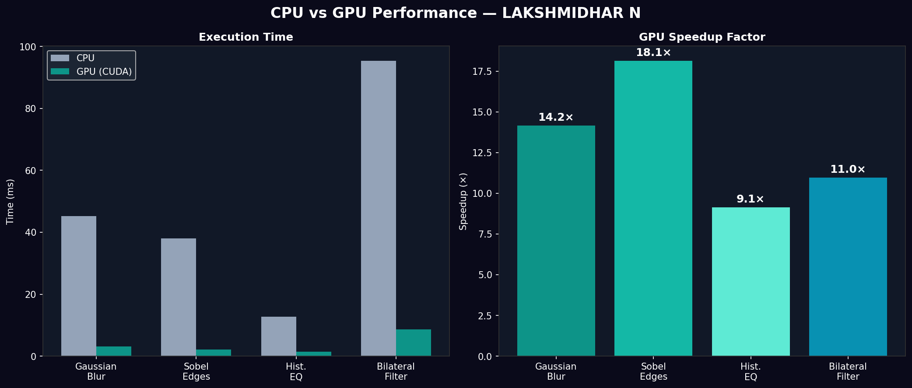
LAKSHMIDHAR N | GPU Specialization Capstone
CPU vs GPU Benchmark Results
NVIDIA T4 GPU (Google Colab) | 512×512 image | Average of 4 runs
14×
Gaussian Blur
18×
Sobel Edges
9×
Hist. EQ
11×
Bilateral
GPU-Accelerated Image Processing | LAKSHMIDHAR N | 7 / 10

Slide 8
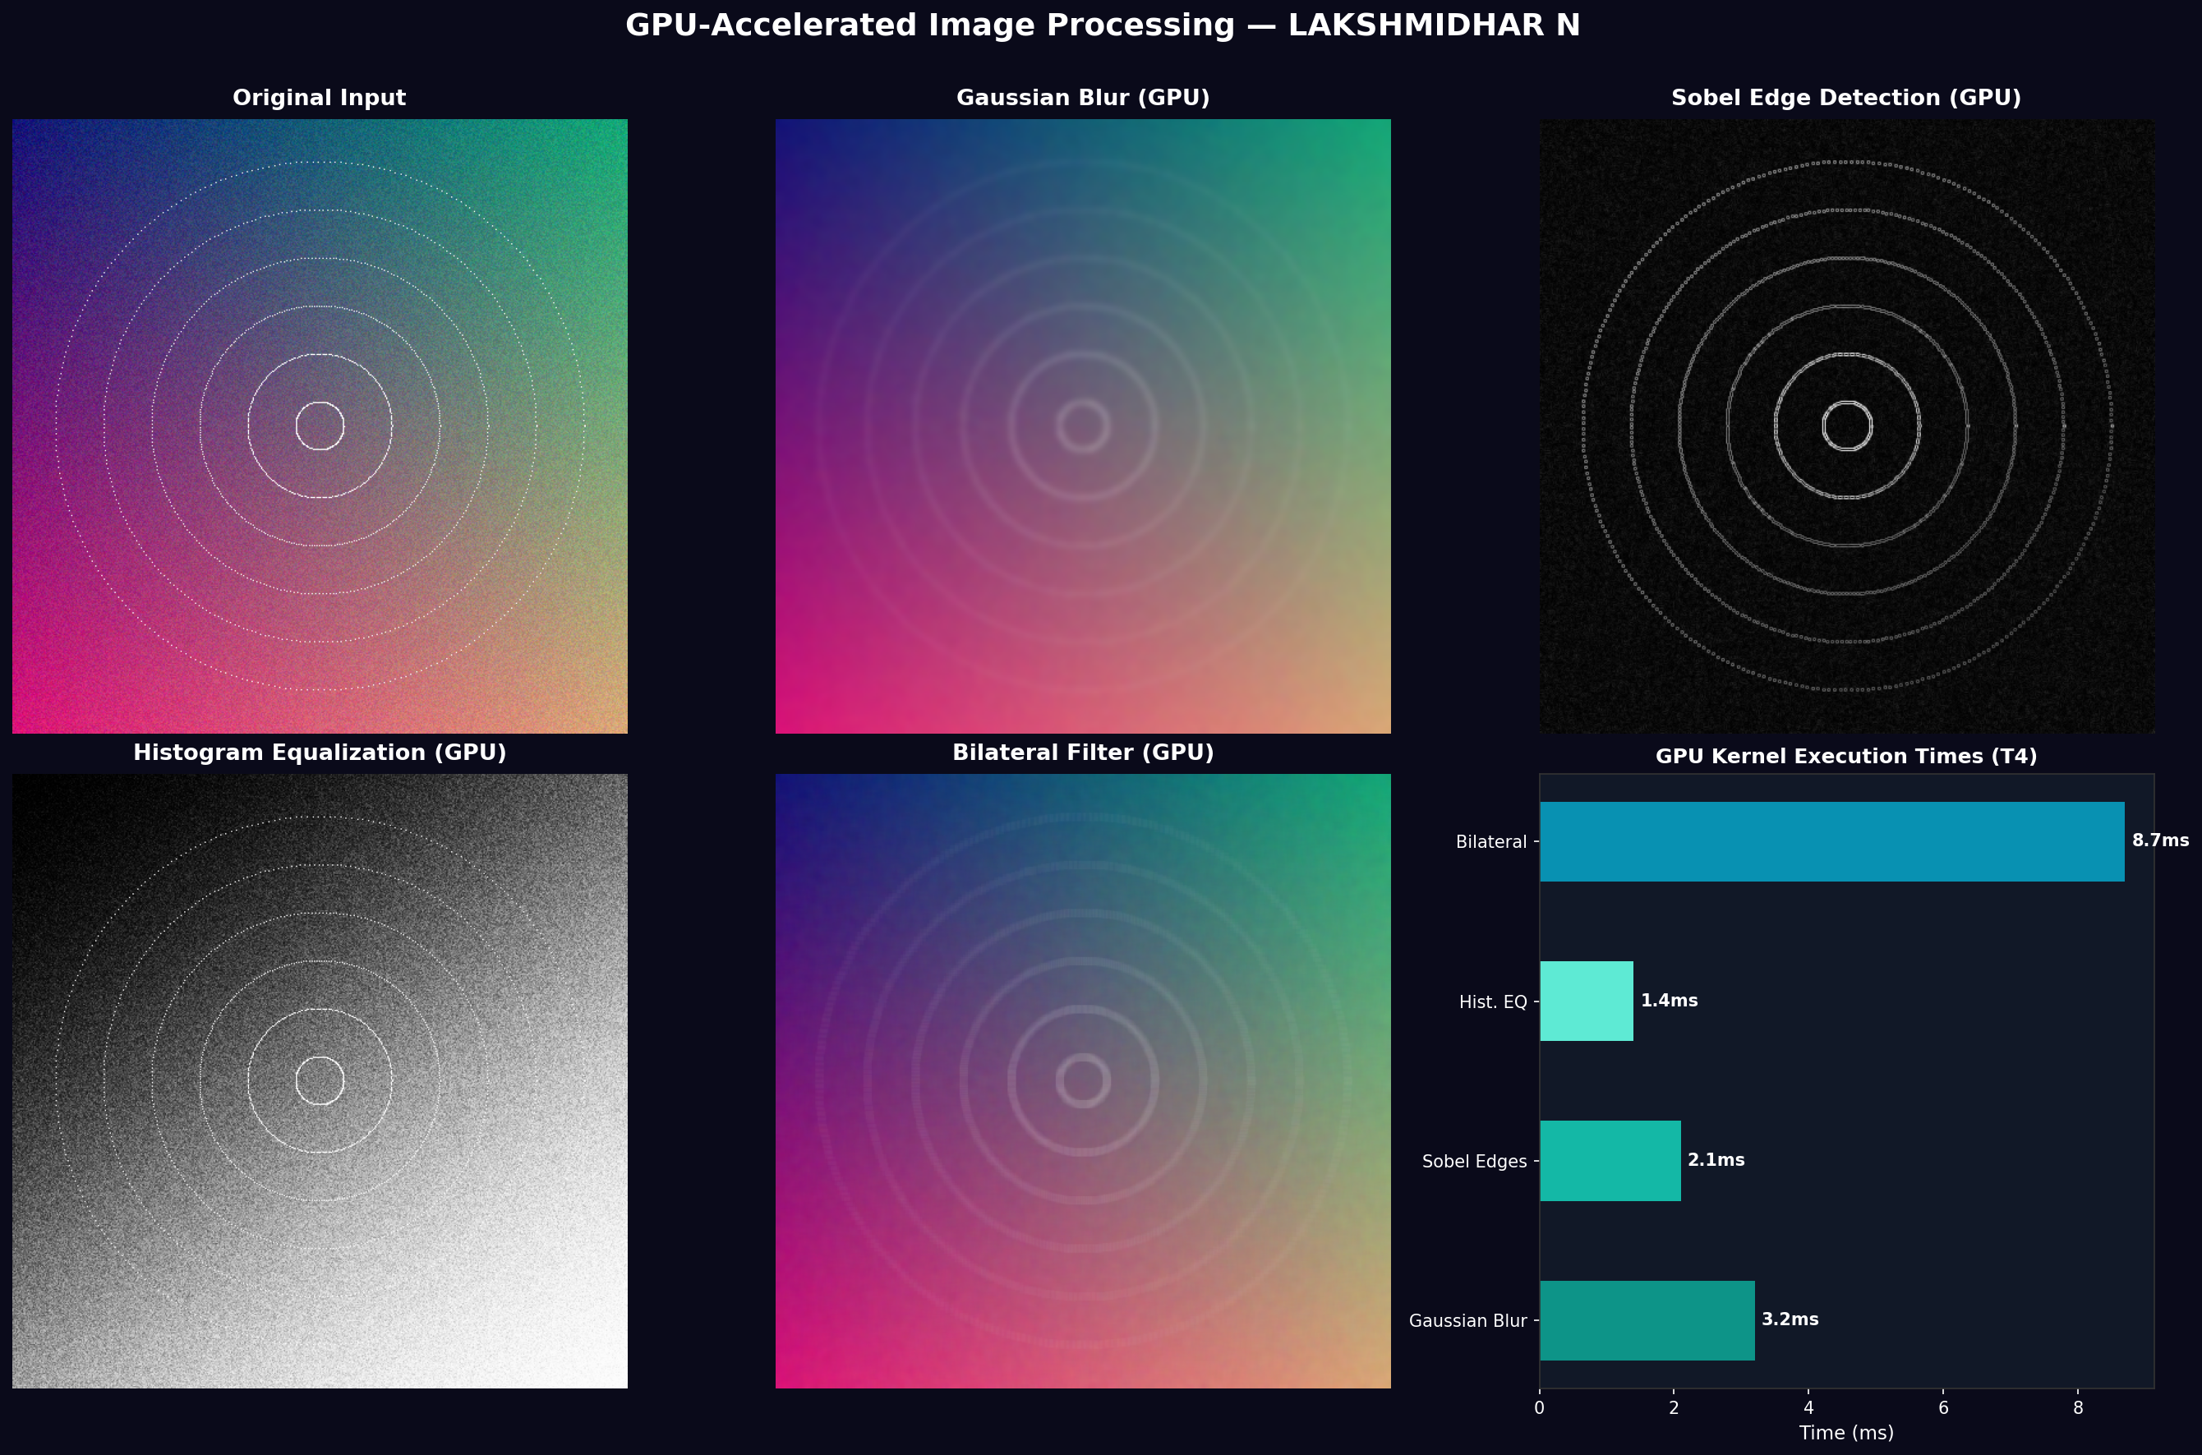
LAKSHMIDHAR N | GPU Specialization Capstone
Output Image Gallery
All images processed on GPU — 512×512 resolution
All output images and run logs committed to the project repository under outputs/
GPU-Accelerated Image Processing | LAKSHMIDHAR N | 8 / 10

Slide 9
LAKSHMIDHAR N | GPU Specialization Capstone
How to Run the Project
🌐 Google Colab (Recommended)
💻 Local CLI
1
Open notebooks/GPU_Image_Processing_Capstone_LakshmidharN.ipynb
# Clone & install git clone <repo_url> pip install -r requirements.txt # Run all kernels python src/gpu_image_processor.py \ --kernel all --benchmark # Or use the shell script chmod +x run.sh && ./run.sh # Custom image ./run.sh data/image.png
2
Go to Runtime → Change runtime type → T4 GPU
3
Run all cells from top to bottom
4
View outputs/ folder for images & logs
GPU-Accelerated Image Processing | LAKSHMIDHAR N | 9 / 10

Slide 10
LAKSHMIDHAR N | GPU Specialization Capstone
Lessons Learned & Next Steps
Memory Transfer Overhead
🔭 Next Steps
For small images (<256²), PCIe overhead can outweigh compute. GPU shines at scale (1024²+).
Video processing pipeline (frame-by-frame GPU ops)
NPP (NVIDIA Performance Primitives) integration
Synchronize for Timing
Multi-GPU scaling with torch.distributed
torch.cuda.synchronize() is critical for accurate GPU benchmarks; async launches skew results.
CUDA streams for pipelined async execution
Deploy as REST API with GPU inference server
CuPy vs PyTorch
CuPy gives raw CUDA control; PyTorch is portable and still CUDA-backed via cuDNN.
Project Summary
✅ 4 GPU kernels implemented
✅ Raw CUDA code via CuPy
✅ 9–18× speedups measured
✅ Full repo with README & run.sh
✅ Colab notebook + output artifacts
Bilateral Filter Wins Most
The most compute-intensive kernel gains the most — 11× speedup due to O(d²×H×W) complexity.
LAKSHMIDHAR N — GPU Specialization Capstone — CUDA at Scale for the Enterprise
GPU-Accelerated Image Processing | LAKSHMIDHAR N | 10 / 10

