Slide 1

SWP391: Final Project Presentation
PROJECT MANAGEMENT SYSTEM
PMS

Slide 2
Project Overview
Product introduction & scope:
- Introduction: Managing projects across various teams and departments can be complex and challenging, especially as organizations grow. This Project Management System (PMS) was developed to address these challenges by providing an all-in-one online platform that improves collaboration, accountability, and oversight.
- Scope: The Project Management System (PMS) is designed to assist organizations in managing their projects information online. The system provides a framework for managing project milestones, teams, allocation resources, set up domains and many more features.

Slide 3
Project Overview
Member:
Team Member:
+ Nguyễn Đức Đạt - HE187230 (Leader)
+ Nguyễn Minh Nghĩa - HE172754 (Dev)
+ Phạm Nhật Minh - HE187288 (Dev)
+ Nguyễn Quốc Anh - HE180388 (Dev)
+ Vũ Văn Trường - HE173305(Dev)

Slide 4
Project Overview
Team Work
1. Project communication
When starting an iteration , the Leader will schedule a meeting to assign tasks to team members.
Meeting: 2 times a week.
GG-meet.
2. Issue
- When there are difficulties or questions during work, team members will discuss with each other to come up with a final solution.
The group will ask questions so the instructor can help during the work process.
- Project tracking: gitlab.com

Slide 5
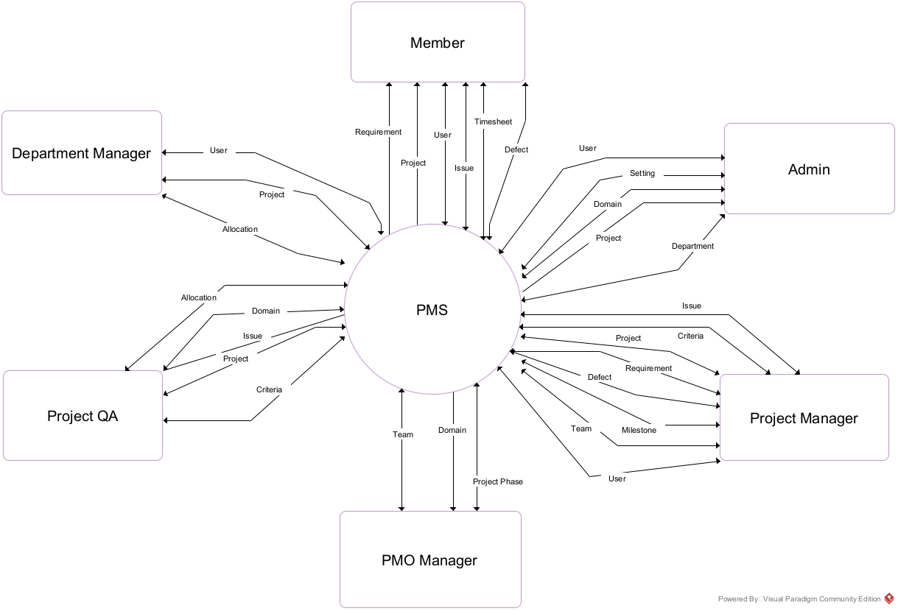
Project Overview
Context Diagram:

Slide 6
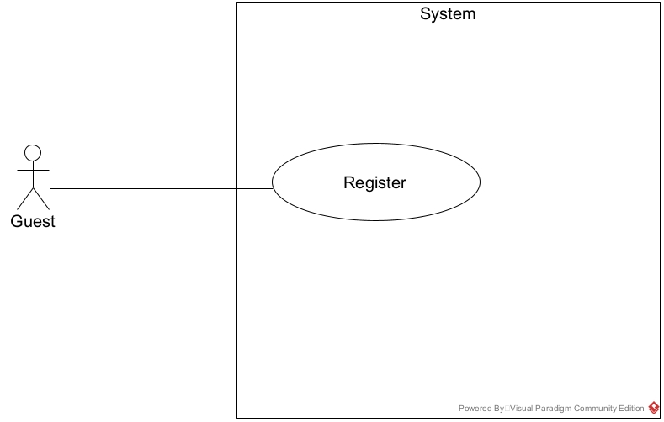
Product Requirements Use Case Diagrams
Guest Usecase

Slide 7
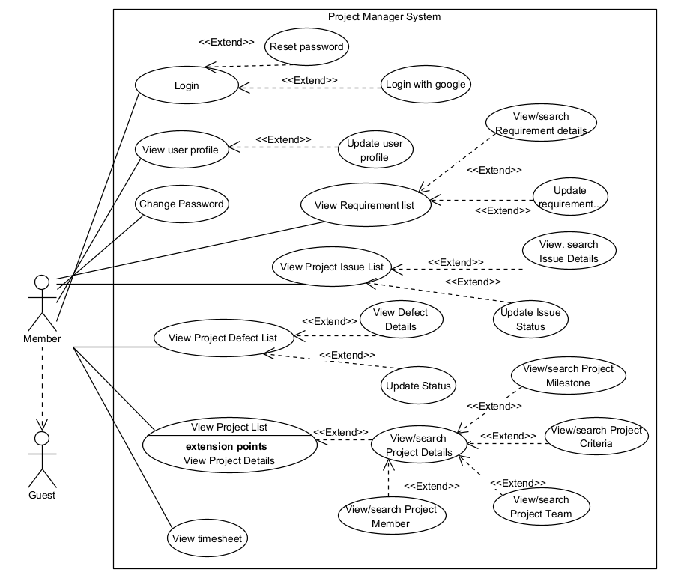
Product Requirements Use Case Diagrams
Member Usecase

Slide 8
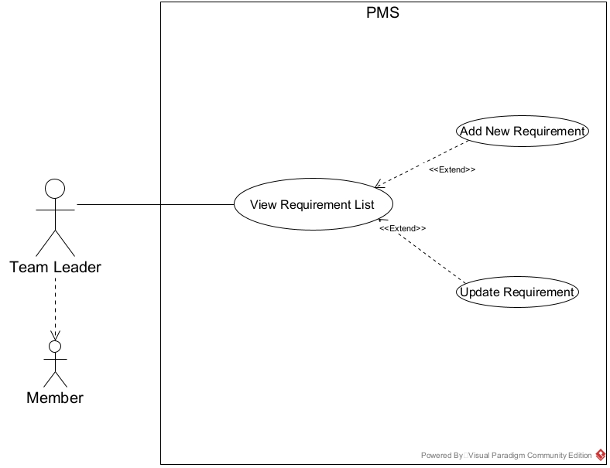
Product Requirements Use Case Diagrams
Team Leader Usecase

Slide 9
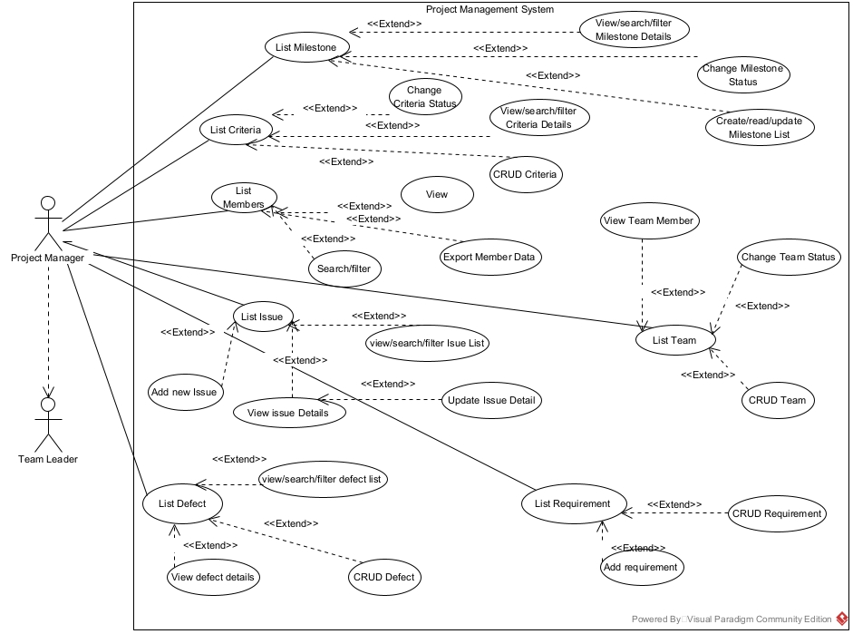
Product Requirements Use Case Diagrams
Project Manger Usecase

Slide 10
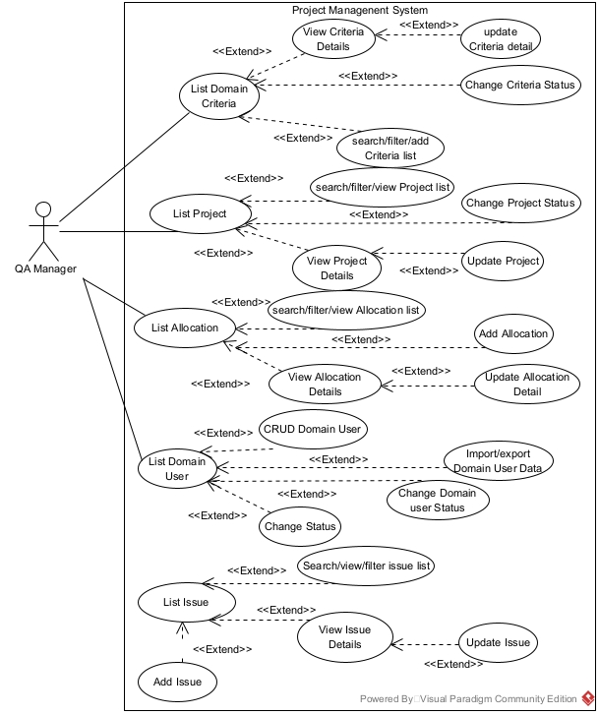
Product Requirements Use Case Diagrams
Project QA Usecase

Slide 11
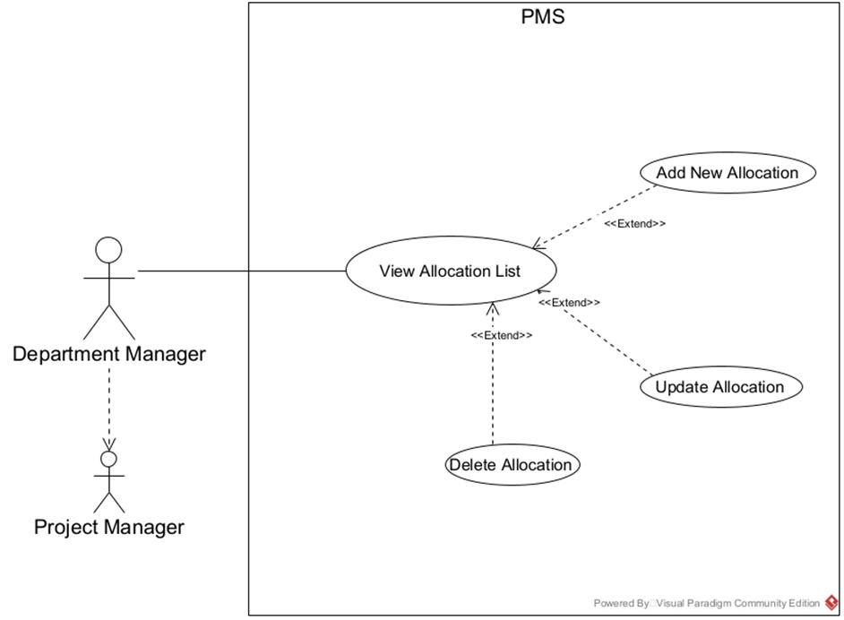
Product Requirements Use Case Diagrams
Department Manager Usecase

Slide 12
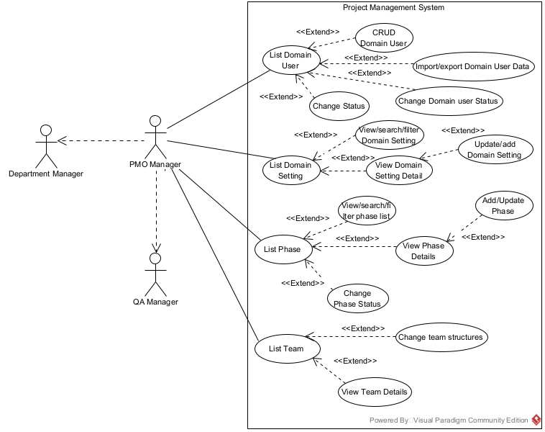
Product Requirements Use Case Diagrams
PMO Manger Usecase

Slide 13
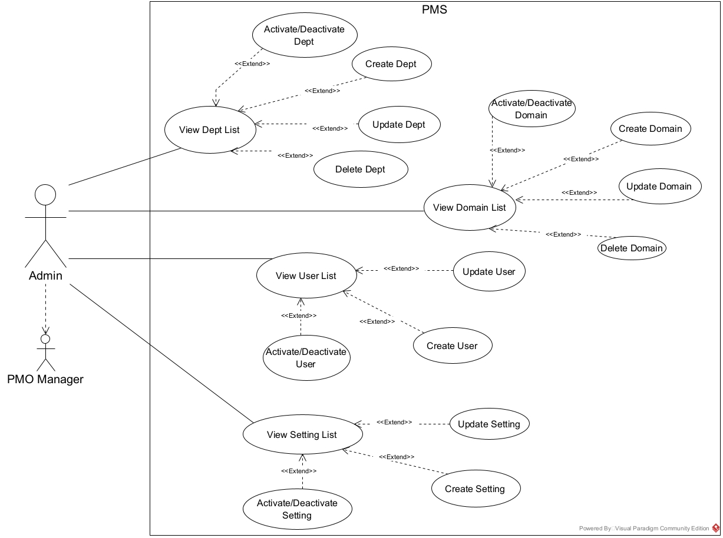
Product Requirements Use Case Diagrams
Admin Usecase

Slide 14
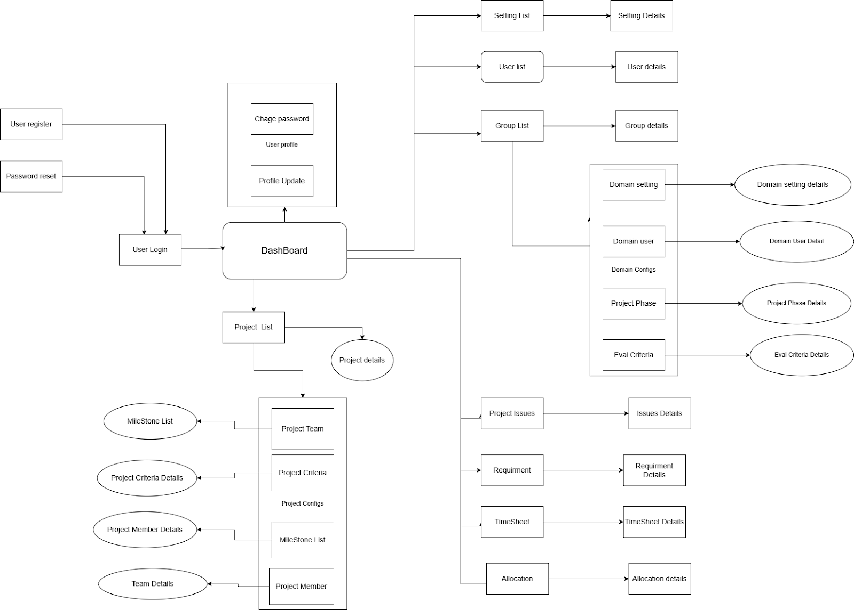
Product Requirements Product Functionalities
- Screen flow

Slide 15
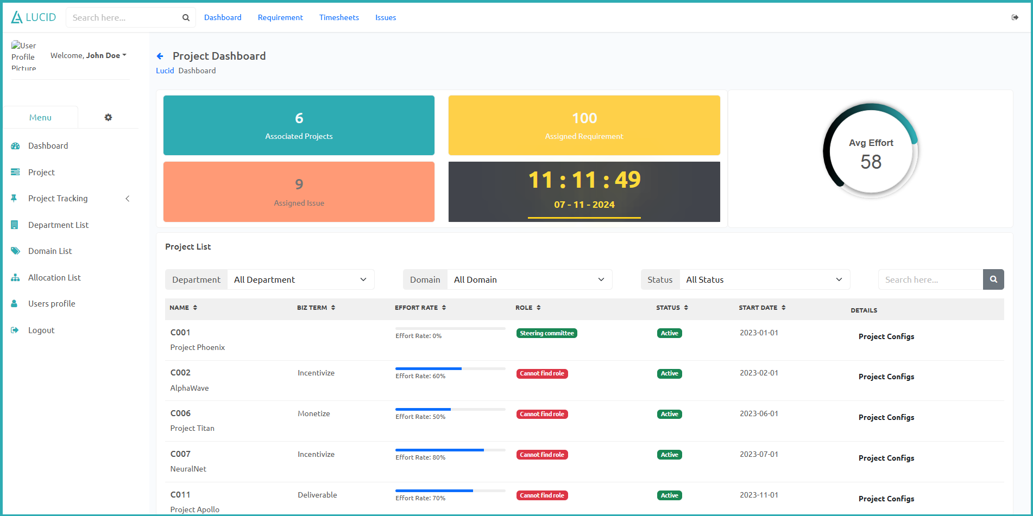
Product Requirements Main Screen UI Design
Main screen: User Dashboard

Slide 16
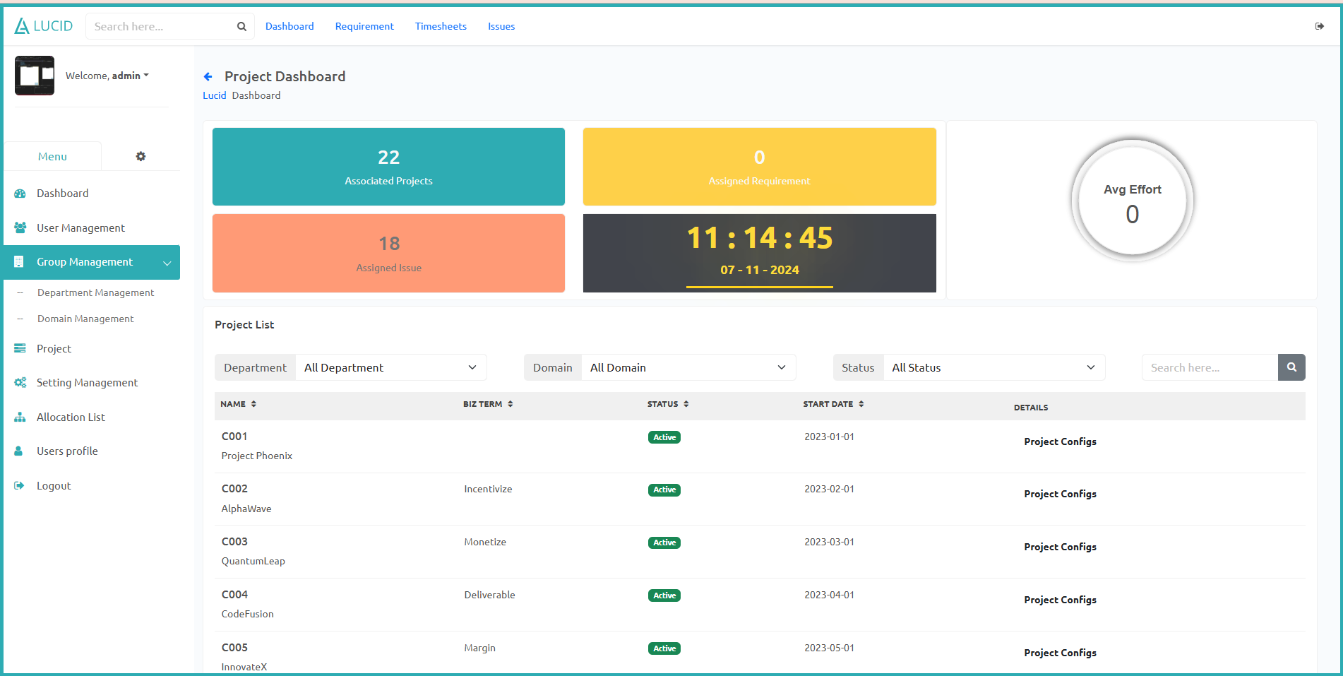
Product Requirements Main Screen UI Design
Main screen: Admin Dashboard

Slide 17
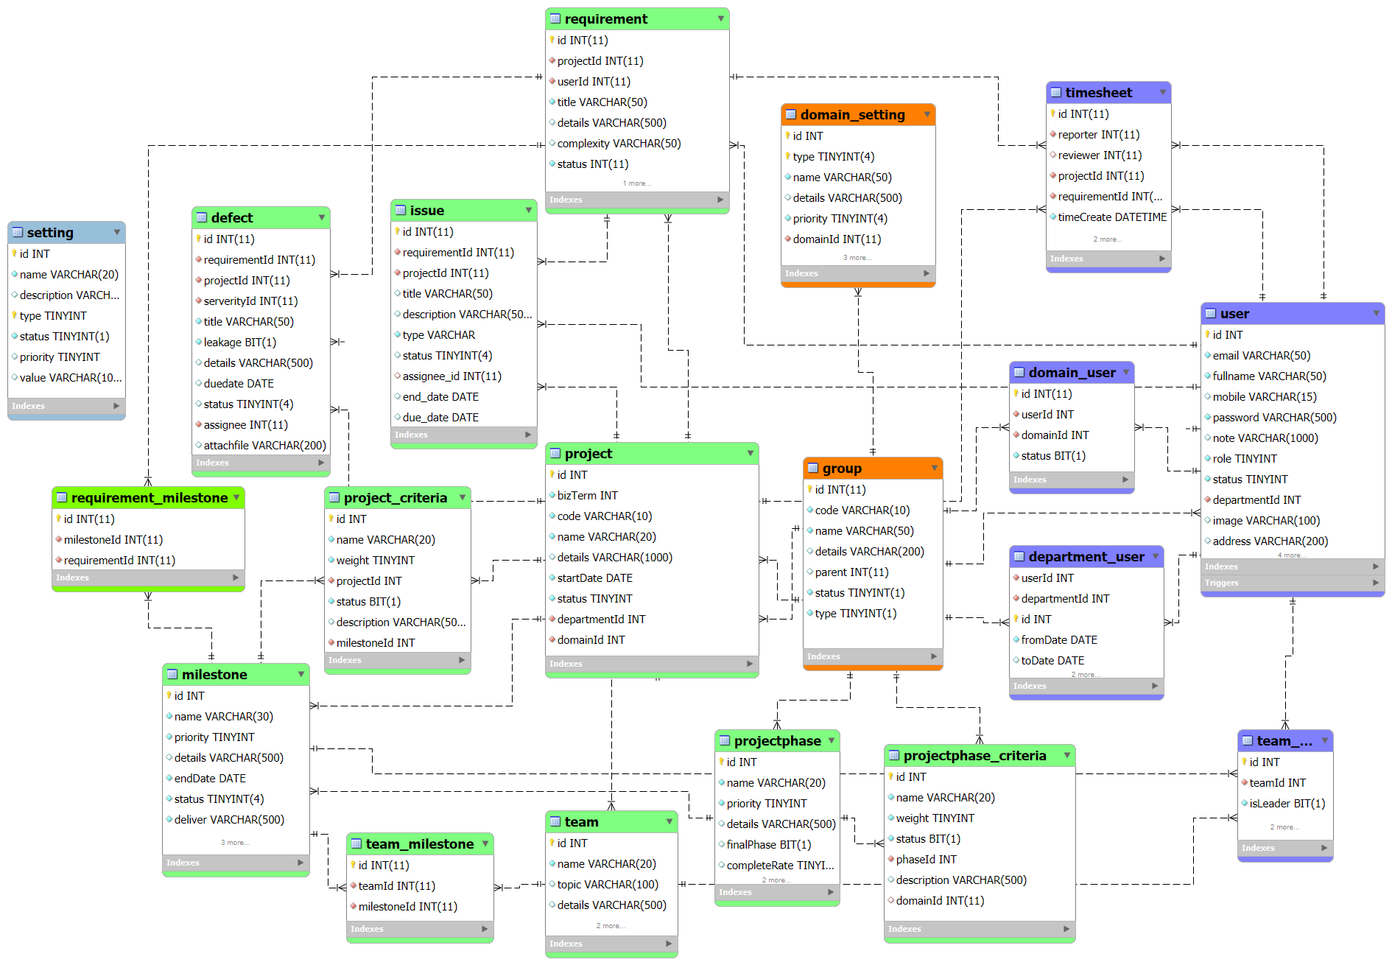
System Design Database Design
Database schema:

Slide 18
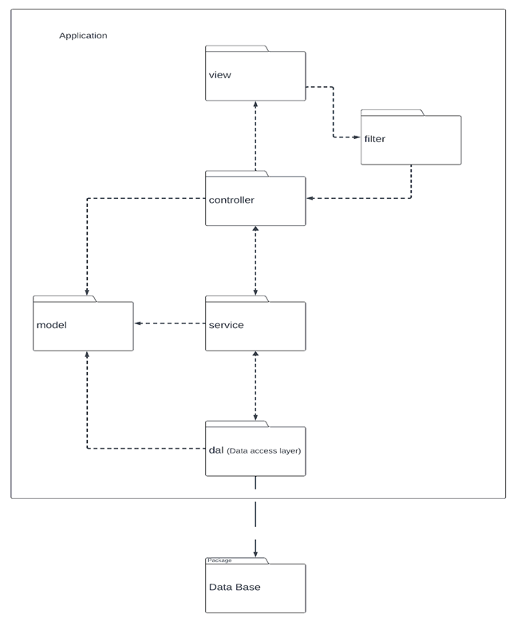
System Design Package Diagram
System package diagram

Slide 19
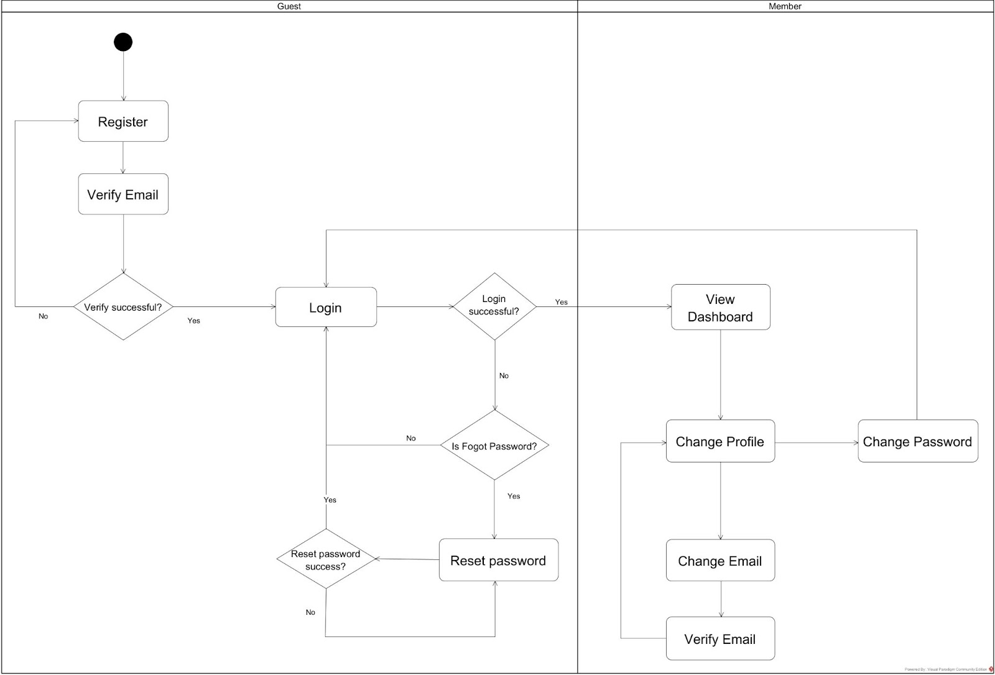
Demonstration
User Authentication Workflow

Slide 20
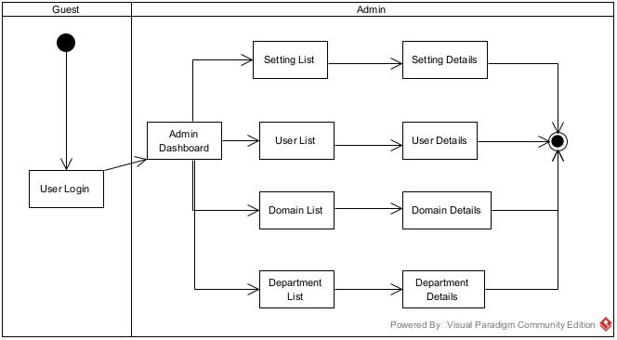
Demonstration
Adminstration Workflow

Slide 21
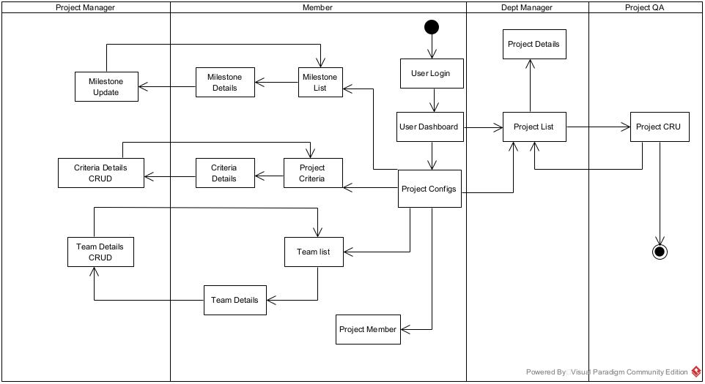
Demonstration
Project management Workflow

Slide 22
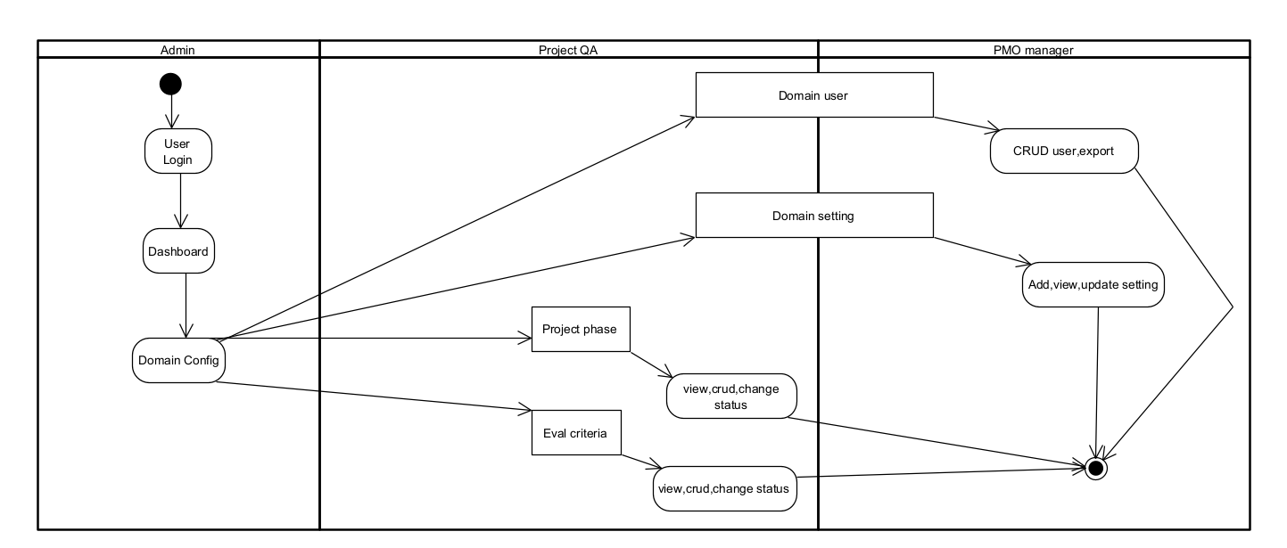
Demonstration
Domain management Workflow

Slide 23
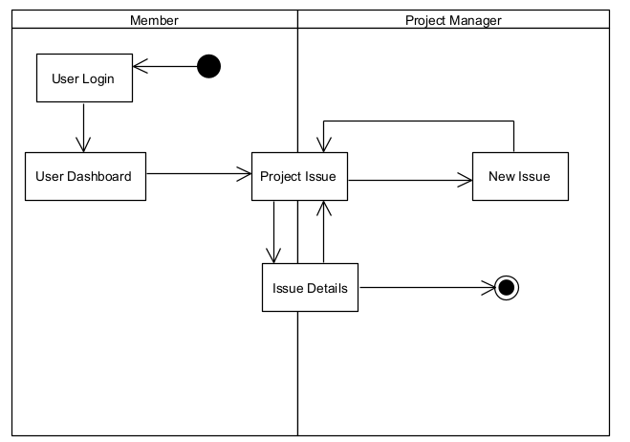
Demonstration
Issue Workflow

Slide 24
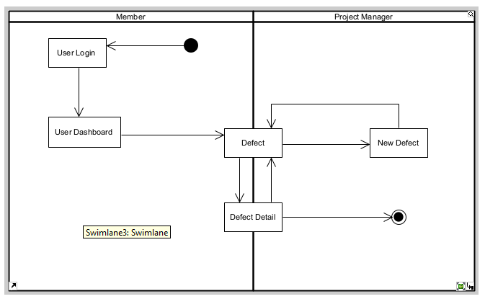
Demonstration
Defect Workflow

Slide 25
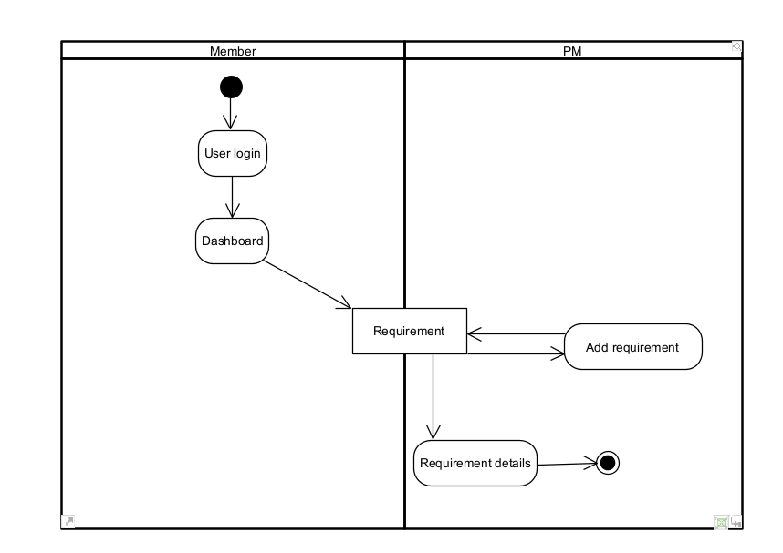
Demonstration
Requirement Workflow

Slide 26
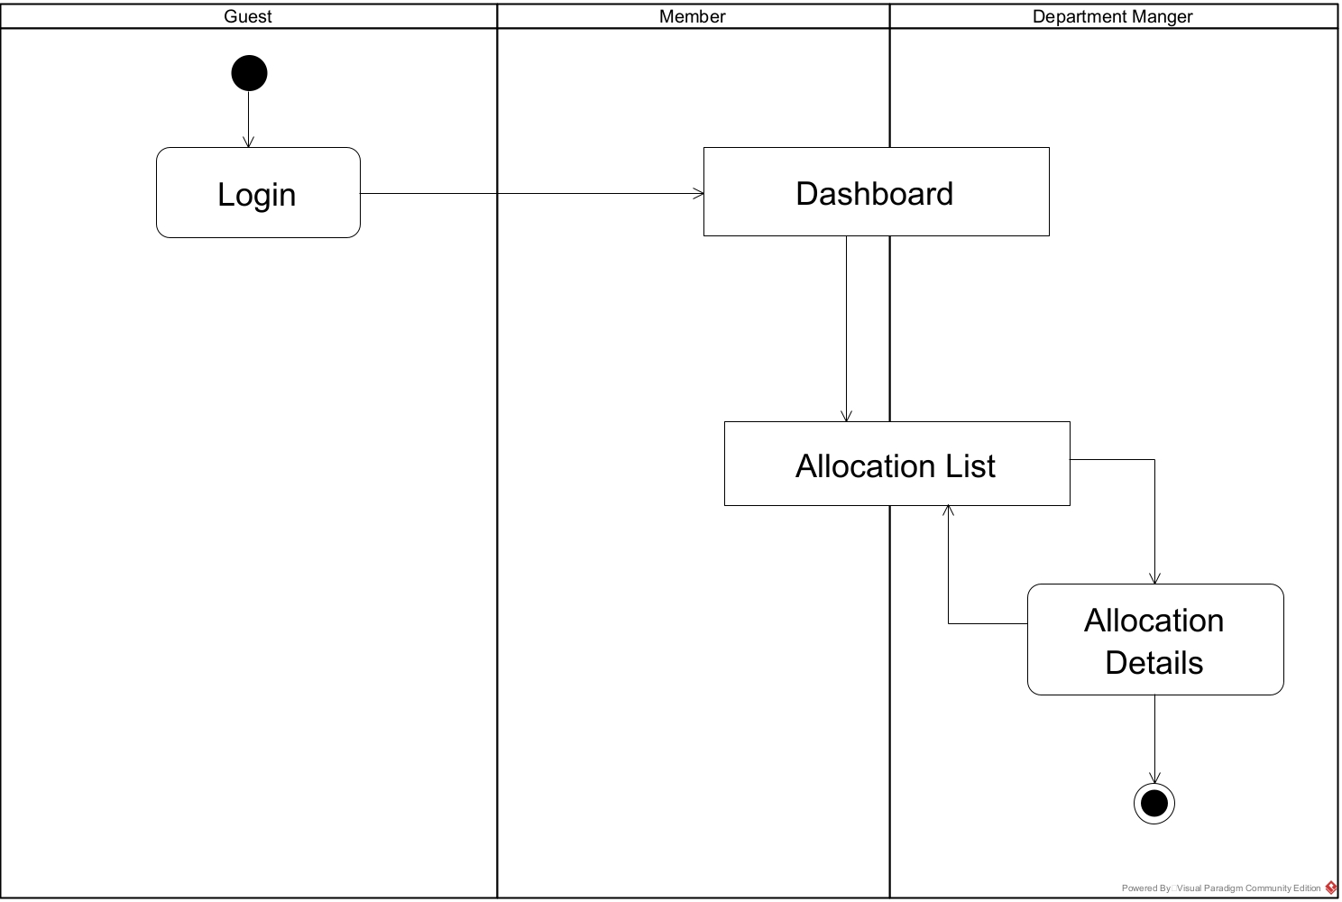
Demonstration
Allocation Workflow

Slide 27


