Slide 1
Distributed Transaction
DuyND

Slide 2
AGENDA
Context
Problem (Distributed Transaction)
​Solutions - Choreography
​Sample

Slide 3
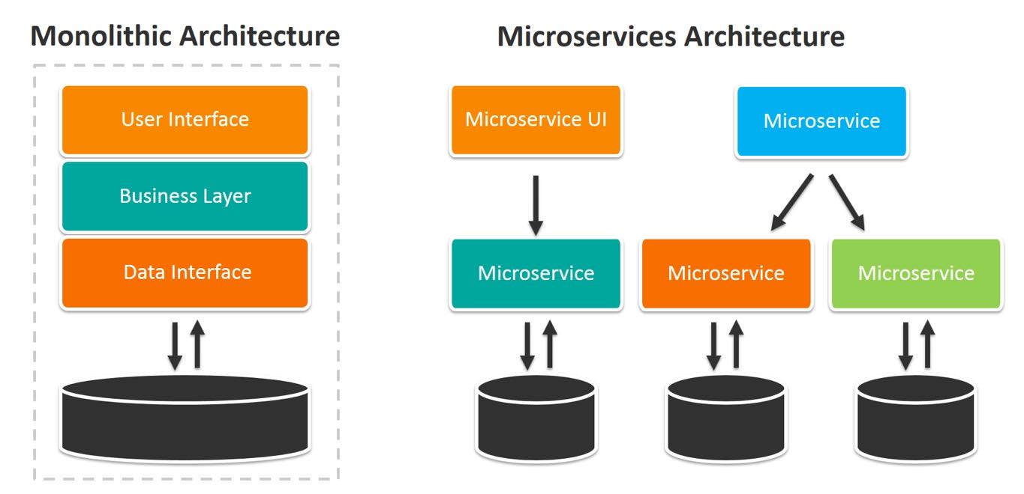
transformation
Microservice key: Independent Deployability
Code
Technology
Scaling
Evolution
Notes:
Monolithic Problems:
Huge and intimidating code base for developers
Development tools get overburdened
Scaling is limited
Deployment frequency is limited

Slide 4



DRAWBACKS OF MSA
Design
Implement & Test
Deploy
Tackle Business Complexity
The partitioned database architecture
Distributed transactions
Testing a microservices application
CI-CD
Scale
Logging
Monitoring
Notes:
Tackle Business Complexity in a Microservice with DDD and CQRS Patterns
Distributed transactions:

Slide 5





Transaction
Definition
Atomicity
Consistency
Isolation
Durability
A transaction is a single unit of work which means either ALL or NONE.
Ensures that all operations within the work unit are completed successfully; If the transaction fails then operations are rolled back to their previous state.
Ensures that the database properly changes states upon a successfully committed transaction.
Enables transactions to operate independently of and transparent to each other.
Ensures that a committed transaction persists in case of a system failure.
Notes:
A transaction is a single unit of work which means either ALL or NONE. If a transaction is successful, all of the data operations are committed and become a durable part of the database. If a transaction encounters errors/exceptions and must be canceled or rolled back, then all of the data modifications/operations need to be removed.

Slide 6
Local Transaction
BEGIN TRAN @TransactionName;
INSERT …
UPDATE...
DELETE...
COMMIT @TransactionName ;
ROLLBACK TRAN @TransactionName;

Slide 7
MSA
Service 1
Service 2
DB 1
DB 2

Slide 8
Solutions
Two-phase commit
Orchestration
Choreography
PARALLEL PIPELINE

Slide 9
Choreography - Event based
Service 1
Service 2
Service 3
Public
Subscribe
Message broker
Notes:
Gửi event mà không cần đợi kết quả.
Logic nghiệp vụ phần tán ở các service.
Các service phải biết mình xử lý thành công hoặc thất bại thì cần public event nào tiếp theo
=> việc thêm 1 service vào flow có thể dẫn tới sửa ở nhiều nơi.
Việc các service chạy song song hay tuần tự phụ thuộc vào nghiệp vụ.

Slide 10
Sample
Order food and payment online

Slide 11
Happy Flow
1. User order on Mobile. Create new order successfully.
2. Payment success
2.1. Notify seller of successful payment
2.2. Send the order to the delivery department
2.3. Send order to the restaurant
3. The restaurant prepares the food
4. Delivery department looking for shipper
5. Shipper delivers food to user
=> Order status COMPLETED

Slide 12

Happy Flow
Order Service
Payment Service
Restaurant Service
Delivery Service
User
ORDER_CREATED
3
4
1
2
PAYMENT_SUCCESSED
RESTAURANT_DONE
DELIVERY_DONE
Message broker

Slide 13
No food to cook
1. User order on Mobile. Create new order successfully.
2. Payment success
2.1. Notify seller of successful payment
2.2. Send the order to the delivery department
2.3. Send order to the restaurant
3. The restaurant check stock but not enough
3.1 Notice to the seller to cancel the order
3.2 Refund to customers
3.3 Notice to delivery department to cancel shipper
=> Update order status to CANCELED_RESTAURANT

Slide 14
NO FOOD TO COOK
Order Service
Payment Service
Restaurant Service
Delivery Service
User
ORDER_CREATED
3
1
2
PAYMENT_SUCCESSED
RESTAURANT_FAILED
Message broker

Slide 15
Can not find Shipper
1. User order on Mobile. Create new order successfully.
2. Payment success
2.1. Notify seller of successful payment
2.2. Send the order to the delivery department
2.3. Send order to the restaurant
3. The restaurant prepares the food
4. Delivery department not found any shipper
4.1. Notice to the seller to cancel the order
4.2. Refund to customers
4.3. Notice to restaurant to cancel the order. If lucky, stock quantity not change
=> Order status CANCELED_DELIVERY

Slide 16
CAN NOT FIND SHIPPER
Order Service
Payment Service
Restaurant Service
Delivery Service
User
ORDER_CREATED
3
4
1
2
PAYMENT_SUCCESSED
RESTAURANT_DONE
DELIVERY_FAILED
Message broker

Slide 17
Demo

Slide 18


Characteristic - No central transaction coordinator - No single-point failure - Loose coupling / fault tolerance - Difficult to maintain/understand - Risk of cyclic dependency
Service
DB
Message broker
Notes:
trách nhiệm được phân chia đều cho tất cả các service trong workflow. Ngoài ra việc chạy multi-instances cho các service cũng là điều hết sức phổ biến nên gần như không có single-point failure.
nếu cần thêm service mới, đơn giản chỉ cần listen trên các event có sẵn (hoặc tạo mới cũng chẳng có vấn đề gì), như vậy thêm thêm/bớt các service diễn ra hoàn toàn không phụ thuộc vào nhau. Tuy nhiên có ảnh hưởng đến business logic hay không lại là bài toán của lúc design.
Difficult to maintain/understand: nếu cần thêm step, thêm event, thêm service, khả năng cao chúng ta cần sửa cả những service publish event liên quan đến service mới. Ngoài ra việc các business phân tán ở nhiều chỗ khiến việc hiểu toàn bộ flow.. khó khăn hơn.

Slide 19
THANK YOU
Nguyễn Đức Duy
0347726171

