Slide 1




Kubernetes Meets OpenTofu: A Recipe for IaC Success
Sao Paulo - 24/02/2024

Slide 2

Lesson 101 – How to cook Tofu

Slide 3
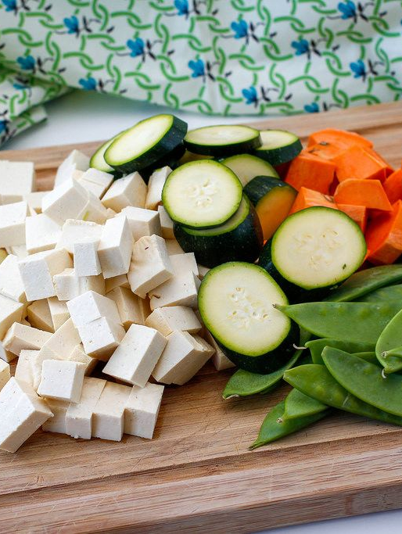
Ingredients for "Cooking OpenTofu"
Fresh OpenTofu from the Linux Foundation.
Generous code + pinch of open-source collaboration.
Cook with innovation until golden and automated.
Garnish with Kubernetes, Helm and community feedback.
Serve to hungry developers and system engineers.
This Photo by Unknown Author is licensed under CC BY

Slide 4


OpenTofu
2011
July 2014
Early Challenges
2018-2020
2016/2017
August 10th 2023
August 25th 2023
January 10th 2024
Slow initial adoption
Significant Growth
Terraform Enterprise
License Changed
Terraform Fork
OpenTofu GA
Terraform 0.1
Released under the Mozilla Public License (v2.0) (the “MPL”)
Only support for AWS and Digital Ocean
Discussions on possibly shutting down the project.
Over 750 contributors, more providers
Release of impactful Terraform 0.12
from MPL to the Business Source License (v1.1) (the “BUSL”)
OpenTofu maintained by The Linux Foundation

Slide 5

Guarantees offered
Open Source: Licensed under a trusted, stable, and vendor-neutral agreement.
Community-Driven: Governed by the community, with contributions judged on merit.
Impartial: Features and fixes judged solely on community value, not vendor impact.
Modular Structure: Encourages development of new tools and integrations.
Backwards-Compatible: Ensures longevity and value of existing code.

Slide 6
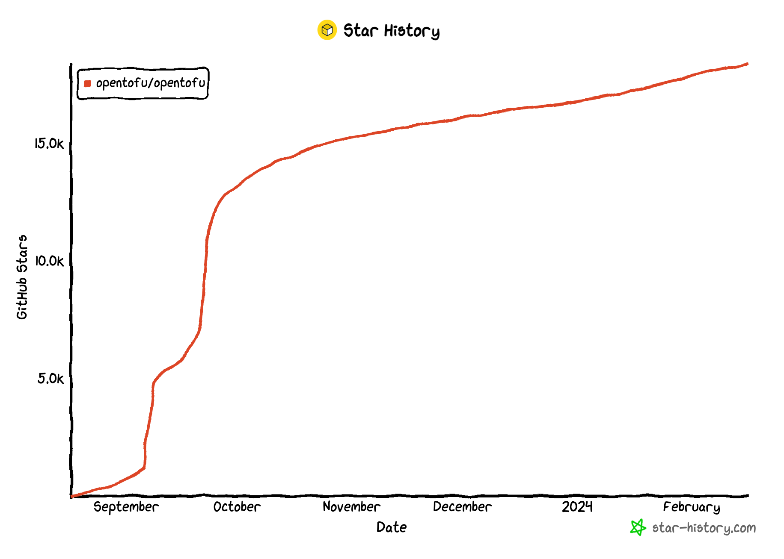
OpenTofu Star History

Slide 7


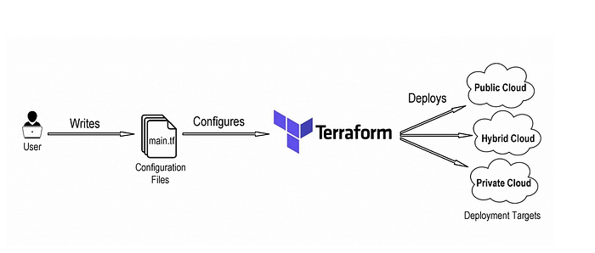
Fai questa slide simile all’immagine in basso a destra. Chiaramente metti sempre OpenTofu
Infrastructure in the cloud
TOFU CLI
Infrastructure on Premises
Platform Engineer

Slide 8
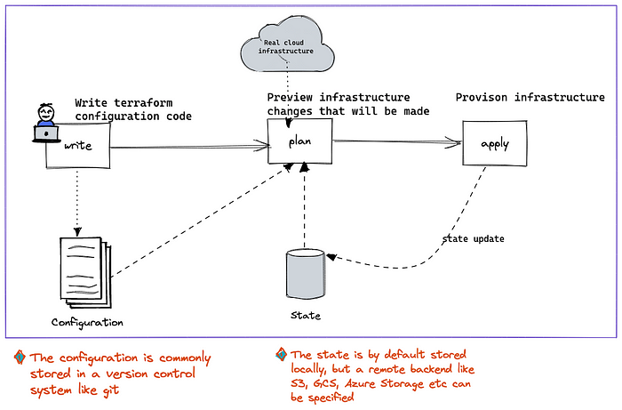
Registry
Init
Aggiungi la fase init, prima di plan e aggiungi il registry di opentofu
Questa slide deve fare da riferimento, su quello che farò nelle demo:
Scrivo il codice e faccio demo, lancio tofu init e faccio demo, lancio tofu plan e faccio demo, lancio tofu apply e faccio demo

Slide 9
Registry
Init
Evidenzia la fase di write

Slide 10
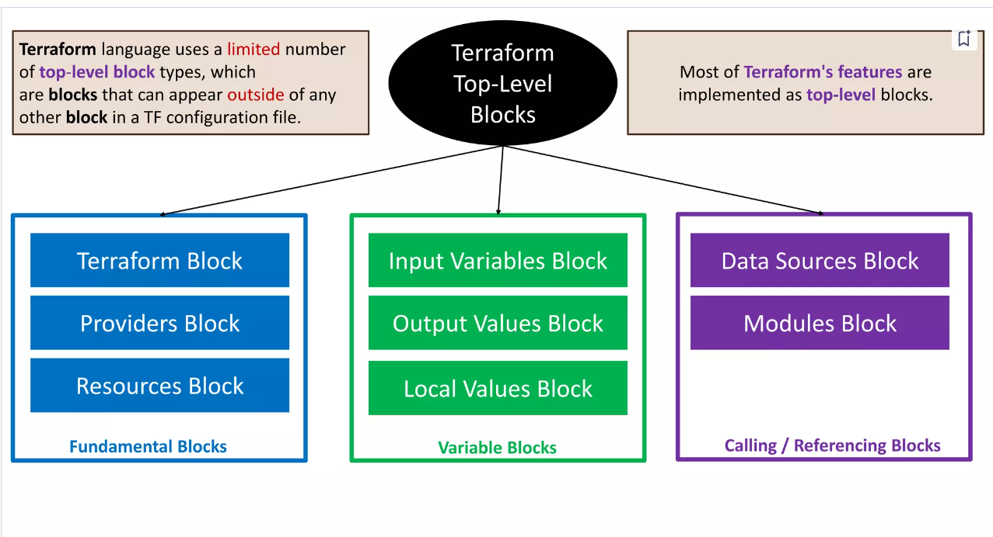
OpenTofu Blocks

Slide 11
OpenTofu Block 1
Variables
(Input Variables)
variable "k8s_server" {}
variable "client_certificate" {}
variable "k8s_client_key" {}
variable "k8s_ cluster_ca_certificate" {}
terraform {
required_providers {
kubernetes = {
source = "hashicorp/kubernetes"
version = ">= 2.0"
}
}
}
provider "kubernetes" {
host = var.k8s_server
client_certificate = var.client_certificate
client_key = var.k8s_client_key
cluster_ca_certificate = var.k8s_ cluster_ca_certificate
}
Terraform block
Providers

Slide 12
OpenTofu Block 2
Resource
resource "kubernetes_namespace" "brasil_namespace" {
metadata {
labels = {
kcd = "brasil"
}
name = "namespace-kcd-brasil"
}
}
output "namespace_created" {
value = kubernetes_namespace.brasil_namespace.metadata[0].name
}
data "kubernetes_namespace" "brasil_namespace" {
metadata {
name = "kube-system"
}
}
Output
(Output Variables)
Data

Slide 13
Demo
Write code

Slide 14
Registry
Init
Evidenzia la fase di init

Slide 15
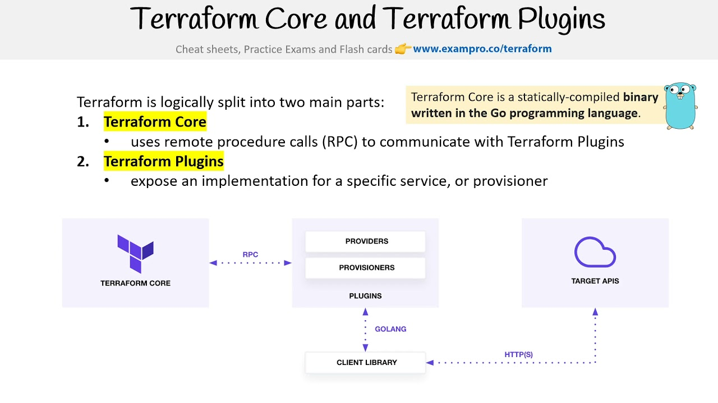
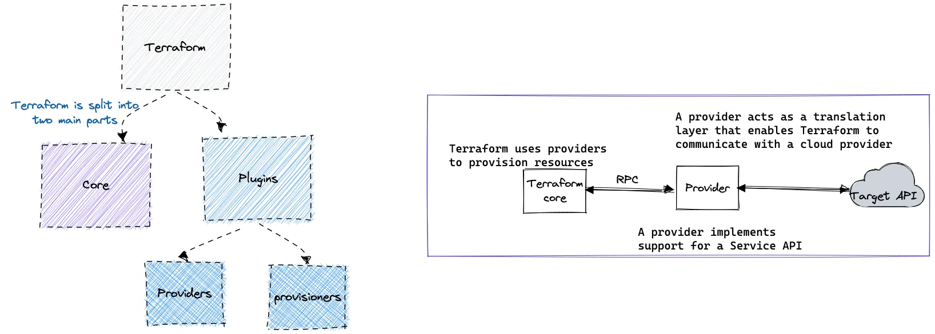
OpenTofu Core and Plugins
Cambia la scritta terraform con opentofu e magari mettici l’icona, se ritieni opportuno puoi fare anche 2 slide

Slide 16
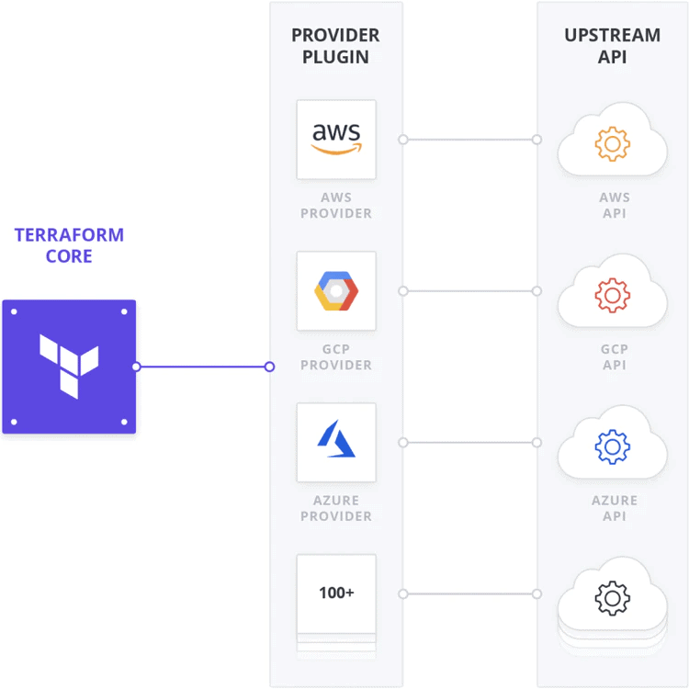
OpenTofu Provider
Rimuovi Terraform Core Image e aggiungi OpenTofu
Aggiungi l’icona di Kubernetes
Cambia il numero da 100+ a 3900+

Slide 17
Demo
tofu providers
tofu Init

Slide 18
Demo
tofu plan –out name.out
tofu apply –name.out

Slide 19
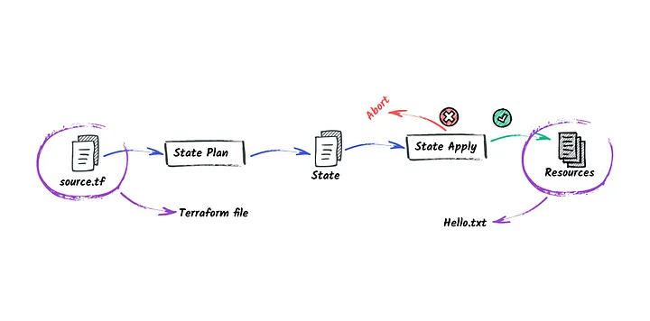
Terraform state file
Cambia al posto di terraform file (scrivi kubernetes namespace)
Al posto di hello.txt scrivi kubernetes namespace created

Slide 20
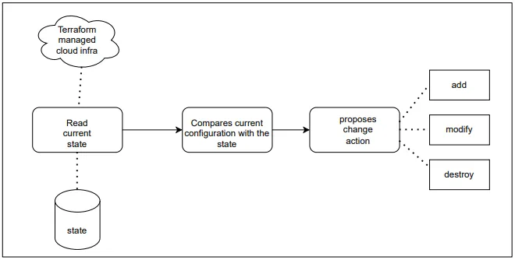

Slide 21
Demo
tofu plan
tofu show
tofu destroy

Slide 22
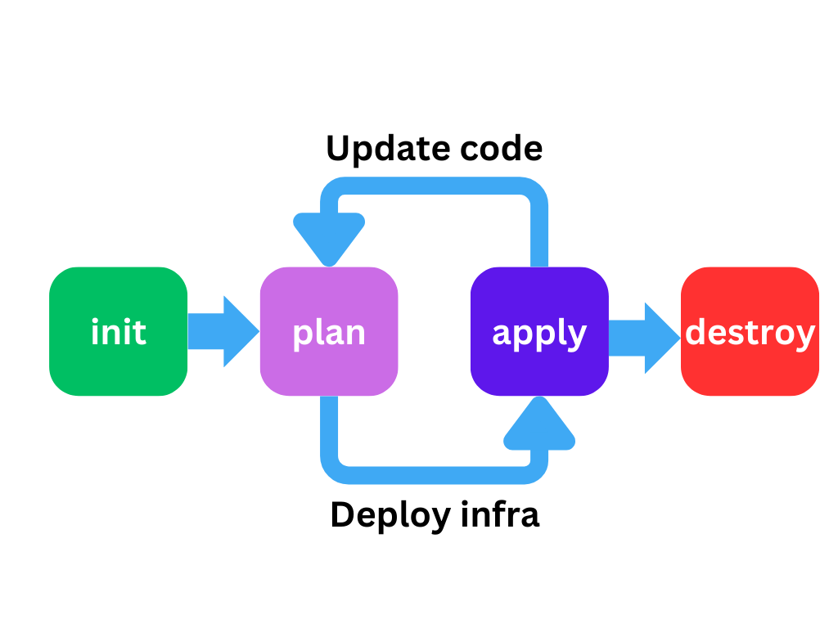
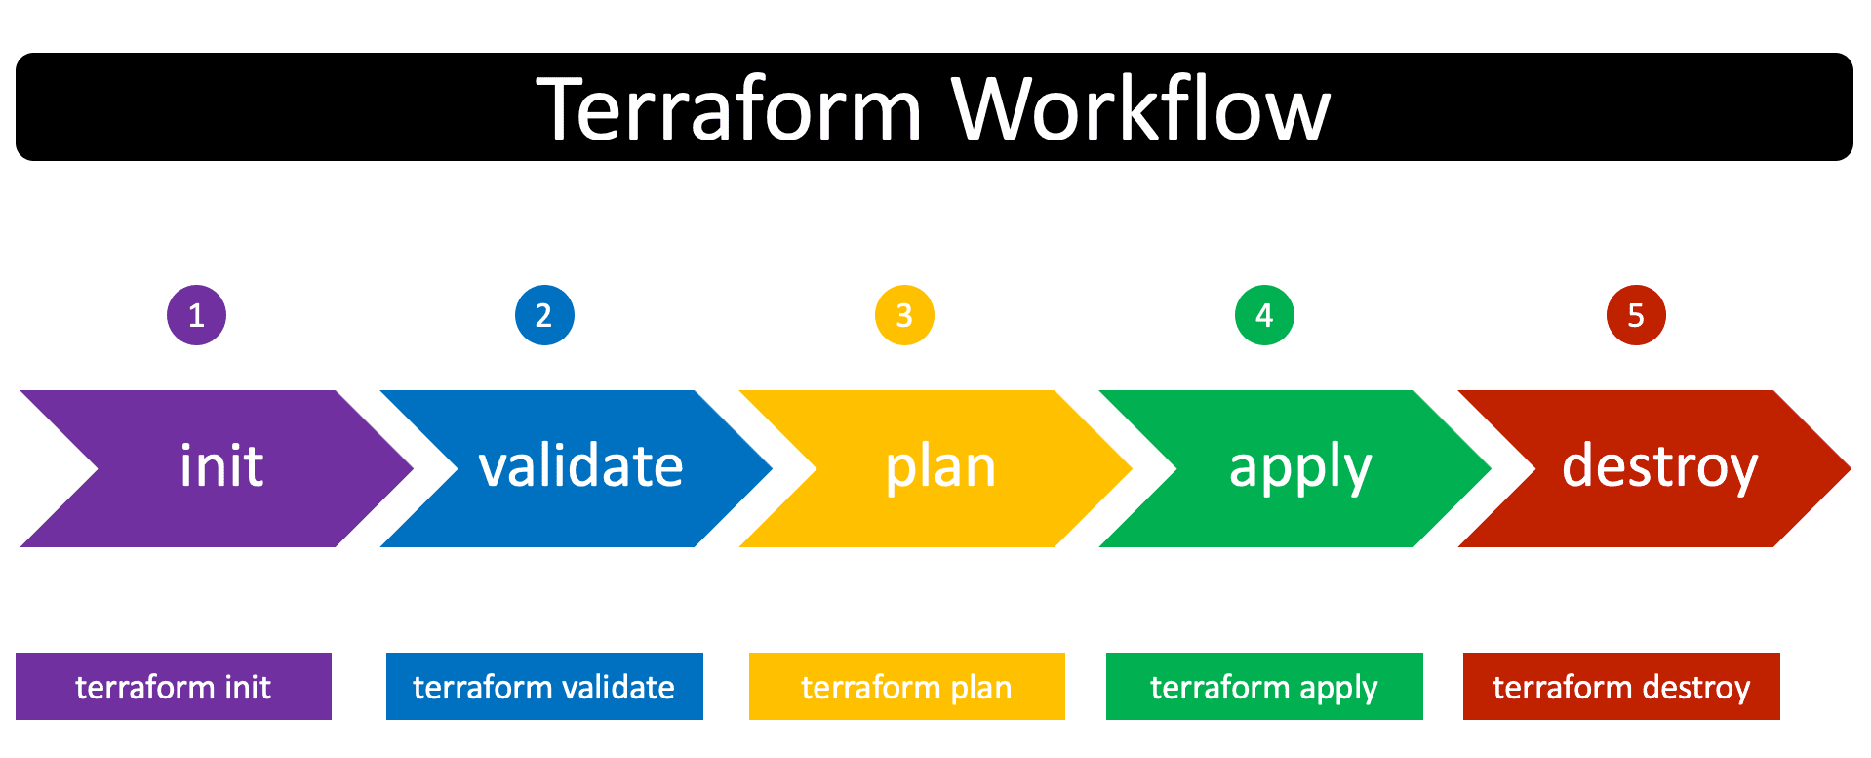
Cambia Terraform workflow in OpenTF Workflow.
Terraform init, validate etc in tofu init, validate …
Fallo togliendo validate e simile all’immagine in alto a destra
Aggiungi nel workflow in alto il fatto che il platform engineer scrive codice

Slide 23
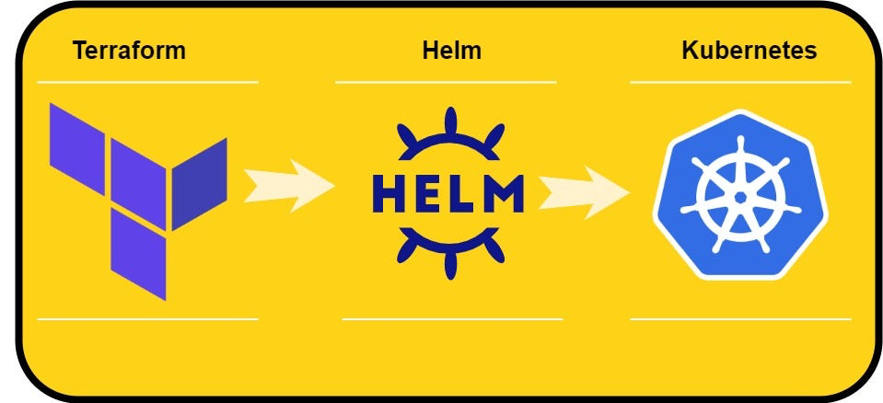
Deploy Helm Chart with Terraform

Slide 24
Demo
Tofu apply (helm chart)

