Slide 1
Start Threat Modeling
Adam Twitty

Slide 2
Agenda
What is a threat model?
Why create threat models?
Who do we need?
Tools & Methods
Diagrams & Getting Started
Reviewing Threats - MSTMT
About Time
Resources

Slide 3
Interrupt me with questions

Slide 4
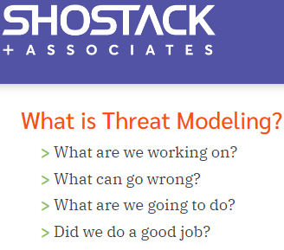
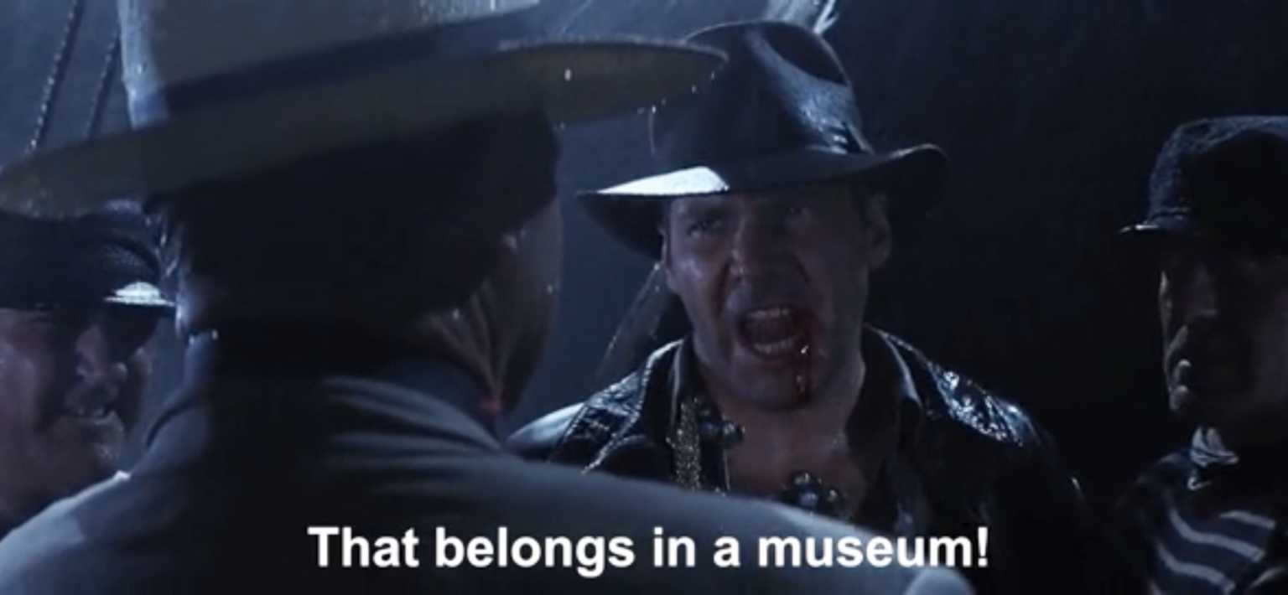
What is a Threat Model?
A collection of artifacts in a library.
Actor & Component Inventory
Diagrams
Bug/Issue/Threat List
Contact List

Slide 5
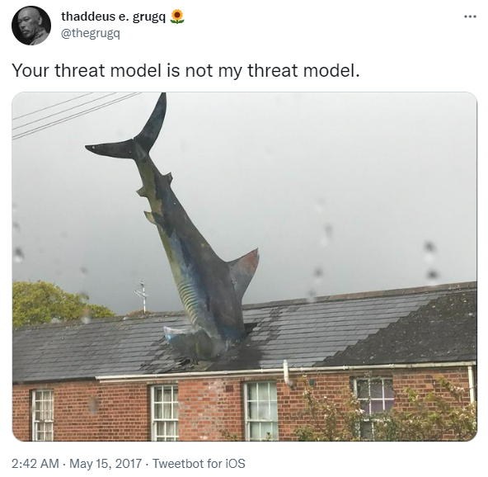
Why create a threat model?
Socialize (and document!) system design
Identify weaknesses
Consider threats from multiple viewpoints
Threats to be considered are heavily influenced by industry vertical, posture of the organization, market share, and customers
System failure is a threat
Writing things down helps us understand them better.

Slide 6
Who do we need?
And who should be able to see this?
Developers
Infrastructure support
Database admins
Compliance
Business Analysts

Slide 7
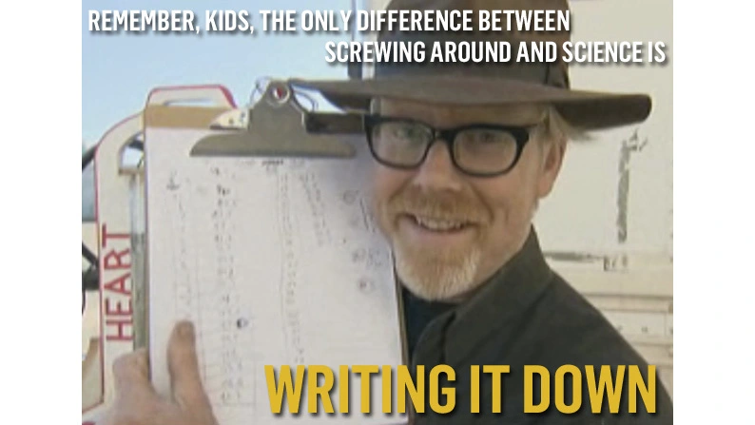
Tools
Methods
White Board
Visio + (Excel || Bug tracker)
OWASP Threat Dragon
Microsoft Threat Modeling Tool
STRIDE
Spoofing
Tampering
Repudiation
Information Disclosure
Denial of Service
Elevation of Privilege
DREAD, PASTA, VAST and others

Slide 8
Diagrams & Getting Started
Start threat modeling
Diagrams
Data Flow
Process Flow
Usability over detail
Don’t make eye exams
Suggested types
Component
System Design
Process Flow
High level connections between actors & components
Poor job showing sequences
Limited depth
Captures entire system in a single view
Quick (relative)
Based on system use case
Can show a step-by-step breakdown of a given process
Limited scope
Captures each interaction in a process
Slow (relative)
9/20/2022
8

Slide 9
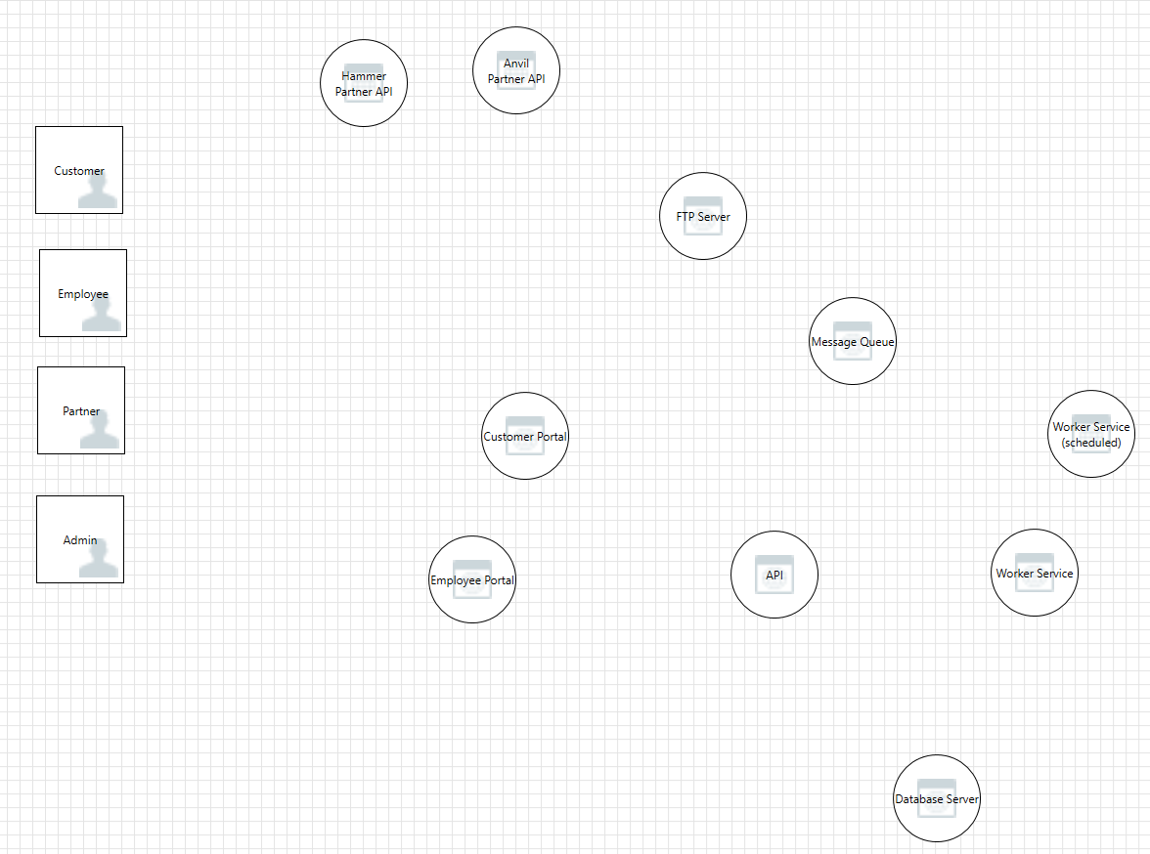
Diagrams - Components
One diagram per system
Template for other diagrams
Update this as you go
Capture
Sources
Processors
Sinks

Slide 10
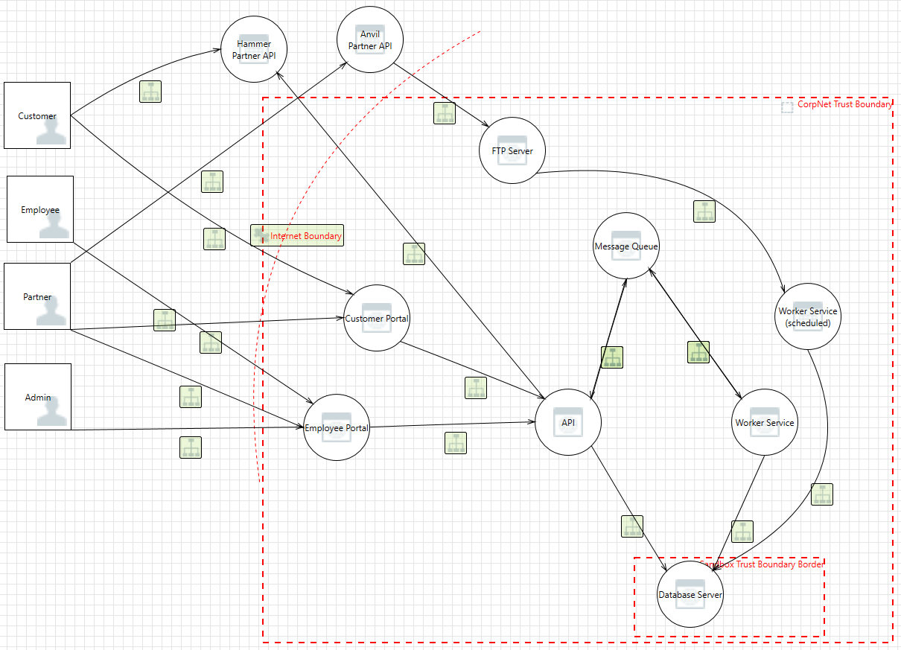
Diagrams – System Design
One diagram per system
If you think this looks like a data flow diagram…
Firewall rule of thumb

Slide 11
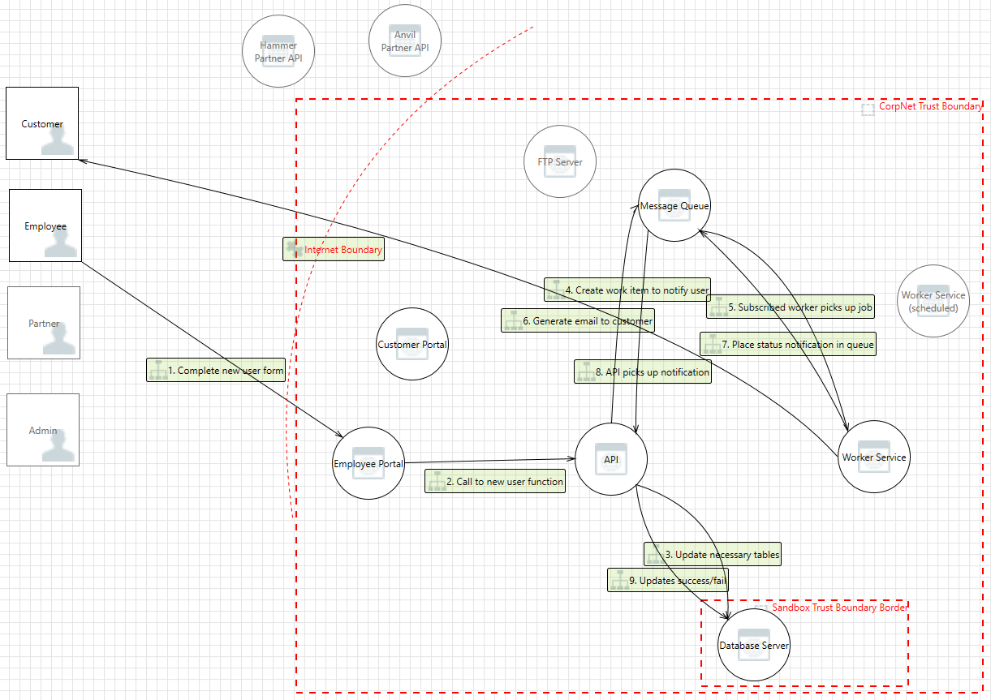
Diagrams – Process flow
One diagram per process
Keep process scoped to a single use/business case
Labeled sequence of connections
Show boundaries of trust
Capture connection details
Comingle where it makes sense

Slide 12
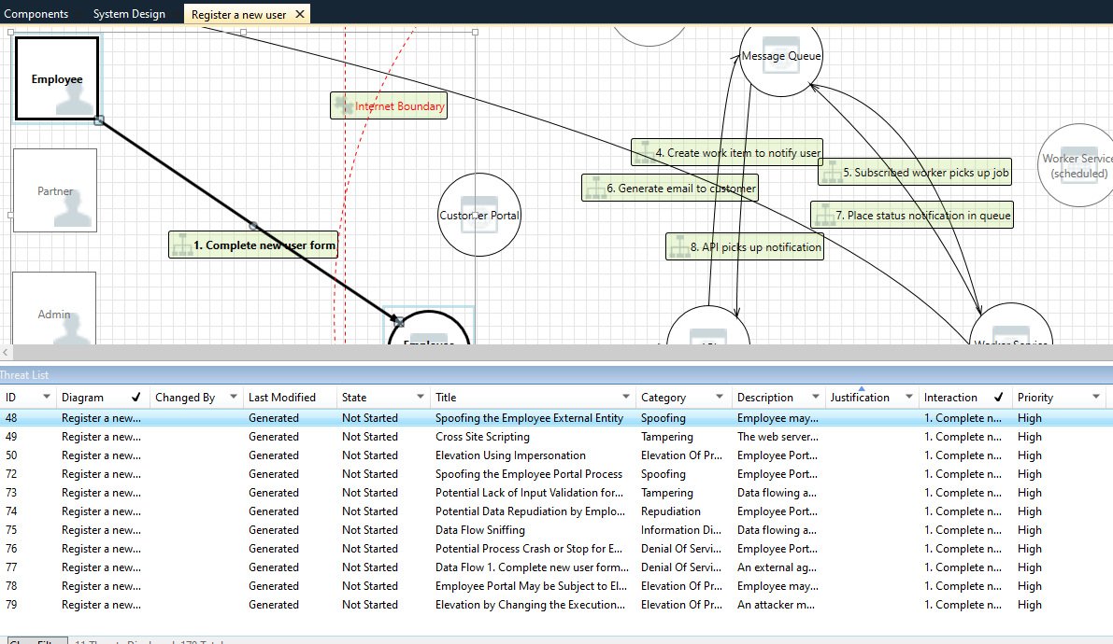
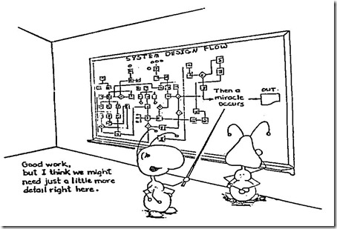
Reviewing Threats
Review each interaction for what could go wrong
Look for attacks and system weakness
Pay attention to action across trust boundaries
Look for missing components
Magic isn’t real

Slide 13
Demo Time

Slide 14

About Time
How long does this take? It depends.
Good documentation up front saves time
Enumerating every threat in every app may be possible, but is it worth your time?
Set aside 30 to 120 minutes for each of these 4 steps
Creating Model
Analyzing threats
Triage
Review

Slide 15
Resources
https://shostack.org/
https://github.com/ndecizion/ThreatModelingPlaybook
Microsoft Threat Modeling Tool https://aka.ms/threatmodelingtool
OWASP Threat Dragon - https://www.threatdragon.com/#/

Slide 16




Thank you
Adam Twitty
adam@colasec.org

