Slide 1
Principle of Application Layer
Sameer Koirala

Slide 2
Overview
Introduction
Network Application Architectures
Processes Communicating
Interface
Addressing Processes
Application Layer Protocols

Slide 3
Introduction
The application layer is where
network applications and their application-layer protocols reside and
the actual communication is initiated and reflected.

Slide 4
Network Application Architectures
Client/Server
Peer to Peer (P2P)
Hybrid

Slide 5
Client/Server
There is an always-on host, called the server
it services requests from many other hosts, called clients
Example: Web, FTP etc.
The server has a fixed, well-known address, called an IP address
clients do not directly communicate with each other

Slide 6
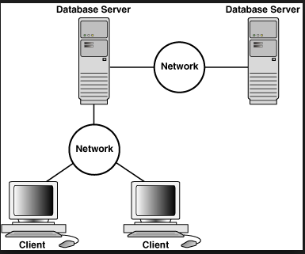

Slide 7
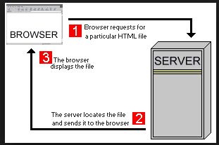

Slide 8
Peer to Peer (P2P)
Minimal or no reliance on servers
Direct communication between pairs of intermittently connected hosts, called peers.
Example: BitTorrent, Skype etc.
Self scalable

Slide 9
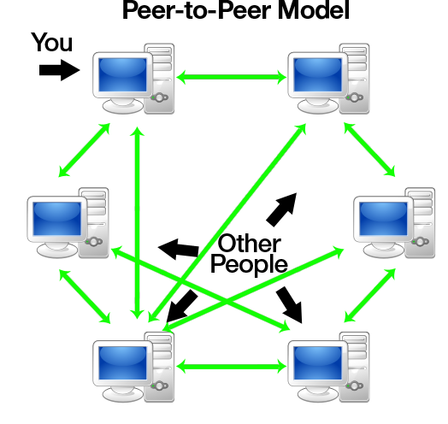

Slide 10
Hybrid
Uses both Client/Server and P2P
Example: Skype, Instant messaging etc.

Slide 11
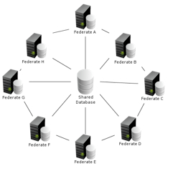

Slide 12
Processes Communicating
Process: a program that is running within an end system.
Process needs to exchange messages across the computer network.
Sender/Receiver Process

Slide 13
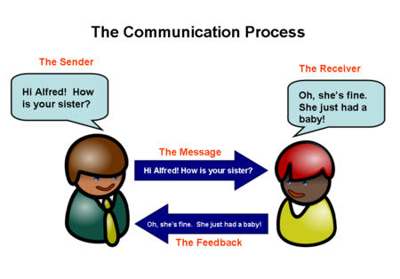

Slide 14
Client and Server Processes
Client Process: initiates the communication
- Example: browser, peer downloading file
Server Process: waits to be contacted
- Example: Web server, peer uploading file

Slide 15
Interface
Socket: the interface between the application layer and the transport layer within a host. (API)
Process → House
Socket → Door
Process assumes there is transportation medium on the other side of socket
Message after reaching destination host passes through socket

Slide 16
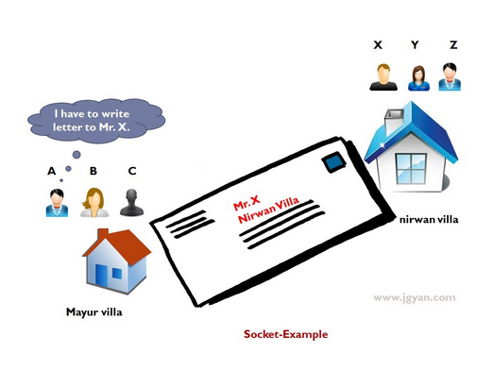

Slide 17
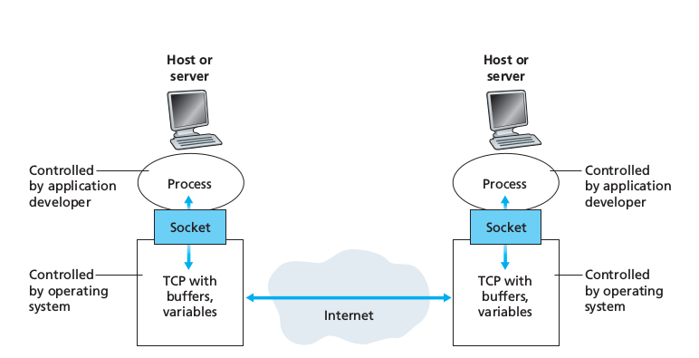

Slide 18
Interface
The only control that the application developer has on the transport-layer side is
the choice of transport protocol
the ability to fix a few transport-layer parameters such as maximum buffer and maximum segment sizes

Slide 19
Addressing Processes
Receiving process needs to have an address
To identify the receiving process following is needed:
the address of the host (IP Address)
an identifier that specifies the receiving process in the destination host (destination port number)

Slide 20
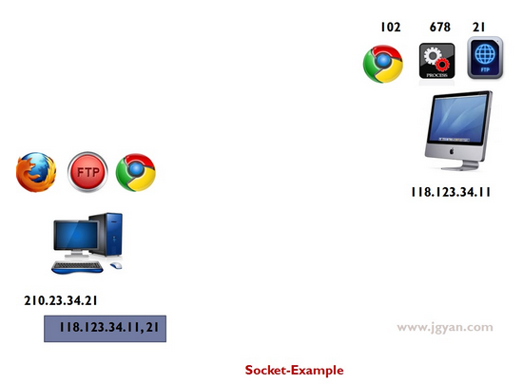

Slide 21
Application-Layer Protocols
Application-layer protocol defines:
The types of messages exchanged
The syntax of the various message types
The semantics of the fields
Rules for determining when and how a process sends messages and responds to messages

Slide 22
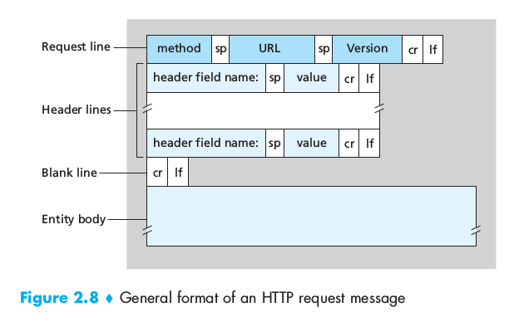

Slide 23
Application-Layer Protocols
Public-Domain Protocols
Hyper Text Transfer Protocol (HTTP)
Simple Mail Transfer Protocol (SMTP)
Proprietary Protocols
Skype

Slide 24
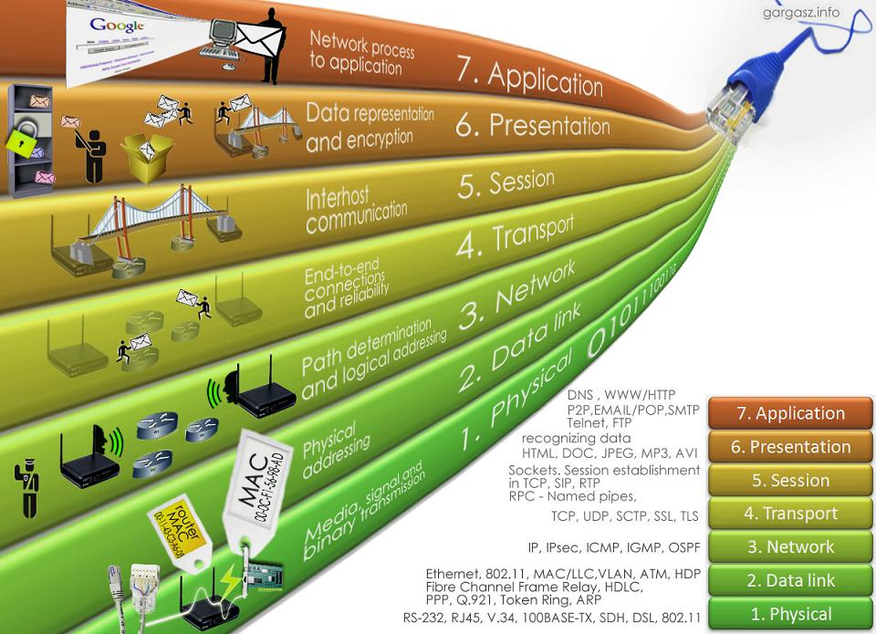

Slide 25


