Slide 1
Congestion Control
-Sumit Shrestha (0209)

Slide 2
Congestion
If load on the network or the number of packets sent to the network is greater than the capacity of the network.
Message is heavy which slows down network response time.
Busty Traffic, Insufficient Memory, Less Bandwidth.

Slide 3
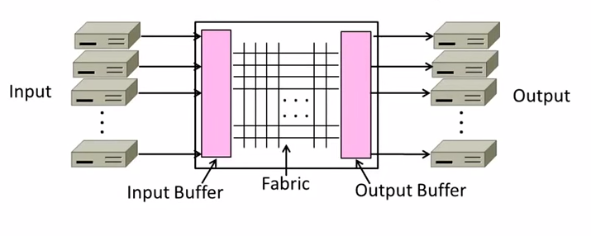
Nature of Congestion

Slide 4
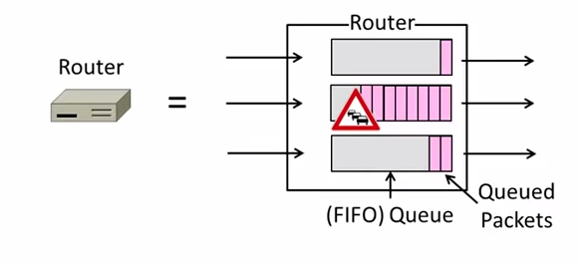
Nature of Congestion

Slide 5
Causes of Congestion

Slide 6
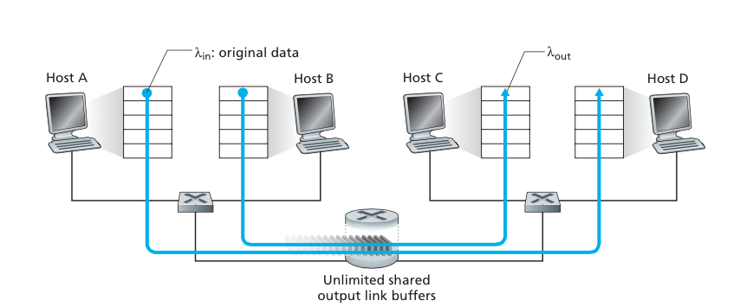
Two Senders, a Router with Infinite Buffers
Large delays
Throughput not higher than R/2

Slide 7
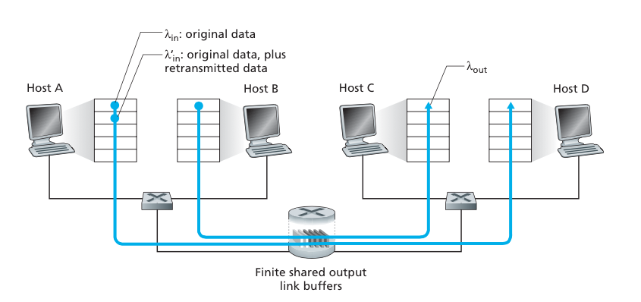
Two Senders and a Router with Finite Buffers
Retransmission

Slide 8
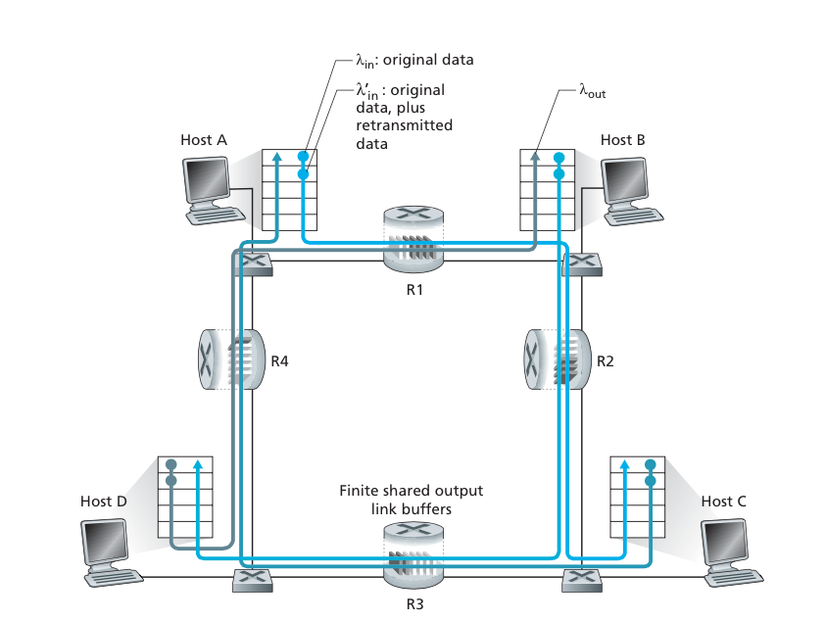
Four Senders, Routers with Finite Buffers, and Multihop Paths

Slide 9
APPROACHES

Slide 10
End-to-End Congestion Control
No explicit feedback from network for slow down.
congestion inferred from end-system observed loss, delay.
Approaches taken by TCP.

Slide 11
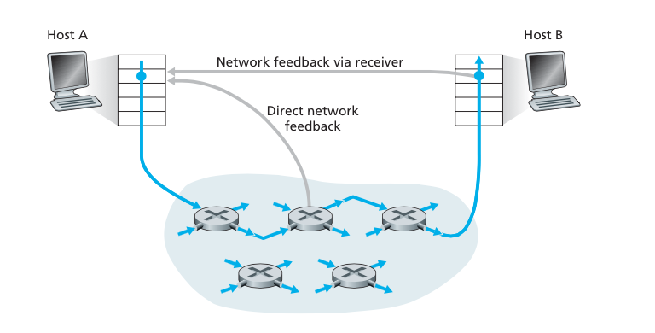
Network-assisted congestion control

Slide 12
TCP Congestion Control

Slide 13
Each TCP sender maintains a congestion window
Max number of bytes to have in transit (not yet ACK’d)

Slide 14
AIMD
Adapting the congestion window
Decrease upon losing a packet
Increase upon success
Always struggling to find right transfer rate
Used by TCP.

Slide 15
TCP Congestion
End-to-End congestion.
Sender limits transmission
LastByteSent - LastByteAcked  CongWin
Rate = CongWin / RTT

Slide 16
APPROACH
increase transmission rate (window size), probing for usable bandwidth, until loss occurs.
􏰋additive increase: increase CongWin by 1 MSS every RTT until loss detected.
􏰋multiplicative decrease: cut CongWin in half after loss.

Slide 17
Slow Start
Start with a small congestion window
Initially, CWND is 1 MSS.
So, initial sending rate is MSS / RTT.
Could be pretty wasteful
Might be much less than actual bandwidth.
Linear increase takes a long time to accelerate.
Slow-start phase (really “fast start”)
Sender starts at a slow rate.
but increases rate exponentially until the first loss.

Slide 18
Slow Start in Action
Double CWND per round-trip time
three duplicate ACKs are detected,
1
2
4
8
Src
D
A
D
D
A
A
D
D
D
D
A
A
A
A
Dest

Slide 19
Congestion Avoidance
Entry- value of cwnd is increased by 1 in every RTT.
Cwnd/MSS segment is send.
Loss Detect – retransmit loss packet and back to slow start
E.g. MSS is 1,460 bytes and cwnd is 14,600 bytes, then 10 segments are being sent within an RTT.

Slide 20
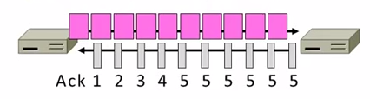
FAST RECOVERY
First fast retransmit and MD cwnd.
Further duplicate ACKs are expected ACKs.

Slide 21
FAST RECOVERY
Repairs a single segment loss quickly and keeps ACK clock running.
AIMD (No timeouts and slow-start after loss)
MD half.

Slide 22
TCP “Sawtooth”
Window
Loss
halved
t

Slide 23
THANK YOU
FINALLY

